Slide 1

A Systematic Security Evaluation of Android’s
Multi-User Framework

Slide 2
Outline
Introduction & Motivation
Background: Implementation
Methodology
Hypotheses & Findings
Conclusion
Notes:
-capabilities that secondary users are not supposed to have

Slide 3
Introduction and Motivation
Two new ways of sharing Android tablets
Multiple Users (MU) – introduced in 4.2
Restricted Profiles (RP) – introduced in 4.3
Google's advice to share “only with people you trust” raises questions about security and privacy
Our work
Understand the implementation
Develop a systematic evaluation methodology
Generate hypothesis
Test hypothesis to demonstrate specific vulnerabilities
Notes:
-capabilities that secondary users are not supposed to have

Slide 4
Background: Implementation (1/2)
Framework – userId
uid = userId * PER_USER_RANGE + (appId % PER_USER_RANGE)
e.g., app 10056 runs as uid 0010056 for user 0 (Owner) and uid 1010056 for user 10
Framework – Permissions
MANAGE_USERS, INTERACT_ACROSS_USERS, INTERACT_ACROSS_USERS_FULL (systemOrSignature)
Notes:
-capabilities that secondary users are not supposed to have

Slide 5
Background: Implementation (2/2)
Framework - Package management
Each userId has its own set of enabled app
Filesystem
User-specific package data isolated under /data/user/<userId>
External storage isolated by way of Linux mount namespaces
Kernel
No changes necessary
Run-time
Concept of current user vs. inactive user(s)
Notes:
PM allows different users to choose different set of apps.
It also allows owner to choose which apps are allowed for RPs
However, the framework is actually platform centric. An app is only installed once for the whole platform but only enabled or disabled
For specific users.
Package list maps packages names to corresponding data directories , appIds, gids.
No changes at level of kernel since linux is naturally a multi user system → userid + appId = uid

Slide 6
Methodology (1/3)
Identify subjects associated with secondary user
Apps and activities
Identify objects shared among users
Evaluate access control path between subjects and objects
Does access control exist along path?
Is the subject properly identified (user, app, state, etc.)?
Notes:
We begin with Yaghmour’s [5] high-level architectural view shown in Fig.
Various categories of system resources
We rely on this diagram to identify objects and subjects that have interesting security aspects unique to multi-user
Then we evaluate the suitability of the access control paths between them.
subjects: apps, stock apps
Objects: resources: public interfaces of other apps, services, abstracted hardware devices, kernel objects

Slide 7
Methodology (2/3)
Access control paths
IPC to service or provider
IPC to exported activity
System call
Person
None
Notes:
Access path between subjects and objects

Slide 8
Methodology (3/3)
Insights & observations...
Multi-user features have introduced important new considerations for the subjects and objects identified
Several access control paths have been modified to account for the presence of multiple users
Lead to questions:
Do Android’s access control points properly account for the new considerations regarding subjects and objects?
If not, can a secondary user exploit these shortcomings, and what is the potential damage?
Establish a set of working hypotheses
Notes:
-capabilities that secondary users are not supposed to have

Slide 9
Findings: Unprotected Activities
Hypothesis 1: “Secondary users may be able to bypass their restrictions by exploiting the unprotected public interfaces of system apps”.
We systematically compared the Settings UI elements accessible to the owner with that of a secondary user.
Settings app implements restrictions based on type of user by hiding certain menu items, while their corresponding activities are exported.
Secondary users can launch these hidden activities directly via intents and bypass the intended restrictions !
Notes:
Examples: VPN Settings, Mobile network, mobile plan settings, etc…

Slide 10
Findings: Unrestricted Administrative Functions
Hypothesis 2: “Secondary users may be able to maliciously reconfigure critical platform-wide settings that are persistent across user switches”.
Secondary users possess certain administrative capabilities which are normally preserved for privileged users.
Secondary users can set a malicious environment for the owner to use.
Examples: Wi-Fi Settings can be changed by secondary users and are persistent across users.
Notes:
Attack: Connect to a malicious hotspot to control all traffic to/from device.

Slide 11
Findings: Use of Sensors and Hardware Devices:
Hypothesis 3: “Inactive users may be able to spy on active users by exploiting improper access control enforcement on shared hardware resources”.
If no proper access control, a non-current user can spy on logged-in user.
To ensure that a hardware resource is only bound to currently logged-in user:
Identify if the user requesting the resource is logged-in.
Track if the user who initiated the request is continuously logged-in during the service lifetime.
Notes:
dIf Android does not enforce proper access control on media/sensors resources based on user status, a non-current user can spy on logged-in user.

Slide 12
Findings: Exploiting Media Resources
Two access control points should be enforced by the MediaServer:
At Request time: check if the userid is equal to current userid.
At User switch time: revoke any resources accessed.
We designed an app that launches the camera under two scenarios:
The app schedules video recording when the victim user is logged in.
The app starts video recording immediately while attacker is logged in.
Success on both scenarios: There is no access control based on user status at request time, nor at user switch time!
Notes:
To ensure that a media resource is not accessible to a non-logged in user,
We investigated the MediaServer and confirmed this observation.

Slide 13
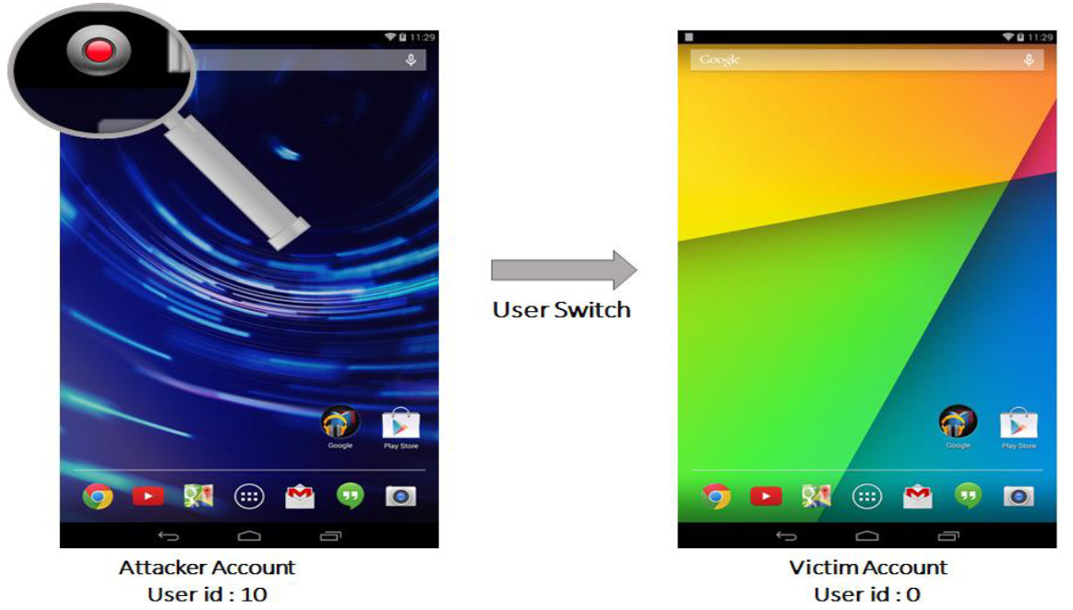
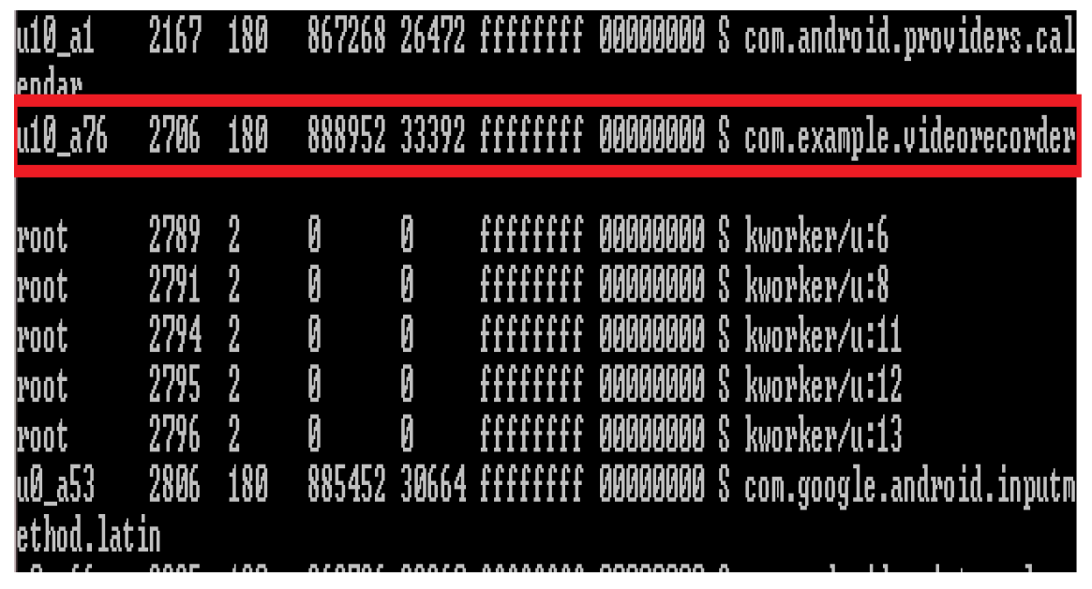
Findings: Exploiting Media Resources
Notes:
-capabilities that secondary users are not supposed to have

Slide 14
Findings: Exploiting Motion, Environmental and Position Sensors
SensorService should apply at least one of the following access controls:
At Registration time/Switch time: only allow current users to register listeners, and unregister all listeners one a switch happens.
At Dispatch time: deliver sensor updates only to listeners belonging to current users.
We designed an app that:
schedules registration to receive sensor event when the victim user is logged in.
registers a listener to receive sensor events when the attacker user is logged in.
In both two scenarios, the app is able to receive sensor updates about victim user!!
Notes:
To ensure that a non-logged in user cannot receive sensor updates, the

Slide 15
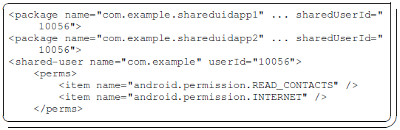
Findings: Shared Package Information
Hypothesis 4: “sharedUserId permissions may not be properly separated when sharedUserId apps are installed by different users:”
Although sharedUserId app’s data is properly isolated in multi-user, this is not the case with permissions!
Permissions are leaked across user boundaries between apps sharing the same UserId.
Notes:
Cause: Platform centric design of PackageManager.
We created a pair of sharedUserId apps belonging to different users. Each one of them declares a different permissions. The effective permissions assigned is the union of all permissions.

Slide 16
Findings: Shared Package Information
Hypothesis 5: “A malicious user may exploit the shared package management to modify another user’s app bytecode or prevent them from installing apps”
All users share the same package code for a specific package name.
If a package has been installed for a specific user, the PackageManager will consider it an update.
DoS: A malicious user can install 50000 dummy apps to prevent other users from installing new apps.
Notes:
-capabilities that secondary users are not supposed to have

Slide 17
Conclusion
Description of the multi-user support
Systematic approach for studying if proper access control is enforced
Provide insights into potential problems through a comprehensive analysis of object/subject resources
Several concerns
Notes:
-capabilities that secondary users are not supposed to have

