Slide 1
Generating Quantum Natural Finite Difference
#21

Slide 2
VQE: A hybrid quantum algorithm
Energy resulting from parameters
Quantum Computer:
Evaluate energy of a Hamiltonian
Classical Optimizer:
Choose new parameters
New Parameters

Slide 3
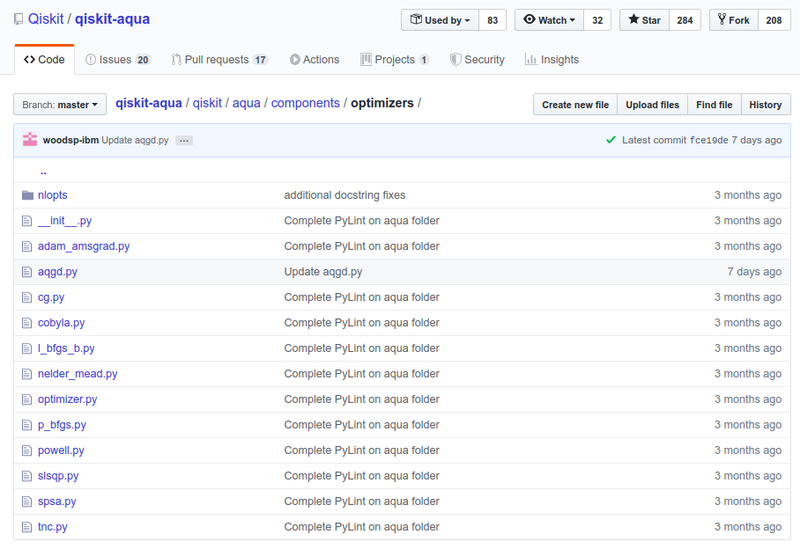
Existing Aqua Optimizers

Slide 4
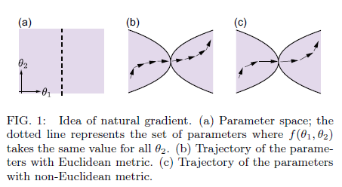
Singular Points In Parameter space (BAD)
Taken from “On the natural gradient for variational quantum eigensolver - Naoki Yamamoto”

Slide 5
Quantum Natural Gradient (QNG) Optimizers
Pros
Moves past singular points fast.
Tailor made for quantum computers.
Cons
Require 3d circuit evaluations per optimization step.
d is the number of parameters.

Slide 6
Extending the QNG
QNG algorithm uses analytic gradients:
(requires 2d circuit evaluations to get those gradients)
OUR optimizer: Quantum Natural Finite Differences:
Does not need analytic gradients
Our approach needs only d evaluations! Rather than 3d
(d = number of parameters in our variational circuit)

Slide 7
 | SPSA | QNFD | QNG
Error Robustness | Good! | Good! | Good!
Circuits run per optimization step | 2 | d+2 | 3d

Slide 8
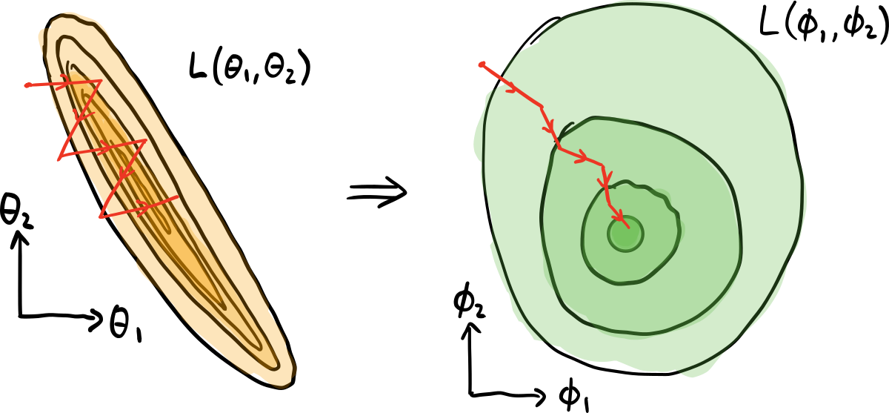

Slide 9
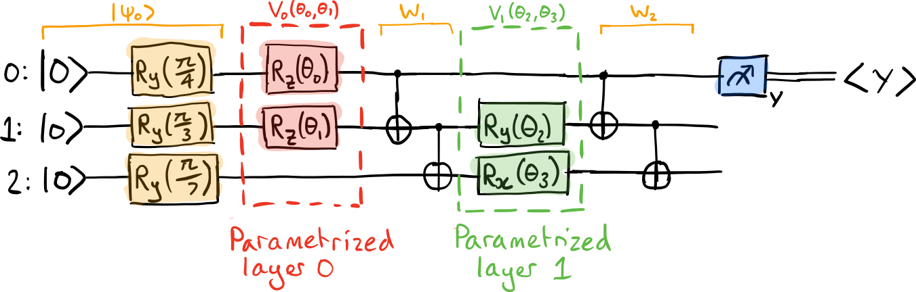

Slide 10
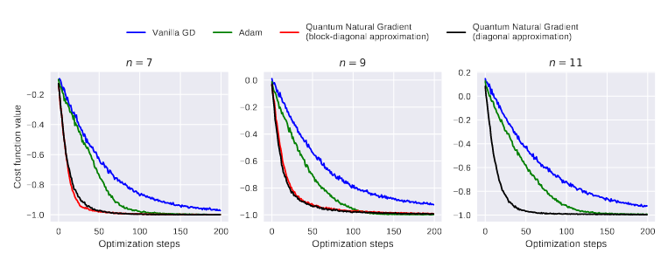
This shows how the QNG converges faster than the rest optimizers.
Figure 4 :

Slide 11
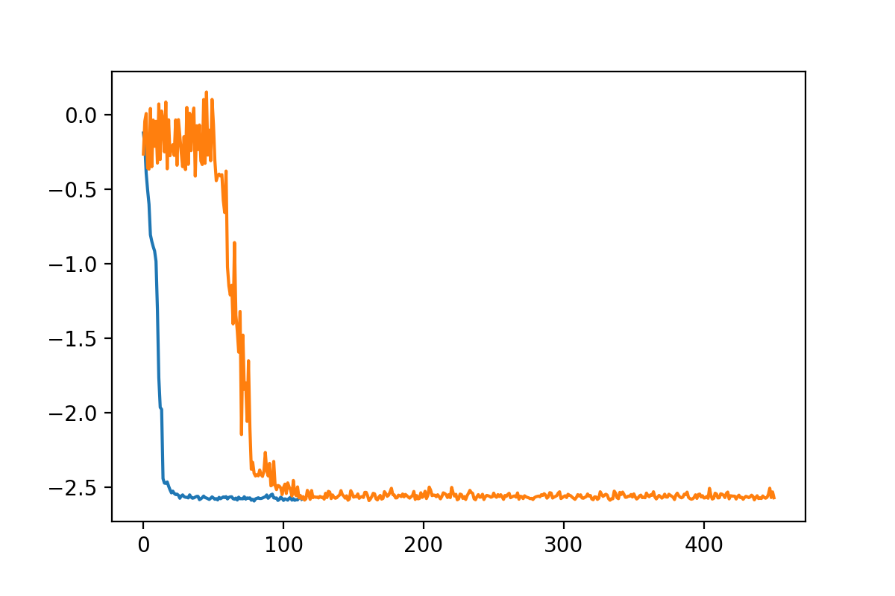
SPSA vs. QNFD (ours)
Cost
Iterations

Slide 12
APPLICATIONS
The possibility to train quantum algorithms (VQE) using gradient descent
In near-term noisy devices it may be of interest to study the relevant geometry for density matrices.

Slide 13
References
[1]. James Stokes, Josh Izaac, Nathan Killoran, Giuseppe Carleo. “Quantum Natural Gradient.” arXiv:1909.02108, 2019.

