Slide 1
Anonymity With Tor
Once upon a time, there was a thing called ‘privacy’

Slide 2

Sydney Platypus Appreciation Society
What: hands-on infosec conference
When: 24 – 25 September 2016

Slide 3
Agenda
Background info
How to use Tor properly for anonymity
Notes:
There are alternatives, like I2P, so don’t feel as if I’m pressuring you to use tor and tor only
You judge for yourself you are trying to defend against

Slide 4

What is Tor
What it does: provide location anonymity
What it does not do: anything else
Notes:
Tor is a bunch of volunteer run servers that you can connect to for anonymityThat means Tor does not encrypt your traffic by default,
And it anonymises where the internet traffic originates from, it does not anonymise your identity
It’s use is for anonymisation, not encryption

Slide 5
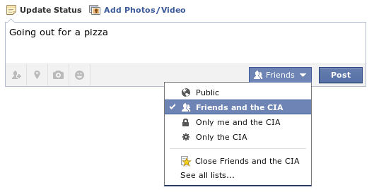
Why Use Tor
You have a right to privacy
Screw lockout laws! Meetup @ my place
Friends and the government
Only me and the government
Only the government
Close friends and the government
Notes:
It’s more, you have the option to use tor
because you have the right to speak freely, the right to read freely, because you have the right to privacy.
People who can benefit from online anonymity include:
People who don’t want to receive constant targeted ads
People who want to research something online without being judged
People who need to whistleblow
People who need to protect their sources
People who don’t want to be discriminated on price because of country or gender
People who don’t want to be denied jobs based on what you search for
People who live in oppressive countries trying to reach out

Slide 6

How Tor Works
Guard
1,700 Guard Relays
7,000 Middle Relays
900 Exit Relays
Platypus
Website
Tor Network
Notes:
When you start Tor, it will download about 7000 list of relays (consensus), and out of those, it will pick 3 guard relays.
When tor chooses relays, it doesn't look at countries, but bandwidth, so the larger the bandwitch, the more likely it will be chosen as a relay.
After this setup, your computer and the guard relay will negotiate a short term session key.
It then connects to the middle relay, where the guard relay and middle relay will setup a different session key.
And again, it will then connect to the exit relay, where the middle relay and exit relay will setup a different session key.
So, 3 layers of encryption

Slide 7

Use a Bridge
Guard
Middle
Exit
Platypus
Bridge
Website
Tor Network
Notes:
tor relays are publically known and so your work, university, ISP, country can block connections to tor by blocking each tor relay
If you use a bridge, you will create a 4th hop at the beginning of your tor connection; and then you can connect tor

Slide 8
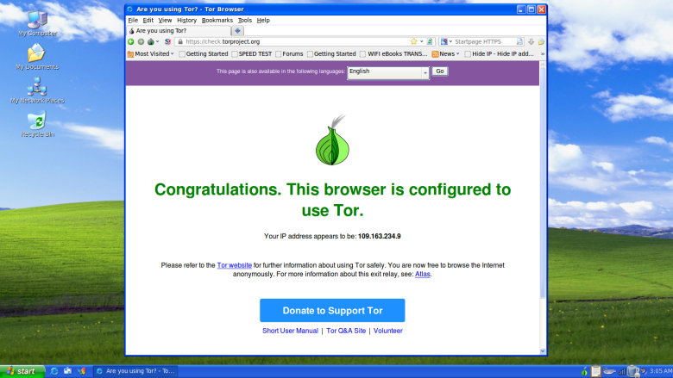
Tor Browser [Demo]
Download to USB via VPN; or use Tails
Notes:
First steps
- Download from https website https://www.torproject.org/
- Use VPN
- Check signature gpg --keyserver x-hkp://pool.sks-keyservers.net --recv-keys 0x4E2C6E8793298290
- Save Tor to USB
- Check connected to tor
- Check DNS leakage
Download – you will be put on a list
But that’s not a reason to not use Tor. Everything you surf on the internet will go through giant surveillance systems, but what you learn when you monitor someone using tor, is someone is using tor, you can’t see the content, all they know is you’re using tor, which is different to they know for sure you want e.g. dating website
plugins
- tor options
- no script
- https everywhere
Pluggable transports
Use pluggable transports to evade Deep Packet Inspection. To use pluggable transports, you should hit “Yes” when Tor asks you “Does your ISP block or otherwise censor connections to the Tor Network?”. This will by default use a protocol called obfs4, which makes it look like you’re watching a youtube video, handling a skype call or downloading a book when you’re actually on tor
tails
Forces all traffic through tor
Will not touch the hard disk and so no malware will be saved on disk
Does not leak DNS
Every data destroyed on shutdown
Logout
- New Circuit
- New Identity
i.e. change IP address to change history
Note: you will be put on a list no if you download tor or tails

Slide 9
The Do Not’s
Change default configurations
Use other browsers at the same time
Open downloaded files online
Provide personal information
Torrent
Notes:
- Leave default browser configurations e.g. do not maximise your screen, do not install browser plugins, because once you change a setting, you will look different to every tor browser on the network, and over time, you will be deanonymised, and that defeats the point of using an anonymity tool
- don't provide your name or other personal information. This includes using facebook or creating a new facebook, because facebook will see that you type the way you type, still sound like you when you talk and see you connect to all your same friends, and so will know it’s the same person
don't torrent over tor as they ignore proxy settings and leaks your IP address in the GET request

Slide 10
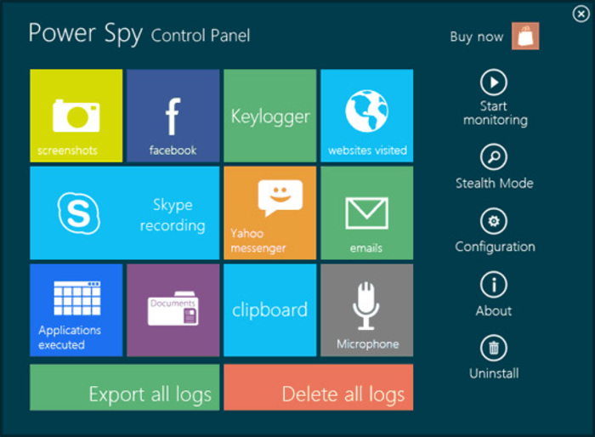
Don’t Use Windows
Notes:
bootstrapping problem
its not impossible to have privacy with windows, it is really hard to have privacy with windows
using tails, you file a bug report, and everyone gets those improvements

Slide 11
Setup A Relay [Demo]
Guard
1,700 Guard Relays
7,000 Middle Relays
900 Exit Relays
Platypus
Website
Tor Network
Notes:
There are safety in numbers, platypus numbers, each relay provides additional diversity to the network
Middle relays
Even if a malicious user employs the Tor network to do something illegal, the IP address of a middle relay will not show up as the source of the traffic. That means a middle relay is generally safe to run in your home, in conjunction with other services, or on a computer with your personal files.
Exit layers
If a malicious user employs the Tor network to do something illegal, the exit relay may take the blame. If you're going to run an exit relay, you should be prepared to deal with complaints, copyright takedown notices, and letters from law enforcement agencies. But, I'm not a lawyer. Ideally exit relays should be operated on a dedicated machine in a hosting facility that is aware that the server is running an exit node.
Windows
https://dist.torproject.org/vidalia-bundles/

Slide 12

Not A Silver Bullet
Correlation is a bitch
Shh!!!
Not a platypus
Notes:
You’ve used the internet for a long time, so no question can the big organisations identify you with you providing your name
Network surveillance, traffic analysis
- Protect you from malware, especially if you're already infected
- Compromise entry and exit node
- eBiometrics - identifies you based on how you use your computer i.e. how long you hold down a key

Slide 13
Hidden Services
Hidden Wiki http://zqktlwi4fecvo6ri.onion/wiki/index.php/Main_Page
Grams http://grams7enufi7jmdl.onion
Reddit https://www.reddit.com/r/TOR

Slide 14
Other Alternatives
I2P
Privacy info: https://www.privacytools.io/

Slide 15
Summary
You have a right to privacy
Tor is not perfect, but better than nothing
Safety in numbers, so run a relay
Keep tor up-to-date
Notes:
Your choice to use something, that we are not claiming to be perfect, but we claim is better than what we have without Tor

Slide 16
Privacy Demand Your Rights

