Slide 1



BunnyHop: Exploiting The Instruction Prefetcher
Zhiyuan Zhang, Mingtian Tao, Sioli O’Connell,
Chitchanok Chuengsatiansup, Daniel Genkin, Yuval Yarom

Slide 2








BunnyHop
We like shared resources !
Instruction Prefetcher
Hey prefetcher, check an address.
NOP
NOP
NOP
Response
Branch Here?
NOP
NOP
BunnyHop: Translate Branch Predictor State to Cache State
Branch Predictor
The Bunny Hops!
NOP
NOP
CMP value, 1
JE Target
NOP
NOP
NOP
Cache
Target
Target
Target
Target
NOP
Cache Attack.
Okey-Dokey!
NOP

Slide 3
With the Power of BunnyHop
More in the paper!
Reverse Engineer
First work on Instruction Prefetcher
Branch Target Buffer
First work on Replacement Policy
First observation of two type branches: Long Branch & Short Branch
Three Cool Attacks
Flush+Reload on Predictor: Learn same thread predictor state
Prime+Probe on Predictor: Learn cross-thread predictor state
Self-Eviction : Confuse the victim to evict its own data

Slide 4




Self-Eviction: The Resident Evil
Evict secret-dependent data from cache
Guide
Prefetch
Poison the Branch Predictor
Poison
Measure victim process
Cache Coloring
Any Instruction
Evict
JMP
JMP
JMP
S
JMP
Evict

Slide 5
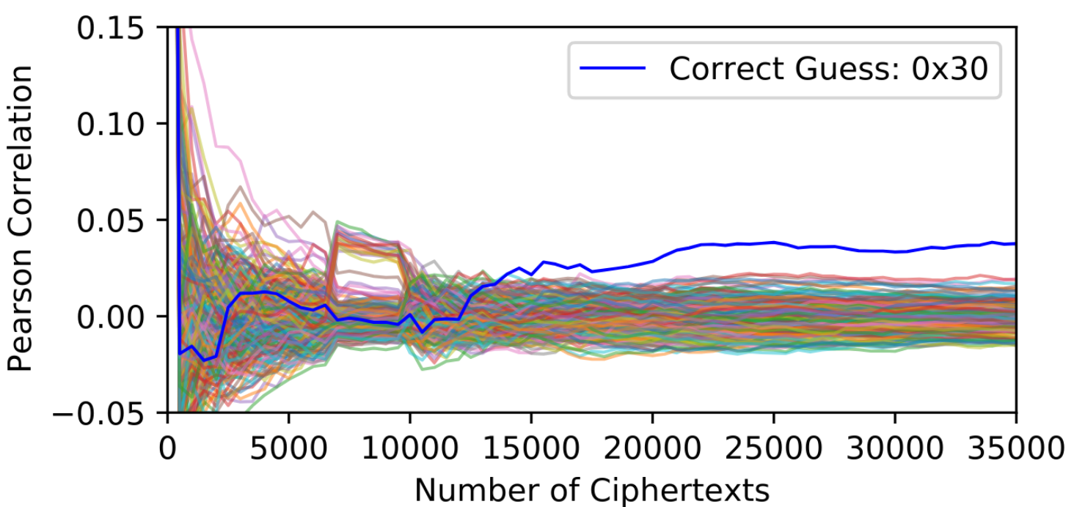
Self-Eviction: The case of AES

Slide 6





Summary
Branch Predictor state can be leaked via cache state
Reverse Engineer the Instruction Prefetcher
Reverse Engineer the Branch Target Buffer
Three attacks on Branch Predictor
Paper
https://github.com/0xADE1A1DE/BunnyHop
Code
Notes:
Give a list of what we have done.

