Slide 1





Ultimate SLH: Taking Speculative Load Hardening to the Next Level
Zhiyuan Zhang, Gilles Barthe, Chitchanok Chuengsatiansup,
Peter Schwabe, Yuval Yarom

Slide 2

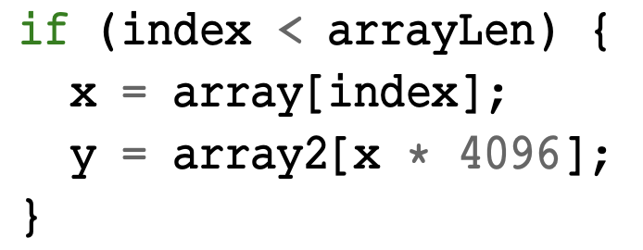

Spectre-V1 Revisit
Misprediction
Obtain secret
Covert Channel
Leak

Slide 3

Speculative Load Hardening (SLH)
Fixed memory access under misprediction
mask = 0;
if (index < arrayLen) {
x = array[index];
y = array2[x * 4096];
}
mask = index < arrayLen ? mask : -1;
-1
-1
-1
x = array[index] | mask;
-1
Track speculative state
Poison memory

Slide 4


Limitation of SLH
Only protect memory
Leakages could also from Control Flow (CCS 2021)
More Leakages?
SLH
SSLH (CCS 2021)
Memory
Control Flow

Slide 5
Leakage Model
Constant-time Model
Memory
Control Flow
Variable-time Instructions
Bring constant-time model to speculative execution
SLH
SSLH (CCS 2021)
Memory
Really Leak?
Control Flow
Variable-time

Slide 6

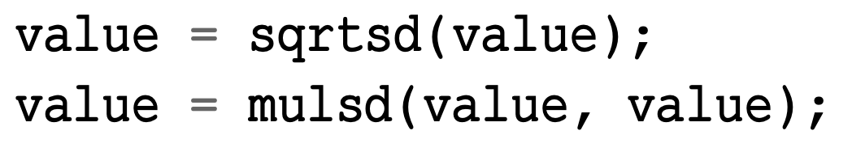

Timing variable-time instructions
On i7-10710U:
Executing a pair of SQRTSD and MULSD:
65536: 5 cycles
2.34e-308: 7 cycles
fast
slow

Slide 7
Timing speculative variable-time instructions
fast
slow
speculative window
if (isPublic) { value = sqrtsd (value);
value = mulsd (value, value);
}
5 cycles
7 cycles
200 cycles

Slide 8
Timing speculative variable-time instructions
fast
slow
speculative window
if (isPublic) { value = sqrtsd (value);
value = mulsd (value, value);
value = sqrtsd (value);
value = mulsd (value, value);
……
}
5 x 30
cycles
7 x 30
cycles
200
cycles
independent_access(x);

Slide 9
Ultimate Speculative Load Hardening
Constant-time Model
Memory access (load + store)
Control Flow Transfers
Variable-time Instructions
Bring constant-time model to speculative execution
SLH
SSLH (CCS 2021)
USLH
Really Leak!
Memory
Really Leak?
Control Flow
Variable-time

Slide 10
Ultimate Speculative Load Hardening
if (isPublic) {
value = sqrtsd (value);
value = mulsd (value, value);
value = sqrtsd (value);
value = mulsd (value, value);
……
independent_access(x);
}
mask = isPublic ? Mask : -1;
value = value | mask;
Compiled by SLH
Compiled by USLH

Slide 11
USLH Benchmark
43%
14%
13%
45%
Time Cost Normalisation

Slide 12





Summary
Leakages could from variable-time operations
Implement and benchmark Ultimate SLH
Gadget search tool
Formal Proof
https://github.com/0xADE1A1DE/USLH
Paper
Code

