Slide 1
Unit-1
WEB ESSENTIALS AND STYLE SHEETS
Clients, Servers, and Communication.
The Internet - Basic Internet Protocols –
The World WideWeb-HTTPrequestmessage-responsemessage-WebClients-WebServers-
Markup Languages: XHTML. An Introduction to HTML – History –Versions -Basic XHTML Syntax and Semantics - Fundamentals of HTML.
CSS-IntroductiontoCascadingStyleSheets–Features-CoreSyntax-StyleSheetsand HTML - Cascading and Inheritance - Text Properties – Positioning.

Slide 2
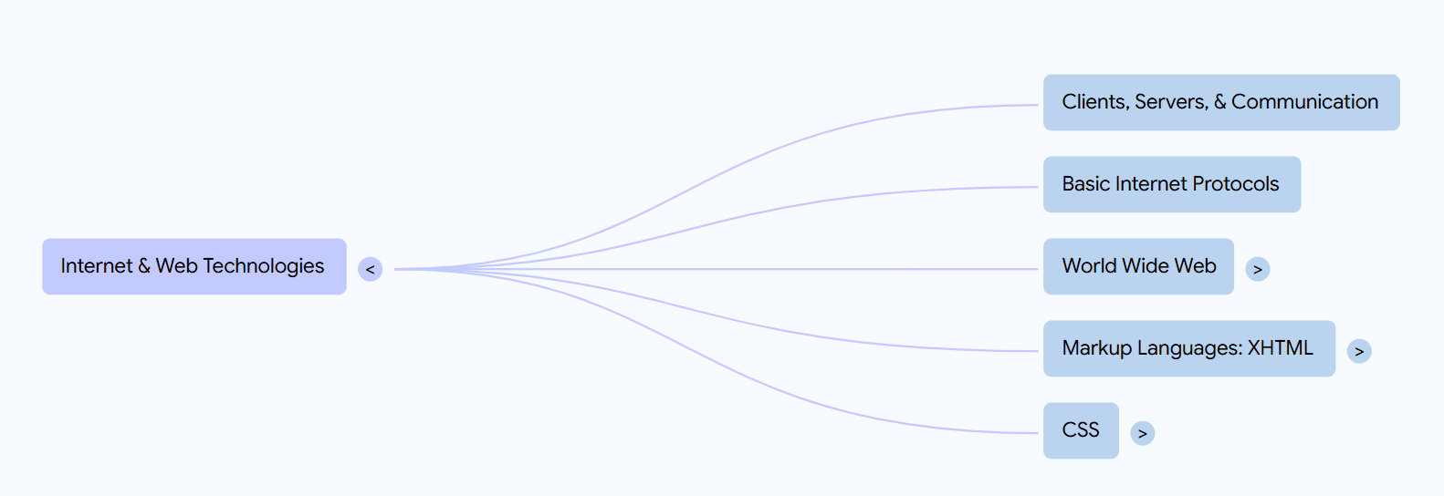

Slide 3
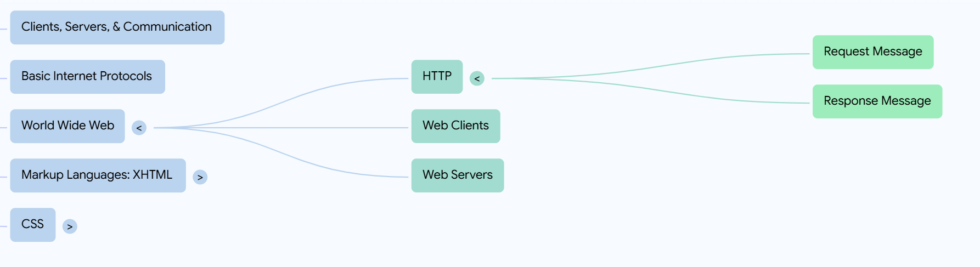

Slide 4
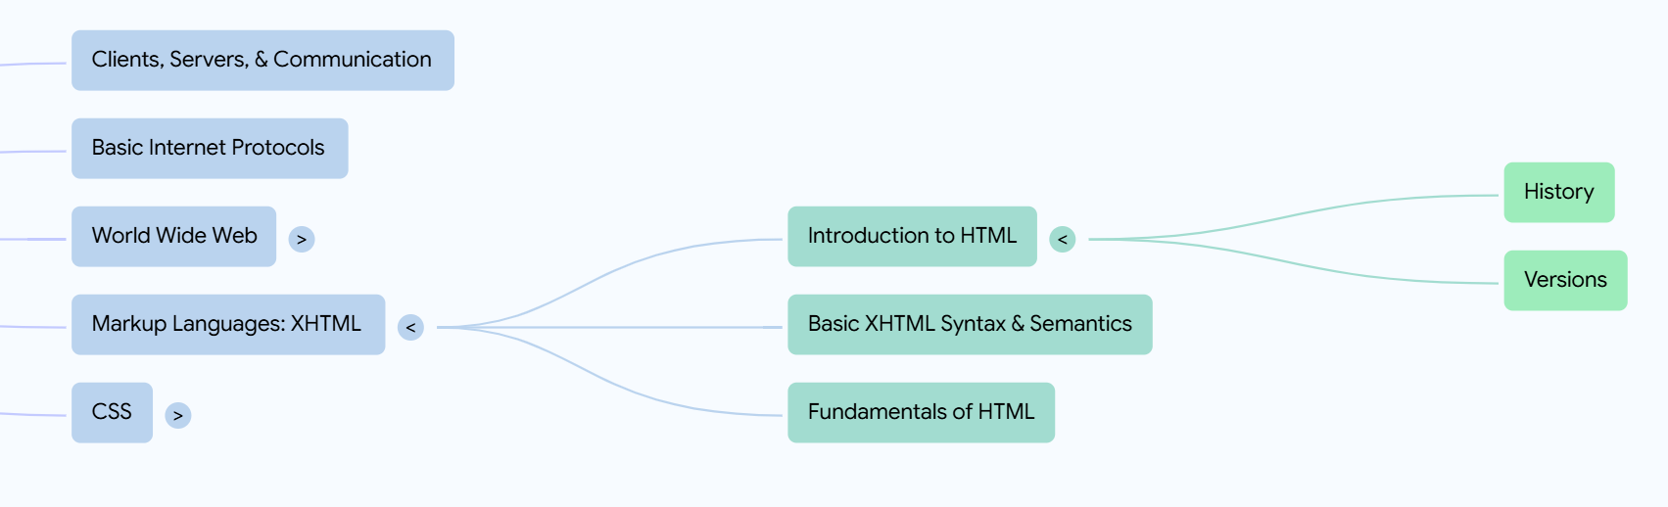

Slide 5
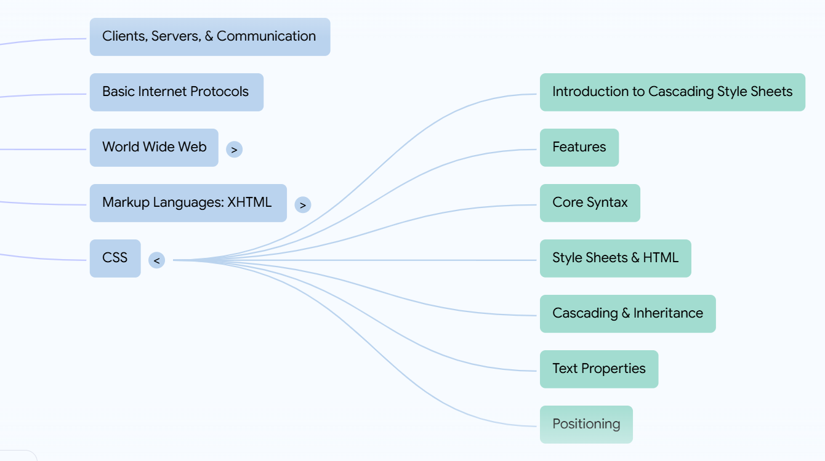

Slide 6
Clients, Servers, and Communication
Client:
A software or device that initiates communication to request services/data.
Examples: Web browser, mobile app, API consumer.
Server:
A program or machine that listens for client requests and sends back responses.
Examples: Web server (Apache), Database server, Mail server.
Communication:
Based on Request-Response Model.
Uses standardized protocols such as HTTP, FTP, SMTP, TCP/IP

Slide 7
The Internet & Basic Internet Protocols
Internet:
A global network connecting millions of private, public, academic, business, and government networks.
Protocol | Purpose
HTTP/HTTPS | Web communication (HyperText Transfer Protocol)
TCP/IP | Reliable transmission between devices
FTP | File Transfer Protocol
SMTP/POP3/IMAP | Email transmission and retrieval
DNS | Resolves domain names to IP addresses

Slide 8
World Wide Web (WWW)
The WWW is a system of interlinked hypertext documents accessible via the internet.
Uses HTTP protocol.
Accessed using web clients (browsers).

Slide 9
HTTP Request Message:
Method (GET, POST, PUT, DELETE)
URL (resource identifier)
Headers (metadata like user-agent)
Body (optional – data sent to server)
HTTP Response Message:
Status code (200 OK, 404 Not Found)
Headers (e.g., content-type)
Body (HTML/JSON/XML)

Slide 10
Web Clients vs Web Servers
Web Clients | Web Servers
Send requests | Respond to requests
Usually browsers or apps | Host websites, APIs
Display content to users | Provide data or HTML content

Slide 11
Markup Languages: XHTML
What is XHTML?
eXtensible HyperText Markup Language
A stricter, XML-based version of HTML
Enforces well-formedness and structure
Key Differences with HTML:
Tags must be properly closed
All elements must be nested correctly
All attribute values must be quoted

Slide 12
HTML: An Introduction
History:
Introduced by Tim Berners-Lee in 1991
Evolved through versions: HTML1 → HTML4 → XHTML → HTML5
Versions:
HTML 4.01 – Traditional standard
XHTML – XML-based strict version
HTML5 – Current modern standard (multimedia, mobile-friendly)

Slide 13
Basic HTML Syntax:
<!DOCTYPE html>
<html>
<head>
<title>My Page</title>
</head>
<body>
<h1>Hello World</h1>
</body>
</html>

Slide 14
CSS (Cascading Style Sheets)
Introduction:
CSS is used to style HTML elements (colors, layout, fonts, spacing).
Separates content (HTML) from presentation (CSS).
Features:
Styling multiple pages with one file
Improved user experience
Responsive design for mobile/desktop

Slide 15
CSS (Cascading Style Sheets) is a style sheet language used to describe the presentation of HTML documents. It controls the layout, colors, fonts, spacing, and overall visual appearance of web pages.
Why Use CSS?
Separates content (HTML) from presentation (CSS)
Reusability across multiple pages
Easier maintenance and cleaner HTML
Enables responsive and visually appealing designs

Slide 16
Types of CSS
1. Inline CSS
2. Internal CSS (Embedded CSS)
3. External CSS

Slide 17
1. Inline CSS
CSS is written directly in the HTML tag using the style attribute.
Syntax:
<h1 style="color: blue; font-size: 24px;">Hello World</h1>
Advantages:
Quick and easy for small changes
Useful for testing/debugging
Disadvantages:
Not reusable
Clutters HTML code

Slide 18
2. Internal CSS (Embedded CSS)
CSS is written inside a <style> tag within the <head> of the HTML document.
<!DOCTYPE html>
<html>
<head>
<style>
h1 {
color: green;
font-size: 30px;
}
</style>
</head>
<body>
<h1>Welcome</h1>
</body>
</html>

Slide 19
Advantages:
Keeps styles in one place within the same file
Good for small projects or single pages
Disadvantages:
Not reusable across multiple HTML files
Makes HTML file heavier

Slide 20
3. External CSS
CSS is written in a separate file with a .css extension and linked using the <link> tag in the <head> section.
Syntax:
HTML:
<link rel="stylesheet" href="styles.css">
styles.css:
css
h1 {
color: red;
font-size: 36px;
}

Slide 21
Advantages:
Reusable across multiple HTML pages
Keeps HTML clean
Better maintainability for large projects
Disadvantages:
Requires additional HTTP request to load the stylesheet

Slide 22
cell padding and cell spacing—two important concepts in HTML tables that affect the spacing inside and between table cells.
1. Cell Padding
It is the space between the cell content and the cell border.
It controls the inner spacing of the table cells.
Example:
Each cell will have 10px padding inside (between content and border).<table border="1" cellpadding="10">
<tr>
<td>Cell 1</td>
<td>Cell 2</td>
</tr>
</table>
Each cell will have 10px padding inside (between content and border).

Slide 23
In CSS, you can also do this with:
td {
padding: 10px;
}

Slide 24
Cell Spacing
It is the space between adjacent table cells.
It controls the outer spacing between cells.
Example:
<table border="1" cellspacing="10">
<tr>
<td>Cell 1</td>
<td>Cell 2</td>
</tr>
</table>
There will be 10px space between the cells.

Slide 25
In CSS, use border-spacing:
table {
border-spacing: 10px;
}

Slide 26
Feature | Description | HTML Attribute | CSS Property
Cell Padding | Space inside the cell (content to border) | cellpadding="value" | padding (on td)
Cell Spacing | Space between the cells (border to border) | cellspacing="value" | border-spacing (on table)

Slide 27
What is an HTML Form?
An HTML form is used to collect user input and send it to a server for processing (e.g., login, registration, feedback).
It uses the <form> tag, and inside it, we place form controls like text fields, checkboxes, radio buttons, and submit buttons.

Slide 28
Basic Syntax
<form action="submit_form.php" method="post">
<!-- Form elements go here -->
</form>

Slide 29
Attribute | Description
action | The URL where form data is sent for processing
method | HTTP method (GET or POST)
name | Name of the form
target | Where to display the response (_self, _blank, etc.)

Slide 30
Common Form Elements:
1. Text Input
<label for="name">Name:</label>
<input type="text" id="name" name="username">
2. Password Field
<label for="password">Password:</label>
<input type="password" id="password" name="pass">
3. Radio Buttons
<p>Gender:</p>
<input type="radio" id="male" name="gender" value="Male">
<label for="male">Male</label>
<input type="radio" id="female" name="gender" value="Female">
<label for="female">Female</label>

Slide 31
4. Checkboxes
<p>Hobbies:</p>
<input type="checkbox" id="reading" name="hobby" value="Reading">
<label for="reading">Reading</label>
<input type="checkbox" id="traveling" name="hobby" value="Traveling">
<label for="traveling">Traveling</label>

Slide 32
5. Dropdown (Select Menu)
<label for="country">Country:</label>
<select id="country" name="country">
<option value="India">India</option>
<option value="USA">USA</option>
<option value="UK">UK</option>
</select>

Slide 33
6. Textarea
<label for="message">Message:</label>
<textarea id="message" name="message" rows="4" cols="30"></textarea>
7. Submit Button
<input type="submit" value="Submit">

Slide 34
8. Reset Button
<input type="reset" value="Clear">
Form Methods
GET → Sends form data in the URL (used for search forms, not secure)
POST → Sends form data in the request body (used for login, registration, secure data)

Slide 35
<form action="process.php" method="post">
<!-- form elements -->
</form>

Slide 36
<!DOCTYPE html>
<html>
<body>
<h2>Registration Form</h2>
<form action="submit.php" method="post">
<label for="fname">First Name:</label>
<input type="text" id="fname" name="firstname"><br><br>
<label for="lname">Last Name:</label>
<input type="text" id="lname" name="lastname"><br><br>
<label>Gender:</label>
<input type="radio" name="gender" value="Male"> Male
<input type="radio" name="gender" value="Female"> Female<br><br>
<label for="country">Country:</label>
<select id="country" name="country">
<option value="India">India</option>
<option value="USA">USA</option>
</select><br><br>
<input type="submit" value="Register">
<input type="reset" value="Clear">
</form>
</body>
</html>

