Slide 1


Let’s Hack Stuff Together An Interactive Penetration Testing Demo

Slide 2





whoami
risk3sixty.com/penetration-testing
Asher Andree
Senior Penetration Tester
CRTO | OSCP | eJPT
0xAsh.io
_bin_Ash
0xAsh

Slide 3
Groundwork

Slide 4
Groundwork
What even is Penetration Testing?

Slide 5


Slide 6


Slide 7


Slide 8
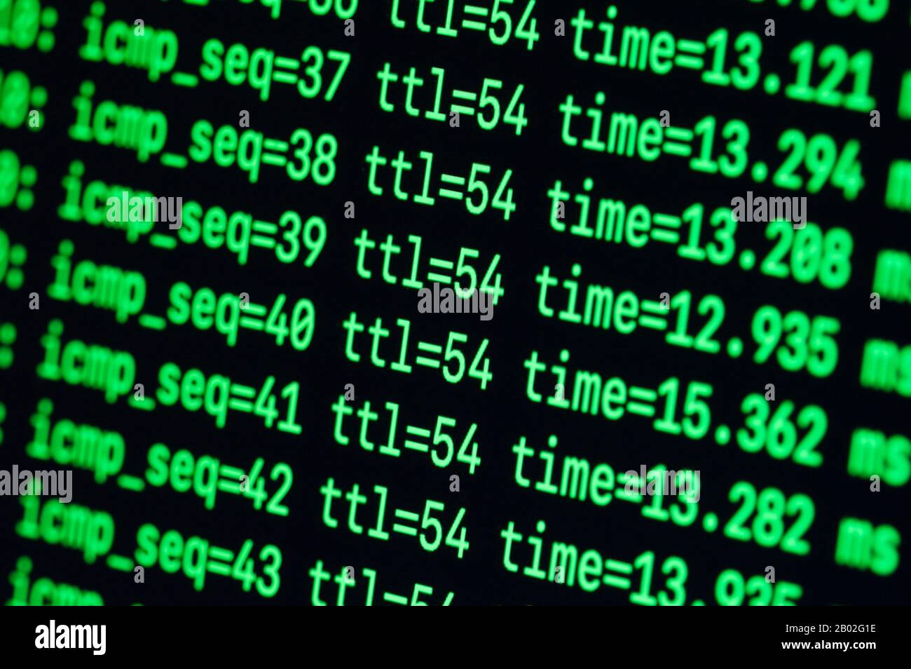

Slide 9



Slide 10
Groundwork
“Security testing of any sort is ultimately about managing organizational risk to threats.”
via: https://redteam.guide/docs/Concepts/red-vs-pen-vs-vuln/

Slide 11
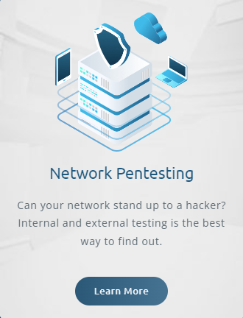
Nuance Matters

Slide 12
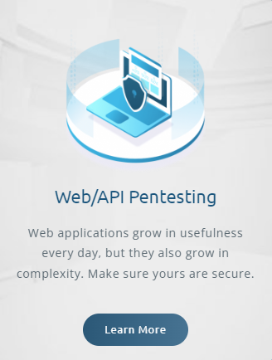
Nuance Matters

Slide 13
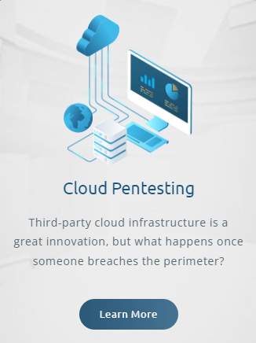
Nuance Matters

Slide 14

Nuance Matters

Slide 15
Network Pentest Engagements
External
Public Address Space
Scanning public ports, services, protocols, etc.
Typically limited attack surface
May use vulnerability scanning tools to speed up processes, but should not only be a vulnerability scan
Internal
Inside an organization’s network(s)
Hitting internal services, ports, protocols
Also, may use vulnerability scanning tools to speed up processes, but should also not only be a vulnerability scan

Slide 16
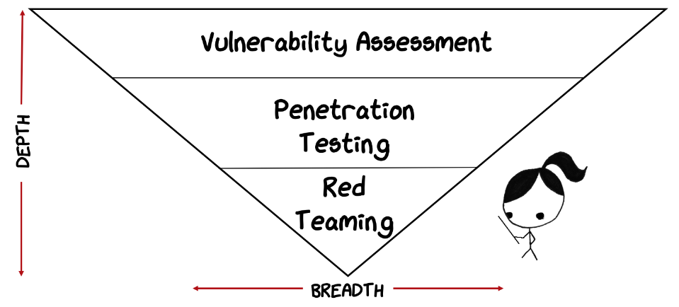
Why Does All of This Matter?

Slide 17
Meet Our Client

Slide 18



Meet Our Client
Contoso Ltd.*
~150 Employees
Lisa Thompson
Dennis Ritchie
New network segment being rolled out
Chief Technical Officer
Lead System Architect
*Contoso Ltd. (also known as Contoso and Contoso University) is a fictional company used by Microsoft as an example company and domain.

Slide 19
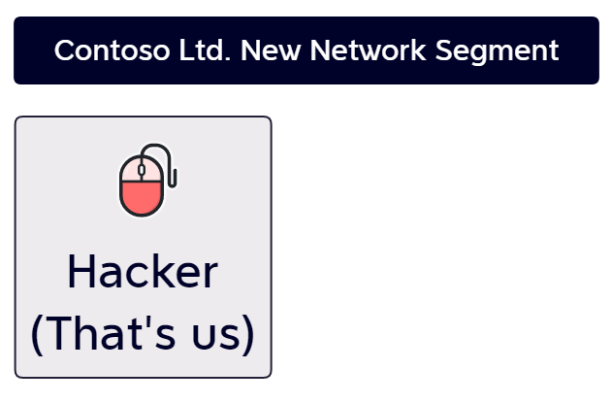

Slide 20
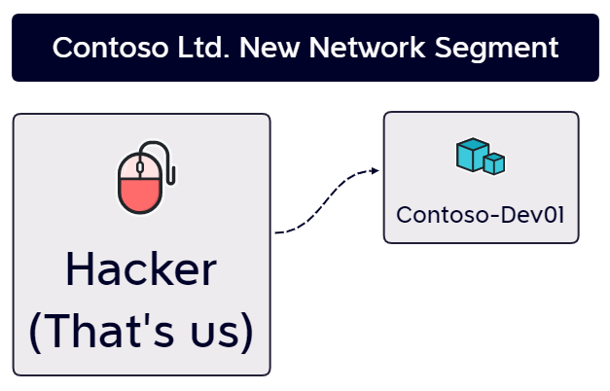

Slide 21
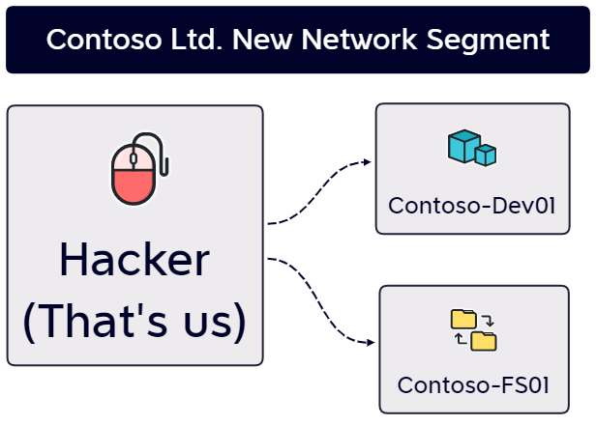

Slide 22
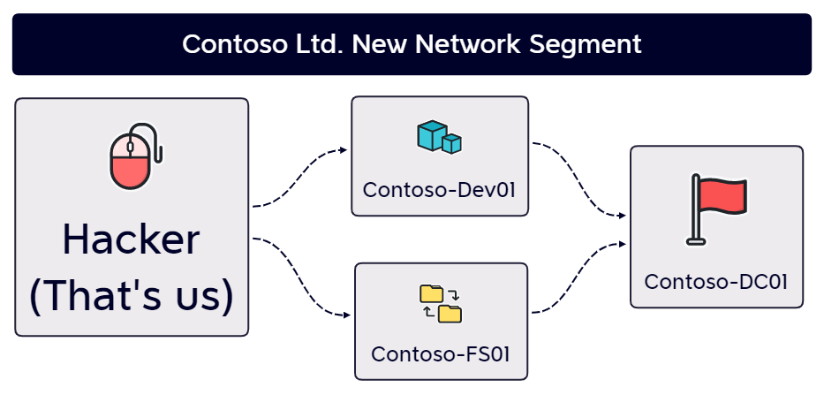

Slide 23
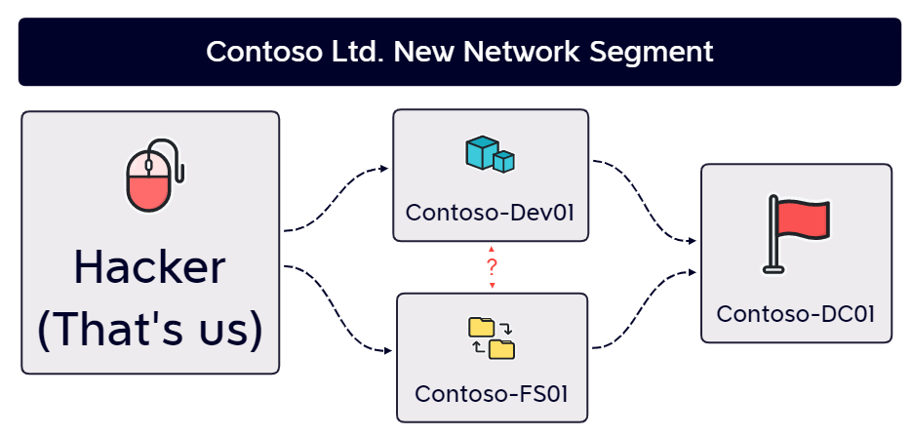

Slide 24


Phil Brudney
“A New Privacy Framework”
1:30 – 2:20 PM Ravinia EFG
Phalanx GRC Demo
Kendall Morris & Christian Hyatt 3:40 – 4:30 PM Maplewood Room (this room)
https://github.com/0xAsh/media

