Slide 1
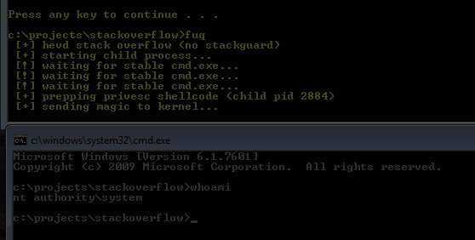
MOLTEN CORE RAID GUIDE v0.8
the complete guide to basic kernel magic

Slide 2
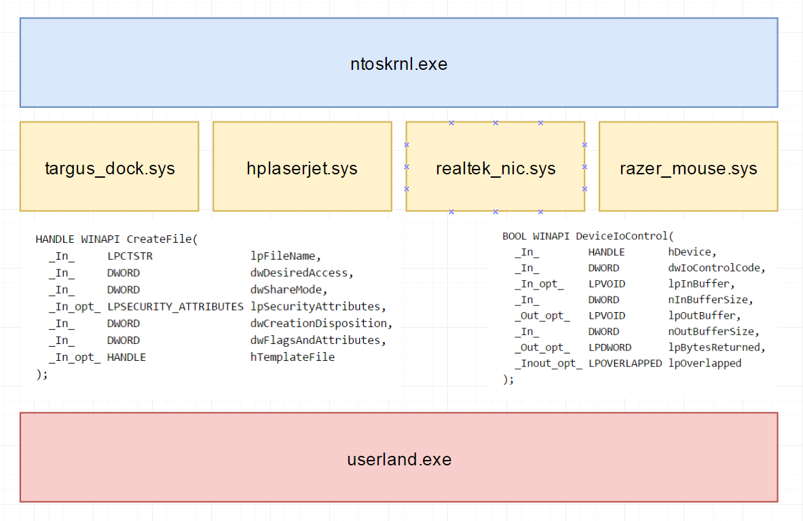
Windows Kernel Overview

Slide 3
Down the Rabbit Hole (Reference)
Set up your Guest VM:
bcdedit /copy {current} /d “debug mode"
bcdedit /set {guid-string} debug on
bcdedit /set {guid-string} debugtype 1394
bcdedit /set {guid-string} channel 4
Set up your VirtualBox:
Serial Ports -> Port 1:
COM4
Host Pipe
\\.\pipe\debug
DO NOT “Connect to Existing Pipe/Socket”
Set up your WinDbg:
File -> Kernel Debug
Pipe
\\.\pipe\debug
115200 Baud Rate
[Y] Pipe, [Y] Reconnect, 0
ed nt!Kd_DEFAULT_MASK 8 (if you want printf debugging)
OSR Loader, HackSys Vulnerable Driver (you trust me, right? :P)

Slide 4
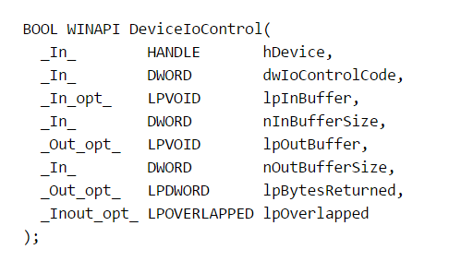
Down the Rabbit Hole

Slide 5
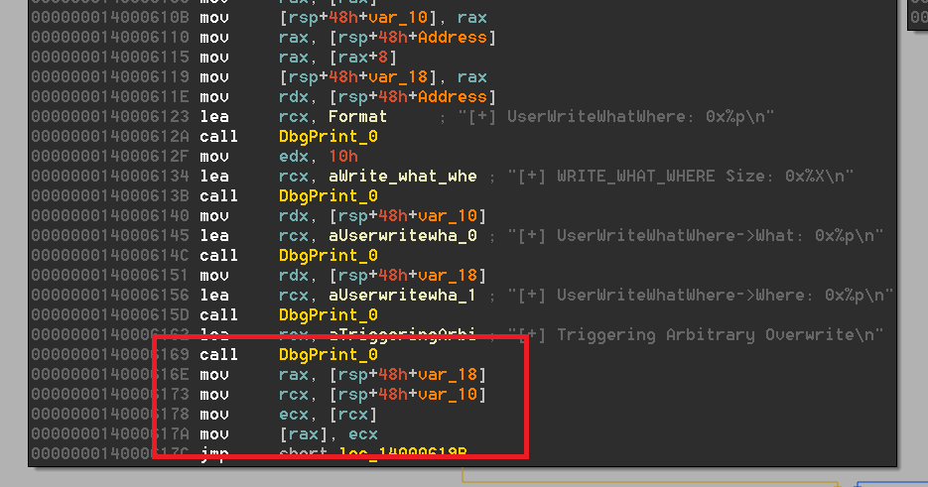
Arbitrary overwrite

Slide 6
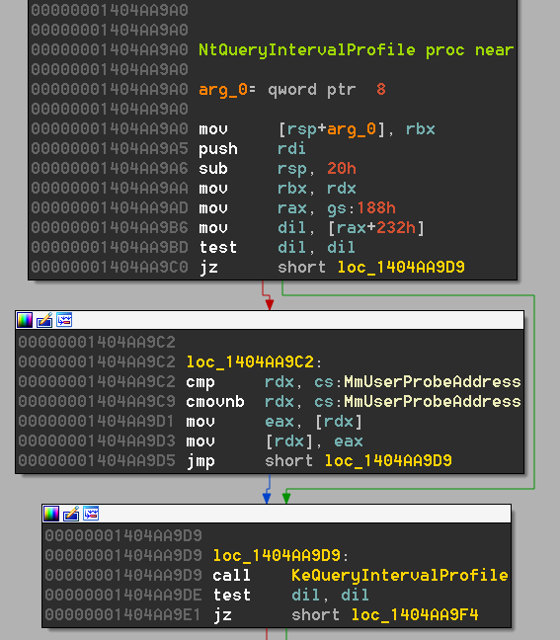
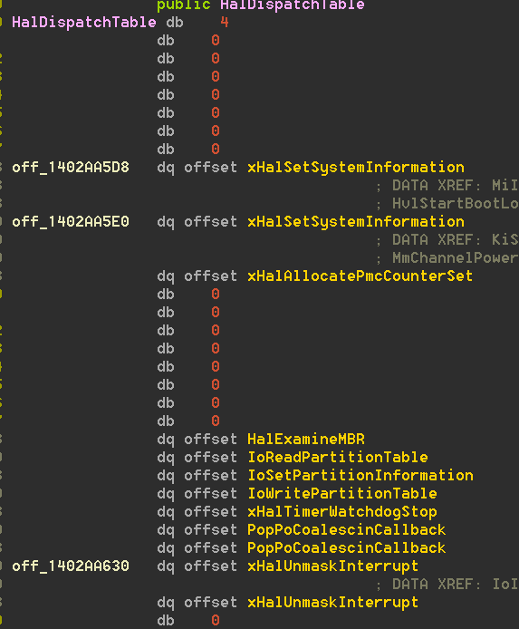
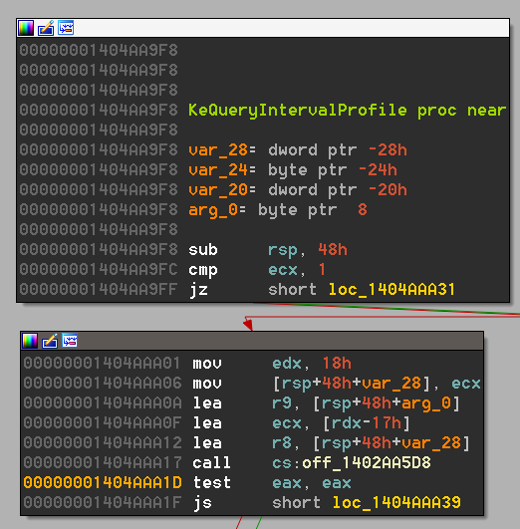
Exploit:NtQueryIntervalProfile (I)

Slide 7
Exploit:NtQueryIntervalProfile (II)
Arbitrary write to HalDispatchTable[1]
Point HalDispatchTable[1] to shellcode
Call NtQueryIntervalProfile
BUT KASLR…
Load “ntoskrnl.exe”, resolve symbol address
Subtract base of ntoskrnl for RVA
Use NtQuerySystemInformation and get address of kernel from Module[0].Base
RVA + Base = Kernel address of anything
STATUS_ACCESSDENIED by Windows 8.1+

Slide 8
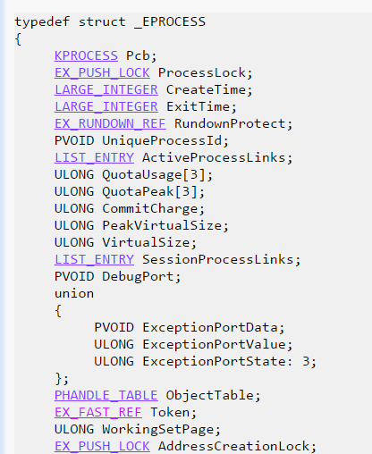
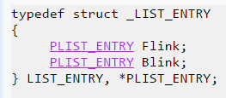
Introducing: The Token Thief
The NT kernel represents privilege via “tokens”
These are stored in an “EPROCESS” structure …
… in a double linked list
== 4?
steal this

Slide 9
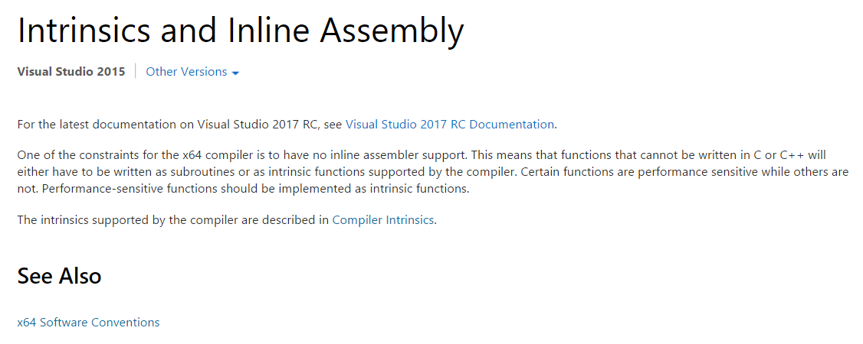
Interlude: Fuck you Visual Studio

Slide 10
Tl;dr
Step 1: Prepare token thief shellcode with our PID.
Step 2: Send IOCTL to overwrite HalDispatchTable[1] with address of our shellcode
Step 3: Call NtQueryIntervalProfile, which triggers our shellcode
Step 4: Steal token from PID 4 to ourselves
Step 5: Create cmd.exe, which spawns under our token (SYSTEM)

Slide 11
Demo: arbitrary overwrite + bonus Shutdown Corruption
~all hail the demo gods~

Slide 12
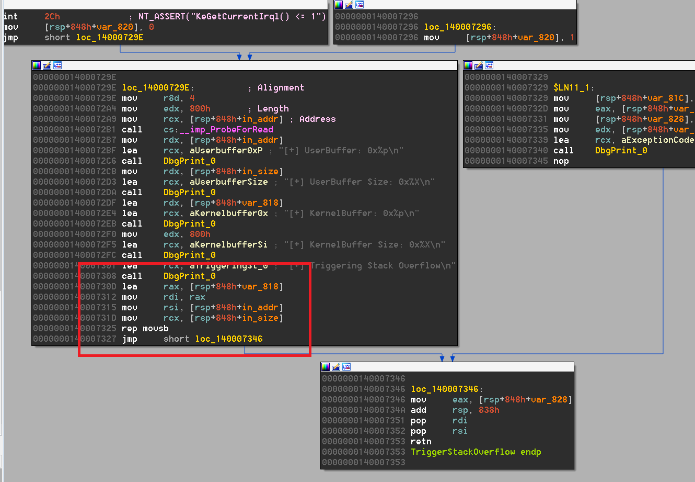
stack overflow

Slide 13
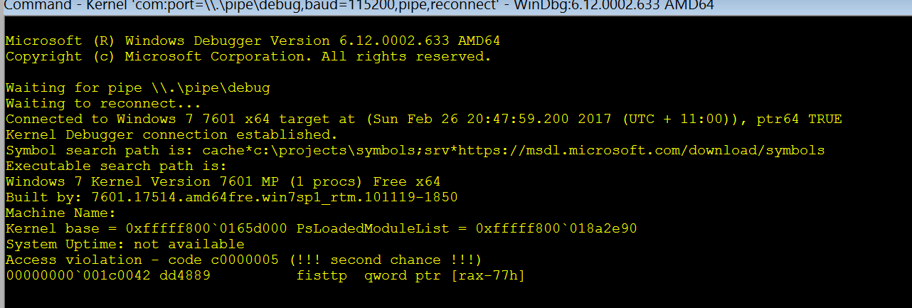
Exploitation: theory vs practice
Theory:
Give input until you overwrite RIP in Ring0
Direct RIP to token stealing shellcode
Return to previous stack frame
ntauthority\system
Practice:
Give input until you overwrite RIP in Ring0
Direct RIP to token stealing shellcode
Return to previous stack frame
fuck shit fuck ?????

Slide 14
Repairingignoring the stack
\xeb\xfe
the shellcode “works”, it just doesn’t return properly – so just let it never return from r0 :D

Slide 15
Demo: kernel stack overflow
~all hail the demo gods~

Slide 16
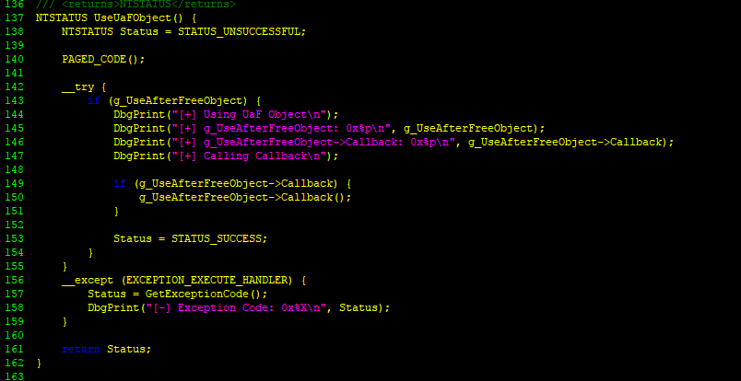
Use after free

Slide 17
use after wat (simplified)
Memory layout is somewhat predictable
Windows + Linux will try to allocate memory in ordered chunks to reduce fragmentation
Free a space, allocate a space of roughly the same size, and you’ll re-use the same address.
Free a space, allocate something malicious into that space, and get code exec via a secondary attack vector.
ALLOC OBJ
DATA
FNPTR
FREE OBJ
ALLOC OBJ
AAAAAAAAAAAAAAAAAAAAA SHELLCODE
USE ALLOC OBJ

Slide 18
Demo: use after free
~all hail the demo gods~

Slide 19
Of targets and opportunity...
driverquery /v lists active drivers
IDA IOCTL Dispatcher / IOCTL finder plugins:
DriverBuddy (lightweight)
win_driver_plugin (little more mature)
Patch quest for DriverEntry fn
Search for IOCTLs -> glorious attack surface
AV’s
HID devices
Anti-cheat systems
capcom.sys
Bridges (USB->Serial)
Bootcamp
Phones
Hubs / Docks
the list goes on...

Slide 20
Thankyou
questions? lin_s on slack

