Slide 1
Developing a Methodology for the Identification of Alternative NoSQL Data Models via Observation of Relational Database Usage
Paul M. Beach¹
Brent T. Langhals, PhD¹
Michael R. Grimaila, PhD¹
Douglas D. Hodson, PhD²
Ryan D. L. Engle, PhD¹
1. Department of Systems Engineering, Wright-Patterson AFB, Dayton, Ohio
2. Department of Electrical & Computer Engineering, Wright-Patterson AFB, Dayton, Ohio
Disclaimer: The views expressed in this presentation are those of the authors and do not reflect the official policy or position of the United States Air Force, the Department of Defense, or the U.S. Government.
Notes:
30 seconds
Good morning, and thank you for your interest in my presentation. My name is Paul Beach, and I am a Air Force officer and PhD student at the Air Force Institute of Technology. My talk today is centered around the direction of my proposed PhD research, specifically in the areas of understanding how observations of relational database usage might inform the selection of a more suitable NoSQL data model.
Disclaimer: These views are my own, not that of the Air Force, the DoD or the US gov’t. And mistakes are especially my own.

Slide 2
Intro
Era of “Big Data” has led to the emergence of novel approaches and supporting technologies to cope with ever-increasing amounts of data
For instance, non-relational (NoSQL) data models
Although typically employed to store, process and retrieve massive datasets across clusters of machines, previous research has highlighted value in smaller, single-box uses
Our research continues these efforts in an attempt to determine if a NoSQL data model may be more suitable than an existing (relational) model in single-box deployments through observation of actual usage
R. D. L. Engle, B. T. Langhals, M. R. Grimaila, and D. D. Hodson, “A Methodology for Evaluating Relational and NoSQL Databases for Small-scale Storage and Retrieval”
Notes:
1 minute
By way of introduction, I’d like to set the stage for my discussion about NoSQL databases.
Although relational databases have enjoyed prominence in most data storage and retrieval application since their emergence in the 1970’s, increasing demands on these systems in terms of data volume, velocity and variety have ushered in the era of “Big Data”, which has led to new and innovative ways of coping with the corresponding challenges presented by Big Data. One such emergence includes a class of non-relational data models, commonly referred to as “NoSQL”.
Most of these data models were designed in response to the need to store, process and retrieve massive datasets stored across clusters of many different machines. However, our previous research has highlighted there is also value in using these NoSQL data models on smaller, single-box deployments.
This research continues that effort. As part of my PhD research, I am studying the feasibility and usefulness of building an observation and decision support tool which, given as input an adequate observation of users’ interactions with an existing relational database, will attempt to identify if there are any NoSQL data models that may be a more suitable fit for the given use case.

Slide 3
Outline
NoSQL Data Models
Methodology
System Overview
Proposed Workload Characterization Criteria
Hypothetical Use Case
Notes:
Here is a quick overview of my talk today. For those unfamiliar with them, I’m going to ever so briefly touch on the four common NoSQL data models. I will then discuss a proposed system to capture and evaluate existing relational database usage. I’ll discuss previous efforts to define criteria to

Slide 4
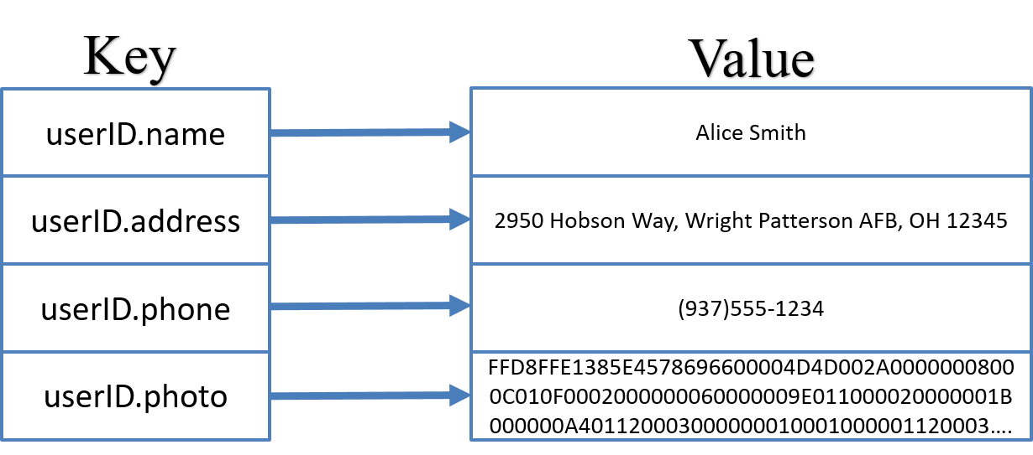
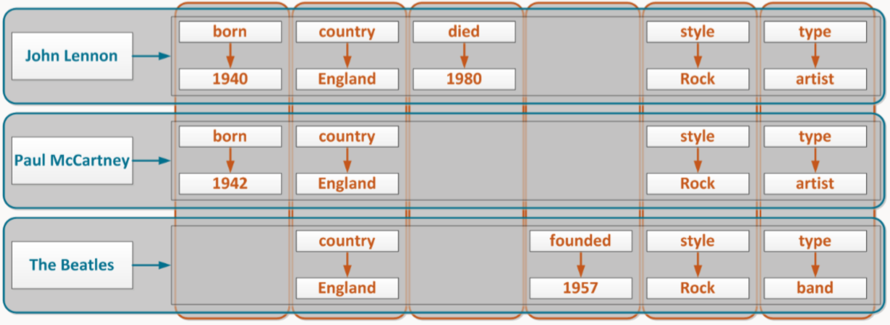
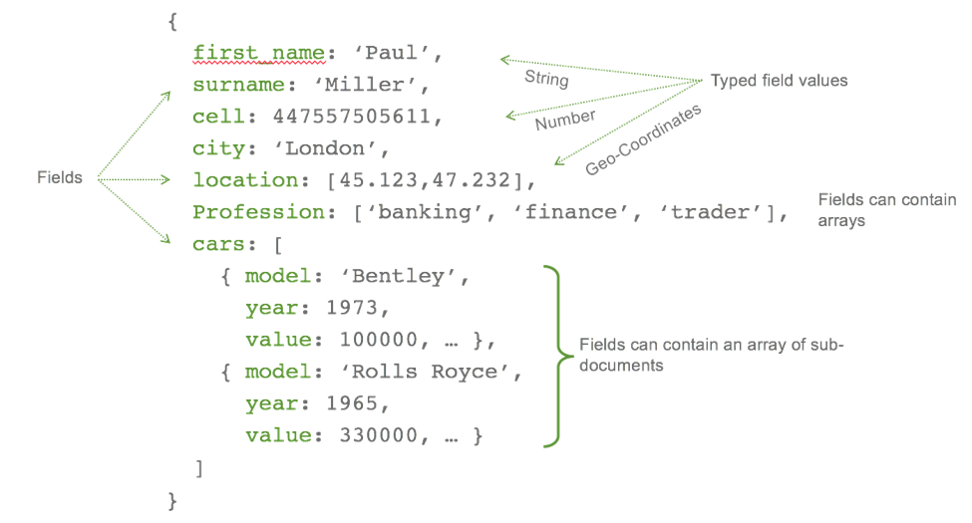
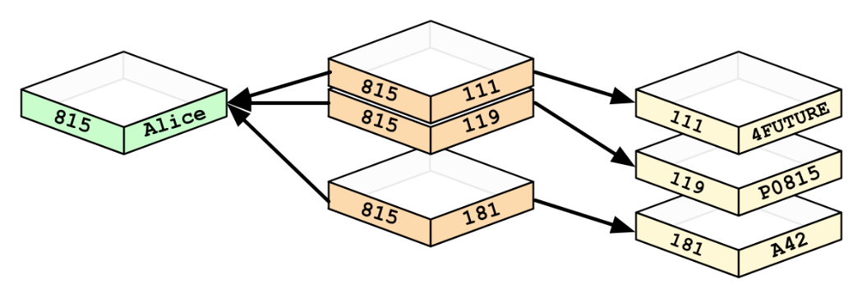
NoSQL Data Models
Key-Value
Document
Column Family
Graph
studio3t.com/whats-new/nosql-database-types/
Notes:
Need to limit to 30-60 seconds.
K-V (Riak, Redis): KV data model employs a very simple structure involving a key and a value, where the key is the unique identifier to lookup the corresponding value. The value itself can be just about anything, from numbers, strings or binary large objects (BLOBS). The value itself is considered opaque in this data model, which typically means that KV databases cannot query based on the stored values but rather only by specifying a key or range of keys. The simplicity of this data model is offset by the fact that KV databases tend to be extremely performant.
Doc (MongoDB, CouchDB): Sometimes called a self-describing, hierarchical tree data structure, data is often encoded as JSON or XML. While like the KV data model it also employs a key lookup, the document model can also perform queries based on stored values.
Col (Cassandra, Hbase): Superficially a column data model may resemble the traditional relational data model (since both contain tables with rows and columns), there are key underlying differences. Values are uniquely identified by specifying a row and column name, and related columns may be grouped together to form column families in order to improve performance when accessing related data since it is stored together. One key difference that sets the column data model apart from the relational model is the ability to store only the data that is of interest. So if you are trying to store data sparsely distributed across many columns, in a relational database you would need to store a lot of NULL values, while column families can have a variable number of columns per row.
Graph (Neo4j): The graph data model is designed to deal with highly interconnected data, stored as nodes and relationships between nodes. Because of its structure, it is easy to query across related data, which would likely require many expensive joins in a relational model.

Slide 5
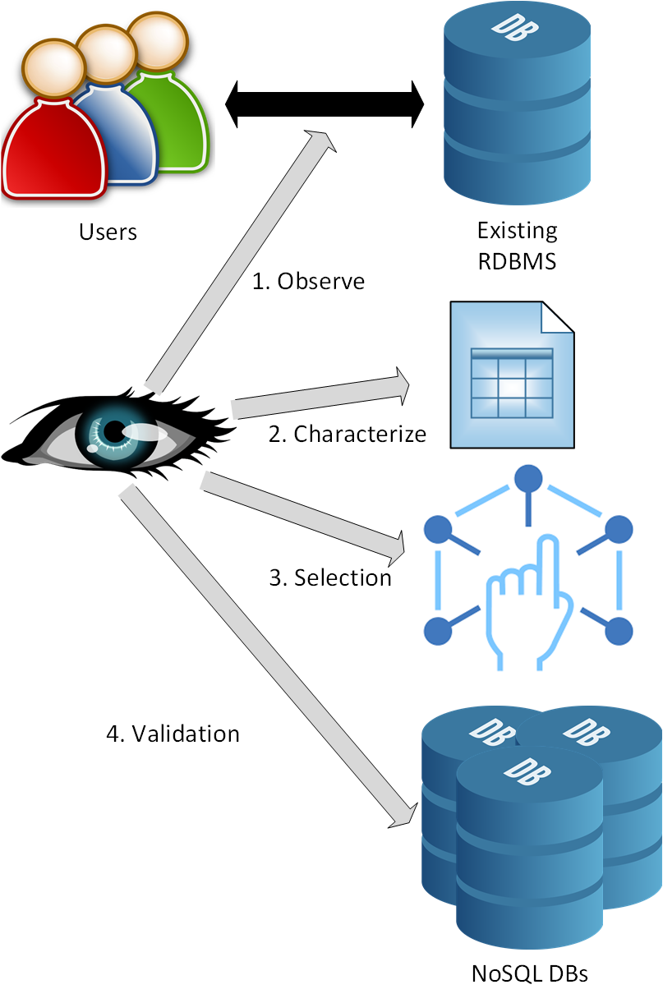
Methodology
Step 1: Monitor Current Usage
Step 2: Characterize Observed Usage
Step 3: Selection of alternative NoSQL data model
Step 4: Validation
Notes:
Step 1: Collect information about queries being performed (by all users)
Step 2: Analyze observed usage
Core workload classifications, query frequency, data volume
Describe keyword parsing (e.g., SELECT, UPDATE, INSERT INTO, DELETE commands)
More complex read/modify/write workloads -> SELECT followed by UPDATE/INSERT/DELETE matching WHERE clauses
Query frequency average measurement of queries over time
Data volume measures average volume of data being stored
Step 3:
Step 4: The outputs of step 2 are used as inputs for a battery of benchmark tests (using YCSB or another similar benchmark tool) to assess performance of similarly resourced NoSQL databases (in terms of CPU, memory, etc)
Should use a core workload mixture analogous to observed usage
System performance metrics may indicate lower system requirements for particular database implementations

Slide 6

Generic System Overview
Proposed System
+---------+-----------+------------+
| Cust_No | Last_Name | First_Name |
+---------+-----------+------------+
| 1001 | Smith | John |
| 2039 | Smith | David |
| 2098 | Smith | Matthew |
+---------+-----------+------------+
3 rows in set (0.05 sec)
Query Monitor
Web App
SELECT * FROM Customers WHERE Last_Name='Smith';
User
Query Logger & Analysis Tool
Web Server
Database Management System Software
Web-based Application
Query Monitoring, Logger & Analysis Tool
Database System
Notes:
At 4 minutes here
Who do I mean by “users”?
Where am I doing the monitoring from?
What am I seeing, both to the DBMS and in return?

Slide 7
Characterizing Workloads
Workload: “requests made by the users of a system”
Can I characterize the workload of a database system by observation alone?
Can the workload evaluation be used to inform the selection of a suitable NoSQL data model?
R. Jain, The art of computer systems performance analysis: techniques for experimental design, measurement, simulation, and modeling. New York: Wiley, 1991.

Slide 8
Proposed Workload Characterization Criteria
Metric | Description
CRUD Ratio
Create | Ratio of create/INSERT queries to total queries
Read | Ratio of read/SELECT queries to total queries
Update | Ratio of UPDATE queries to total queries
Delete | Ratio of DELETE queries to total queries
Retrieval capabilities
Complexity | Query by key or range of keys, vs queries by value, conditionals, joins, etc.
Transparency | Ability to access individual elements within the specified records
Other Metrics
Variety | Measurement of the variety of query structures
Size | Metric determining size of average query from small (<1kb) to large (>1tb)
R. D. L. Engle, A Methodology for Evaluating Relational and NoSQL Databases for Small-scale Storage and Retrieval (Doctoral dissertation).
Notes:
What are we doing here?
We begin by identifying the general makeup of the workload in terms of create, read, update and delete operations, commonly referred to as CRUD operations. By understanding the general makeup of the queries, this information may be useful later in our decision model in pointing towards a given data model. For instance, a write-heavy workload consisting of few read operations relative to all other operations may indicate that a wide-column data model is appropriate, as databases utilizing this model tend to perform well in such applications.
Similarly, some NoSQL data models are able to cope with complex queries, while others like the key-value data model typically do not. Therefore, evaluating the observed queries to determine if they are using simple lookup queries or more complex ones may help inform the selection of a particular data model.
Transparency refers to the notion that the data model can access some subset of related elements as opposed to having to access the entire value. For instance, you can use a key-value model to store just about any value you like, so it is possible to store an array of values within a single key-value element, however the key-value database has no option other than to return the entire value to the user and let the user deal with parsing out the value. Conversely, the nested structure of a document data model means that a user would be able to index and address sub-elements of interest.
When we’re talking about variety, we’re interested in determining if the user is making a bunch of different, ad hoc queries over time or if we are seeing the same few types of queries over time. The values or lookup keys being used may change, but the overall structure remains constant indicating that the queries the user needs to execute are likely to be well known and unchanging over time (at least for the current use case). The column-family data model in particular can take advantage of this foreknowledge of queries by storing related data together for more efficient storage and retrieval.
Finally, the average size of the queries being observed can help inform the selection of a data model. From a purely performance-based perspective, databases that employ the document and column data models tend to handle larger data values, while the key-value and graph data models tend to handle smaller values well.
So here we might expect to see?

Slide 9
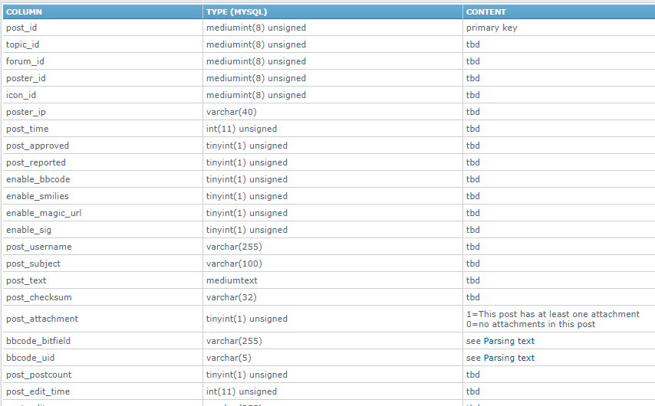
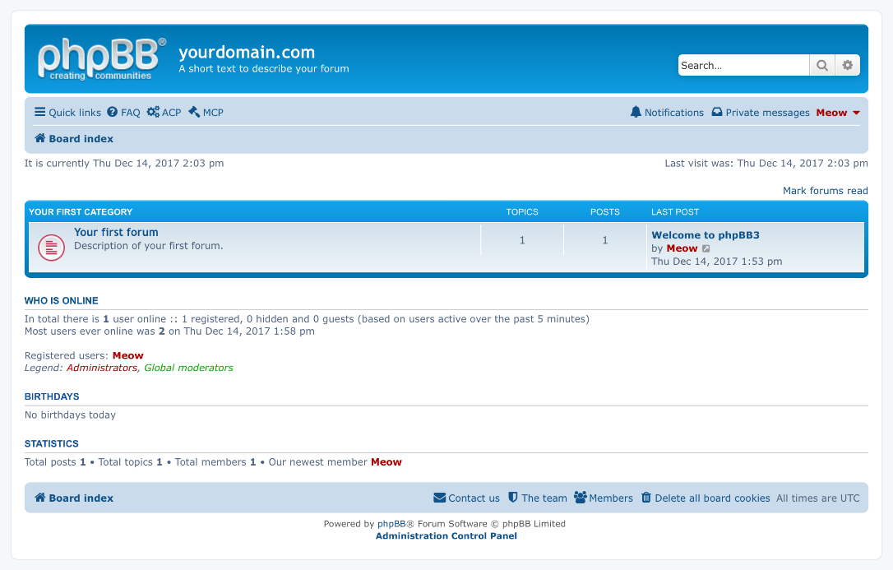
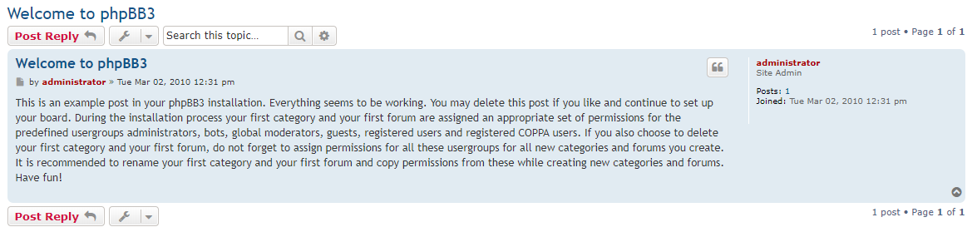
Hypothetical Use Case: Online Forum System
Consider the example of an online forum system
Consist of entities such as subforums, discussion threads, comments, users, etc.
Employs relational (MySQL) backend
try-phpbb.com
Notes:
Online forums typically consist of a number of distinct entities such as subforums, discussion threads, comments, and users. Subforums organize discussion topics into related areas, which consist of discussion threads. The discussion threads are ordered by recency (the most recently commented upon threads are generally presented first, replacing threads that have not recently been commented on), and these threads are composed of individual comments. Finally, it should be noted that the comments are made by the users who visit the forum. In reality, there may be many more relevant entities in a realistic forum system (e.g., messages between users).
For the sake of this example, consider a user visiting an individual subforum, where they would be presented with a list of discussion threads that are ordered by recency of comments within each discussion thread. Usage patterns of such a system would typically involve a high-read workload (e.g., 95%) and a low-write workload (e.g., 5%), since forums are often used for community discussions where one user makes a comment that is subsequently read by many other users. Also, the most recent discussions are typically the ones being browsed at any given time, so access patterns would follow a distribution where the most recent information is accessed more often.
A typical RDBMS system such as MySQL would organize this database with a normalized schema keeping each of these entities (i.e. subforums, discussion threads, comments, and users) separate. Thus, when the user visits a subforum a series of many SQL queries would need be issued to collect and then present the proper information to the user. For example, first the system would need to query a list of all threads in the subforum that the user was visiting, which would be a relatively simple SELECT query. However, in order to know the correct order to display them in, each of the comments for each of the discussion threads would need to be queried and sorted by most recent, requiring individual SELECT statements with an ORDER BY clause for each topic. Finally, when discussion threads are listed in subforums, they also typically include information about the most recent post, such as when it was made and by which user. Therefore, another batch of SELECT statements using JOIN operators would be required to obtain the proper usernames associated with each of the most recent comments for each discussion thread.
phpbb_posts table

Slide 10
Hypothetical Use Case (con’t)
SELECT post_id, forum_id, post_text FROM phpbb_posts WHERE topic_id=151
SELECT post_id, forum_id, post_text FROM phpbb_posts WHERE topic_id=124
SELECT post_id, forum_id, post_text FROM phpbb_posts WHERE topic_id=94
INSERT INTO phpbb_posts (forum_id, post_text) VALUES (‘2’, ‘Lorem Ipsom…’)
SELECT post_id, forum_id, post_text FROM phpbb_posts WHERE topic_id=151
SELECT post_id, forum_id, post_text FROM phpbb_posts WHERE topic_id=100
SELECT post_id, forum_id, post_text FROM phpbb_posts WHERE topic_id=1
UPDATE phpbb_posts SET post_text = ‘What happens in Vegas’ WHERE post_id=12452
SELECT post_id, forum_id, post_text FROM phpbb_posts WHERE topic_id=124
SELECT post_id, forum_id, post_text FROM phpbb_posts WHERE topic_id=94
INSERT INTO phpbb_posts (forum_id, post_text) VALUES (‘2’, ‘Lorem Ipsom…’)
SELECT post_id FROM phpbb_posts WHERE post_text LIKE ‘%stays in Vegas%’
Create | Read | Update | Delete
.17 | .75 | .08 | .00
Simple | Complex
.92 | .08
Size
1kb
Notes:
What are we doing here?
We begin by identifying the general makeup of the workload in terms of create, read, update and delete operations, commonly referred to as CRUD operations. By understanding the general makeup of the queries, this information may be useful later in our decision model in pointing towards a given data model. For instance, a write-heavy workload consisting of few read operations relative to all other operations may indicate that a wide-column data model is appropriate, as databases utilizing this model tend to perform well in such applications.
Similarly, some NoSQL data models are able to cope with complex queries, while others like the key-value data model typically do not. Therefore, evaluating the observed queries to determine if they are using simple lookup queries or more complex ones may help inform the selection of a particular data model.
Transparency refers to the notion that the data model can access some subset of related elements as opposed to having to access the entire value. For instance, you can use a key-value model to store just about any value you like, so it is possible to store an array of values within a single key-value element, however the key-value database has no option other than to return the entire value to the user and let the user deal with parsing out the value. Conversely, the nested structure of a document data model means that a user would be able to index and address sub-elements of interest.
When we’re talking about variety, we’re interested in determining if the user is making a bunch of different, ad hoc queries over time or if we are seeing the same few types of queries over time. The values or lookup keys being used may change, but the overall structure remains constant indicating that the queries the user needs to execute are likely to be well known and unchanging over time (at least for the current use case). The column-family data model in particular can take advantage of this foreknowledge of queries by storing related data together for more efficient storage and retrieval.
Finally, the average size of the queries being observed can help inform the selection of a data model. From a purely performance-based perspective, databases that employ the document and column data models tend to handle larger data values, while the key-value and graph data models tend to handle smaller values well.
So here we might expect to see?

Slide 11


Hypothetical Use Case (con’t)
Read-heavy
CRUD ratio = [.17, .75, .08, 0]
Complexity = [.08, .92]
Size = 1kb
Some complexity
Small values
Graph
Notes:
So how would I validate it?

Slide 12

Questions?
Paul Beach, PhD student Air Force Institute of Technology paul.beach@afit.edu

Slide 14
Evaluation Criteria
Metric | Description
Result Timeliness
Create | Time to insert a new value
Read | Time to read a value
Update | Time to update a value
Delete | Time to delete a value
Retrieval capabilities
Aggregate functions | Ability to gather summary statistics (e.g., AVG, SUM)
Notes:
Provide examples of what some of these would look like
Result Timeliness
Create – Col
Read – KV & Doc tend to have high read performance (esp for key-based lookups in Doc)
Update
Delete
Retrieval capabilities
Simple
Complex
Agg functions
Transparency

Slide 15
Evaluation Criteria (con’t)
Metric | Description
Other Metrics
Data Type Enforcement | DBMS enforces data type
Query omniscience | (Lacking) foreknowledge of queries (i.e., observing diverse and/or ad hoc queries)
Manipulation | Ability to update elements within a record
Cross-record Consistency | Ability to perform updates to multiple records based on relationships
Plasticity | Ability to dynamically add or remove elements in existing records
Large aggregates | The average records size is considered large (e.g., >1GB)
Notes:
DTE
Query omniscience
Manipulation
CAC
Pla
Large aggregates less useful in single-box environment (locality principle applies everywhere)

