Slide 1
TRAVELTIDE · CUSTOMER ANALYTICS
Customer Segmentation to
Drive Retention
Six behaviour-based segments · a tailored perk for each · a built-in KPI & A/B test
Unsupervised machine-learning analysis of flights, hotels, sessions & users
Data Science · Mastery Project · June 2026
Paul Brendle
Notes:
Welcome. Today I'll show how we turned TravelTide's raw flight, hotel, session and user data into six customer segments, each with a tailored retention perk and a measurement plan. The throughline: most of our traffic doesn't convert, and the customers we do have need very different things to stay. Set an upbeat, executive tone.

Slide 2
AGENDA
What we'll cover in the next 10 minutes
01
The retention problem & the four datasets
Why we built this and what we started from
02
From raw tables to features
Joining, cleaning and engineering session- and user-level signals
03
What the data shows
Key business insights from both views
04
Six segments, two-stage clustering
How we found them and why we trust them
05
A perk for every segment
Matching the reward to the behaviour
06
Measuring success
A retention KPI and a six-arm A/B test
TravelTide · Customer Segmentation for Retention
2
Notes:
Quick roadmap: the problem and the data, how we engineered features, what we found, the six segments, the perks, and finally how we'll prove it works. Keep this to ~20 seconds.

Slide 3
BUSINESS CONTEXT
Lots of browsing, little booking — retention is the lever
65.5%
5,746
2.2×
of sessions end with no booking
customers in the analysis cohort
higher spend from bundle bookers
▪ TravelTide is an online flight + hotel platform with a large browsing audience and a much smaller booking base.
▪ The retention need: traffic mostly doesn't convert, comparison-shopping pulls bookers to competitors, and long gaps between trips create silent churn.
▪ Project goal: a loyalty / retention programme that gives the right perk to the right customer to drive repeat, revenue-generating bookings.
▪ Method: unsupervised clustering — the number and nature of segments are discovered from behaviour (k is not pre-set); perks are designed after the segments are known.
TravelTide · Customer Segmentation for Retention
3
Notes:
Frame the problem in business terms. Two-thirds of sessions never book — that's the headline. We have ~5,700 customers to work with, and bundle bookers are worth more than 2x. We chose unsupervised ML deliberately: we let the data tell us how many customer types exist, then design rewards. Don't dwell on the method yet.

Slide 4
THE METHOD
An end-to-end unsupervised pipeline, with one decision per stage
1
Clean
Keep structural NaNs; drop minors & bad dates
2
Join
Session-centric table: 46,863 sessions
3
Engineer
Session → user features (57 candidates)
4
Select
19 features across 5 behaviour dimensions
5
Preprocess
Zero-impute · log1p skew · RobustScaler
6
Cluster
Two-stage K-Means → 6 segments
7
Design perks
One tailored reward per segment
8
Measure
RBR-90 KPI + six-arm A/B test
Every stage is one deliberate, documented choice — the model is only as good as these decisions.
TravelTide · Customer Segmentation for Retention
5
Notes:
This is the whole journey on one slide. Clean and join the data, build features at the customer level, pick the 19 that matter, preprocess so no single big number dominates, cluster in two stages, then design perks and a measurement plan. I'll walk the key forks next. ~45 seconds.

Slide 5
THE RAW MATERIAL
Four platform tables, joined around the customer
USERS
SESSIONS
FLIGHTS
HOTELS
One row per customer
The spine — one row per visit
One row per booked flight
One row per booked hotel
▪ Birthdate, gender, marital / children
▪ Home country, city, airport
▪ Sign-up date (→ tenure)
▪ Start / end, page clicks
▪ Flight & hotel booked flags
▪ Discounts, cancellation, trip_id
▪ Seats, checked bags, base fare
▪ Departure / return, destination
▪ Airline, airport coordinates
▪ Rooms, nights, price / room
▪ Check-in / check-out times
▪ Hotel name & city
Snapshot window: 2023-01-04 → 2023-07-29 (~29 weeks). Joined sessions → users (inner) + flights & hotels (left) on trip_id.
TravelTide · Customer Segmentation for Retention
4
Notes:
Four tables. Sessions is the backbone — every visit, booked or not. Flights and hotels only exist when someone actually books, so they attach by trip_id. Users gives demographics. Important caveat to mention: this is a 29-week snapshot, which shapes how we measure retention later.

Slide 6
VIEW 1 · SESSION-LEVEL DATA
Every visit becomes one row — the behavioural raw signal
46,863
34.5%
25.9%
cleaned sessions
sessions with any booking
are flight + hotel bundles
▪ Built by an inner join to users plus left joins to flights and hotels — flight/hotel fields are blank exactly when no such booking happened (structural, not dirty data).
▪ Cleaning decisions: keep structural NaNs; impute discount amounts (0 if none offered, median if offered-but-cancelled); drop 2,121 under-18 sessions (illegal + likely typos).
▪ Re-derived nights from check-in / check-out (the raw column disagreed 60% of the time) and dropped 227 sessions with check-out before check-in.
▪ Result: a trustworthy session table where each row faithfully records what a customer did in one visit.
TravelTide · Customer Segmentation for Retention
6
Notes:
First view: the session table. The key idea is that blanks here are meaningful — no flight booked means no flight columns, that's correct, not missing. Mention the disciplined cleaning: we fixed the nights column and removed minors. End on trust: every row is a faithful record.

Slide 7
FEATURE ENGINEERING · SESSIONS
Turning timestamps and flags into behaviour
Conversion
Spend & price
Trip shape
Effort
▪ any_booking / bundle / browse_only
▪ completed_booking (non-cancelled)
▪ total_session_spend
▪ discount_savings_pct
▪ lead_time_days, trip_duration
▪ is_solo, is_international*
▪ session_duration_min
▪ page_clicks
Two engineering details that protect signal quality
▪ *International flagging is a 3-layer classifier: Canadian Y-prefix codes, an override list for city-name collisions (London-UK vs London-Ontario), then a North-America coordinate box — so 'international' is accurate, not guessed.
▪ Completed-only variants (fares, nights, airline) strip out cancelled trips, so price and loyalty signals aren't diluted by bookings that never happened.
TravelTide · Customer Segmentation for Retention
7
Notes:
We convert raw fields into behaviour: did they book, how much did they spend, how far ahead, solo or group, how hard did they work to decide. Two craftsmanship points worth calling out: the international classifier handles tricky airport codes properly, and we compute clean 'completed-only' metrics so cancellations don't pollute the signal.

Slide 8
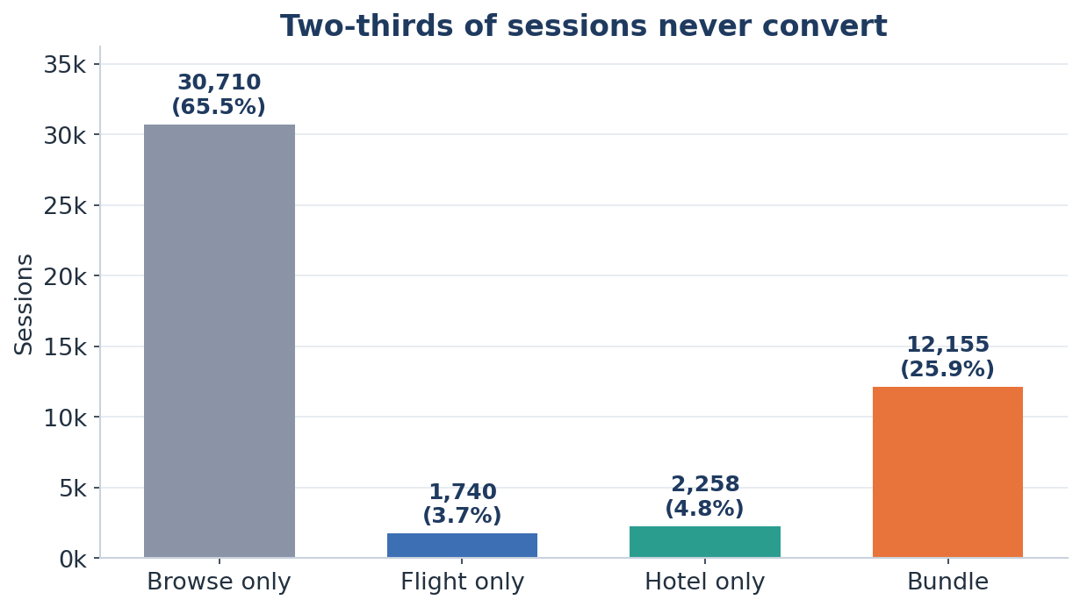
INSIGHT 1 · CONVERSION
Two-thirds of every visit ends without a booking
WHAT THE DATA SHOWS
▪ 30,710 of 46,863 sessions (65.5%) are browse-only — the engineered browse_only flag fires on two of every three visits.
▪ Of the third that do book, bundles (25.9%) outnumber flight-only (3.7%) and hotel-only (4.8%) combined.
▪ So conversion is rare, but when it happens it skews to the highest-value basket — the full flight + hotel trip.
WHAT IT MEANS
▪ Activation is the single biggest lever: nudging even a few percent of browsers into a first booking dwarfs any up-sell.
▪ Bundles are the value engine — protect and grow them; a bundle nudge on flight-only sessions is high-leverage.
▪ Treat 'did they book?' as a first-class KPI, not a vanity metric — it is the activation target the perks must move.
65.5%
34.5%
25.9%
browse-only sessions
convert to a booking
are flight+hotel bundles
8
Notes:
Open with the headline number: two-thirds of visits never book. That's the engineered browse_only flag firing on 65% of sessions. But notice the shape of the third that do convert — bundles beat flight-only and hotel-only combined, so our rare conversions are concentrated in the most valuable basket. The implication is twofold: activation is the biggest growth lever, and bundling is where the value already lives, so we protect and grow it.

Slide 9
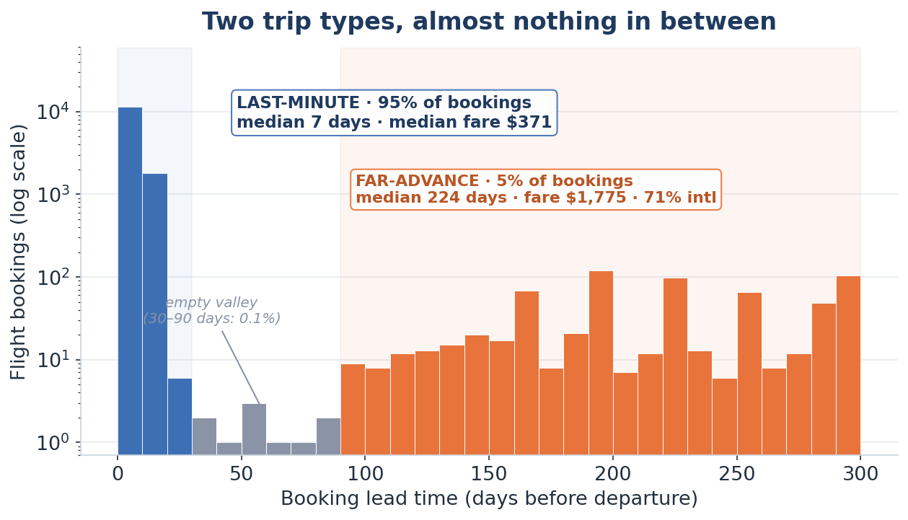
INSIGHT 2 · PLANNING HORIZON
We're really running two businesses: impulse trips and far-advance trips
WHAT THE DATA SHOWS
▪ The engineered lead_time_days feature (departure minus session start) is sharply bimodal — not a smooth spread.
▪ 95% are last-minute: median 7-day lead, median fare $371, mostly domestic.
▪ A separate ~5% book far ahead: median 224 days, median fare $1,775 (~5×), and 71% fly international.
▪ Almost nobody books in the 30–90 day middle — a genuine empty valley, so these are two distinct populations.
WHAT IT MEANS
▪ One booking flow and one perk can't serve both — speed/loyalty for the impulse mass, flexibility for the planners.
▪ The far-advance group is small but the highest-value trips on the platform — they are the Premium-planner segment.
▪ A single engineered feature already isolates a premium segment before any clustering — proof the feature work pays off.
95%
~5×
0.1%
book ≤ 30 days out
fare on far-advance trips
fall in the 30–90d gap
9
Notes:
This is the replacement insight, and it's the surprising one. When we engineered lead time, the distribution wasn't a smooth curve — it split into two clean humps with an empty valley between. Ninety-five percent book within a week or two, cheap and domestic. But a small five percent book around two hundred days out and pay roughly five times the fare, mostly international. Practically nobody sits in between. So we're really serving two different businesses with one website. That tiny far-advance group is our premium planners — and this single engineered feature flagged them before we even clustered.

Slide 10
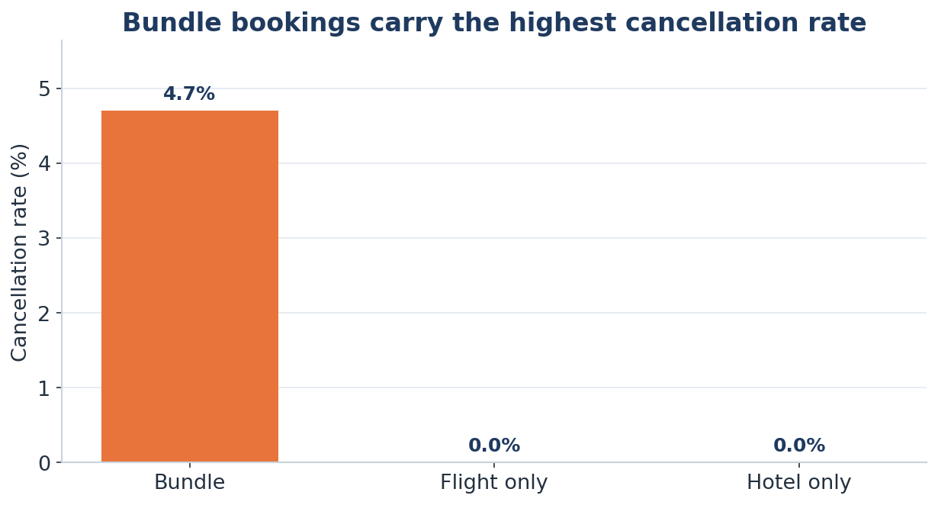
INSIGHT 3 · COMMITMENT
Cancellation risk lives almost entirely in bundles
WHAT THE DATA SHOWS
▪ Using the engineered completed_booking / cancellation flags, bundle bookings cancel at 4.7% — flight-only and hotel-only are essentially 0%.
▪ Cancellation is not spread across booking types; it is concentrated in exactly the high-value bundle we most want to grow.
▪ So the same basket that drives the most revenue (Insight 1) also carries the most reversal risk.
WHAT IT MEANS
▪ Tie the best perks to completed (non-cancelled) trips, so we reward realised revenue, not speculative bookings.
▪ When we push bundles, pair them with cancellation safeguards (flexible-change framing) rather than raw discounts.
▪ Forecast realised — not gross — bundle revenue; gross bookings overstate it by the cancellation share.
4.7%
~0%
25.9%
bundle cancellation rate
flight- / hotel-only
of sessions are bundles
10
Notes:
Third insight, and it connects back to the first. Cancellations aren't spread evenly — they're concentrated almost entirely in bundles, at about five percent, while flight-only and hotel-only barely cancel at all. That's awkward, because bundles are exactly the high-value basket we want to grow. So the takeaway is to grow bundles but defend the revenue: tie our best rewards to completed trips, pair bundle pushes with flexible-change safeguards, and forecast realised rather than gross bundle revenue.

Slide 11
VIEW 2 · USER-LEVEL DATA
Roll sessions up to the customer — the unit we cluster
5,746
57
6 groups
customers (one row each)
candidate features built
of behaviour summarised per user
▪ Each customer's sessions are aggregated into rates, averages and totals — booking propensity, price sensitivity, trip profile, engagement, lead time, spend, plus tenure, recency and age.
▪ Rates over counts: e.g. cancellation_rate (comparable across users) instead of cancellation_sum (biased by how often someone visits).
▪ Aggregation naturally handles the structural blanks — a non-flyer simply contributes zero flights, which is the truth about them.
▪ This customer-level table is the input to clustering — we group people, not visits.
TravelTide · Customer Segmentation for Retention
11
Notes:
Second view: we collapse all of a customer's sessions into one row with ~57 summary features. Crucial design choice — we use rates, not raw counts, so a frequent visitor and an occasional one are compared fairly. This per-customer table is what we actually cluster.

Slide 12
FEATURE ENGINEERING · USERS
From 57 candidates to 19 that actually separate people
Booking behaviour
Price & spend
Travel profile
Engagement / lifecycle / age
▪ any_booking_rate
▪ bundle_booking_rate
▪ cancellation_rate
▪ avg_fare_completed
▪ avg_hotel_rate_completed
▪ total_spend
▪ flight_discount_rate
▪ avg_discount_savings_pct
▪ international_rate
▪ avg_lead_time_days
▪ return_flight_rate
▪ avg_nights_completed
▪ avg_seats
▪ distinct_airlines
▪ avg_page_clicks
▪ avg_session_duration_min
▪ recency_days
▪ tenure_days
▪ user_age
Selection principles: independence (drop near-inverses & collinear pairs) · rates over counts · completed-booking versions · flight↔hotel symmetry. Gender (88% female) and home country (83% USA) dropped — too skewed to split customers.
TravelTide · Customer Segmentation for Retention
12
Notes:
We had 57 candidate features and trimmed to 19 across these five dimensions. The principles: avoid redundancy, prefer comparable rates, use completed-booking versions, and keep flight and hotel symmetric. We dropped demographics like gender and country because they're too lopsided to separate anyone. Don't read every feature — point to the groups.

Slide 13
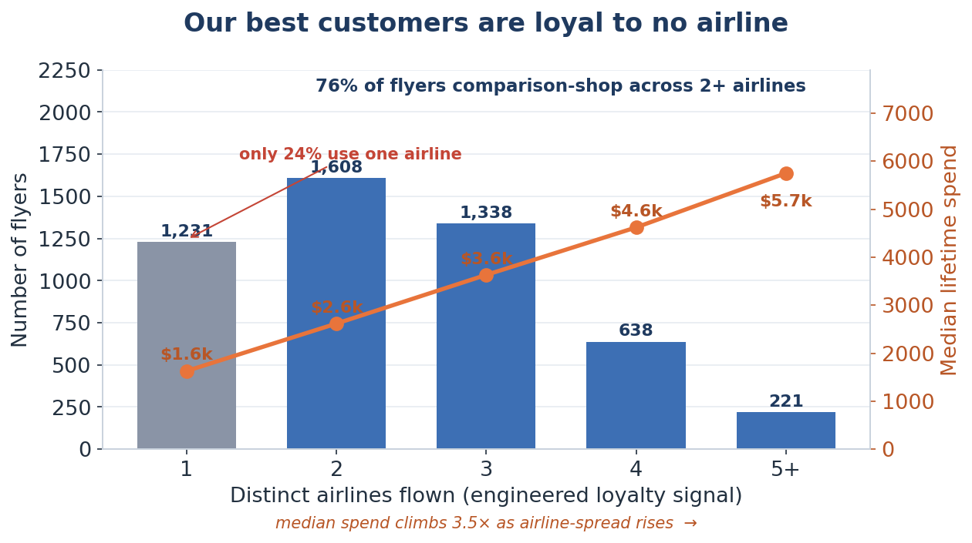
INSIGHT 1 · LOYALTY
Our most valuable customers are loyal to no airline
WHAT THE DATA SHOWS
▪ distinct_airlines — an engineered feature counting the carriers each customer actually flew — is our airline-loyalty signal.
▪ Only 24% of flyers stick to a single airline; 76% spread across 2+, and 44% across three or more.
▪ As airline-spread rises, median lifetime spend climbs $1.6k → $5.7k and booking rate rises 22% → 70%.
▪ So our most engaged, highest-value customers are precisely the ones with no attachment to any single carrier.
WHAT IT MEANS
▪ No airline lock-in is holding our best customers — they can drift to whoever is cheapest, which is real churn risk.
▪ But that unclaimed loyalty is the opportunity: a TravelTide points programme can capture what airlines never did.
▪ This is exactly why the engaged-mainstream perk is loyalty lock-in, not a discount — turn shoppers into members.
24%
76%
3.5×
loyal to one airline
shop across 2+ airlines
spend gradient by spread
13
Notes:
Lead with the strategic surprise. Our engineered airline-count feature shows three in four flyers never settle on one airline — and the more carriers they spread across, the more they're worth, all the way to nearly six thousand in lifetime spend. The point isn't that flying more costs more; it's that nobody owns these customers' loyalty. That's the churn risk and the opportunity at once — and the reason our flagship perk for the core is a TravelTide loyalty programme, not another discount.

Slide 14
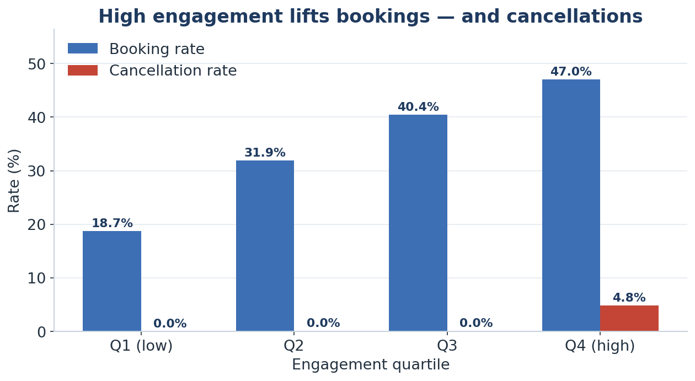
INSIGHT 2 · ENGAGEMENT
High engagement lifts bookings — and cancellations in equal measure
WHAT THE DATA SHOWS
▪ Engagement score = avg_page_clicks × avg_session_duration_min — an engineered measure of research intensity per customer.
▪ The top engagement quartile books at 47% vs 18.7% in the bottom — a 2.5× conversion advantage.
▪ But the same top quartile cancels at 4.8% vs ~0%; the engagement-to-cancellation correlation (0.83) is the strongest in the data.
▪ Heavy researchers both commit the most and reverse the most — deliberate, often speculative bookers.
WHAT IT MEANS
▪ Engagement isn't one signal — split it: high-engagement + low-cancel earn loyalty rewards; high-engagement + high-cancel get flexibility.
▪ For the budget deal-hunters (most engaged, highest cancellation), tie rewards to completed trips and offer flexible change, not deeper price cuts.
▪ Don't optimise for clicks alone — engagement that ends in cancellation inflates gross bookings but not revenue.
47%
4.8%
0.83
top-quartile booking rate
top-quartile cancel rate
engagement↔cancel corr
14
Notes:
Second insight, and it's a warning label. We built an engagement score from clicks times session time. The most engaged quarter of customers convert two and a half times more than the least engaged — great. But they also cancel far more, and that link is the strongest relationship in the whole dataset. So engagement is double-edged: the keenest researchers are our best converters and our biggest cancellers. The implication is to treat the two halves differently — reward the committed, give the flaky ones flexibility, and tie the richest perks to trips that actually complete.

Slide 15
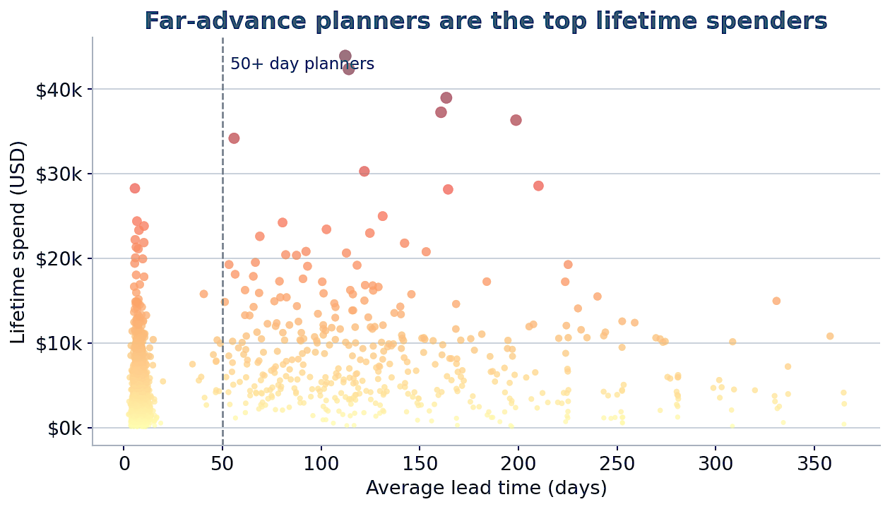
INSIGHT 3 · PLANNING HORIZON
Far-advance planners are our highest-value customers
WHAT THE DATA SHOWS
▪ Plotting the engineered avg_lead_time_days against total lifetime spend, the very top spenders are almost all long-lead planners.
▪ Last-minute bookers (under 10 days) cluster at the low end; the highest-value customers book 50+ days ahead.
▪ Lead time is a cleaner value signal than fare alone — it reflects deliberate, high-value trips (international, longer stays, bundles).
▪ These planners form the Premium far-advance segment: ~$7,868 lifetime spend, about 4× the light-mainstream tier.
WHAT IT MEANS
▪ Win planners with flexibility, not discounts — a 145-day horizon makes free changes / no cancellation fees the decisive perk.
▪ Re-engage them proactively 60–90 days before their typical booking window, ahead of competitors' offers.
▪ Protect this thin, high-value tier with premium service — losing even a few is disproportionately costly.
145 days
$7.9k
57%
planners' avg lead time
their lifetime spend (~4×)
of planners fly international
15
Notes:
Third insight, and it points straight at our most profitable customers. When we plot how far ahead people book against what they spend, the biggest spenders are almost all far-advance planners — the top of the chart books months out, while last-minute bookers sit at the bottom. Lead time turns out to be a better value signal than the fare on any single trip. These are our premium segment, worth roughly four times the light tier. We keep them with flexibility and service — and by reaching out before their long planning window opens.

Slide 16
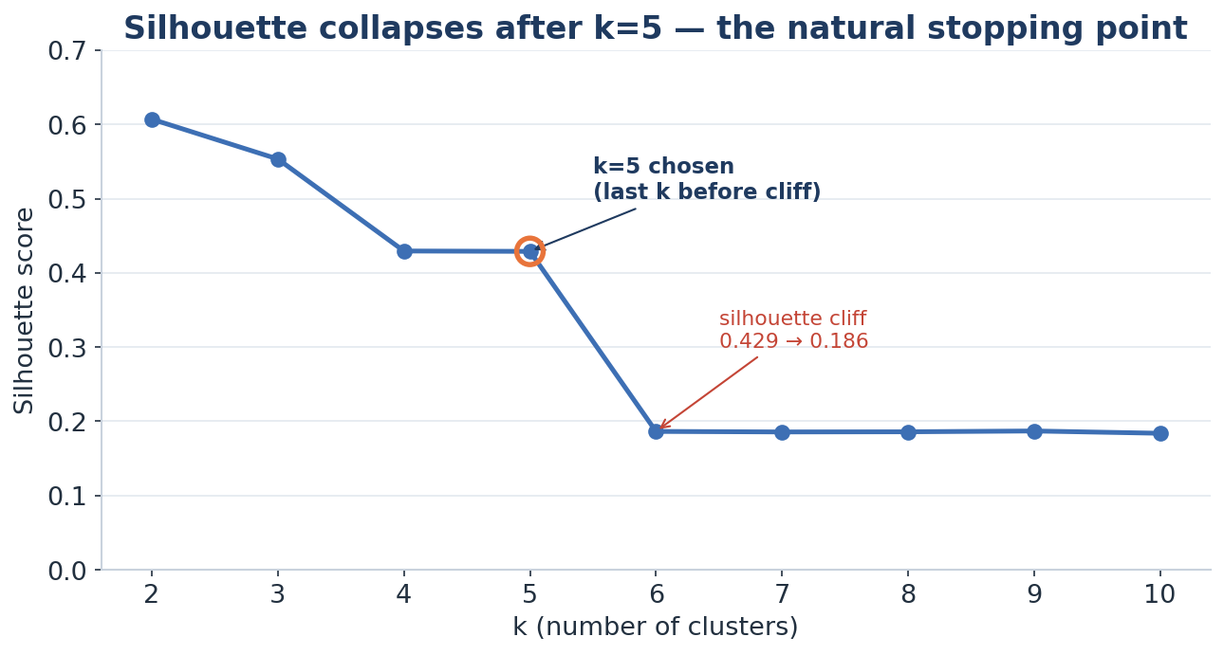
CLUSTERING APPROACH
Stop at k=5, then split the mainstream — a two-stage design
▪ Silhouette (cluster quality) holds through k=5, then falls off a cliff at k=6 — so k=5 is the natural stopping point.
▪ k=5 gives four clean, distinct niche segments plus one mainstream mass that is 75% of users.
▪ That mainstream is too big and varied for a single perk — so we re-cluster it on its own.
▪ Inside the mainstream there's no sharp gap (it's a soft continuum), so we split it into two tiers — engaged vs occasional — on business grounds, ≈50/50.
▪ Result: four data-driven niches + two business-driven tiers = six actionable segments.
TravelTide · Customer Segmentation for Retention
16
Notes:
Here's the modelling judgement. The silhouette score tells us cluster quality; it's healthy up to five clusters then collapses, so five is where the real structure ends. But one of those five is three-quarters of customers — too coarse to act on. So we zoom in and split just that group into two usable tiers. Four natural niches plus two business tiers gives six segments.

Slide 17
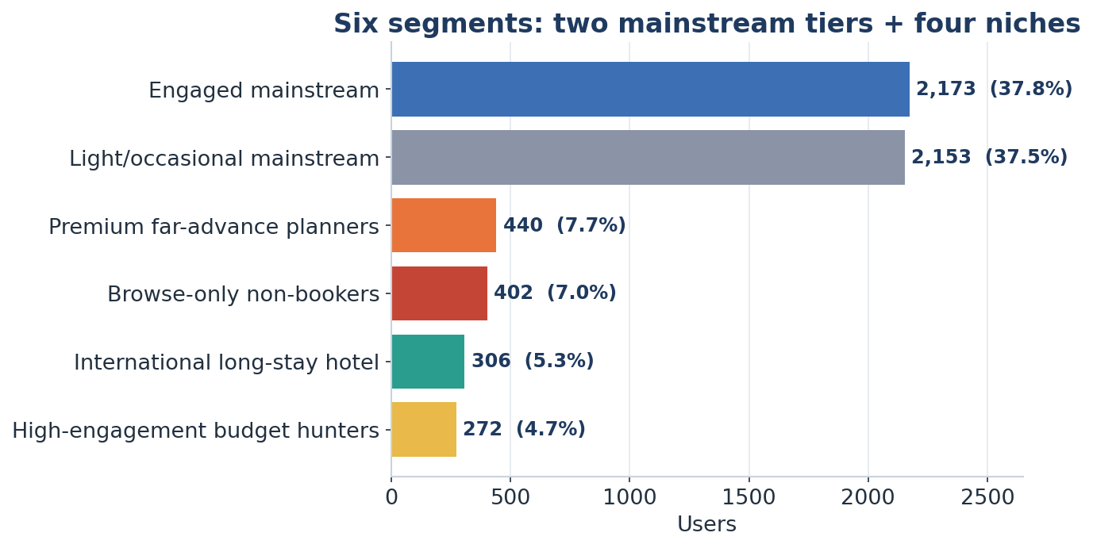
THE SIX SEGMENTS
Two mainstream tiers carry the base; four niches need special care
Segment | Users | Signature
Engaged mainstream | 2,173 | 48% book · 39% bundle · $4.8k spend
Light / occasional | 2,153 | 27% book · solo · $2.1k spend
Premium planners | 440 | 145-day lead · $1.6k fare · $7.9k spend
Browse-only | 402 | 0% booking · highest recency
Intl long-stay hotel | 306 | 100% intl · 7.9 nights · no flights
Budget hunters | 272 | 43 clicks · 30% disc · 12% cancel
Validation: the four niches are genuinely distinct (silhouette 0.50); the mainstream split is a deliberate business call.
TravelTide · Customer Segmentation for Retention
17
Notes:
These are the six. Two big mainstream tiers — engaged and occasional — are ~75% of customers between them. Then four sharp niches: premium far-advance planners (our highest value), browse-only non-converters, international hotel-only guests, and intense budget deal-hunters. The niches are statistically tight; the mainstream split we own as a business decision.

Slide 18
THE PERKS
Match the reward to the behaviour and the churn risk
Segment | Headline perk | Why it retains
Engaged mainstream | Loyalty points + bundle free-night + free bag | Forfeitable value locks in unattached frequent bookers
Light / occasional | Time-limited comeback offer + small sweetener | Urgency shortens the gap; graduate them upward
Premium planners | No cancellation fees + premium service | Flexibility kills 145-day-lead risk; status loyalty
Browse-only | Bold first-booking offer + risk removal | Lower the activation barrier (capped test budget)
Intl long-stay hotel | Bundle free-night to win the flight leg | Capture share-of-wallet → full-itinerary customer
Budget hunters | Members-only deals + reward completed trips | Win the price comparison; curb cancellations
Principle: price-insensitive segments get service & flexibility; price-driven segments get deals; unproven segments get low-cost, time-boxed offers.
TravelTide · Customer Segmentation for Retention
18
Notes:
Now the payoff: a tailored perk per segment. Notice the logic differs by segment. Affluent planners don't need discounts — they need flexibility and service. Deal-hunters live for price. The mainstream gets loyalty lock-in. Browse-only gets a capped activation offer. International hotel guests get a bundle perk to win the flight we currently lose. Reward fits behaviour.

Slide 19
NEXT STEP · MEASUREMENT
Next: define one metric that tells us if the perks actually retain
PROPOSED PRIMARY METRIC
WHY THIS METRIC
Repeat-Booking Rate (RBR-90)
▪ The goal made measurable — repeat, revenue-earning bookings, as one number that is comparable across all six segments.
▪ Completed bookings only, so we never reward speculative bookings that get cancelled.
▪ Segment-adaptive: for browse-only non-bookers it simply becomes the first-booking (activation) rate.
▪ Track alongside it: booking frequency, revenue retained, and net revenue after perk cost.
The share of a segment that makes at least one completed (non-cancelled) booking within 90 days.
Perk launch ────── 90-day window ────── booked again?
One definition, two uses: profile each segment today, then re-measure after launch.
TravelTide · Customer Segmentation for Retention
19
Notes:
We've delivered the two things we set out to: the segments and the perks. The natural next step is to decide how we'll know they work. We'd propose one simple, honest metric — the Repeat-Booking Rate: did a customer make another completed booking within ninety days. One definition serves twice: it profiles each segment today and reads the experiment after launch. And it adapts by segment — for browse-only customers it's just the first-booking rate. This is a proposal, not something we've run yet.

Slide 20
NEXT STEP · VALIDATION
Then: prove each perk causes the lift — and covers its cost
HOW WE'D TEST
A customer segment
▪ One experiment per segment (six in all) — the perks pull in opposite directions, so each is tested within its own segment.
▪ Randomise per user: perk arm vs. a holdout that keeps today's experience.
▪ Primary endpoint: Repeat-Booking Rate. Guardrails: cancellation rate and net revenue after perk cost.
▪ Decision rule: ship a perk only if it lifts RBR, covers its cost, and doesn't raise cancellations.
▼ randomise 50 / 50
Perk arm
Holdout control
▼ after a 90-day window
Compare Repeat-Booking Rate
▼ if lift + covers cost + no cancellation rise
Ship · iterate · drop
TravelTide · Customer Segmentation for Retention
20
Notes:
Once the metric exists, the step after that is to prove the perks cause retention, rather than just assuming it. We'd run one experiment per segment — six in all, because the perks pull in opposite directions — randomising customers into the perk or a holdout. The primary read is the Repeat-Booking Rate, with cancellation and cost as guardrails, and a clear decision rule: ship only if a perk lifts retention, pays for itself, and doesn't increase cancellations. Again, this is the proposed validation plan, not work we've already done.

Slide 21
RECOMMENDATIONS
Protect the core, activate the edges, prove every perk
Protect the engaged mainstream first
Largest segment, $4.8k spend, 75% repeat rate — small churn here is the most expensive churn. Lead with loyalty lock-in.
Make bundling the company-wide lever
Bundlers spend 2.2× more; three segments' perks route through 'book flight + hotel with us.'
Treat niches as targeted bets
Flexibility for premium planners, activation for browse-only, share-of-wallet for hotel-only, price-credibility for deal-hunters.
Ship only what the test proves
Significant RBR-90 lift AND positive net revenue AND no cancellation regression — otherwise iterate or drop.
TravelTide · Customer Segmentation for Retention
21
Notes:
Four recommendations. One: protect the engaged mainstream — it's where the absolute revenue risk is. Two: make bundling a company-wide push, it shows up everywhere. Three: run the niches as focused bets with the right lever each. Four: discipline — only roll out perks that pass the test on lift, net revenue and cancellations.

Slide 22
IN SUMMARY
Six segments. Six perks. One way to prove it.
▪
65.5% of sessions never convert — retention and activation are the opportunity.
▪
Two-stage clustering → 6 actionable segments, validated where the data is sharp.
▪
Each segment gets a perk matched to its behaviour and its specific churn risk.
▪
RBR-90 KPI + a six-arm A/B test turn 'should work' into 'did work, net of cost.'
Thank you — questions welcome.
Notes:
Wrap up: the conversion gap is the opportunity, two-stage clustering gives six segments we can act on, each gets a fitting perk, and the KPI plus A/B test let us prove value before we spend. Invite questions. ~25 seconds.

