Slide 1
Hack-a-doc
How to contribute to the containers and Hyper-v on windows documentation

Slide 2
Why are we doing this?
One Microsoft strategy: Content is a shared deliverable
Content devs, engineering teams, and other partners all contribute
We can ship more—and better—content with eng/PM contributing
Collaboration: easier to work across teams on the content
Simple markdown authoring plus a git repo eases cross-team collaboration vs proprietary content tools
Lower friction publishing: faster time-to-live for content
The OA system, or its counterpart in Azure.com, enables faster cadence publishing than the proprietary CMS tools

Slide 3
Fastest way to edit
Go here: VSOnline (https://mseng.visualstudio.com/DefaultCollection/Documentation/_git/HyperV)
Make sure you are in the right branch:
Containerbits – containers content for TP3 and internal docs
win10 – Hyper-V on Windows 10
Select the .md file and then click Edit.
When you are done, click Save.

Slide 4
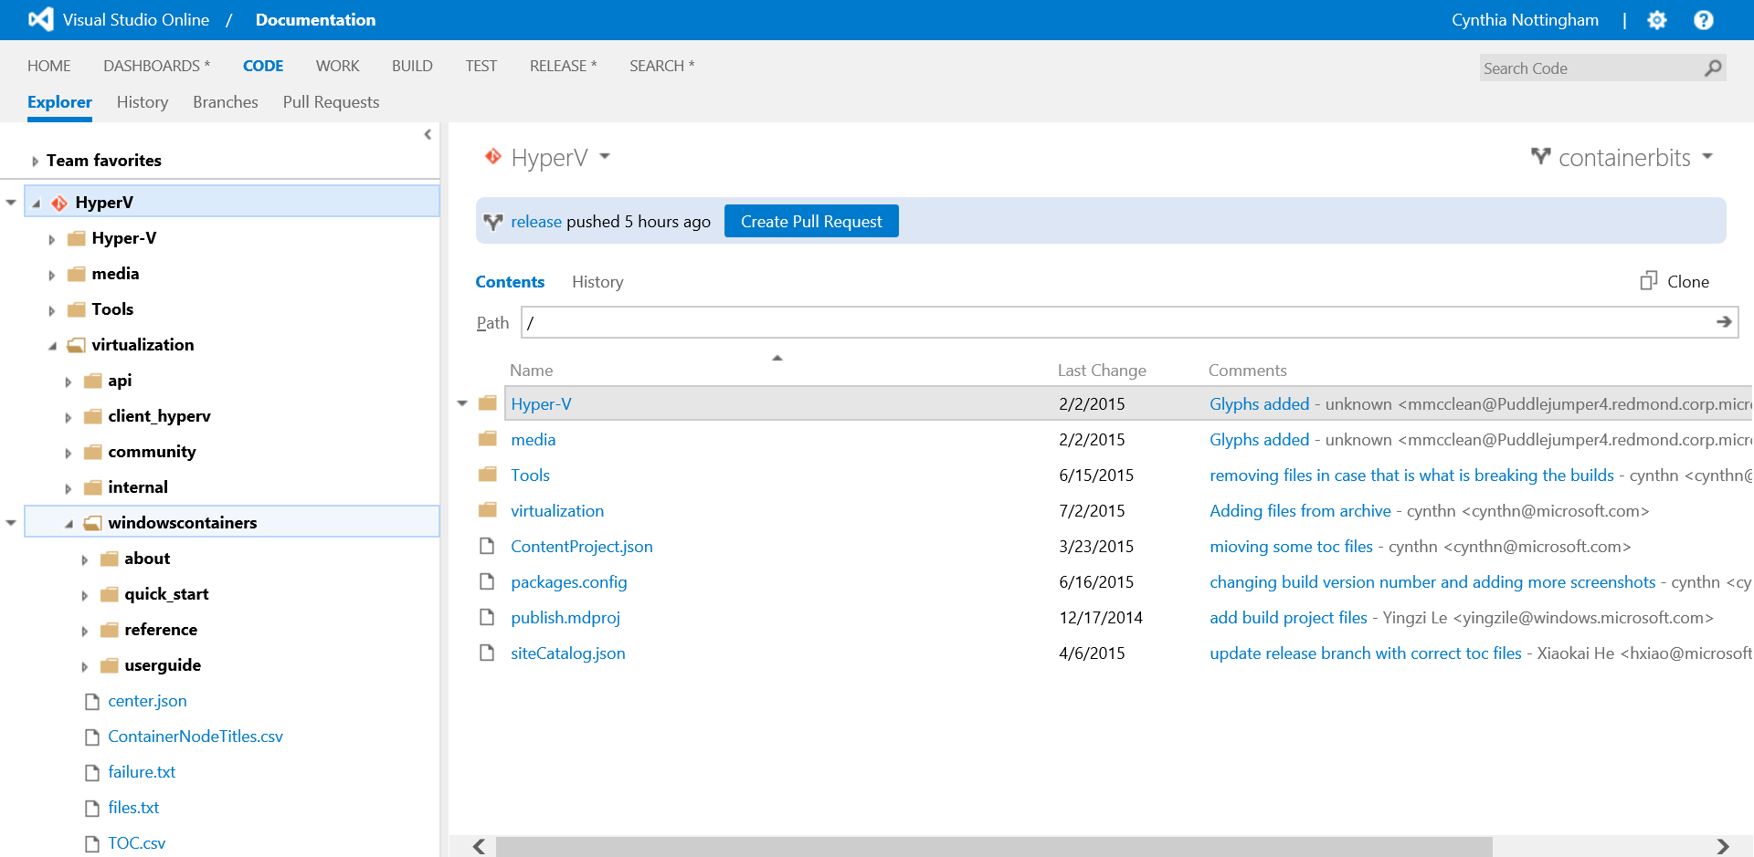
Structure of the repo (containerbits)

Slide 5
Install Git
Install Git for Windows (http://git-scm.com/download/win)
Gitbash is the command-line app that you will use to interact with your local Git repository
Git GUI can also be used, but the functionality is limited.
You can accept all the default settings during installation
To use Git from Visual Studio, install the Visual Studio extensions (https://visualstudiogallery.msdn.microsoft.com/8f594baa-e44e-4114-8381-e175ace0fe97)

Slide 6
Clone the repo
Go to the repository in VS Online
On the right part of the page, click Clone and copy the address for cloning into your clipboard. Is should be: https://mseng.visualstudio.com/DefaultCollection/Documentation/_git/HyperV
In GitBash, change to the folder where you want the local copy of the repository:
cd <path_to_my_repo>
To clone the repo, type:
git clone https://mseng.visualstudio.com/DefaultCollection/Documentation/_git/HyperV
Git will ask for your username and password. If you are having issues, try the steps in slide 16 to create an access token.
git fetch --all

Slide 7
Get the right branch locally
In GitBash, switch to the right branch (like containerbits) and pull down that branch, type :
Git checkout containerbits
Git pull
Important branches:
Containerbits – container stuff for TP3 and also an area (Internal) for parking stuff in progress or for internal-only docs
Win10 – Hyper-V stuff for desktop Hyper-V in Win10
Archive – this is the branch where we stored everything that wasn’t ready for Ignite. If you worked on something earlier and can’t find it in the other two branches, check here! But, don’t work there. Copy and paste into one of the other branches.

Slide 8
Install a writing tool
There are several options:
VS Code (recommended)- https://www.visualstudio.com/en-us/products/code-vs.aspx
Atom - https://atom.io/ (another good freeware OSS editor)
Any text editor

Slide 9
Using VS Code
VS Code docs
Quick tips
Preview a file. CTRL+Shift+V. Or click the Split Editor button and then in the second pane, click Open Preview.
Auto save and revert. VS Code auto saves, which can confuse folks who make a lot of mistakes and think closing the file will revert. Use the File | Revert File option if you need to revert.
Turn on word wrap:
Go to File > Preferences > User Settings
Find the setting “editor.wrappingcolumn”: 300,
Copy that setting to the curly braces in the .json pane and change it to: “editor.wrappingColumn”: 0,
Save and close the settings file.

Slide 10
Using Atom
Atom docs
Quick tips
Preview your article : CTRL+Shift+M

Slide 11
Write something!
In GitBash, type:
Git pull
This is like refresh and ensures you have all recent changes. Do it often!
Open an existing .md file in your editor and start working.
Basic markdown (we use GitHub Flavored Markdown):
Paragraphs are implied – nothing needed.
*bold*
```code```
# Heading 1 #
## Heading 2 ##
1. starts a numbered list
When you are done, add it to Git:
use cd to navigate to the right folder
Git add <file>.md
Git commit –m “Here is what I did in this file....”
Git push

Slide 12
Comments
If a document is only for internal use, the first heading should say # Internal – title #
You can use HTML comments in the markdown files to ask questions or leave yourself notes. These will be stripped out by the writing team when the content goes live, so this only works while the content is under development:
<!– My comment -->

Slide 13
Create a new topic
Create a new file and name it something readable with .md as extension
At the top of the file, before any whitespace, you need 2 things:
ms.ContentId: <GUID> (use new-guid cmdlet in Powershell or Tools -> Create GUID in VS)
title: <title of the file>
When you are done, add it to Git:
Git add myfile.md
Git commit –m “my new file”
Git push
Add the file to <your repo path>\virtualization\toc.csv. For example, this is the entry for the When to use containers topic in the About section of the Windows Containers content:
****,windowscontainers/about/when_containers.md
When you are done, add the updated toc.csv back to git too (see above – add, commit, push!)

Slide 14
Viewing your staged content
Staging for containerbits and win10 runs automatically at 12:00 and 4:00 every day.
Today at the hack: will stage content at 12:30 and 3:30.
Preview sites are here:
Containerbits - https://sandboxmsdnworking.redmond.corp.microsoft.com/en-us/virtualization/windowscontainers/about/about_overview
Win10 - https://int.msdn.microsoft.com/en-us/virtualization/client_hyperv/about/client_hyperv
If you need a one-off preview build, find Cynthia Nottingham on SFB and she can launch it.

Slide 15
Advanced stuff
Don't rename a markdown file, don't change the GUID and don't reuse GUIDs. OA matches the GUID to the file name in the builds and the file name is used for the URL. If you need to change a file name, you need to delete the old one, create a new file and give it a new GUID.
Azure contributors guide – set up for authoring in GitHub

Slide 16
Create an access token
If you are having permissions issues with VSOnline, you may need to create an access token.
Go to the repository in VS Online to create an access token:
Click on your name in upper right-hand area of browser
Click My Profile > Security tab > Personal Access tokens > Add
In Description, name it Git and then in Expires In change it to 1 year. Leave the other defaults and then click Create Token.
Before you do anything else, make sure you copy and paste the token someplace safe!!!! A .txt file on your OneDrive for Business is a good place.
When you are asked for username in GitBash, use your full e-mail address.
The first time you are asked for a password in GitBash, use the Git token that you created.

Slide 17
Modern Voice Resources

Slide 18

Everyday words
Destroy. All. Robot. Language.
Before After
modify | change
perform | do
execute | run
terminate | end

Slide 19
Modern Voice
Voice Principles | Considerations | + Intent
Use everyday words | Word choice is an important part of voice. Be less formal, not less technical. Use natural language, not cute or casual language. Imagine you’re talking to a peer. Use technical words when they’re the right words. Use words that your audience uses. Explain new technical concepts using real-life examples. | Everyday words express the intent the way a reader does Use keywords in the title and description Use keywords in the section headers
Write concisely | Use everyday words. Use locators (>) for “click, click, click” instructions. Don’t repeat words that are in the UI. Read out loud. Are you out of breath? Consider using art. Delete words that aren’t essential. | It’s easier to be concise when you are focused on one thing Use intent data to suggest what you can delete or move elsewhere
Easy to scan | Write concisely. Use art. Use tables, lists, and bolding. Put your section headers to work. Take the birds’-eye view. Put the most important thing first. | The article’s main intent is impossible to miss The title and description tell me I’m in the right place The section headers lead me through the article There’s no unnecessary information getting in my way The article is organized so I can find my answer
Show empathy | Be a partner, not a judge. Talk like you’re helping a coworker. Don’t imply the problem is their fault. If the situation is genuinely frustrating, acknowledge it. You don’t have to be their buddy, but don’t be a jerk. Leave disclaimers to the lawyers | The tone of the article supports the customer The article addresses the customer’s point of view and what matters to them

Slide 20

The Voice Recipe
1. Intent
Pick ONE THING, the simplest and clearest way to answer the customer intent.
2. Context
Describe the WHY behind the function.
3. Want fries with that?
Add more options or tips that satisfy the intent. But if they answer a DIFFERENT intent, link instead.

