Slide 1
Project Accounting, Time-Entry, and Labor Metrics Optimizations
GCPUD HCMS Project

Slide 2
Technology Adoption
Capability Envisioning…
Increase process automation!
Roles + Workflow + Automation
Business Insights
Analytics
Metrics
Data Consistency
Project Accounting
Payroll Processing
How do we increase Operational Consistency in order to harvest Business Insights?
Timesheet Processing
Operational Consistency
Notes:
KEY POINT : We need to increase our Operational Consistency by applying even more Automation!
Everyone naturally expects consistent data. Good business decisions depend upon insights gained from consistent business operations analytics. Even so, few seem to understand the intrinsic relationship between business operations capability and resultant quality of analytical information. Business sponsors often expect consistency in reporting that would be impossible without corresponding prior operations enablement.
The following illustration depicts this correspondence. You may recognize that the shape of the curve between the axis is exponential and not directly proportional. This shape works in our favor per the following observations.
• A slight increase in Operational Consistency (i.e. a movement to the right along the horizontal axis) results in a dramatic increase in Data Consistency (i.e. upward movement along the vertical axis). In other words, a small operational improvement can go a long way.
• How can we know our consistency position on this curve? That’s a function of metrics. Operational Consistency measurements provide insights into where we are at any point in time.
• How can we improve our consistency position? That’s the art and science of Operations Management involving People, Processes, and Technologies. Or, more specifically, the organizational application of Roles, Workflow, and Automation to business processes.

Slide 3
Project Accounting, Time-Entry, & Labor-Metrics
Key Business Value Objectives
Time Entry
Eliminate (or minimize) manual labor-metrics entry.
Improve the user-experience of WFM timesheet completion. Minimize inconveniences and application delays.
Project Accounting
Increase automation and minimize manual data-entry.
Increase labor-metrics data-consistency.
Leverage Analytics to achieve business insights

Slide 4
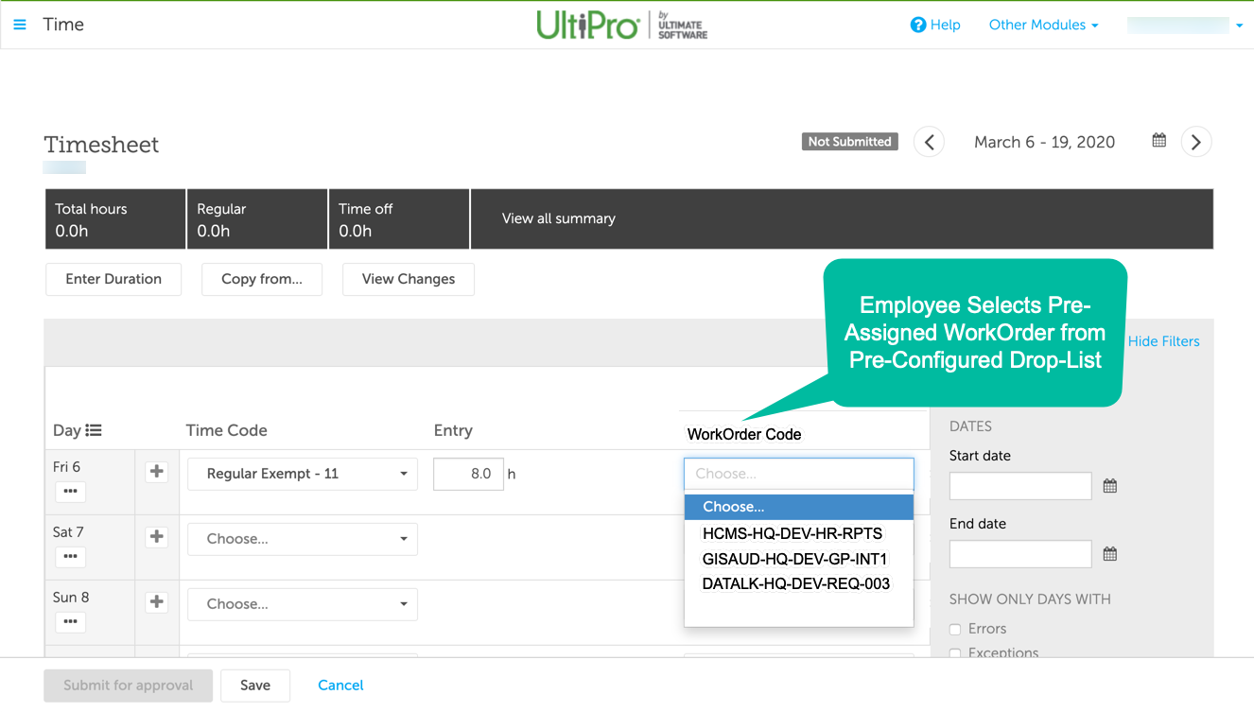
Time-Entry Optimization
WorkOrder Reference Codes

Slide 5
Project Accounting, Time-Entry, & Labor-Metrics
Key End-User Experiences and Considerations
Time Entry
Simplified as each non-Maximo Employee selects only one labor-metric (i.e. WorkOrder) from a pre-assigned and pre-configured drop-list.
UltiPro Workforce Management (WFM) labor-metrics, labor-metrics-groups, and time-sheet configurations require a one-time change from existing. Automated maintenance thereafter.
No necessary changes for Maximo employee time-entry.
Managers and Supervisors
A new Project Portal enables managers and supervisors to maintain project accounting and work-order assignments for their teams.
Departmental projects and corresponding labor-metrics attributes are synchronized from MSGP and WorkOrders are sent to WFM.
Employee time-sheets within WFM are automatically configured with new WorkOrder selections upon project assignments.
Project Accounting
MSGP remains the source-of-truth for all project accounting codes and categories.
Existing Project Accounting GL Report remains the feed-back mechanism for updating the MSGP Project Module and Data-Warehousing systems. No need to change existing SmartConnect Maps.
No need to modify existing Cognos Project Accounting GL Report to support the WorkOrder labor-metric.
Modify FME integration to derive full GL report by mapping WorkOrders to attributes.

Slide 6
Project Accounting
WorkOrder Management
Define WorkOrders
Timesheet Processing
Employee Time-Entry
WorkOrder Selections
Payroll Processing
Labor-Costs Fulfillment
Define Labor-Metrics
Time & Expense Audits
Time-Entry Validations
Service Bus
Auto-Configure Timesheets
Mappings to Labor-Metrics
Auto-Configure Labor-Metrics
Project Accounting, Time-Entry, & Labor-Metrics
Key Functional Areas and Data-Flows
Project Accounting
Import GL Report to Project Module
WorkOrder Management
Manager, Supervisor Reporting
Service Bus
Map WorkOrders to Labor-Metrics
Transfer GL Data-Sets
Analytics
Generate Project Accounting GL Report
Generate Audit Reports
Data Analysis

Slide 7
Functional Areas Existing and New* Systems
WorkOrder Management
Maximo
Payroll Processing
Analytics
TBD
FME
WFM
WFM
UP Core
WFM
Cognos
Cognos
DataWH*
Cognos
Project Accounting
MSGP
FME
UP Core
WFM
MSGP
FME
WFM
Cognos
Timesheet Processing
Project Portal*
Project Portal*
Project Portal*
Which systems participate in the solution by functional area?

Slide 8
User-Roles by Functional Area People + Process + Tools = Roles + Workflow + Automation
WorkOrder Management
Employee
Payroll Processing
Analytics
TBD
Manager, Supervisor
Payroll Admin
Reporting Admin
Audit Admin
Project Accountant
Projects Accountant
Payroll Admin
Manager, Supervisor
Finance Admin
Project Accounting
Projects Accountant
Payroll Admin
Finance Admin
Manager, Supervisor
Projects Accountant
Manager, Supervisor
Payroll Admin
Reporting Admin
Employee
Timesheet Processing
Which users-groups participate in the solution by functional area?

Slide 9
Logical Use-Cases per User-Role-Group
Usage-Scenarios – Managers and Supervisors
Managers and Supervisors utilize a Project Portal to manage departmental Project and WorkOrder reference codes. Project attributes originate via MSGP. WorkOrders are reference codes that represent specific labor-metrics combinations associated with specific Projects. Employees are assigned to various Projects and select assigned WorkOrders when logging their time-worked. During subsequent timesheet processing, WorkOrder codes enable automated resolution of time-entries against corresponding labor-metrics. Project Accountants rely upon labor-metrics to derive Analytics that provide business process insights.
Priority | Functional Areas | User-Role Groups | Capabilities
 | WorkOrder Management | Manager, Supervisor | Create, Read, Update, and Delete WorkOrder codes for their respective teams. These WorkOrder codes correspond uniquely to labor-metric sets.
 | WorkOrder Management | Manager, Supervisor | Publish WorkOrder codes with corresponding descriptions. Enable such distribution via email, for example, to recipient employee groups and individuals.
 | WorkOrder Management, Project Management | Manager, Supervisor | Search and View WorkOrder codes and labor-metrics for all Departmental Projects.
 | Project Management | Manager, Supervisor | Create, Read, Update, and Delete employee memberships per Department Projects.
 | Timesheet Processing | Manager, Supervisor | Create, Read, Update, and Delete time-entries into pay-period based TimeSheets on behalf of Employee team-members. Provide WorkOrder codes with each time-entry line-item.

Slide 10
Logical Use-Cases per User-Role-Group
Usage-Scenarios – Employees
Employees are assigned to various Projects and leverage WorkOrder codes to log their time against as they complete timesheet entries within UltiPro WFM. WorkOrders are pre-configured automatically within drop-down selection lists. Each Employee selects from a list of only those WorkOrder assigned to them specifically. Employees may need to search for both Project information, labor-metric combinations, and corresponding WorkOrder codes. Employees leverage a Project Portal to accomplish self-service Project Management activities.
Priority | Functional Areas | User-Role Groups | Capabilities
 | WorkOrder Management | Employees | Read (i.e. View) WorkOrder codes for assigned projects.
 | WorkOrder Management | Employees | Search for WorkOrder codes by description keyword and code values.
 | Project Management | Employees | Request Managerial, Administrative, or Finance support for Project Management services.
 | WorkOrder Management | Employees | Export WorkOrder codes and descriptions for all assigned Projects. Export to PDF, Text, Email, or Print.
 | WorkOrder Management | Employees | Navigate to their “Project Portal” using multi-media hyperlinking (e.g. URL) with WorkOrder parameter. Maximize use of URL type referencing from end-user facing deliverables.
 | Timesheet Processing | Employees | Create, Read, Update, and Delete time-entries into pay-period based TimeSheets. Provide WorkOrder codes with each time-entry line-item.

Slide 11
Logical Use-Cases per User-Role-Group
Usage-Scenarios – Project Accountants
Project Accountants leverage the Project Module within MSGP to define and organize project codes and descriptions. Project costs, including labor, are categorized using attributes defined by these accountants. As Employees accomplish work, their timesheet entries are coded with WorkOrder values referencing unique Project attributes. Subsequently, the MSGP Project Module is updated during Payroll Processing with a Project Accounting GL report. Accountants subsequently leverage Analytics to derive business insights. Project Accountants leverage a Project Portal to accomplish self-service Project Management activities.
Priority | Functional Areas | User-Role Groups | Capabilities
 | WorkOrder Management | Project Accountants | Create, Read, Update, Delete labor-metrics sets and corresponding per-set WorkOrders. This may be automated leveraging existing MSGP and related tooling.
 | Project Accounting | Project Accountants, Payroll Admins | Create, Read, Update, Delete Manager/Supervisor role-group memberships. HR Systems (i.e. UltiPro Core) are the source of truth for Manager/Supervisor role assignment.
 | Analytics | Project Accountants | Export a pay period based Project Accounting GL report. Currently, this report originates from UltiPro Cognos.
 | Analytics | Project Accountants | View Project Accounting Analytics provided via various data-analytics systems including ODS, MSGP, SSRS, and Cognos. The technology roadmap suggests more sophisticated data-analytics solutions.

Slide 12
Logical Use-Cases per User-Role-Group
Usage-Scenarios – Payroll Admins
Payroll Admins accomplish several activities during Payroll Processing. These include Timesheet Validations, Time-Entry Remediations, Time-Off Accounting, Benefits Accounting, and subsequent PayCheck creation. Payroll Admins also manage the variety of business and employee HR record attributes from which derivation of time-to-dollars occurs. Payroll Admins also support Project Accountants in the maintenance of labor-metrics and also utilize analytics supporting project accounting consistency.
Priority | Functional Areas | User-Role Groups | Capabilities
 | Project Management | Payroll Admins, Project Accountants | Create, Read, Update, Delete Manager/Supervisor role-group memberships.
 | Timesheet Processing | Payroll Admins | Validate employee Timesheets and corresponding time-entry line-items are reasonably correct.
 | Timesheet Processing | Payroll Admins | Configure and Manage timesheet and labor-metrics categories with corresponding employee groupings within WFM and UltiPro Core.
 | Timesheet Processing | Payroll Admins | Manage the automated (or semi-manual) import of labor-metrics into target WFM configurations.
 | Timesheet Processing | Payroll Admins | Export time transactions for subsequent time-to-dollars payroll processing. The results of this process determine subsequent Project Account GL Reporting via Cognos.
 | Payroll Processing | Payroll Admins | TBD – many more detailed capabilities that potentially overlap with the Time Entry and Labor Metrics solution domain.

Slide 13
Logical Use-Cases per User-Role-Group
Usage-Scenarios – Finance Admins
Finance Admins leverage Project Accounting Labor Metrics and associated Analytics to accrue and forecast labor-costs per project. Finance Admins originate metrics categories along with specific codes and descriptions. From a labor-costs perspective, the Employee timesheet represents the primary source of metrics applications. Managers, Supervisors, and Payroll Admins collaborate with Reporting Admins to facilitate workflows that create a feedback-loop supporting Project Accounting business processes.
Priority | Functional Areas | User-Role Groups | Capabilities
 | Project Management | Finance Admins | Create, Read, Update, Delete Project Accounting attributes within MSGP and maintained via the Finance Attribute Manager tooling. (Existing functionality.)
 | Project Management | Finance Admins | Subscribe to Project Accounting Analytics (i.e. Consumer) originating within WFM/Cognos reporting. A key report is the Project Accounting GL report.
 | Project Management | Finance Admins | Audit and Assess, via Analytics key process indicators, the data consistency of corresponding project management operational practices.

Slide 14
Logical Use-Cases per User-Role-Group
Usage-Scenarios – Reporting Admins
Reporting Admins create and maintain the Analytics supporting business processes associated with Project Accounting, Time Validations, and Payroll Processing. Reporting Admins collaborate with other user-roles to identify key process indicators, implement role-group dashboards, and create role-group self-service reporting.
Priority | Functional Areas | User-Role Groups | Capabilities
 | Analytics | Reporting Admins | Create time-entry validation reporting for Payroll Admins to leverage prior to Payroll Processing.
 | Analytics | Reporting Admins | Create payroll validation reporting for Payroll Admins to leverage during Payroll Processing.
 | Analytics | Reporting Admins | Create Project Accounting reporting for Project Accountants to leverage throughout the Project Management life-cyle.
 | Analytics | Reporting Admins | Create and management Manager/Supervisor Project Management Dashboard applications with supporting analytics.

Slide 15
Automation-Roles by Functional Area People + Process + Tools = Roles + Workflow + Automation
Timesheet Processing
WFM Integration
Payroll Processing
MSGP
Integration
Analytics
Service Bus
Cognos Integration
WFM Integration
Cognos Integration
UltiPro Core Integration
Maximo Integration
WFM Integration
UP Core Integration
Cognos Integration
Project Portal Integration
Maximo Integration
Cognos Integration
Project Accounting
MSGP Integration
Cognos
Integration
UltiPro Core Integration
Project Portal Integration
WorkOrder Management
MSGP Integration
WFM Integration
Cognos Integration
Project Portal Integration
WFM Integration
UltiPro Core Integration
Cognos Integration
Which systems integrate with others by functional area?

Slide 16
Logical Use-Cases per Automation-Role-Group
Service-Scenarios – MSGP Integration
MSGP Integrations include data-set exchanges with Maximo, WFM, and UltiPro Core. FME and SmartConnect are leveraged as primary interface and service-bus type integration mechanisms. MSGP is the source-of-truth for Project Accounting attributes. MSGP also serves as the General Ledger for all project-cost accounting.
Priority | Functional Areas | Automation Role | Capabilities
 | Project Accounting | MSGP Integration | Service consumers of custom labor metrics. Consumers include Maximo, WFM, UltiPro Core, and Project Portal. Export via SQL Views.
 | Project Accounting | MSGP Integration | Receive Projecting Accounting GL Report for project-cost accounting. This receive mechanism is currently implemented as a data-set transfer from Cognos via FME and SmartConnect.
 | Project Accounting | MSGP Integration, Project Portal | WorkOrders for standard and non-standard projects (e.g. safety meetings, events, training) are to be generated with “effective-time” dates to enable WorkOrder lifecycle management. This will reduce the “list” of WorkOrders that an employee must track over time.

Slide 17
Logical Use-Cases per Automation-Role-Group
Service-Scenarios – Project Portal Integration
Project Portal Integrations serve to enable WorkOrder management. The portal synchronizes with MSGP to import project and labor-metrics attributes. Unique WorkOrder codes are derived from these attribute-sets. Correspondingly, WorkOrder codes are provided to WFM for updating timesheet configurations per employee. The Project Portal consumes resultant Project Accounting Analytics from Cognos to enable end-user validations and analysis.
Priority | Functional Areas | Automation Role | Capabilities
 | WorkOrder Management | Project Portal Integration | Synchronize project and labor-metrics attributes from MSGP (read).
 | WorkOrder Management | Project Portal Integration | Generate unique WorkOrders for departmental projects and establish one-to-one correspondence between WorkOrder and labor-metrics-sets.
 | Timesheet Processing | Project Portal Integration | Expose (publish) Workorder and labor-metrics-sets for subscribers. A primary consumer of labor-metrics-sets is the WFM timesheet configuration service.
 | Analytics | Project Portal Integration | Import (consume) analytics from Cognos for updating end-users (Managers/Supervisors) with project accounting validations and analysis.
 | Project Accounting | MSGP Integration, Project Portal | WorkOrders for standard and non-standard projects (e.g. safety meetings, events, training) are to be generated with “effective-time” dates to enable WorkOrder lifecycle management. This will reduce the “list” of WorkOrders that an employee must track over time.

Slide 18
Logical Use-Cases per Automation-Role-Group
Service-Scenarios – WFM Integration
WFM Integrations include receiving WorkOrder lists from the Project Portal, timesheets from Maximo, and several attributes from UltiPro Core. WFM imports labor-metrics and timesheet configuration data-sets via API or File Import. WFM exports several data-sets including Payroll Exports via file, Time-Entry data-sets via API, and various WFM reports via Cognos.
Priority | Functional Areas | Automation Role | Capabilities
 | WorkOrder Management | WFM Integration | Consume per-employee WorkOrder lists from the Project Portal.
 | Timesheet Processing | WFM Integration | Export timesheet validation reports via WFM Analytics and API.
 | Timesheet Processing | WFM Integration | Export payroll processing input file.
 | Timesheet Processing | WFM Integration | Export timesheet data-sets to Cognos via the WFM Cognos Package.
 | Timesheet Processing | WFM Integration | Import Maximo end-user timesheets via API. Accept non-Maximo end-user time-entries via the WFM Timesheet functionality.
 | Project Accounting | WFM Integration | WorkOrders must possess an effective-duration so that cumulative per-employee WorkOrder lists do not grow unnecessarily longer over time.

Slide 19
Logical Use-Cases per Automation-Role-Group
Service-Scenarios – Cognos Integration
Cognos Integrations support Project Accounting include export of the Project Accounting GL Report. This report pulls pay-period based information from both WFM and UltiPro Core. The report establishes time-entry line-item costs with corresponding tracking of referenced WorkOrder metrics. Subsequently, this GL report is exported Reporting-As-A-Service (RaaS) API, merged with full labor-metrics attributes (from the Project Portal), and import to MSGP (via SmartConnect); all within a Service Bus (i.e. FME) process.
Priority | Functional Areas | Automation Role | Capabilities
 | Payroll Processing | Cognos Integration | Create the Project Accounting GL Report.
 | Analytics | Cognos Integration | Export the Project Accounting GL Report.

Slide 20
Logical Use-Cases per Automation-Role-Group
Service-Scenarios – UltiPro Core Integration
UltiPro Core Integrations include receiving Project ID’s from MSGP via API import. An existing Service Bus (i.e. FME) solution accomplishes this synchronization. WFM synchronizes with UltiPro Core for numerous employee and rate-categorization attributes. Cognos pulls information on schedule from UltiPro Core supporting data-warehouse based analytics. A key integration with WFM is the import of Payroll Export files which serve to launch integrated Payroll Processing workflows.
Priority | Functional Areas | Automation Role | Capabilities
 | Timesheet Processing | UltiPro Core Integration | Import Payroll Export files from WFM.
 | Analytics | UltiPro Core Integration | Export data-sets for Payroll Processing, Audit Processing, and GL Accounting.
 | Project Accounting | UltiPro Core Integration | Import Project ID’s as integrated time-entry labor-metrics.

Slide 21
Next Steps…
Near-Term
Using UltiPro WFM in TEST, reconfigure non-Maximo Timesheets to remove existing custom labor-metrics and add the WorkOrder custom labor-metric. Associate the Timesheet configuration with corresponding labor-metrics grouping.
Within WFM, prototype the automated configuration of the WorkOrder labor-metric via WFM API or via configuration file-import.
Within WFM, confirm the ability to Create, Read, Update, and Delete* WorkOrder labor-metrics via automation.
Prototype an ability to accurately generate WorkOrder values from MSGP Project Accounting attributes and to correctly manage mappings between these.
Modify the existing FME Cognos Project Accounting GL Report automation to resolve a single WorkOrder column with corresponding labor-metrics.
Mid-Term or Concurrent
Develop an initial Project Portal with sufficient capability for basic usage-scenarios.
Develop workflow and dataflow mechanisms to map and add full labor-metrics to the Project Accounting GL Report and import this report to the MSGP Project Accounting Module.
Longer-Term or Concurrent
Add Manager/Supervisor Project Dashboard capabilities to the Project Portal.
Expand Project Accounting capabilities with KPI-based Data Analytics.
Add automated time-entry to timesheets for meetings, events, and scan-in type venues.

Slide 22
Solution Architecture

Slide 23
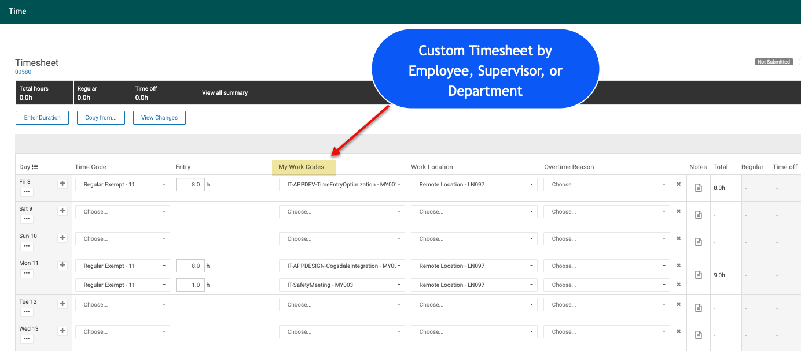
myHR Custom Timesheets Simplified Time-Entry Example – See Interactive Prototype on WFM Test
Notes
Current Labor Metrics are referenced by “My Work Codes” selection list (a 1-To-Many mapping).
Correlation of final, fully resolved, Labor-Metrics to Time-Entry data-sets occurs via Snowflake hosted data analytics operations.

Slide 24







Time-Entry and Labor-Metrics Data Sources Sparse Data Collection from Multiple Business Workflows
End-User Apps
Automation Apps
UltiPro WFM Timesheets
Meetings & Calendars via MS Graph API
Field Engineer Apps
Data Lake
Time-Entry Transactions and
Labor-Metrics
Attributes
MSGP & Enterprise Data Sources

Slide 25
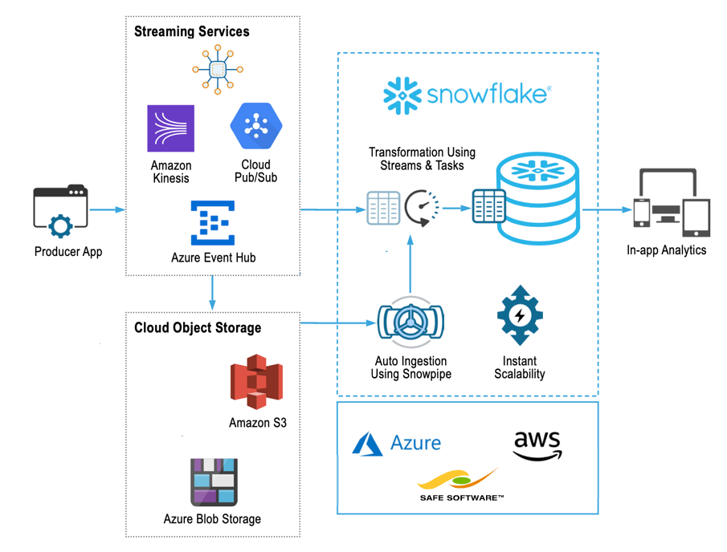





Common Solutions Architecture Using Cloud-Native Platform Technologies
Time-Entry Transactions
Data Transmission
MSGP, Sharepoint, & PowerBI
Apps
Business
Process
Data-Sets
Business Processes
WFM Time-Sheet
Configurations
Data-Flow from Point-of-Generation towards Consumption

Slide 26
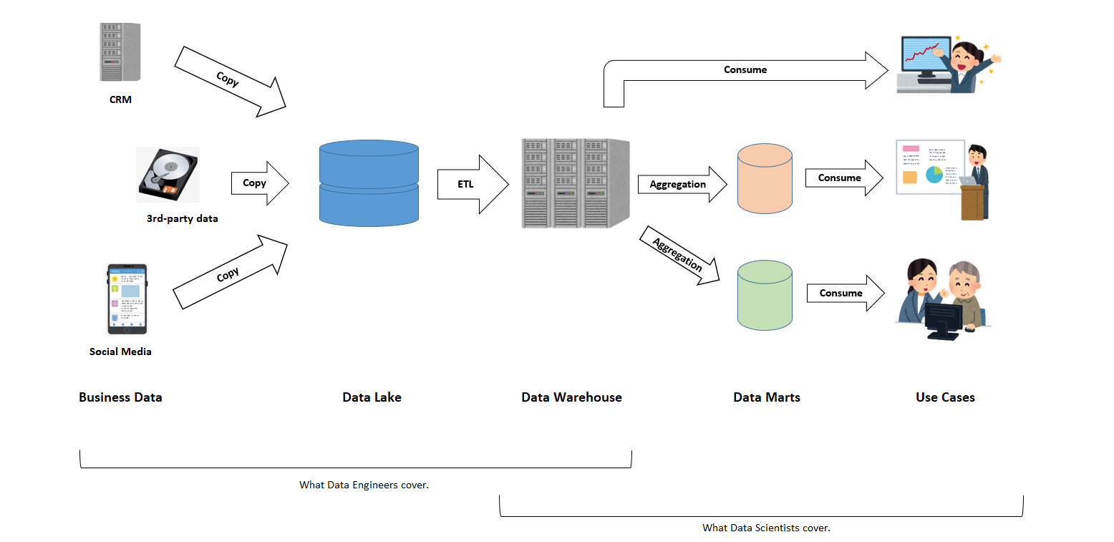
Cloud-Data Architecture A General-Purpose Data Platform

Slide 27










Data-Pipelines Automated Data Collection, Transformation, Aggregation, and Consumption
Data
Sources
Data
Lake
Data
Warehouse
Data
Mart
BI
Dashboards
myHR
Applications
Data Transmission
Visualize
ETL
KPI Push/Pull
Use-Case Scenarios
Raw Data
Curated Data
Data Consumption
Data-Flow from Point-of-Generation towards Consumption

Slide 28
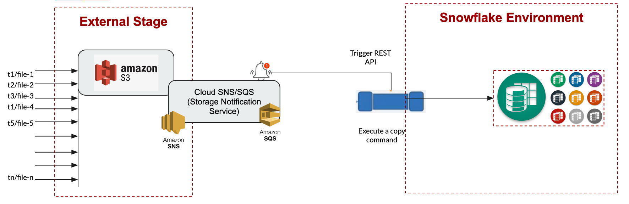
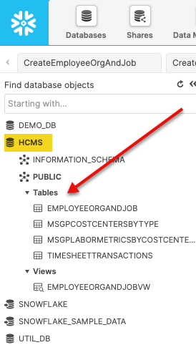
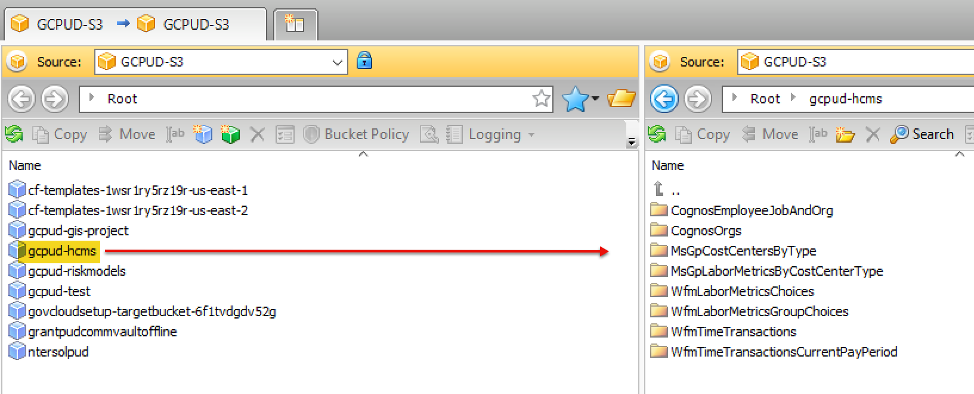
Data-Pipelines Data-Lake Ingress Pattern

Slide 29

Labor Metrics Source-Target Data-Flow (1) Labor Metrics – MSGP to Workforce Management
Scheduled Service
MSGP GPFIS
WFM WebServices
Snowflake HCMS
M365 PowerBI
myHR LaborMetrics
Get Accounting
Attributes
Accounting
Attributes
Add Labor Metrics
Labor Metrics
Choices
Add, Update, Disable Group Metrics
Labor Metrics
Group Choices
Notes
Labor Metrics may be Added via the WFM API, but not modified nor deleted (CRUD).
Labor Metrics Management Use-Cases:
Create Labor Metrics Groups
Update Labor Metrics Choices
Set Labor Metrics Group Choices
Assign Employees to Labor Metrics Groups
Set Historical Labor Metrics Group Choices (actual use versus GP categories)

Slide 30
Labor Metrics Source-Target Data-Flow (2) Labor Metrics, Cost Centers, Projects – MSGP to Snowflake HCMS
Scheduled Service
MSGP GPFIS
WFM WebServices
Snowflake HCMS
M365 PowerBI
myHR LaborMetrics
Get Accounting
Attributes
Accounting
Attributes
Add Labor Metrics, Cost Centers, and Projects
HCMS Db
MsGpLaborMetricsByCostCenter
And
MsGpCostCentersByType
Tables
Notes
Import via S3 Data-Lake from sync with MSGP.
These data-sets are copies of authoritative data from MSGP. Used within Snowflake for correlation between multiple HCMS dependent solution-scenarios.

Slide 31
Time-Entries Source-Target Data-Flow Time-Entry Transactions – WFM to Snowflake
Scheduled Service
MSGP GPFIS
WFM WebServices
Snowflake HCMS
M365 PowerBI
myHR LaborMetrics
Get Time-Entry Transactions
WFM REST API
Add Historical and Current Time-Entry Transactions
HCMS Db
TimesheetTransactions
Table
Notes
Import via S3 Data-Lake from sync with WFM Web Services.
Distinction between “Open” and “Closed” time-entry transactions.
Differing business processes that depend upon whether or not Timesheets have been submitted for payment (i.e. Closed); or, employees are actively submitting time-entries (i.e. Open).

Slide 32
Employee Org & Job Source-Target Data Flow Employee Org & Job Records – Cognos to Snowflake
Scheduled Service
MSGP GPFIS
UltiPro Cognos WebServices
Snowflake HCMS
M365 PowerBI
myHR LaborMetrics
Get Employee Org & Job Report
RaaS API
Add/Update Employee Org and Job Records
HCMS Db
EmployeeOrgAndJob
Table
Notes
Import via S3 Data-Lake from sync with UltiPro Cognos “Report as a Service” API.
Business-Only Employee information (avoids PII).
Multiple business-process consumers of Employee Org and Job data-sets (e.g. M365 Sharepoint Apps).

Slide 33


Portal Application Data-Flow Time, Work-Codes, and Labor Metrics End-User Scenarios
MSGP GPFIS
WFM WebServices
Snowflake HCMS
M365 PowerBI
myHR on M365 and Azure
Scheduled Service
Timesheet
Analytics
HCMS Cloud-Data
Employee
Time-Management
Portal
WFM
Labor Metrics
Groups Configuration
Notes
HCMS Data Warehouse forms a data-hub from which other applications and services read and update common data-sets.
Employees and Supervisors establish Work-Code to Labor-Metrics mappings.
Timesheet configurations are established via Workforce Management (WFM) synchronization

Slide 34
Data-Flows by Functional Area Labor Metrics – Time Management Portal
Scheduled Service
MSGP GPFIS
WFM WebServices
Snowflake HCMS
M365 PowerBI
myHR LaborMetrics
Timesheet
Analytics
HCMS CloudData
Employee
Time-Management
Portal
WFM
Notes
HCMS Data Warehouse forms a data-hub from which other applications and services pull common data-sets.

Slide 35
Work-Code Management Portal Establish mappings between Work-Codes and Labor-Metrics

Slide 36
Time-Entry Pay-Period Processing Payroll Processing of Pre-Export Validations and Analytics

Slide 37
Arcos Integration – Time and Labor-Metrics Ingress Sparse Data-Collection from Arcos Usage Scenarios

Slide 38
Teams Integration – Time and Labor-Metrics Ingress Sparse Data-Collection from Teams and Office365 Usage Scenarios

Slide 39
Time Management UI Mock-Ups

Slide 40
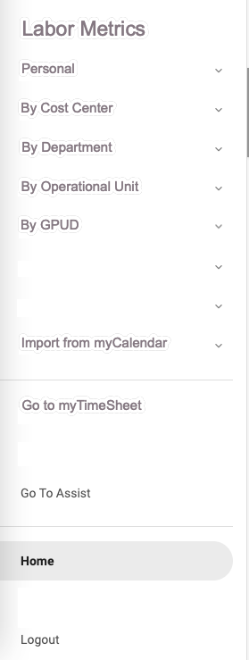
Employee Self-Serve (1) Create, Read, Add, Remove Labor-Metrics Work-Codes
myWorkCodes
myRole 
Refresh
Add to
Timesheet
Remove from Timesheet
Download

Slide 41
Employee Self-Serve (2) Import Time Entries from Calendar
Time Entries – Import from Calendar
myRole 
Refresh
Add to
Timesheet
Remove from Timesheet

Slide 42
Manager Self-Serve (1) Create, Read, Add, Remove Labor-Metrics Work-Codes
MyTeam’s WorkCodes
myRole 
Refresh
Add to
Timesheets
Remove from Timesheets
Download

Slide 43
Project Accountant Self-Serve (1) Create, Read, Disable, Assign Labor-Metrics Work-Codes
Project Accounting WorkCode Management
myRole 
Refresh
Add to
Timesheets
Remove from Timesheets
Disable Forever
Download
Upload

Slide 44
Payroll Admin (1) Create, Read, Update, Delete Labor-Metrics WorkCodes

Slide 45
SysAdmin (1) Create, Read, Update, Delete Labor-Metrics Work-Codes

