Slide 1
CNN projects for Spring 2015

Slide 2
Members
"Jayaprakash, Sangeetha" sjayaprakash6@gatech.edu
Joshua Lee jlee755@gatech.edu
Ria Gupte ria.gupte@gmail.com
"Diao, Enmao" <emdiao@gatech.edu>

Slide 3
2 1 Groups
FPGA implementation group
step1 : Write a simple CNN using matlab or C source code
step 2: Naïve CNN on FPGA
step 3: KAIST_CNN on FPGA
step 4: SP_CNN on FPGA
step 5: Bigger scales on FPGA
CNN algorithm developments
Functional simulator
Test out other inputs
Other neural networks
Convolutional neuron network
future work

Slide 4
CNN Simulator
https://dmanatunga@bitbucket.org/dmanatunga/cnn-simulator.git
author: Dilan Manatunga manatunga@gmail.com
Look at matlab directory, look at the holefiling example

Slide 5
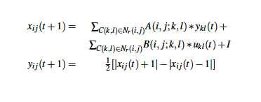
Naïve CNN
8-bit operations
input comes from a memory
Registers for A,B templates
y function is fixed
Put a ALU for functional units
C(I,j)
C(I,j)

Slide 6
First CNN Design
6x6 CNN
input image 8 bits. (6x6 image cells)
MAC: Multiply + Adder
Each cell has 9 MAC units to compute with outputs, 9 MAC units to compute with neighbor input values, 1 final adder to sum constant
A,B, I value registers

Slide 7
MAC Sharing CNN
Naïve CNN: All 9 inputs are summed together
MAC sharing CNN: use only 1 MAC unit to sum all 9 inputs
→ A basic model for KAIST_CNN

Slide 8
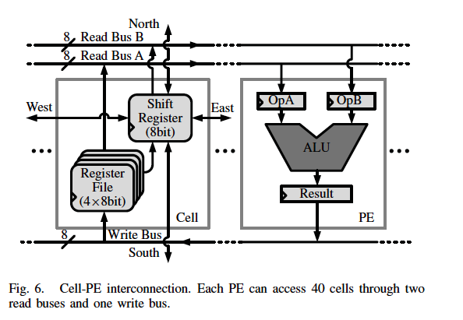
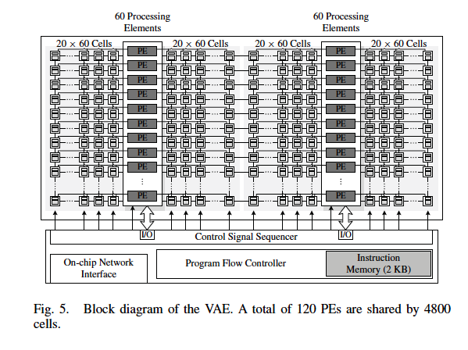
KAIST_CNN
ALUs are shared
Required a shift register

Slide 9
SP-CNN
Start from CNN-P ,
Connect with a SRAM memory
2 CNN-Ps
Connect with a SRAM memory

