Slide 1
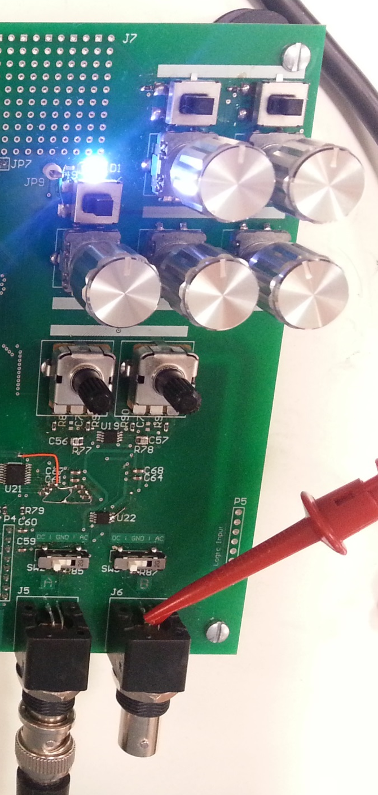
Trigger Mode (Normal / One-shot)
Trigger Slope (+/-)
Trigger Level (CW: + / CCW: -)
Trigger Delay (CW: + / CCW: -)
Ch. A Vertical Sensitivity (CW: + / CCW: -)
Ch. B Vertical Sensitivity (CW: + / CCW: -)
Time Sensitivity (CW: + / CCW: -)
Ch. A Vertical Offset (CW: + / CCW: -)
Ch. B Vertical Offset (CW: + / CCW: -)
Ch. A Input Mode Select (DC / GND / AC)
Ch. B Input Mode Select (DC / GND / AC)

Slide 2
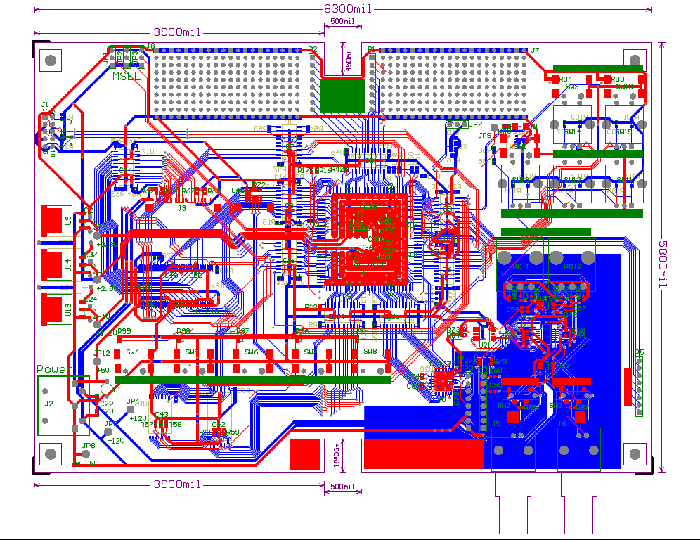

Slide 3
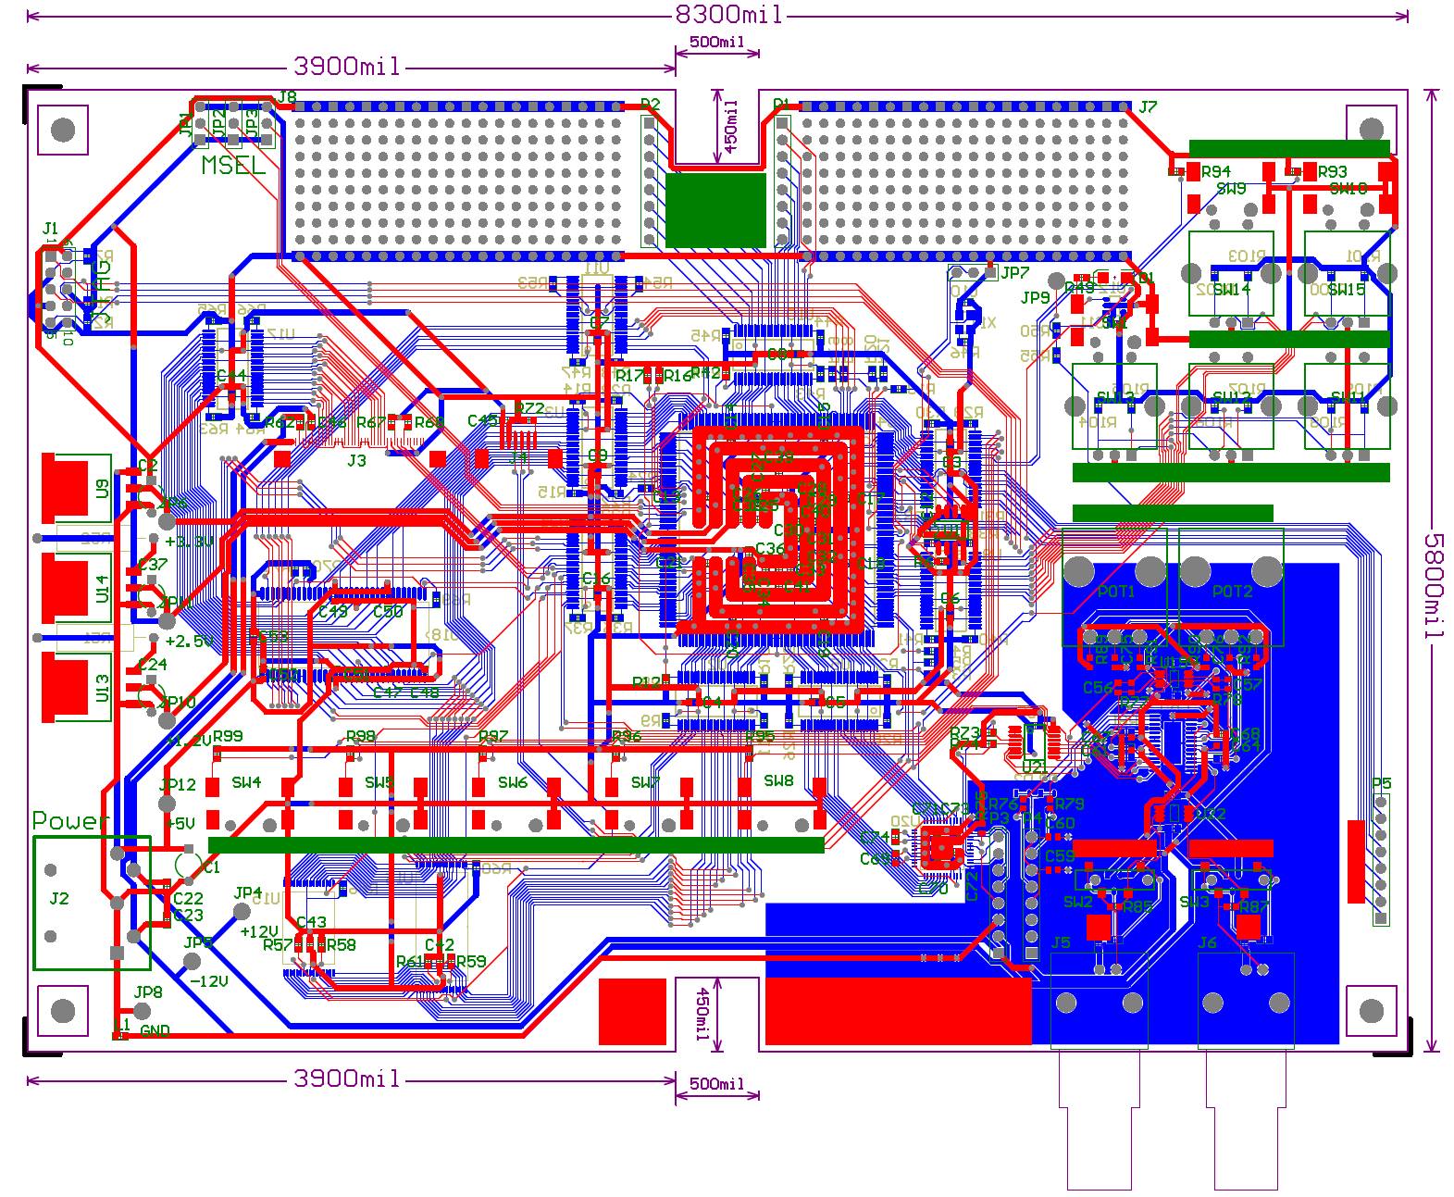
Mode
Playground
Switches
JTAG
VRAM and
Display
Clock
Reset
VRAM Address Bus
I/O Buffers
FPGA
Power
Analog Frontend
Data Bus
Switches
Logic
Memory
Address Bus

Slide 4


Slide 5
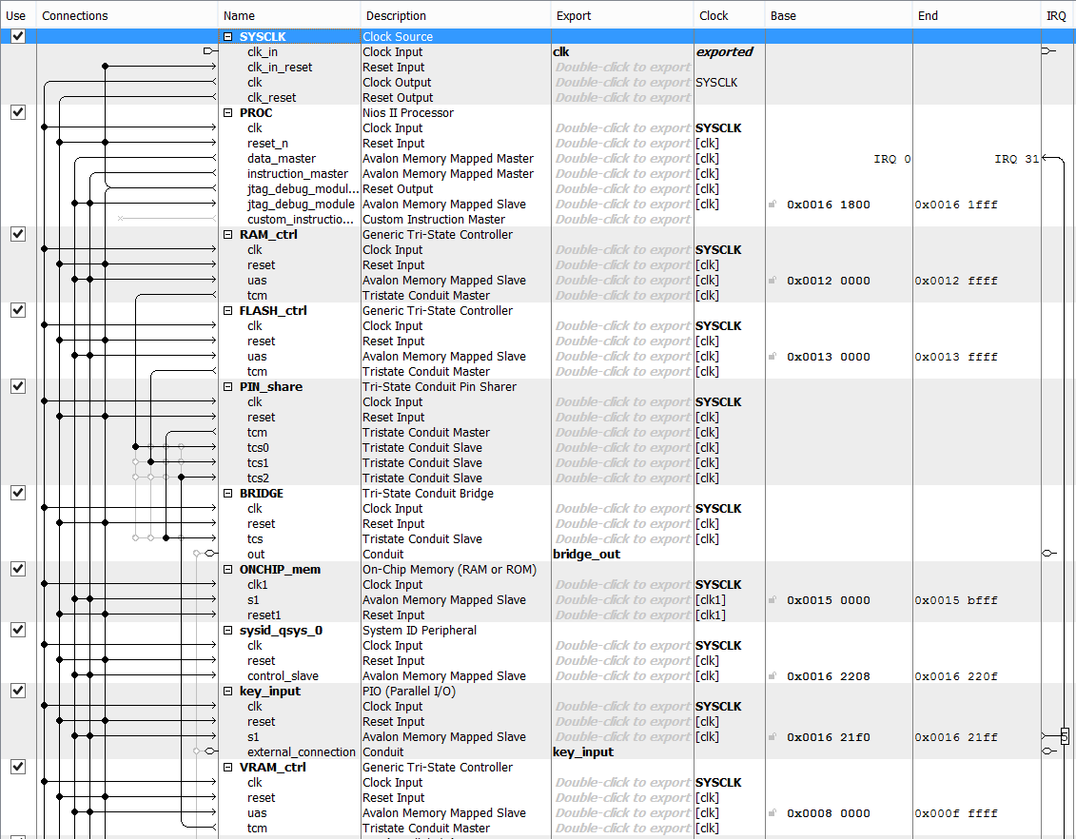
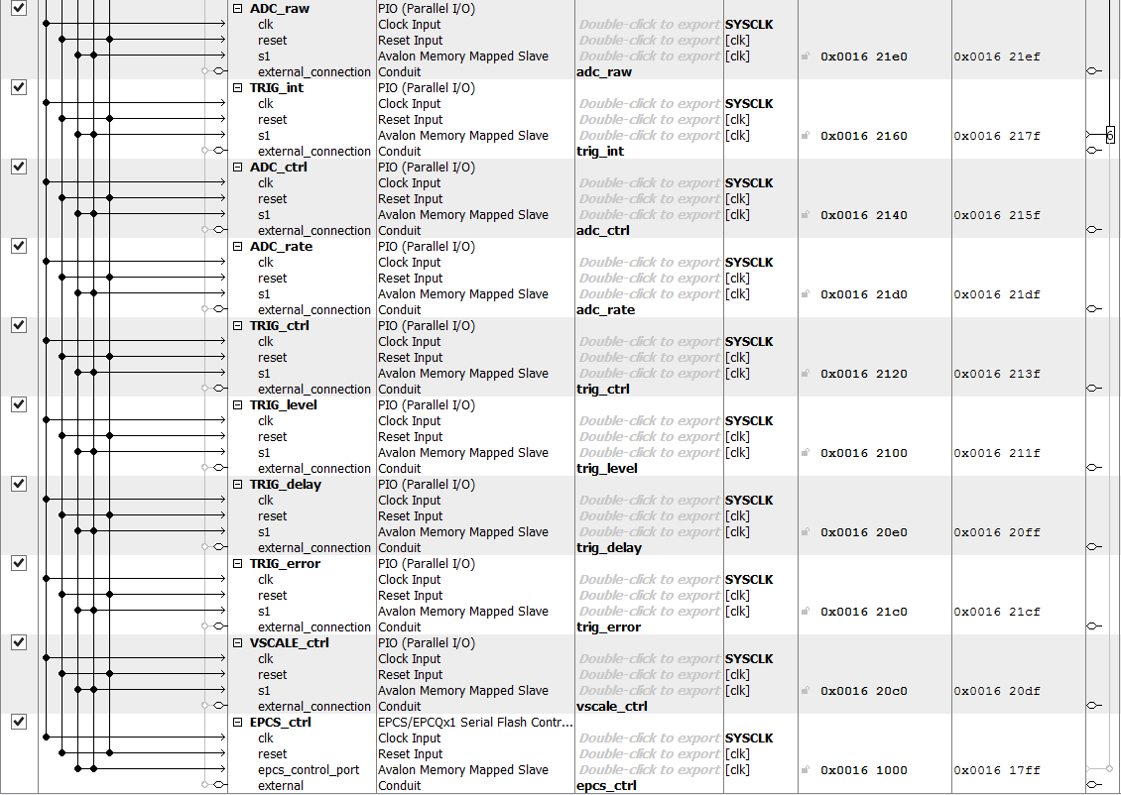

Slide 6
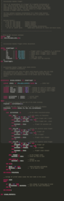
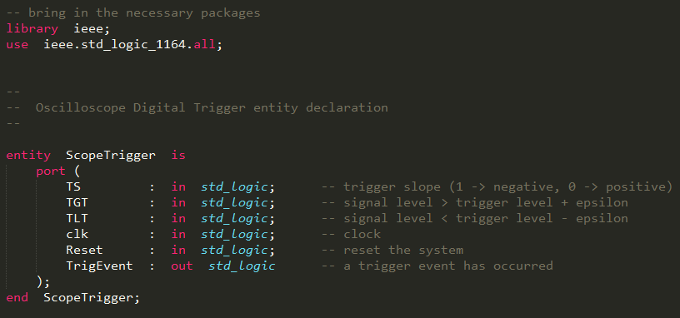
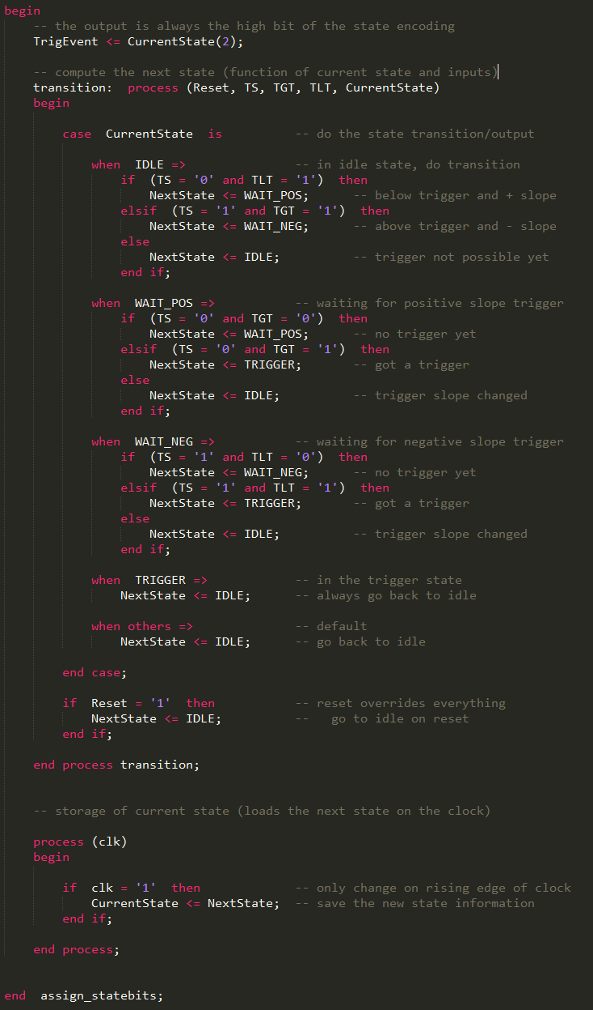
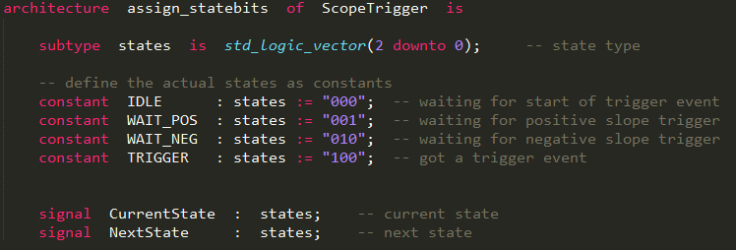
1
2
3

Slide 7
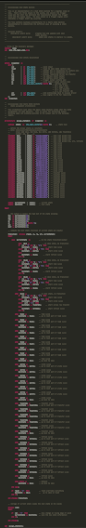
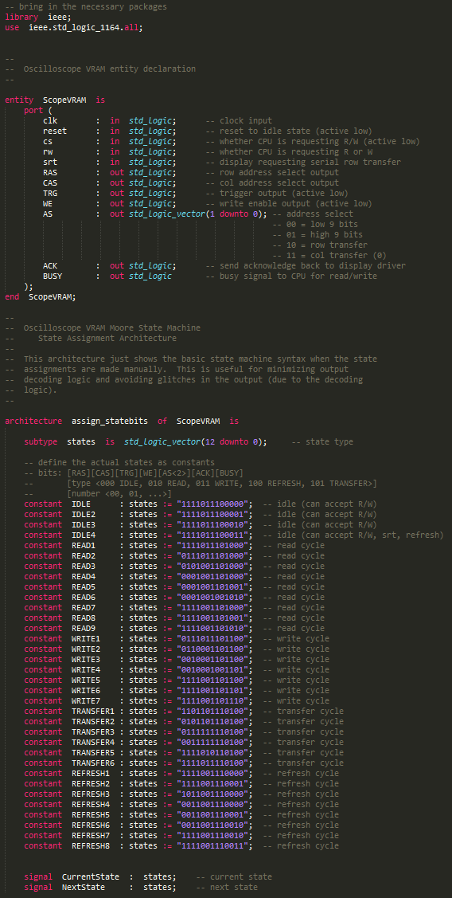
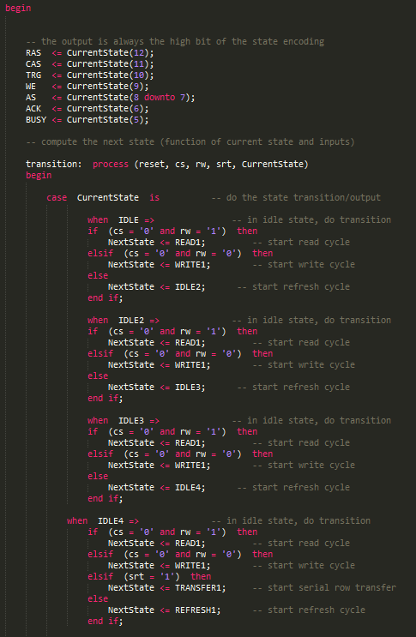
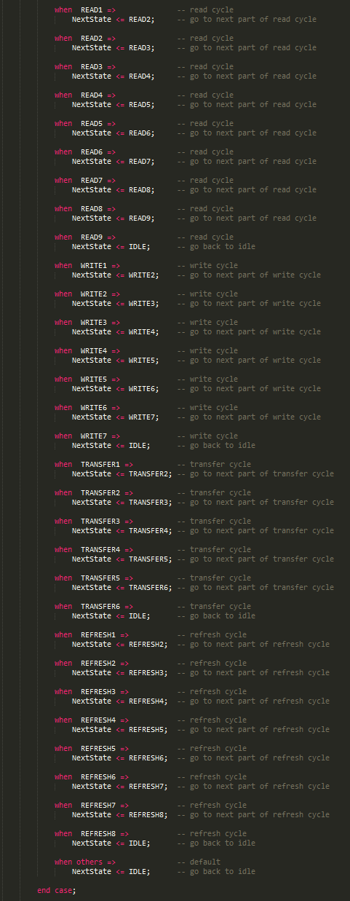
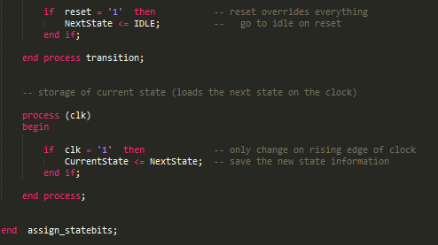
1
2
3
4

Slide 8
Main Loop
main
Menu
Samples and Triggering
menu
tracutil
menuact
sampleinit
Keys / UI
VRAM and Display
keyproc
lcdout
keyint

