Slide 1
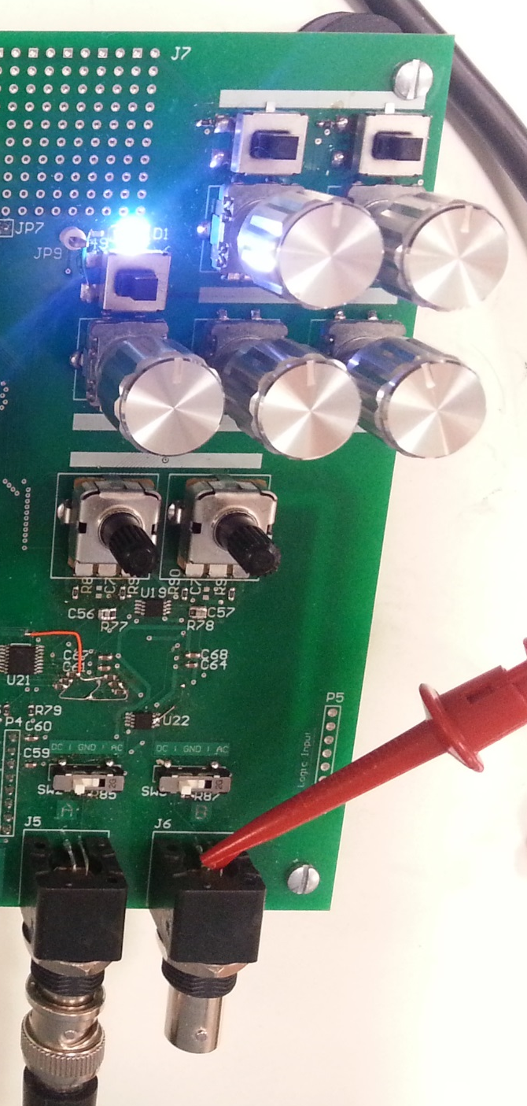
Trigger Mode (Normal / One-shot)
Trigger Slope (+/-)
Trigger Level (CW: + / CCW: -)
Trigger Delay (CW: + / CCW: -)
Ch. A Vertical Sensitivity (CW: + / CCW: -)
Ch. B Vertical Sensitivity (CW: + / CCW: -)
Time Sensitivity (CW: + / CCW: -)
Ch. A Vertical Offset (CW: + / CCW: -)
Ch. B Vertical Offset (CW: + / CCW: -)
Ch. A Input Mode Select (DC / GND / AC)
Ch. B Input Mode Select (DC / GND / AC)

Slide 2
