Slide 1
UDACITY
FME
BIT Scholarship

Slide 2
o
O
e
AGENDA
Intro to Myself
What is ETL?
What is FME?
Useful Resources
Knowledge Community
License
Example Projects
01
02
03

Slide 3

Geomatics Engineering, B.Eng.
2011-2015 Yildiz Technical University, Istanbul, Turkey
Caner Akin
Location Intelligence Analyst
Caner Akin is a Location Intelligence Analyst with over five years of experience that allows him to fulfill complementary roles of a data analyst, software developer, and GIS architecture design.
GIS-Geospatial Management, Postgraduate
2016-2017 Niagara College Canada
Geomatics Designer
2017-2021 Associated Engineering (Ont.) Ltd.
Part-time Professor
2019 - Present Conestoga College
Programming in C
Programming for Absolute Beginners
2019 - Present Niagara College
Enterprise Geodatabases & FME
C
X
Location Intelligence Analyst
2021- Present GHD

Slide 4
What is ETL?
M
S
o
Extract
Transform
Load
Connect data in hundreds of systems, including
CAD, GIS, BIM, Microsoft Office Programs,
SQL, ORACLE, Rasters and more.
Transform data in limitless ways and manipulate projection, attributes, and data structures.
Finally upload the data into the new destination(s).

Slide 5
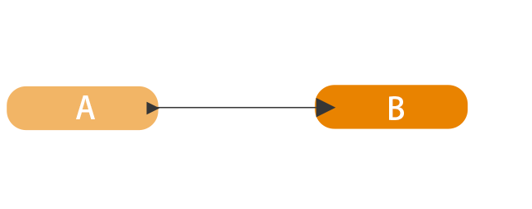
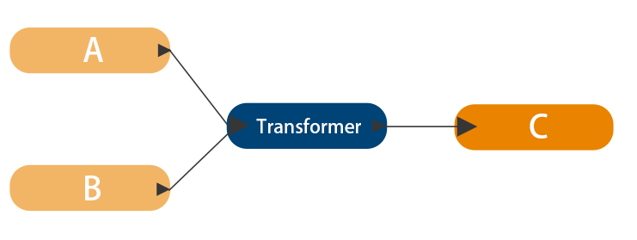

Slide 6
FME
Feature Manipulation Engine
A
Transform data in limitless ways and manipulate projection, attributes, and data structures.
K
Connect data in hundreds of systems, including CAD, GIS, BIM, Microsoft Office Programs, SQL, ORACLE, Rasters and more.
P
Develop your own transformer and improve your solutions using Python, R or SQL Scripting.

Slide 7
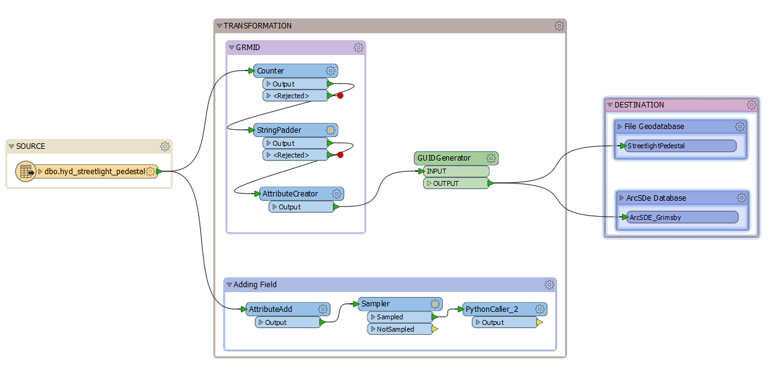

Slide 8
A
01
Knowledge Base
You can post your question, get online support, follow the topic you are curious about.
c
FREE LICENSES
There are multiple free licenses
FME for Covid-19
Trial License
License for Home Use
Student License
Non-profit Research License
Licenses for Recent Grads
Resources
02
Online Training
Free online training, webinar series, annual user conferences
J
03
Tutorials
Many tutorials and coming more

Slide 9
Migration to Esri using
FME
| The Town of Grimbsy
Example Project

Slide 10
Town’s Previous Process
b
Web Server
Finally, the data was published in the web server
ArcGIS
GIS based information was processed in this level.
A
m
AutoCAD
AutoCAD was used as a spatial data distributor
SQL Server
The main database
d

Slide 11
M
01
AutoCAD and SQL
Using Autocad with SQL presented many challenges
r
The main three problems
Problems
02
Lack of Normalization
Attribute naming wasn’t proper for all the columns. Some of the attributes were not readable
b
03
Unique ID
There was no readable UniqueID

Slide 12
Conceptual Design
Map the information and come up with the basic understanding of the database
Data Model Structure
Use a structure that will communicate with other cities/towns and easy to understand
K
Conceptual Design
Caner’s Beautiful Solution
d
Data Model Structure
U
Unique ID
Define the primary and foreign keys and update it with a new ID
Unique ID Generation
d
Data Normalization
Data Normalization
Clean up the data, remove null values, define constrains, define metadata, organize all the columns

Slide 13
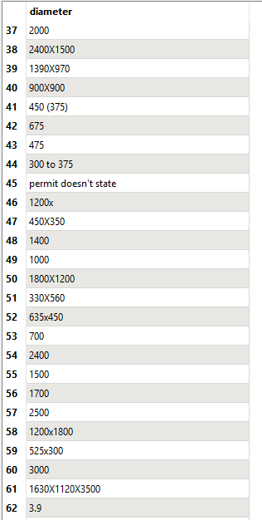
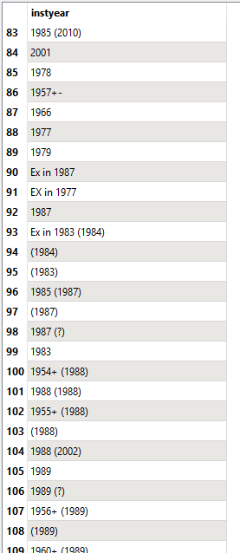
Inconsistent Data Example

Slide 14
FME
We will continue with another example of FME

Slide 15
Thanks for
Joining!

