Slide 1
序列密码
bibi

Slide 2
序列密码（流密码）
分组密码通常是按固定规模将明文分组，对每组均使用一个固定的加密变换来进行运算
流密码则是使用一个随时间变化的加密变换，一次加密一个明文的独立符号单位
爆破/Z3 （QWB streamgame系列）
代数攻击（WCTF2019 toy）
快速相关攻击（QWB streamgame系列）
……（时间问题，需要较长的学习周期，各位可以自学）

Slide 3
序列密码的入门案例：随机数

Slide 4
Random Prediction
bibi

Slide 5
Why Learn It
REVERSE
0CTF 2017 -- Zer0llvm
PWN
N1CTF PWN500 -- vegas
CRYPTO
30C3CTF 201 -- Number
WEB
Boston Key Party CTF 2015 -- Museum of Fine Arts
MISC
Trend Micro CTF 2016 -- BlackJack

Slide 6
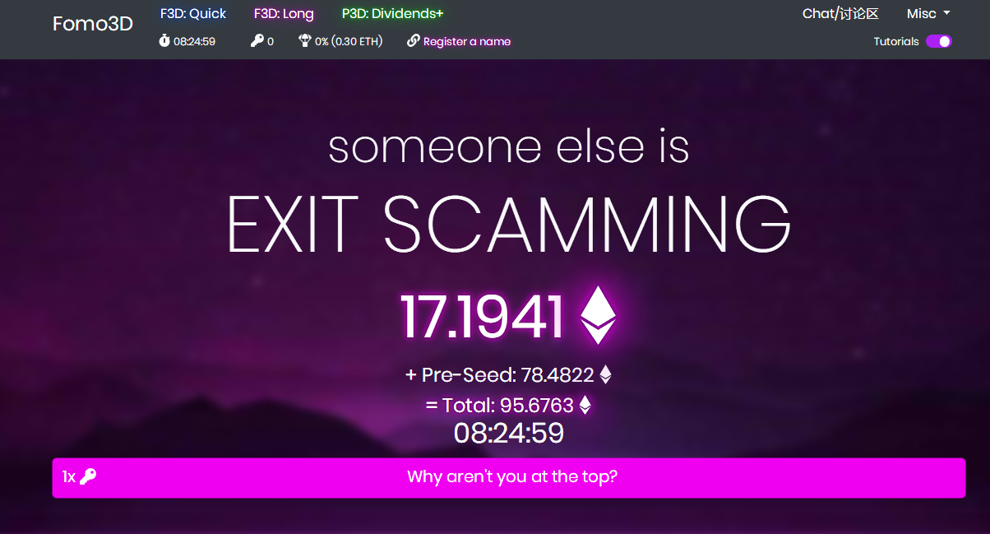

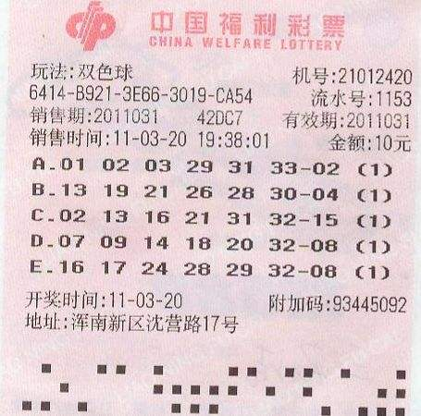
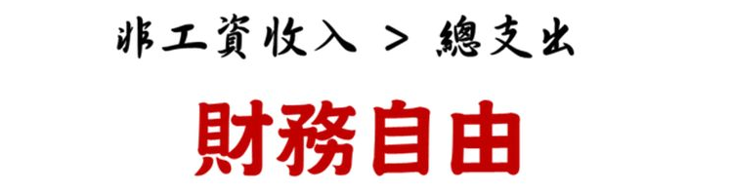
If we can predict

Slide 7
What is “random”
No real random
In computer
Stream cipher: Generate from a seed
Circuit noise
PRNG (Stream cipher: Generate from a seed)
Pseudo-Random Number Generator, 伪随机序列发生器

Slide 8
PRNG Features
Stream cipher
Distribution characteristics
Same seed same output
Seed: time, Circuit noise

Slide 9
level 0: Brute Seed
Time()
Local: know a output
Remote: know nothing
Windows
import time
print time.time()
1540555499.76
Linux
import time
print time.time()
1540555548.799107

Slide 10
Challenge Time: level0
Jarvis OJ [xman2019]babyrpd

Slide 11
Before true game: state and output
seed
State:
state0
state1
state2
state3
state4
Output:
out0
out1
out2
out3
out4

Slide 12
Level 1: Linear Congruential PRNG
java.util.Random, elder c’s rand(), some of platform’s php’s rand()
48 bits seed as internal initial state
Linear: next_state = (state * multiplier + addend) mod (2 ^ precision)
multiplier = 25214903917
addend = 11
Precision = 48
State -> output: bitshifted to the right by 16 bits
nextInt(), nextLong(), …… -- 32 bits or multiple

Slide 13
seed
=
Linear
Linear
Linear
Linear
Linear
State:
state0
state1
state2
state3
state4
>>6
>>6
>>6
>>6
>>6
Output:
out0
out1
out2
out3
out4

Slide 14
ATTACK
output->state -- Impossible: 16 bits were discarded – 32 bits known
If: 64 bits known – we can predict
16 bit discarded: 65536 possible values – brute it!
seed
=
Linear
Linear
Linear
Linear
Linear
State:
state0
state1
state2
state3
state4
>>6
>>6
>>6
>>6
>>6
known
Output:
out0
out1
out2
out3
out4
given two integers from java.util.Random, we can predict all future generated integers

Slide 15
Random random = new Random();
long v1 = random.nextInt();
long v2 = random.nextInt();
for (int i = 0; i < 65536; i++) {
long state = v1 * 65536 + i;
if (((state * multiplier + addend) & mask) >>> 16) == v2) {
System.out.println("Seed found: " + state);
break;
}
}
Try yourself

Slide 16
Challenge Time: level1
Jarvis OJ [xman2019]mediumrpd
multiplier = 25214903917
addend = 11
next_state = (state * multiplier + addend) & 0xffffffffffff
output = state >>6

Slide 17
Level 2: Mersenne Twister
Ruby's rand()，Pythons random module，PHP's mt_rand()
State：624 32 bit words (integers)
624 states -> 624 next states

Slide 18
Generating the next state
State:
state0
state623
state624
statexxx
Int
……
……
Obtaining the next number
Output:
out0
out623
out624
outxxx
Int

Slide 19
MT_RAND()
State:
……
624 integers

Slide 20
State->Number
……
currentIndex++;
int tmp = state[currentIndex];
tmp ^= (tmp >>> 11);
tmp ^= (tmp << 7) & 0x9d2c5680;
tmp ^= (tmp << 15) & 0xefc60000;
tmp ^= (tmp >>> 18); return tmp;
……
State: 624 integers → Number: 624 integers (624*32=19968 bit)

Slide 21
State use out: generate new state
Old State
……
int[] state;
for (i = 0; i < 624; i++) {
int y = (state[i] & 0x80000000) + (state[(i + 1) % 624] & 0x7fffffff);
int next = y >>> 1;
next ^= state[(i + 397) % 624];
if ((y & 1L) == 1L) {
next ^= 0x9908b0df;
}
state[i] = next;
}
New State
……
Notes:
任意连续

Slide 22
Generating the next state
State:
state0
state623
state624
statexxx
……
……
Obtaining the next number
Output:
out0
out623
out624
outxxx
Known: 624 integers (624*32=19968 bit)

Slide 23
Reverse It！
tmp ^= (tmp >>> 11);
tmp ^= (tmp << 7) & 0x9d2c5680;
tmp ^= (tmp << 15) & 0xefc60000;
tmp ^= (tmp >>> 18); return tmp;
value = unBitshiftRightXor(value, 18); value = unBitshiftLeftXor(value, 15, 0xefc60000); value = unBitshiftLeftXor(value, 7, 0x9d2c5680); value = unBitshiftRightXor(value, 11);
10110111010111100111111001110010 tmp
00000000000000000010110111010111100111111001110010 tmp >>> 18
10110111010111100101001110100101 tmp ^ (tmp >>> 18)
Because of “^=“, there is no information lose

Slide 24
Generating the next state
State:
state0
state623
state624
statexxx
……
……
Obtaining the next number
Output:
out0
out623
out624
outxxx
Known: 624 integers (624*32=19968 bit)
Collect 624 integers outputs
Use 624 outputs recover 624 states
Use 624 states to generate next 624 states
Use next 624 states to generate next 624 outputs

Slide 25
Maybe in future’s challenge
int[] state;
for (i = 0; i < 624; i++) {
int y = (state[i] & 0x80000000) + (state[(i + 1) % 624] & 0x7fffffff);
int next = y >>> 1;
next ^= state[(i + 397) % 624];
if ((y & 1L) == 1L) {
next ^= 0x9908b0df;
}
state[i] = next;
}
Collect 0th, 1st, 397th outputs
Use 3 outputs recover 3 states
Use 3 states to generate 624th state
Use next 624th state to generate 624th output

Slide 26
Challenge Time: level2
Jarvis OJ [xman2019]hardrpd
I support a useful lib for you, enjoy it!
http://47.97.215.88/hardrpd/

