Slide 1
区块链智能合约安全
bibi

Slide 2
做题必备工具-安装
梯子
Chrome
MetaMask插件
做题必备网址
https://etherscan.io ## https://ropsten.etherscan.io ## else
http://remix.ethereum.org
Notes:
还有其他的 不同题目不一样 但是这个是所有题目都需要的

Slide 3
基本操作：访问http://47.97.215.88获取信息
从水管获取测试网络的eth
转账
向0xC5A1986589109dfB267f070E51B69C77FACaADcC转0.1个eth
部署智能合约
部署baby.sol到ropsten
查看部署的合约的信息
调用智能合约
查看现有的owner是谁
更换一个账号
调用智能合约，修改owner
查看修改后的owner

Slide 4
漏洞类型
重入攻击
未检查Call返回值
条件竞争
权限控制
交易顺序依赖
短地址攻击
整型溢出
时间戳依赖
可预测的随机数

Slide 5
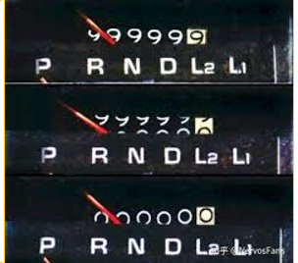
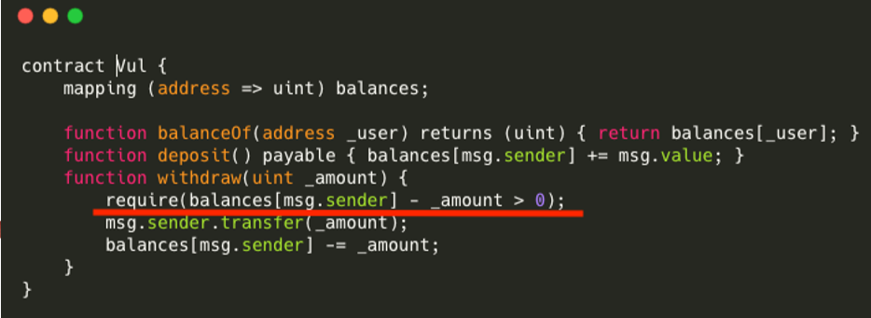
整数溢出漏洞
uint8: 0~2^8-1
uint256: 0~2^256-1

Slide 6
整型溢出例题：访问http://47.97.215.88获取
1 部署合约
2 查看自己账户的余额
3 放入1个token，取走2个token
4 观察变化并思考为什么

Slide 7
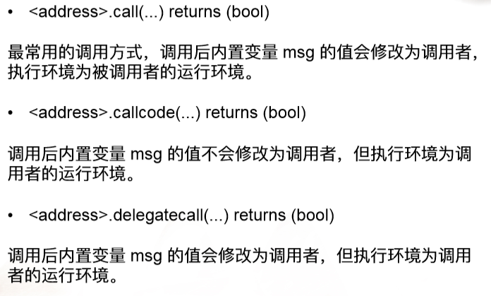
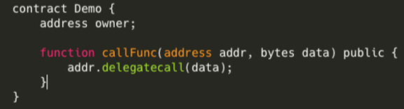
Call函数簇滥用
data可控，伪造恶意合约

Slide 8
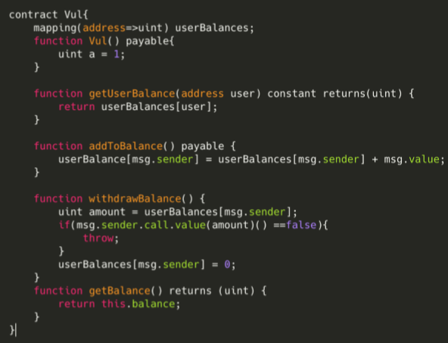
重入漏洞
条件：逻辑顺序（检查、取钱、扣除余额）
攻击效果：多次提钱/绕过验证逻辑

Slide 9
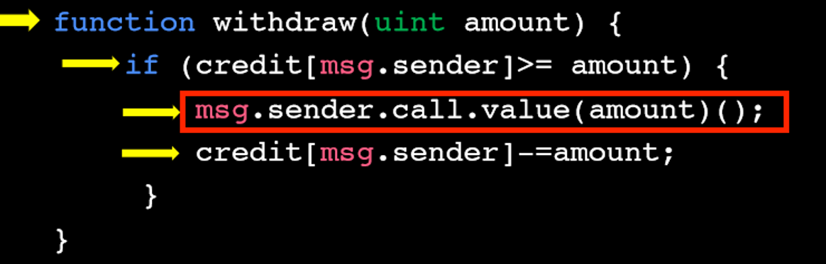
Reentrancy Attack
1
2
3
check if your balance is enough for you to withdraw so much money
transfer money to you
update your balance
Notes:
Back to the topic, how did hackers take away these 50 million dollars?
The attack method he uses is exactly the Reentrancy Attack.
Let‘s look at the Dao’s implementation code.
This function realizes the function of withdrawing money.
It has 3 steps.
The first step is to check if your balance is enough for you to withdraw so much money.
The second step is to transfer money to you.
The third step is to update your balance.
You might say that there is no problem, why can it be attacked?

Slide 10
user
Smart Contract
Withdraw 100eth
Check the user's balance
I will transfer the money soon
payable
Money
transfer process
Update user’s balance
Notes:
Let's take a look at the detailed interaction process.
First the user makes a request to withdraw 100 eths.
The smart contract will check if there are 100 eths in the user's account.
If the user’s balance is sufficient to extract, the smart contract will enter the transfer process.
The transfer process will tell the user: "I will transfer the money soon“.
The user will respond:”OK, come on!” than the money will transfer to user.
Finally, smart contracts update the user’s balance.

Slide 11
check if your balance is enough for you to withdraw so much money
transfer money to you
update your balance
Transaction 1
Transaction 2
check
interaction
effect
Notes:
Throughout the process, the problem occurs in the processing order of the three steps.
The first step is check, the second step is interaction, the third step is effect.
The order of interaction and effect is wrong.
If we interact first, when the process pass the check and interact with the user, the user can initiate another transaction.
Because the user’s balance is not updated, so the second transaction can also pass the check.
In the end, both money will be taken away.

Slide 12
user
Smart Contract
Withdraw 100eth
Check the user's balance
I will transfer the money soon
transfer process
Withdraw 100eth
Check the user's balance
transfer process
Notes:
Let's take a look at the detailed interaction process.
First the user makes a request to withdraw 100 eths.
The smart contract will check if there are 100 eths in the user's account.
If the user’s balance is sufficient to extract, the smart contract will enter the transfer process.
The transfer process will tell the user: "I will transfer the money soon“.
The user don’t respond:”OK, come on!” Instead, the user initiates a new withdrawal.
The user's balance hasn't been updated, so the check passed. the smart contract will enter the transfer process again.

Slide 13
check
check
interaction
interaction
……
check
interaction
effect
check
effect
interaction
effect
Notes:
Not only can you re-enter the transfer process once, you can re-enter it many times.

Slide 14
check if your balance is enough for you to withdraw so much money
transfer money to you
update your balance
check if your balance is enough for you to withdraw so much money
update your balance
transfer money to you
check
check
interaction
effect
effect
interaction
Notes:
So how to fix this vulnerability? Very simple, just adjust the order of interaction and effect.
We check first, than update the user’s balance, Finally transfer the money.

Slide 15
check if your balance is enough for you to withdraw so much money
update your balance
transfer money to you
Transaction 1
Transaction 2
check
effect
interaction
Notes:
If we do this, in the first transaction:
First we check
Then we update the user's balance
Finally, we transfer money to the user.
At this point, when interacting, if the user initiates a second transaction,
This transaction will not pass the check
Because the user’s balance has been updated at this time
What he takes away is always his own money.

Slide 16
题目：重入漏洞+整型溢出
mapping(address => uint) public creditOf;
……
function withdrawCredit(uint amount) public{
require(creditOf[msg.sender] >= amount);
msg.sender.call.value(amount*1000000000)();
creditOf[msg.sender] -= amount;
}
function () public payable {
if (!isEnter) {
isEnter = true;
magic_bank.withdrawCredit(1);
}
}

Slide 17
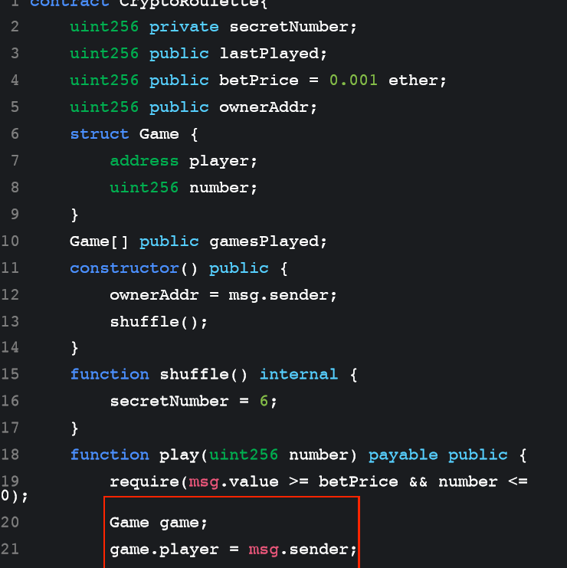
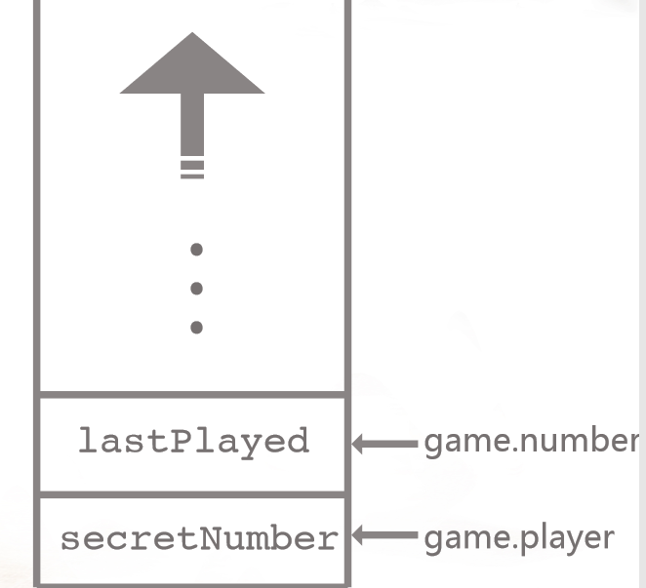
变量覆盖问题

Slide 18
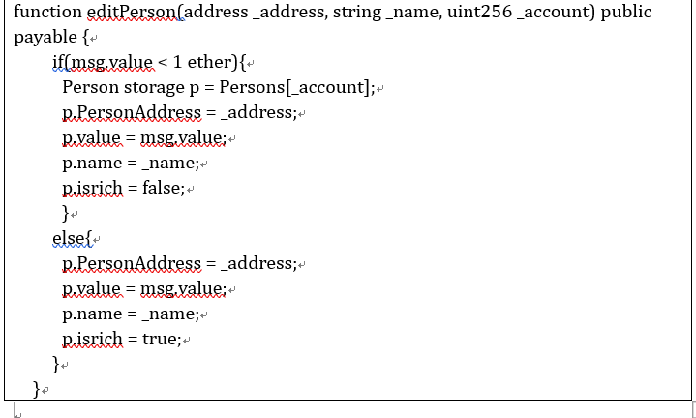
例题
https://ropsten.etherscan.io/address/0xc2c6856eb65f93a2d41937984d9ce92573ae89c7

Slide 19
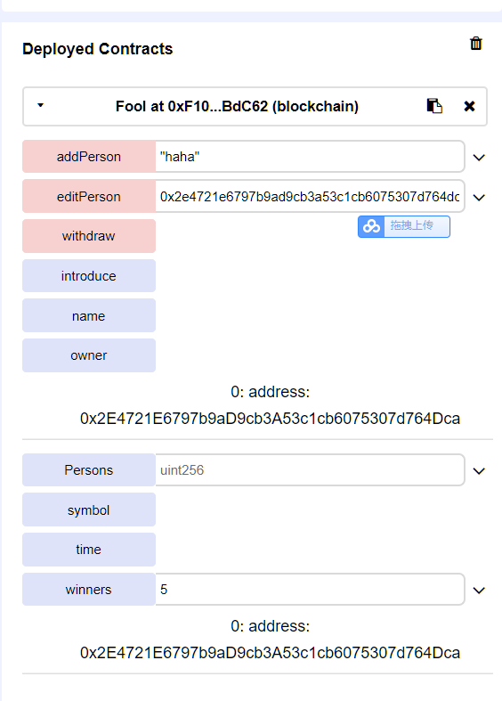
Editperson中存在逻辑问题，如果转入的eth>=1，那么会进入else的分支，其中p没有初始化，可以修改storage中的owner。

Slide 20
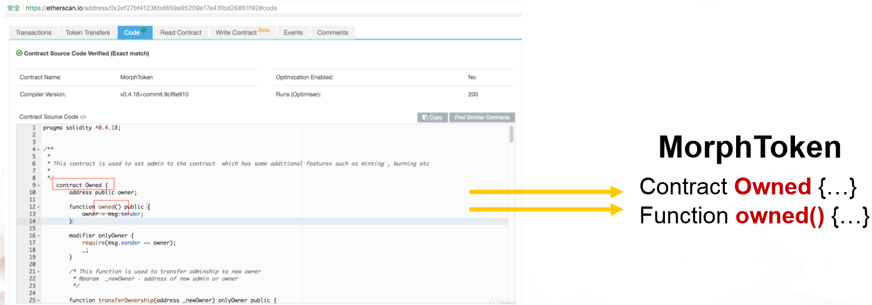
权限控制：构造函数失控

Slide 21
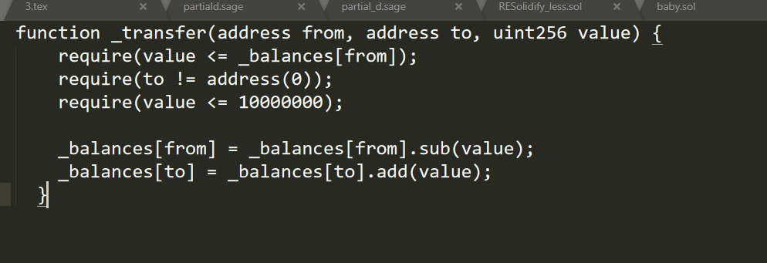
权限控制 转账函数问题-参数使用失控

Slide 22
未初始化问题
contract Fool {
address public owner;
string public name = "Fool contract";
string public symbol = "FC";
string public introduce = "Become owner and withdraw eth";
uint256 public time;
struct Person {
address PersonAddress;
uint256 value;
string name;
bool isrich;
}
Person[] public Persons;
address[] public winners;
......
function editPerson(address _address, string _name, uint256 _account) public payable {
if(msg.value < 10 ether){
Person storage p = Persons[_account];
p.PersonAddress = _address;
p.value = msg.value;
p.name = _name;
p.isrich = false;
}
else{
p.PersonAddress = _address;
p.value = msg.value;
p.name = _name;
p.isrich = true;
}
}
......

Slide 23
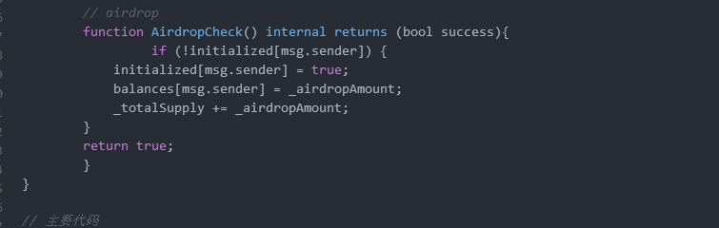
薅羊毛
合约创建合约
薅羊毛

Slide 24
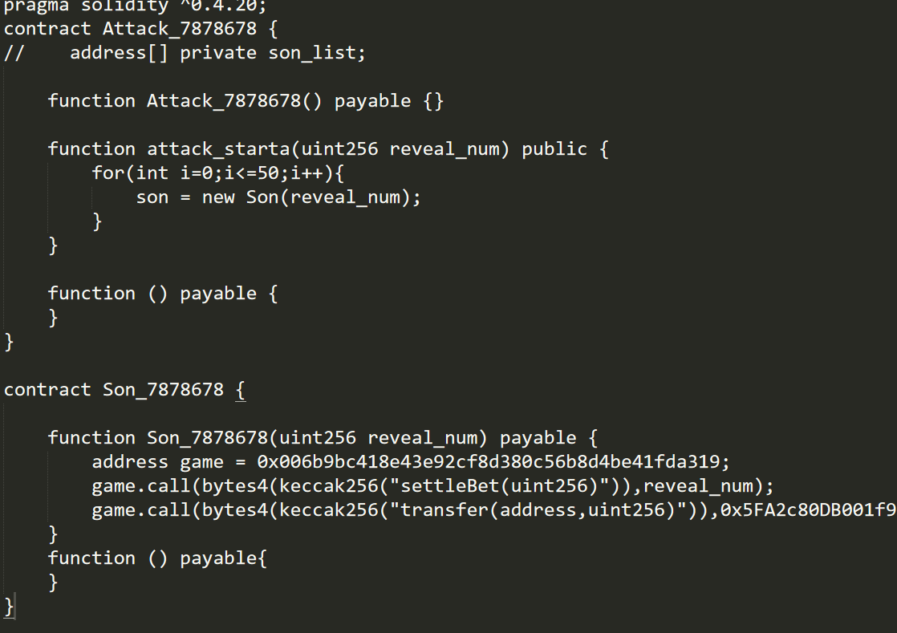

Slide 25
一些方法：自毁强制转账
如果对方合约没有余额且且没有payable
漏洞触发需要对方余额
selfdestruct(address recipient): 销毁当前合约，并且把当前合约的余额发送指定地址

Slide 26
一些方法：生成具有固定后缀的地址
function do_guess(uint256 number) payable public {
require(msg.value >= min_bet && number <= 10);
require(!winners[msg.sender]);
Guess guess;
guess.playerNo = uint16(uint256(msg.sender)&0xffff);
guess.number = number;
guesses.push(guess);
if (number == current) {
msg.sender.transfer(100000000000000000);
winners[msg.sender] = true;
}
every_day_im_shufflin();
last = now;
}
合约通过变量覆盖使用address的值覆盖了一些值
我们需要操控address的值
-》生成特定后缀的address
contract GuessMe {
uint256 private current;
uint256 public last;
address public owner;
uint256 public min_bet = 0.001 ether;
……

Slide 27
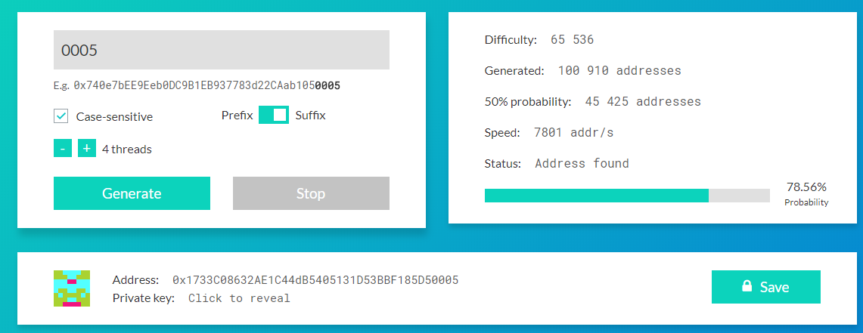
https://vanity-eth.tk

Slide 28
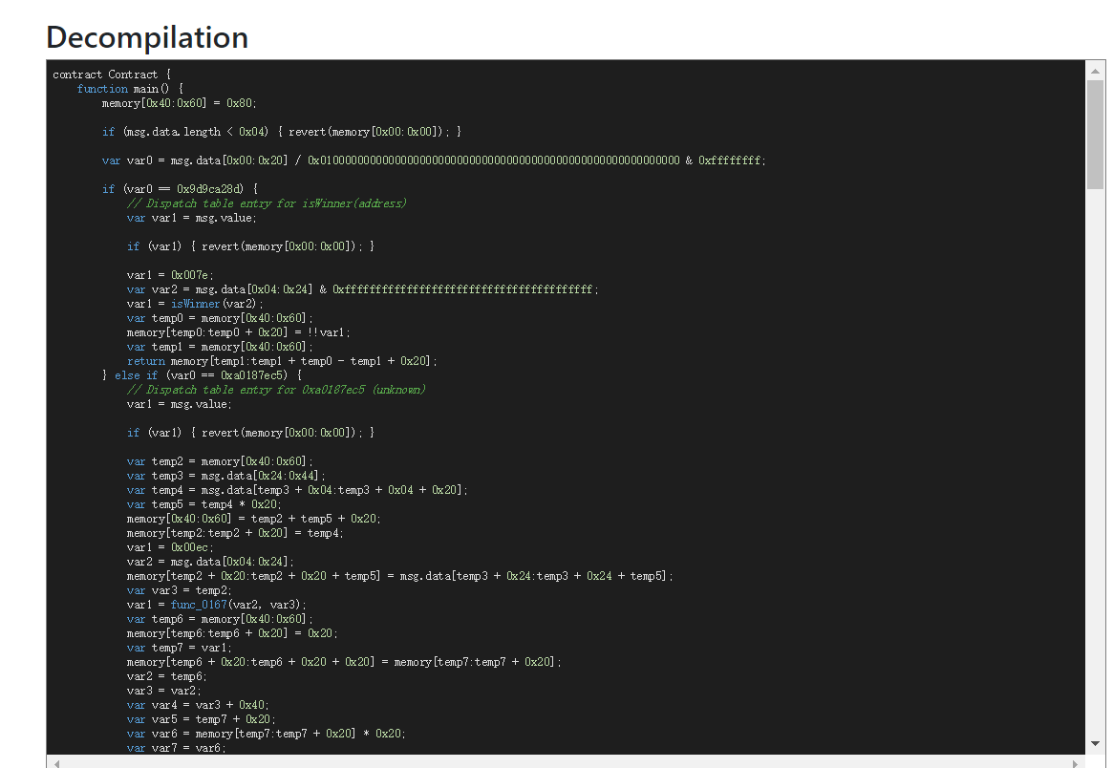
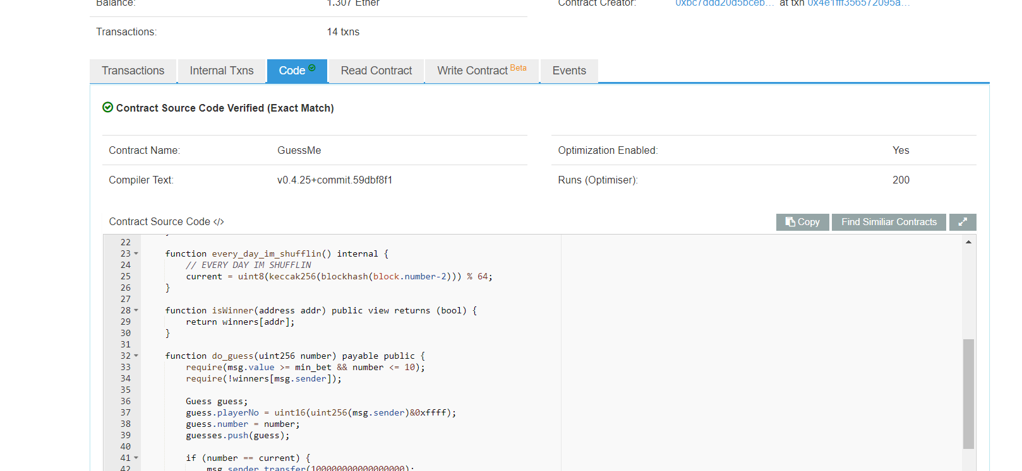
开源和逆向
ida-evm
binja
https://ethervm.io
JEB
开源（地址）

Slide 29
例题
JarvisOJ，crypto，babybank

Slide 30
真实智能合约安全事件

Slide 31
2011-2018年安全事件统计
安全事件
交易平台安全事件：56.67%
矿工安全事件：8.33%
共识机制安全事件：3.33%
智能合约安全事件：6.67%
其他安全事件：25%
交易损失
交易平台安全事件：13.44亿美元
矿工安全事件：6328万美元
共识机制安全事件：3100万美元
智能合约安全事件：12.4亿美元
其他安全事件：1.856亿美元

Slide 32
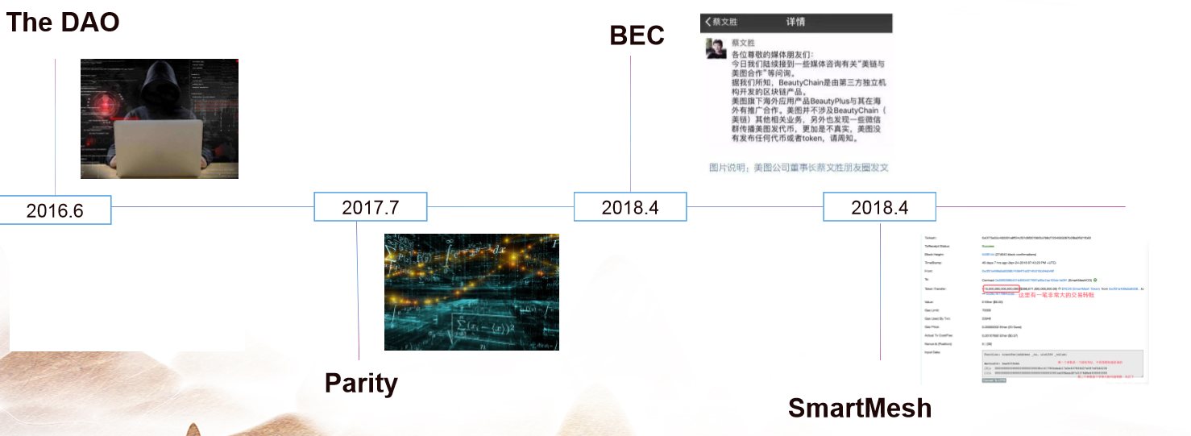
重要事件

Slide 33
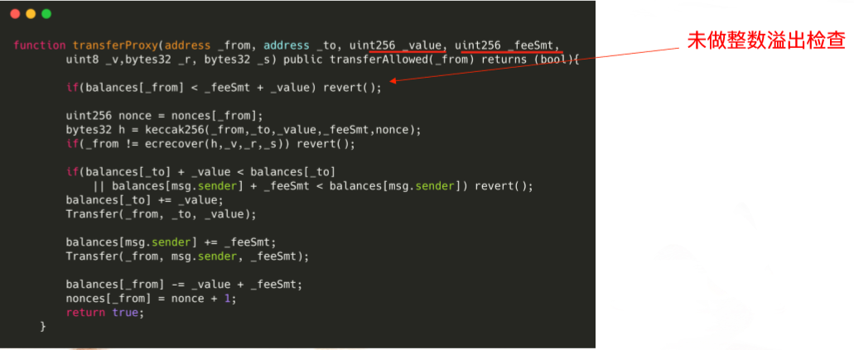
SMT整数溢出攻击事件 -- ⼀行代码蒸发64亿

Slide 34
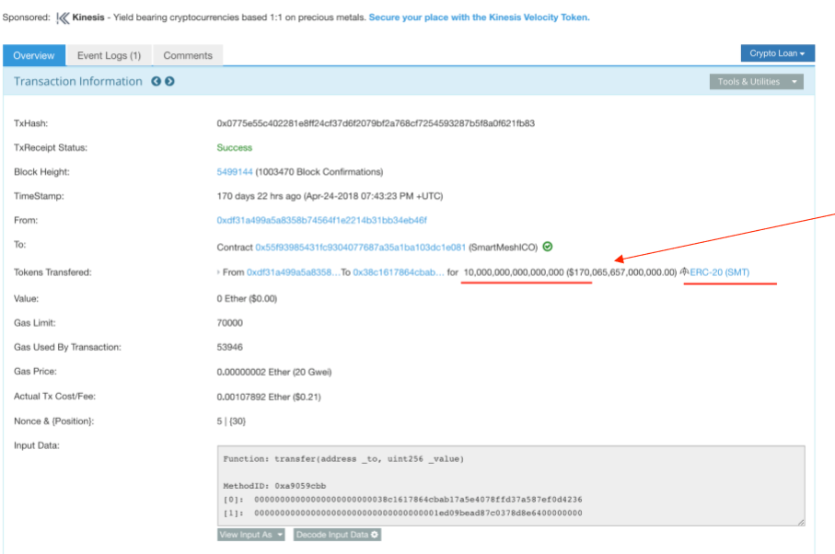

Slide 35
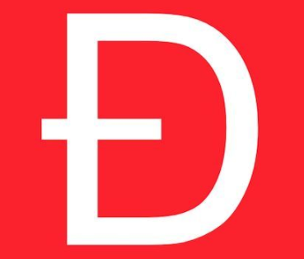
THE DAO-众筹项目
crowd-funding project (众筹项目)
2016.5
an smart contract of Ethereum(以太坊)
Token(代币)
Function of participants:
purchase tokens
sell tokens
vote on crowdfunding plans based on the amount of tokens they hold(根据持币数量对众筹计划进行投票)
$150,000,000
Notes:
Next I will introduce a famous security incident.
The DAO project is a crowd-funding project initiated by “Slock. It”, a block chain Internet of Things company.
The project was created in early May 2016.
It is implemented as an smart contract of Ethereum.
What you need to know is that it realized a kind of token through a smart contract.
In this project, participants can purchase tokens, sell tokens, and vote on crowdfunding plans based on the amount of tokens they hold.
The dao has achieved great success, raising cryptocurrencies worth about $150 million.

Slide 36
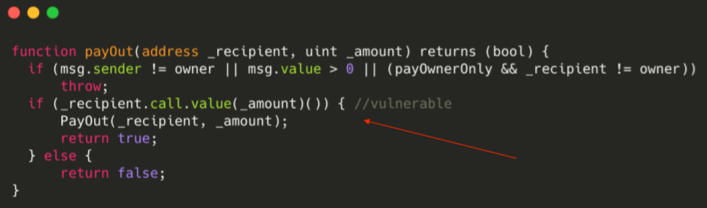
THE DAO-重入攻击

Slide 37
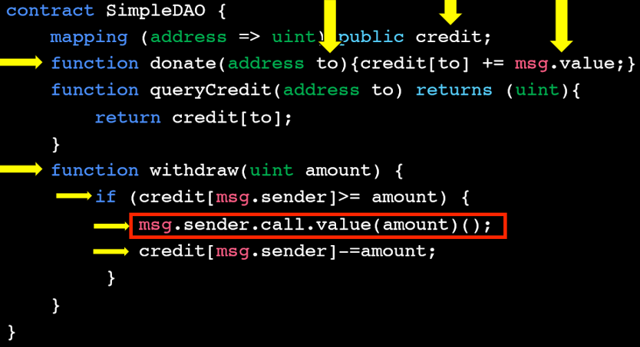

Slide 38
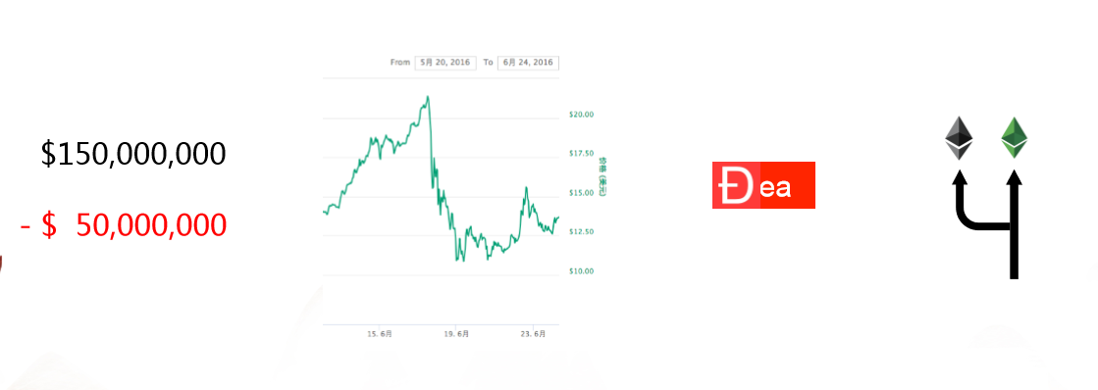
Hacker
2017.6.17, hacker->vulnerability->attack the DAO
Illegal withdrawal of $50,000,000
Notes:
However, on June 17, 2016, something happened.
A hacker discovered a vulnerability of this smart contract.
He used this vulnerability to attack the DAO project.
Through the attack, the hacker turned away the cryptocurrency worth $50 million.
So what impact does this matter have?
Firstly, the hackers took away 50 million of the 150 million.
Secondly, Ethereum’s currency has lost more than half.
Thirdly, the DAO became the DEA. (death)
Finally, Some people want to roll back this operation, some people don’t want. This divergence led to the fork of Ethereum.

Slide 39
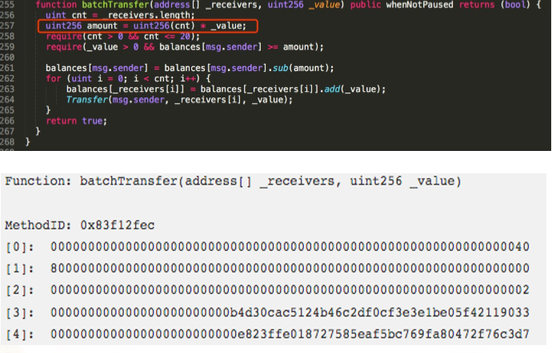
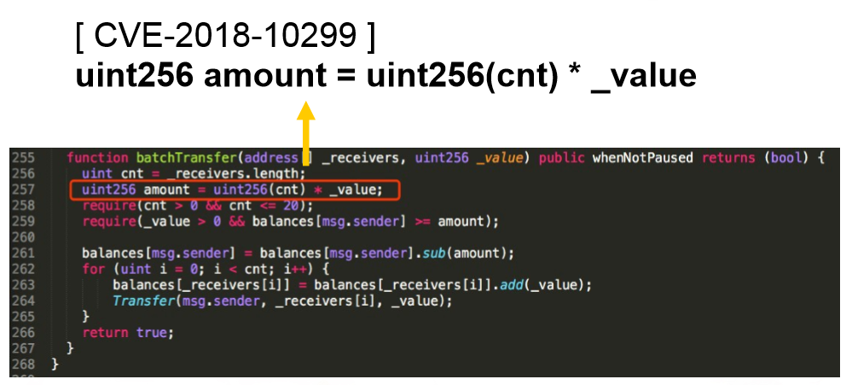
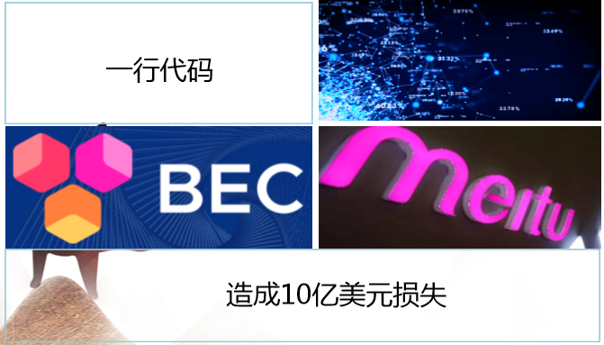
安全事件BEC

Slide 40
安全事件EDU
// 批准转账上限（批准目标可以代我转账的上限）
function approve(address _spender, uint256 _value) public returns (bool success) {
allowed[msg.sender][_spender] = _value;
Approval(msg.sender, _spender, _value);
return true;
}
// 代我转账的流程
function transferFrom(address _from, address _to, uint256 _value) public returns (bool success) {
/// same as above
require(_to != 0x0); // 检测转账对象非空地址
require(balances[_from] >= _value); // 检测被转账者余额大于_value
require(balances[_to] + _value > balances[_to]);
uint previousBalances = balances[_from] + balances[_to];
balances[_from] -= _value;
balances[_to] += _value;
// 减少从被转账者到本交易发起者的允许转账额度，但没有做异常检测，导致报错后继续执行
allowed[_from][msg.sender] -= _value;
Transfer(_from, _to, _value);
assert(balances[_from] + balances[_to] == previousBalances);
return true;
}
曝出合约漏洞之前，EDU的交易K线就已出现了大量抛售的现象。从5月20日午夜开始，大量EDU被人抛售，而持续的抛售带来的则是市场的进一步恐慌，EDU的价格持续走低，直到EDU的交易对被迫关停，期间累计售出的EDU超过20亿。

