Slide 1
Malware Authoring
Nick Anderson
Sometimes Muffins…

Slide 2
Motivation
Sun Tzu – The Art of War
“It is said that if you know your enemies and know yourself, you will not be imperiled in a hundred battles; if you do not know your enemies but do know yourself, you will win one and lose one; if you do not know your enemies nor yourself, you will be imperiled in every single battle.”

Slide 3
Malware Classification
Virus
Self Replicating code, installed in existing user code w/o consent
Worm – Similar, but do not infect existing files
Trojans
Harmful program guised as a legitimate application
Ransomware
Extorts money from victim by encrypting device
Rootkits, Bootkits, …
Designed to provide high levels of stealth for malware
RAT (Backdoor, Remote Admin Toolkit)
Downloader/Dropper
Pull down actual malware and possibly install persistence
…

Slide 4
What this talk is…
Windows User Land
Keystroke Logging
Clear-text Exfill
Very very obvious and detectable to humans
Not so much to AV

Slide 5
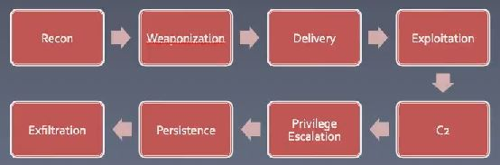
Exploitation Kill Chain

Slide 6

Code
What is your purpose?
Exfill sensitive data
Destruction
Botnet
Shenanigans
How do you accomplish your purpose?
Google
MSDN
StackOverflow
reddit

Slide 7
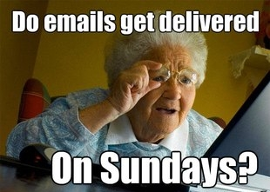
Delivery
0-days
Spear-Phishing
Physical Mediums
This not our focus
Vulnerability Analysis
Bug Hunting

Slide 8
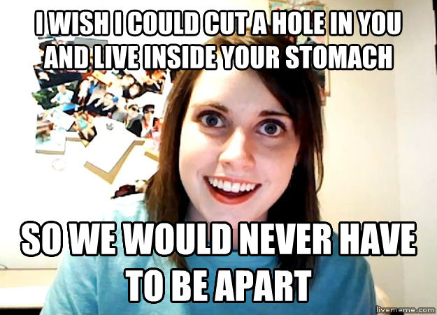
Persistence
Registry Keys
Windows Services
…

Slide 9
Code and Demos and Code.
Let’s sacrifice our virgins to the demo gods, that this demo may work and be successful.
C++ and Python

Slide 10
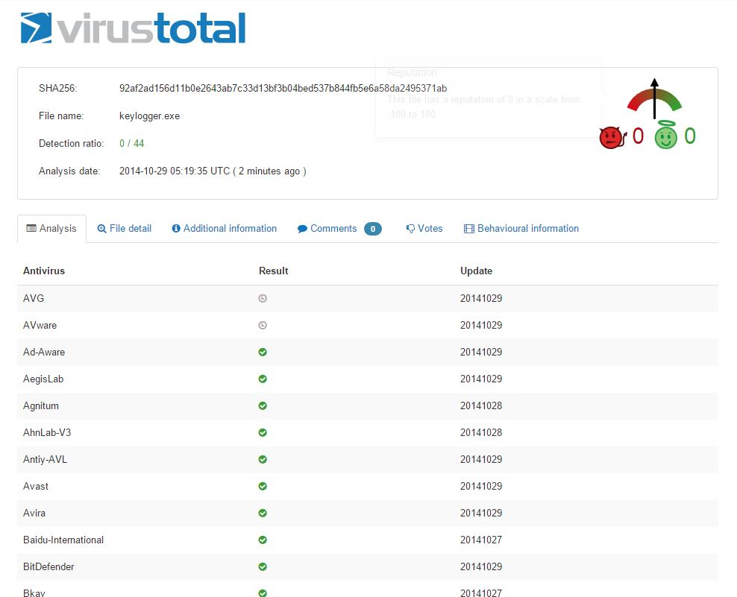
lul-1.

Slide 11
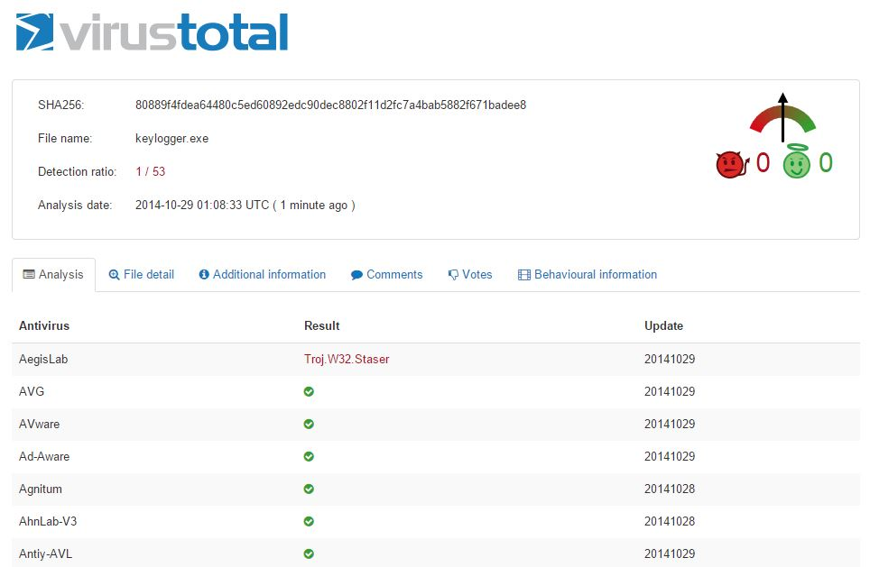
lul-2.
Notes:
Intent. Intent. Intent. This program is comprised of largely innocent and innocuous functionalities, yet with the right intent it’s considered malicious.

Slide 12
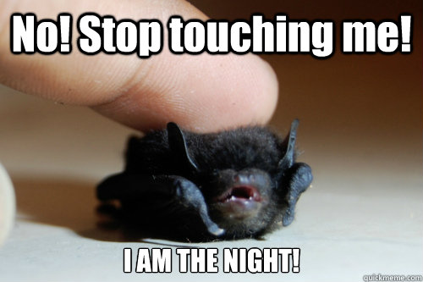
Next Steps
Kernel Level
DKOM – Direct Kernel Object Manip
Hooking
Dll/Process Injection
Third Party rootkits
Why code something when China will do it for you?
Additional Functionality
Imagination!
Encryption
Stealth

Slide 13
Questions?

