Slide 1

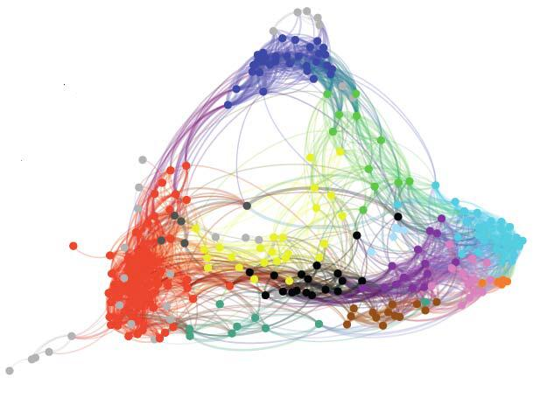
2
Research directions

Slide 2

Key challenges
3D-space: adjustable height and mobility (extra degree of freedom), optimizing continuous trajectory is often intractable
Complexity of environment: locations of users, channel CSI is relevant to UAV’s position
Multiple UAVs: interference management, collision avoidance
More optimization constraints: UAV’s flight time and energy consumption
Coupled optimization variables: UAV’s mobility and QoS metrics
1

Slide 3
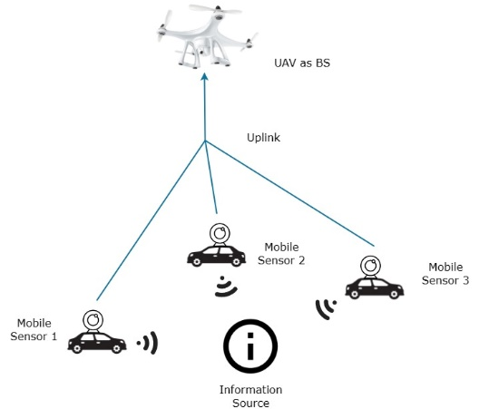
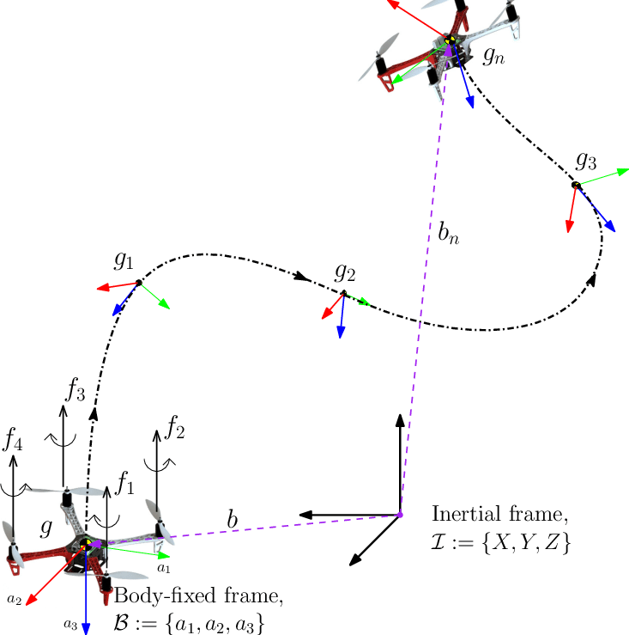
Research directions
UAV deployment
Trajectory optimization
relatively large time scale
relatively small time scale
1
Notes:
deployment问题和trajectory optimization问题的区别：
deployment问题通常关注的是在一段相对长时间内的UAV位置，在一段时间内，UAV被用作固定的基站来服务用户，需要在每个时间段开始前计算好部署UAV的位置，以提高通信质量或者减少能量消耗
但另一方面，轨迹优化问题关注的是UAV每个瞬时的位置，UAV需要在相对较短的时间内调整位置，多个瞬时的位置坐标可以被视为一整段轨迹的近似，通过优化UAV的飞行轨迹来最大化吞吐量或者减少能量消耗

Slide 4
State of the art works
Optimization goals: coverage, sum-rate maximization, BERs, maximize the minimum rate, throughput, minimize transmit power
Intuition: UAV needs to approach the user with poor link quality
Single UAV:
Speed and path planning
Altitudes vs. wireless channels:
Low altitudes: shadowing effect limited, probability of existing LOS links decrease , thus the coverage radius decrease
High altitudes: path loss, high probability that LOS links exist , but the pass loss also increases
Multiple UAVs:
Maximize number of ground users with multiple UAVs
Minimize the number of UAVs to cover all ground users
Co-op with the ground stations: task allocation, UAV as wireless relay
1

Slide 5
Thanks!
. . . .. . . . .. . . . .. . . . .. . .. . . .

