Slide 1
Tutorial on Assignment 2
CS275@ShanghaiTech
2023 Spring

Slide 2
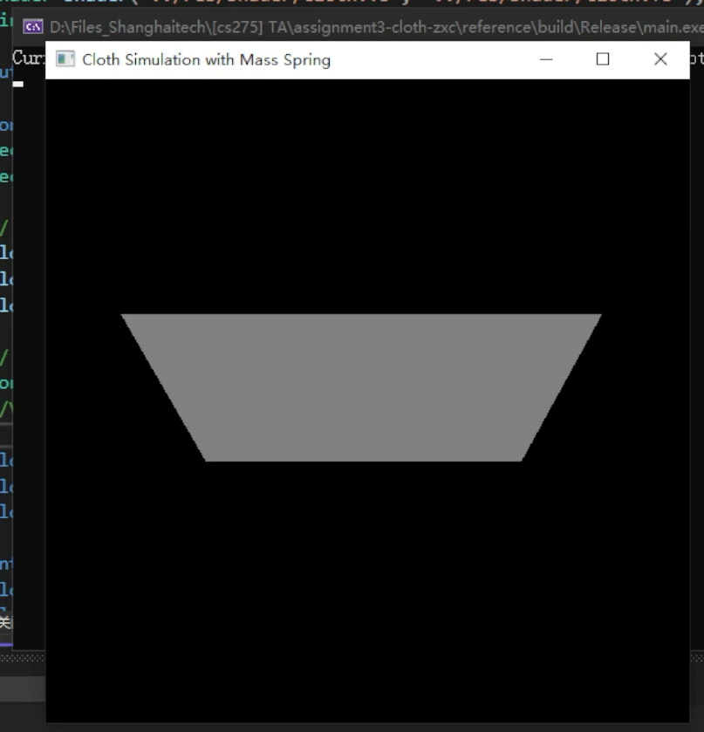
A Quick Glance
Simulate a piece of cloth with the Mass Spring System
Mass Spring Solver
Particle & Spring data structure
Time Integrator
Force
Velocity
Position
Constraint

Slide 3
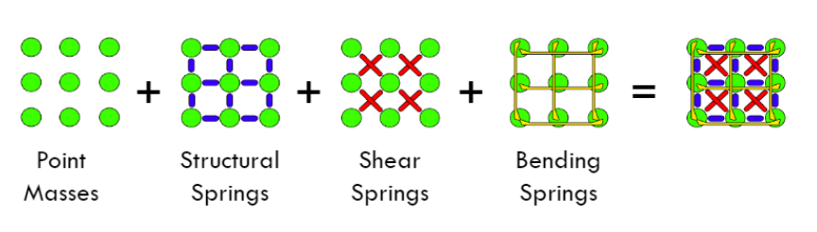
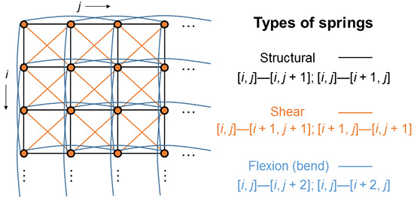
Mass Spring Model

Slide 4

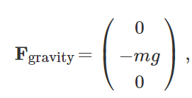

Forces
Spring force
Gravity
Damping force
p
q

Slide 5
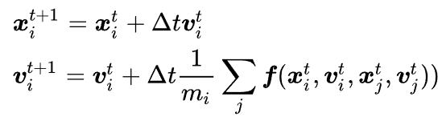
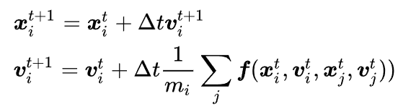
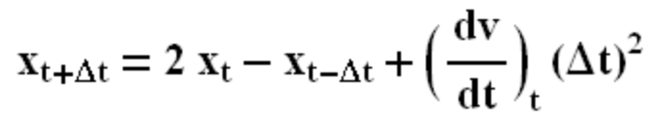
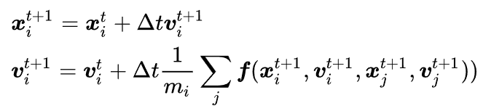
Dynamics Integrator
A good integrator with a small timestep gives stable result
Alternative Integrator
Explicit Euler
Semi-Implicit
Verlet Integration
Implicit Method

Slide 6
Pipeline
Initialize spring
In each time step
Compute and apply spring to particle force
Apply gravity
Apply damping
Update particle velocity
Update particle position
Apply constraints

Slide 7
Empirical Parameters
4m x 3m cloth
40 x 30 particles
Total mass: 1kg
larger mass -> more stable
Stiffness: 50.0
smaller stiffness -> more stable
Timestep 0.002s
smaller timestep -> more stable

Slide 8
Q & A

