Slide 1


A presentation by
Neuland Ingolstadt e.V.
09.12.2023

Slide 2
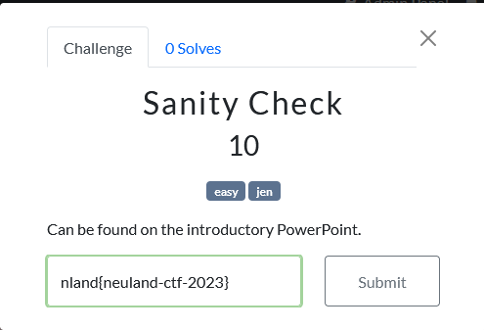
Neuland CTF
Solved puzzles/vulnerabilities exploited → “flags”
“Flag” → Points
Team with the most points wins
Flag format: nland{<flag>}
MISC
Steganography
Cryptography
Blue Team
Open Source Intelligence
PWN
Reverse Engineering
Web

Slide 3
neuland-ctf-2023
Neuland CTF
It is strictly forbidden to perform any kind of Denial of Service or any other unwanted actions against the servers or associated infrastructure.
Do not try to brute force the flag submission system.
Do not perform any unwanted actions against other teams/members.
Do not try to exchange flags/write-ups/hints of the challenges during the competition with other teams participating or to other external entities.
Do not distribute the content of the CTF (the challenges) to third party entities for help.
All teams must be consisted with maximum 3 members.
Any violation of these terms will automatically disqualify the player from the competition.

Slide 4
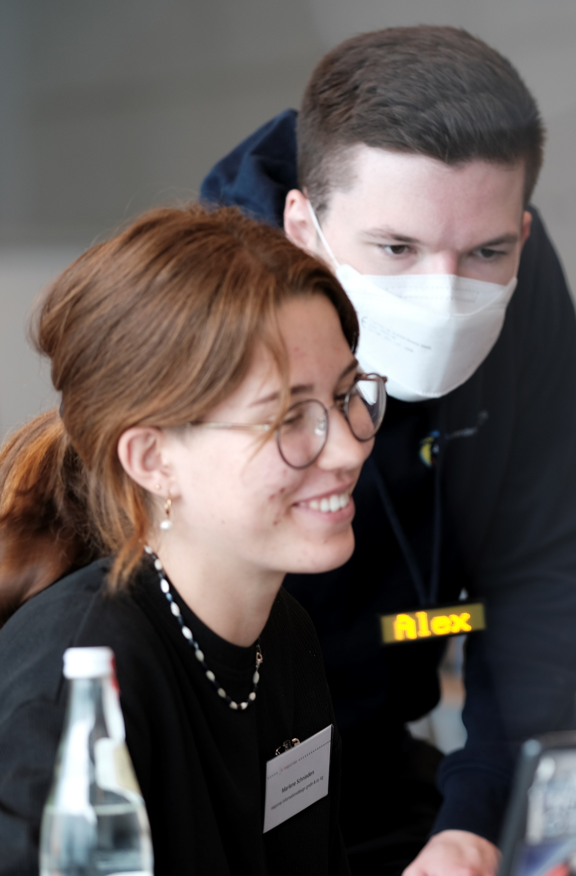
Prices
1. Team: 250 €
2. Team: 150 €
3. Team: 100 €
4. & 5. Team: 15 € Voucher per team member

Slide 5
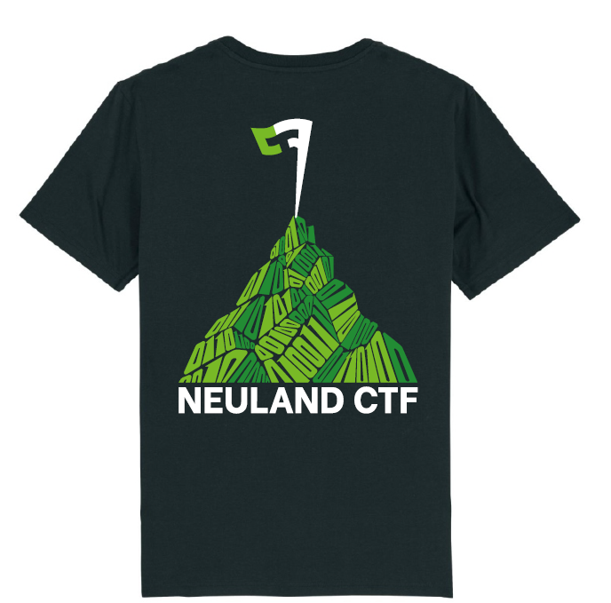
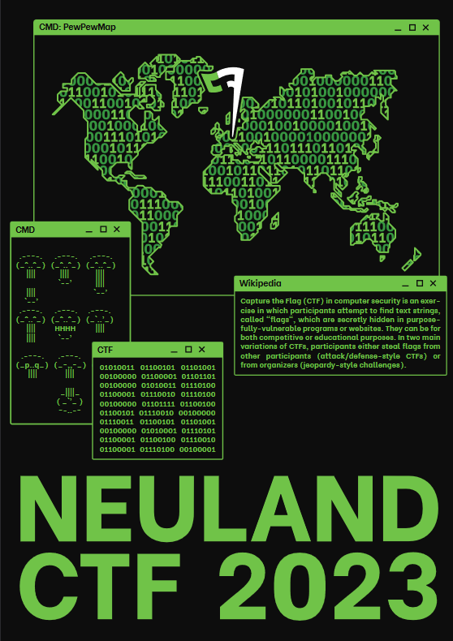
T-Shirts & Merch
More details by e-mail after the CTF
Stickers and Merch

Slide 6

Time schedule
10:30 - 11:00 Uhr Welcome, Introduction
11:00 - 19:00 Uhr CTF competition
13:00 Uhr Pizzatime
19:00 - 21:00 Uhr Get Together and Food

Slide 7




CTF sponsors

Slide 8
CTF sponsors

Slide 9
CTF sponsors

Slide 10
CTF sponsors

Slide 11
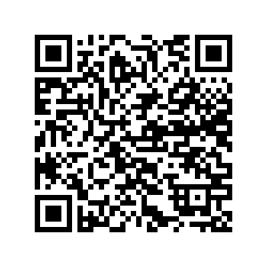
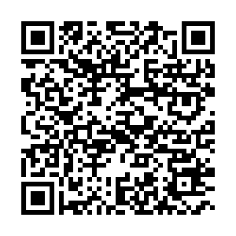
CTF sponsors
Working student software development
Junior Java Developer
Junior IT consultant digitization

Slide 12
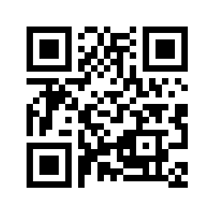
CTFd
nland{neuland-ctf-2023}
Capture The Flag platform for the event
https://ctfd.informatik.sexy/

Slide 13
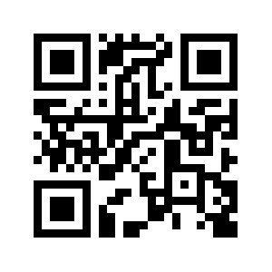
Blogpost
Writeups
https://0xffd700.com/

Slide 14
Blogpost
Writeups
https://0xffd700.com/

