Slide 1

InnerLoop
Privacy‑First Voice‑Assisted Personal Pattern Intelligence
Discover the hidden loops between money, time, and mood — without sending personal life data to a cloud AI.
Bangla / Banglish voice input
Local browser AI
Personal pattern discovery
01

Slide 2

The daily-life data problem
Three signals move together, but users see them separately.
People remember the outcome, not the pattern.
৳ 500 disappears in small purchases before the user knows where it went.
Time slips into scrolling, travel, waiting and unplanned breaks.
Mood changes are recorded late — after triggers become unclear.
Existing tools answer “what happened?” InnerLoop asks “what keeps repeating?”
02

Slide 3
Market gap: tools are powerful, but siloed
Finance, time, and mood products rarely explain cross-domain relationships.
Finance trackers
show spend categories
Time trackers
show apps & focus
Mood journals
show emotions & habits
Personal analytics
needs integrations
The missing layer
A privacy‑first engine that connects daily spending, activity, and mood into personal loops.
Capture
Connect
Change
Sources: Daylio official features, RescueTime official features, Monva official site, Exist official site.
03

Slide 4
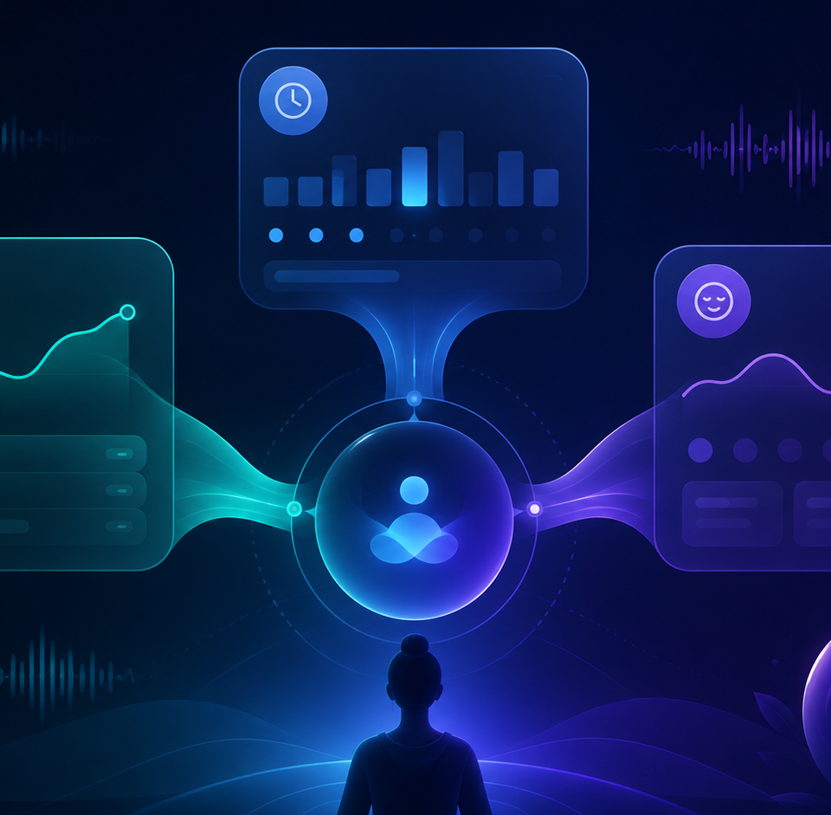
The solution: voice-assisted pattern intelligence
Designed for low-friction capture, local processing, and explainable insight.
1
Speak
“Rickshaw 120, studied 2 hours, mood low.”
2
Confirm
User edits before saving — no silent AI decisions.
3
Learn
Baseline and anomaly engine uses personal history.
4
Explain
Shows observed loops with count and confidence.
04

Slide 5
Product experience: from diary to decision
Five features make it more than a tracker.
1. Guided voice entry
Expense / Time / Mood modes reduce recognition errors.
2. Structured extraction
Amount, category, duration, mood and trigger become editable records.
3. Personal baseline
Compares the user with their own normal, not generic advice.
4. Life Loop discovery
Finds repeated event sequences across spending, time and mood.
5. Experiment Lab
Before/after comparisons for small behaviour experiments.
Winning demo moment: switch Wi‑Fi off, capture a short voice log, and show a loop generated from historical demo data.
05

Slide 6

Technical architecture: local-first AI in the browser
No paid AI API. Personal records stay on the user’s device.
Voice recorder
Browser microphone + short guided commands
Speech model
Transformers.js Whisper model in Web Worker
Classifier
Custom ONNX category model
Local store
IndexedDB / Dexie for private records
Insight engine
Baseline, anomaly and loop analysis
Technical references: Transformers.js supports in-browser models; ONNX Runtime Web supports browser inference; MDN notes Web Speech Recognition may rely on server engines in some browsers.
06

Slide 7
Benchmark analysis: prove the AI is feasible
We benchmark the risky parts before claiming accuracy.
Benchmark
Metric
Acceptance target
Speech recognition
Word error rate + latency
Short commands under 10–15s
Category classifier
F1-score by class
≥80% on voice transcript test set
Browser performance
Load time + memory
Works on Chrome/Edge mid-range laptop
Pattern engine
Observed count + confidence
No insight below minimum data threshold
Benchmark dataset design
Clean typed text + noisy voice transcripts + Banglish variations. This prevents a demo that only works on perfect examples.
07

Slide 8
Competitor analysis
InnerLoop wins by combining three categories, not by replacing them.
Product
Primary focus
Voice / capture
Cross-domain patterns
Local-first privacy
Daylio
Mood journal + stats
Manual journal
Mood/activity correlations
App lock
RescueTime
Time tracking + focus
Automatic app tracking
Productivity patterns
Cloud/account-based
Monva / Nami
Finance tracking
Voice / scan options
Spending insights
Offline-first finance
Exist
Personal analytics
Integrations
Correlation engine
Integration-dependent
InnerLoop
Money + time + mood
Bangla/Banglish guided voice
Life Loop sequences
Browser-local by design
Positioning: InnerLoop is not “another tracker”; it is a privacy‑first relationship engine across personal life signals.
Sources: Daylio, RescueTime, Monva/Nami, Exist official feature pages.
08

Slide 9
Why it can stand out at project show
Strong demo + measurable AI + privacy engineering.
Differentiation
Money, time and mood are analyzed together, then shown as repeated loops.
Trust design
AI extraction is never auto-saved; user confirms before storage.
Security angle
Local IndexedDB, encrypted export, no ad SDK, no paid cloud AI API.
Ethical boundary
No depression diagnosis; insights are associations with observation count.
Faculty-friendly claim
“We are not building a medical app or a generic tracker. We are engineering a local-first personal pattern discovery system.”
09

Slide 10
12-week MVP roadmap
A controlled build path that de-risks AI early.
Weeks 1–2
Manual records + local database + clean dashboard
Weeks 3–4
Voice capture + transcript pipeline benchmark
Weeks 5–6
Bangla/Banglish dataset + custom classifier
Weeks 7–8
Baseline, anomaly and loop engine
Weeks 9–10
Experiment Lab + privacy controls
Weeks 11–12
Testing, polish, demo data and project-show story
MVP exit criteria: voice log → confirmed record → personal baseline → loop insight → experiment comparison.
10

Slide 11
References used for competitor and technical framing
Official product and technology documentation.
Daylio
daylio.net — mood journal, goals, stats, app lock
RescueTime
rescuetime.com/features — automatic time tracking, focus, reports
Monva / Nami
monva.app and nami.lt — finance tracking, voice input, offline-first claims
Transformers.js
huggingface.co/docs/transformers.js — browser ML / speech tasks
ONNX Runtime Web
onnxruntime.ai/docs — browser inference support
MDN Web Speech
developer.mozilla.org — browser speech recognition limitations
Generated visual assets were created specifically for this deck to represent the product concept.
11

