Slide 1
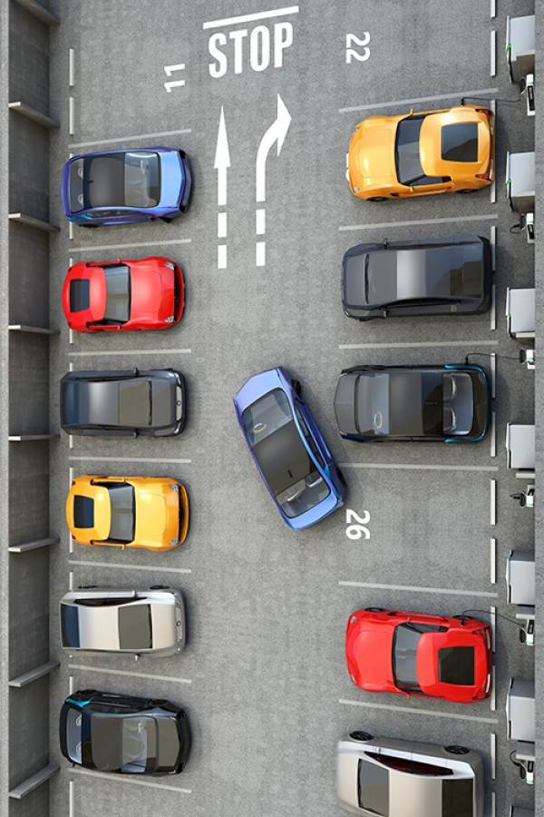
IMAGE
Dhaka traffic / roadside
parking photo
PARKEASE BD
A Shared Parking Platform to Ease Dhaka's Traffic Congestion
Research / Project Proposal Presentation

Slide 2
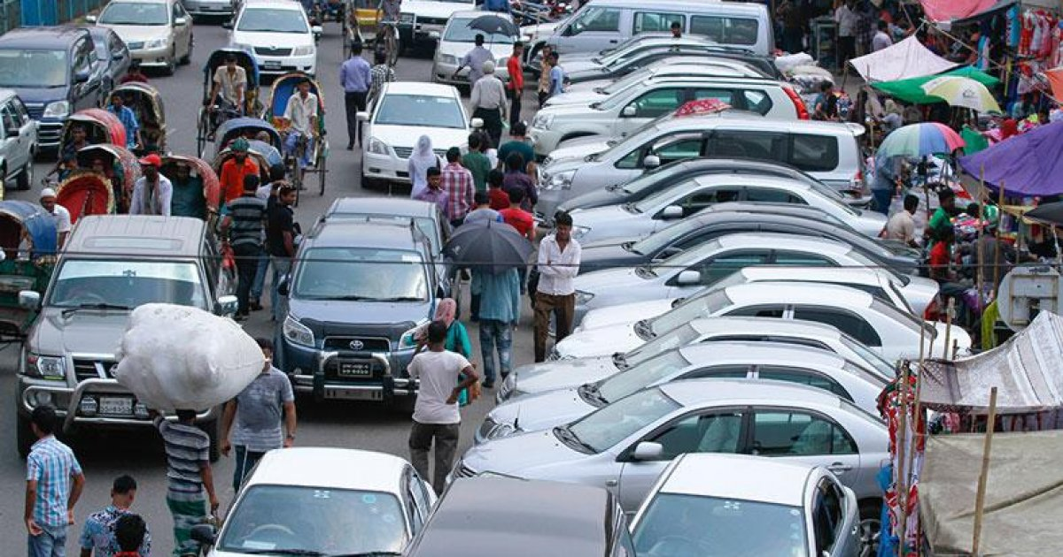
The Problem
Dhaka faces severe traffic congestion, worsened by vehicles parked on roads near malls, hospitals, offices, and educational institutions.
A large number of residential parking spaces sit unused during the day while residents are at work or elsewhere.
This creates a mismatch: private parking capacity goes to waste while daytime demand near commercial areas stays high.
A digital platform can connect property owners with drivers, cut roadside parking, and better use existing urban infrastructure.
ParkEase BD
2

Slide 3
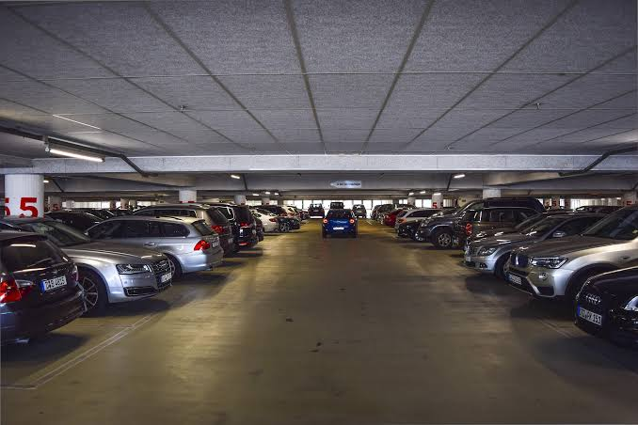
Proposed Solution
ParkEase BD is a location-based shared parking platform that lets residential property owners and building managers rent out unused parking spaces by the hour.
IMAGE
App / parking-space
concept image
1
Drivers search for available parking near their destination
2
Compare rates and facilities, then reserve a time slot
3
Platform manages conflicts, entry/exit verification, overtime, cancellations, and owner earnings
Goal: convert unused private parking into bookable daytime parking, reducing illegal roadside parking and improving accessibility.
ParkEase BD
3

Slide 4
Target Users
1
2
3
4
5
Property Owners
Building Managers
Drivers
Security Guards
Small Businesses
Residential owners with unused daytime parking spaces
Manage shared parking areas in apartments/buildings
Private-car and motorcycle drivers visiting hospitals, offices, malls, universities
Verify vehicle entry and exit at parking sites
Need temporary parking for visitors or employees
ParkEase BD
4

Slide 5
Who Benefits?
Property Owners & Managers
Vehicle Owners & Drivers
Earn extra income from spaces that often stay unused during the day
Get secure, reserved parking near their destination without wasting time
Security & Building Staff
General Public & The Nation
Take on added responsibility, potentially justifying better pay
Less roadside parking, reduced congestion, smoother movement in the city
ParkEase BD
5

Slide 6
Core Features
Priority 1 – 3
1
Time-Slot-Based Parking Listing
Owners list spaces with location, photos, vehicle-size support, hourly price, hours, and available slots; can disable/update availability anytime.
2
Nearby Parking Discovery & Reservation
Drivers search by location, destination, vehicle type, price, and availability; system prevents double-booking of overlapping time slots.
3
Secure Entry & Exit Verification
A temporary QR code or one-time code is verified by security staff at entry and exit, ensuring only the authorized vehicle uses the space.
ParkEase BD
6

Slide 7
Core Features
Priority 4 – 5
4
Overstay, Cancellation & No-Show Management
Calculates extra charges for overstaying, notifies driver and owner before expiry, and applies configurable cancellation, grace-period, refund, and no-show rules.
5
Owner Earnings & Platform Settlement
Dashboard shows completed bookings, occupied hours, earnings, penalties, and commission, with a transparent ledger and weekly/monthly summaries.
ParkEase BD
7

Slide 8
Technology Stack
Layer | Technology
Backend | Node.js, Express.js, TypeScript
Frontend | Next.js, React, TypeScript, Tailwind CSS
Database | PostgreSQL with Prisma ORM
Maps & Location | OpenStreetMap + Leaflet
Real-Time Updates | Socket.IO
Auth & Security | JWT, refresh tokens, bcrypt, RBAC
Container / VCS | Docker, Git + GitHub
ParkEase BD
8

Slide 9
Feasibility Analysis
Can this realistically be built and run this semester?
1
2
3
4
5
Technical
Economic
Operational
Legal
Schedule
Proven stack (Node.js, Next.js, PostgreSQL);
Main risk is conflict-safe booking logic.
Near-zero build cost; open-source tools and a simulated wallet this phase.
Feasible at pilot scale;
Depends on owner and guard adoption.
Low risk this semester — no public roads, no real payments yet.
Achievable in a typical 12 weeks semester, phased by feature.
Overall: feasible as a semester project; a commercial rollout would need real payments and a funded adoption plan.
ParkEase BD
10

Slide 10
SWOT Analysis
Strengths
Weaknesses
Targets a real, well-documented Dhaka congestion problem
Free/open-source stack keeps build cost near zero
Clear niche: unused residential daytime parking
No real payment integration this semester
Verification relies on guard compliance, not hardware
No existing user base or marketing budget
Opportunities
Threats
DNCC's own Smart Parking app shows market readiness
Rising mobile-banking use enables future payments
Residential inventory is far larger than on-street spaces
City corporation could expand its own app's coverage
A funded entrant could copy the model faster
Owners may be wary of granting stranger access
ParkEase BD
11

Slide 11
Competitor Analysis
ParkEase BD against the four parking apps already operating in Bangladesh
 | ParkEase BD | Parking Koi | DNCC Smart Parking | Yes Parking | DG Parking
Market | Dhaka, residential daytime | Dhaka, Ctg, Sylhet | Dhaka (Gulshan), on-street | Partner venues (e.g. museum) | Garages / institutions (B2B)
Space source | Private residential owners | Private homes, garages, yards | City-run street spaces | Venue's own parking lot | N/A — software for operators
Verification | QR / one-time code, guard | Host / field-agent managed | App tied to plate / zone | App booking + on-site agents | Digital entry/exit log
Revenue model | Commission (planned) | Profit-sharing with hosts | Government-run, no fee | Per-visit parking fee | B2B software licence
Sources: Daily Star, TBS, Dhaka Tribune, Prothom Alo, Future Startup, and each app's Google Play listing.
ParkEase BD
12

Slide 12
Benchmark Analysis
Feature-by-feature comparison against the closest reference products
Feature | ParkEase BD | Parking Koi | DNCC Smart Parking | Yes Parking | DG Parking
Time-slot based reservation | Yes | Yes (hourly/monthly) | Partial | Yes | No
Residential / private listings | Yes | Yes | No | No | No
Overstay & cancellation rules | Yes | Not published | Tiered fee | Not published | N/A
Owner / host earnings view | Yes | Yes (host payouts) | N/A | N/A | Operator reports only
Real payment gateway | No (simulated) | Yes | Yes | Yes | N/A (logs only)
Live in Dhaka today | Pilot / proposed | Yes, since 2018 | Yes (Gulshan pilot) | Yes, select venues | Yes (B2B tool)
ParkEase BD leads on residential listings and owner-earnings transparency; Parking Koi is the closest functional match but relies on manual host/agent management, and DG Parking serves operators rather than drivers.
ParkEase BD
13

Slide 13

IMAGE
Parking area / skyline
image
Thank You
Questions & Discussion
ParkEase BD — Turning unused parking into a solution for Dhaka's streets

