Slide 1
AWS
EC2
CADVISOR
DOCKER
FRONTEND – SUBNET 10.0.1.0/24
BACKEND – SUBNET 10.0.2.0/24
Traefik – PORT 80
NGINX
NGINX
NGINX
NGINX
Adminer – PORT 8085
PostgresSQL
API FastAPI – PORT 8081
node-exporter
CADVISOR
Grafana – PORT 3000
REDIS
PROMETHEUS

Slide 2

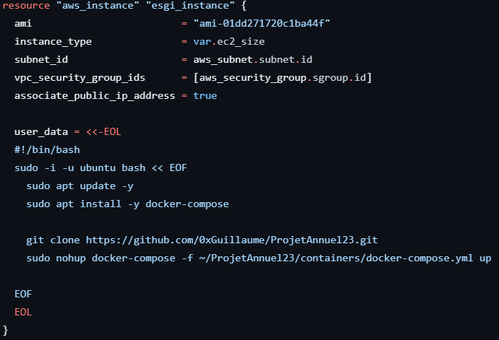
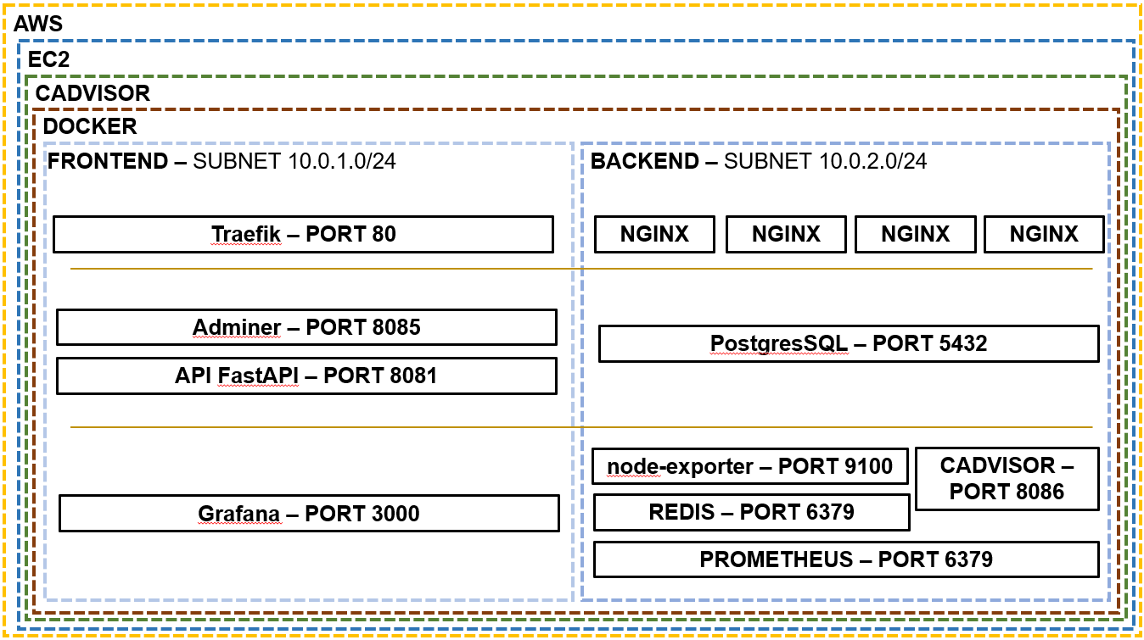
TERRAFORM

Slide 3
