Slide 1
AWS
EC2
CADVISOR
DOCKER
FRONTEND – SUBNET 10.0.1.0/24
BACKEND – SUBNET 10.0.2.0/24
Traefik – PORT 80
NGINX
NGINX
NGINX
NGINX
Adminer – PORT 8085
PostgresSQL – PORT 5432
API FastAPI – PORT 8081
node-exporter – PORT 9100
CADVISOR – PORT 8086
Grafana – PORT 3000
REDIS – PORT 6379
PROMETHEUS – PORT 6379

Slide 2

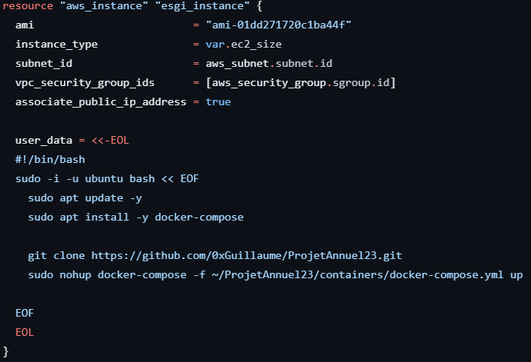
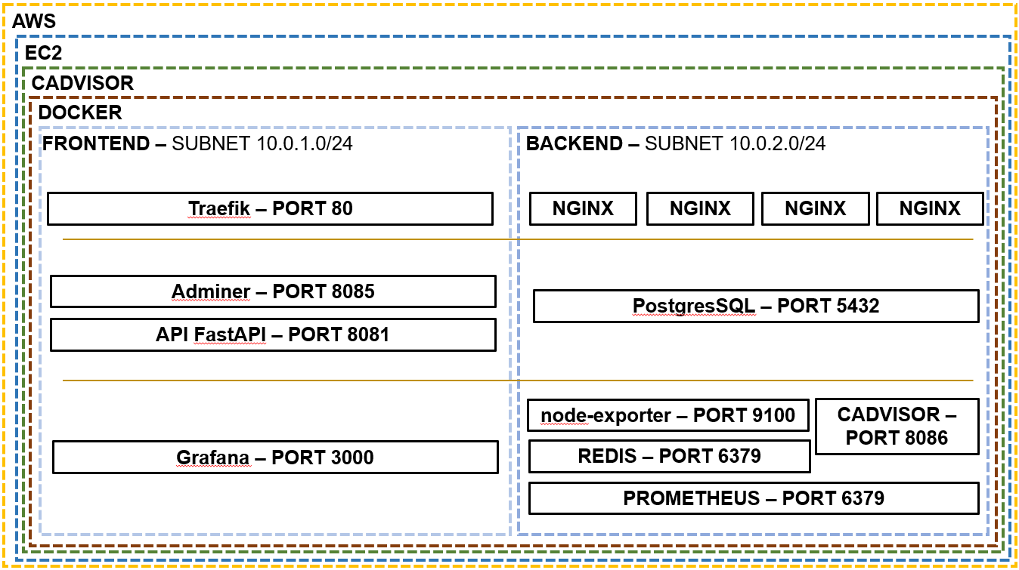
TERRAFORM

Slide 3
