Slide 1
Digital Forensics
Intro & Essentials
Mohammed Hassan

Slide 2
Table of Content
What is Digital forensics?
Why do we need it?
When can someone start learning it?
Demo
Where DFIR analysts work?
How to learn it (resources)?
Mohammed Hasan

Slide 3
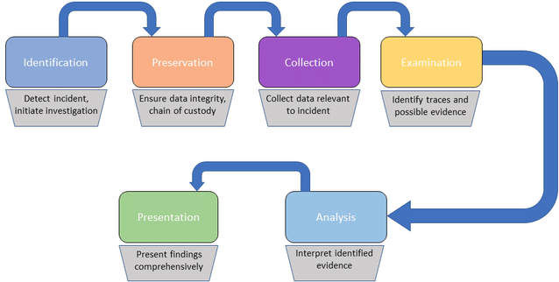
What is Digital forensics?
Mohammed Hasan

Slide 4
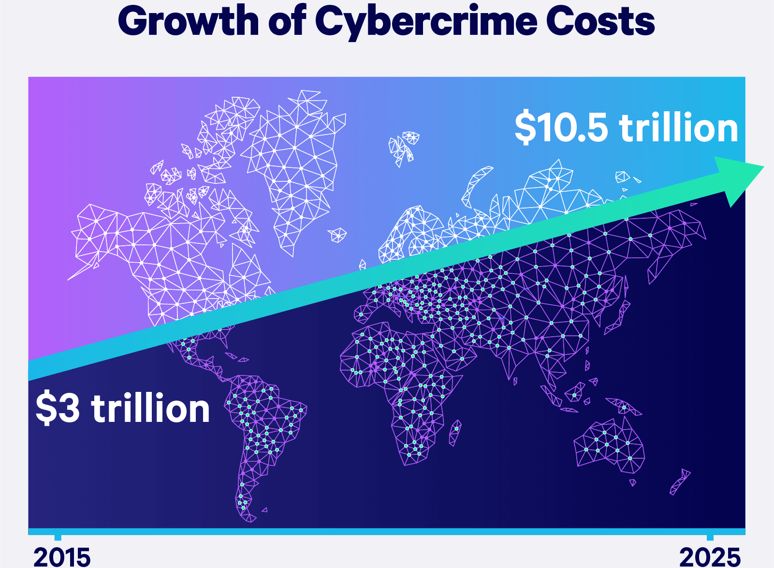
Why do we need it?
Identifying the cause and possible intent of a cyberattack
Mohammed Hasan

Slide 5
Why do we need it?
Increasing security hygiene, retracing hacker steps, and finding hacker tools
Searching for data access/exfiltration
Identifying Areas of Weakness and Vulnerabilities
Mohammed Hasan

Slide 6
When can someone start learning it?
Soft Skills
Cognitive mindset
Technical Skills
Network
Oses internals and structure
Documents (PDF, DOC, XLS) structure
Scripting
Mohammed Hasan

Slide 7
Demo
Network -> Wireshark
Disk image -> arsenalimagemounter & FTK
Memory -> volatility & BelkaSoft
Malicious document -> PDFStreamDumper & OLEtools
Mohammed Hasan

Slide 8
Where DFIR analysts work?
Financial service organizations – such as banks and accountancy firms.
Forensic computing companies and consultancies.
Government agencies and departments – both national and regional.
Government intelligence services – for instance, Government Communications Headquarters (GCHQ) in the Uk.
IT and telecommunications companies.
Police forces and law enforcement agencies – such as the National Crime Agency (NCA).
The public sector – including the health sector.
Mohammed Hasan

Slide 9
How to learn it (resources)?
Practicing (https://training.dfirdiva.com/listing-category/dfir-blue-team-ctfs)
99% of CTFs != What DFIR analyst really do.
Books & Courses
SANS roadmap: www.sans.org/cyber-security-skills-roadmap/
Incident response and digital forensics book
Introductory computer forensics: a hands on practical approach book
Experts to follow
@binaryz0ne, @phillmoore, @attrc, @DFIRScience, @DidierStevens
Mohammed Hasan

Slide 10

Thanks for Watching
Contact: 0xMohamedHasan
Mohammed Hasan

