Slide 1
Digital Forensics
Intro & Essentials
Mohammed Hassan

Slide 2
Table of Content
What is Digital forensics?
Why do we need it?
When can someone start learning it?
Demo
Where DFIR analysts work?
How to learn it (resources)?
Q & A
Mohammed Hasan

Slide 3
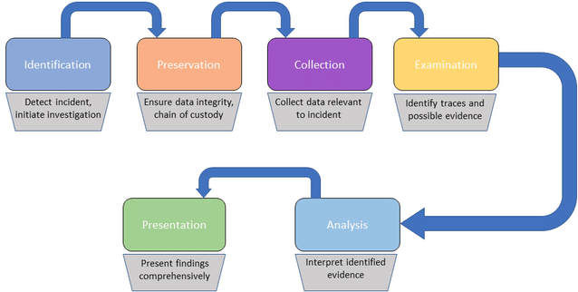
What is Digital forensics?
Mohammed Hasan

Slide 4
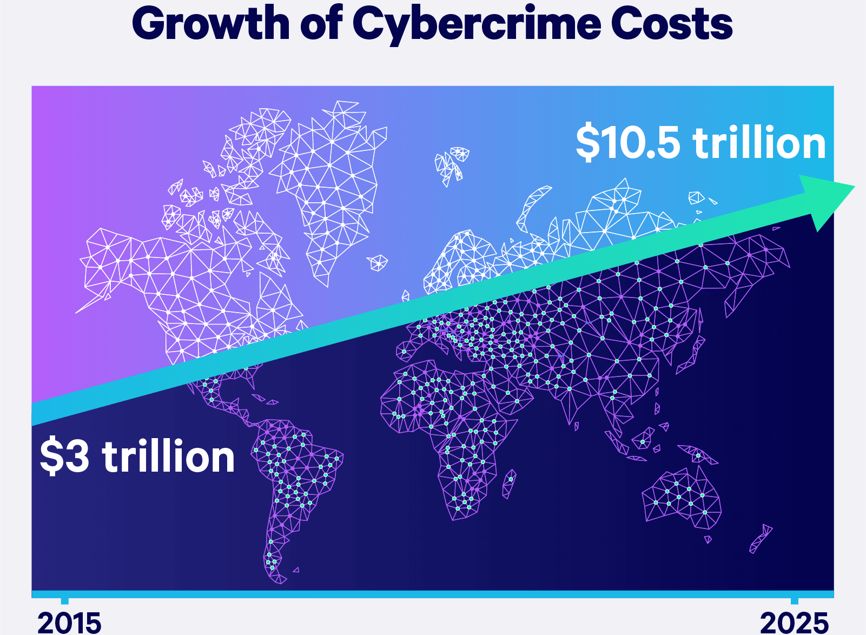
Why do we need it?
Identifying the cause and possible intent of a cyberattack
Mohammed Hasan

Slide 5
Why do we need it?
Increasing security hygiene, retracing hacker steps, and finding hacker tools
Searching for data access/exfiltration
Identifying Areas of Weakness and Vulnerabilities
Mohammed Hasan

Slide 6
When can someone start learning it?
Soft Skills
Cognitive mindset
Technical Skills
Network
Oses internals and structure
Documents (PDF, DOC, XLS) structure
Scripting
Mohammed Hasan

Slide 7
Demo
Network -> Wireshark
Disk image -> arsenalimagemounter & FTK
Memory -> volatility & BelkaSoft
Malicious document -> PDFStreamDumper & OLEtools
Mohammed Hasan

Slide 8
Where DFIR analysts work?
Financial service organizations – such as banks and accountancy firms.
Forensic computing companies and consultancies.
Government agencies and departments – both national and regional.
Government intelligence services – for instance, Government Communications Headquarters (GCHQ) in the Uk.
IT and telecommunications companies.
Police forces and law enforcement agencies – such as the National Crime Agency (NCA).
The public sector – including the health sector.
Mohammed Hasan

Slide 9
How to learn it (resources)?
Practicing (https://training.dfirdiva.com/listing-category/dfir-blue-team-ctfs)
99% of CTFs != What DFIR analyst really do.
Books & Courses
SANS roadmap: www.sans.org/cyber-security-skills-roadmap/
Incident response and digital forensics book
Introductory computer forensics: a hands on practical approach book
Experts to follow
@binaryz0ne, @phillmoore, @attrc, @DFIRScience, @DidierStevens
Mohammed Hasan

Slide 10

Thanks for Watching
Contact: 0xMohamedHasan
Mohammed Hasan

