Slide 1
Digital Forensics & Incident Response
Windows DFIR | EventLogs
Mohammed Hasan

Slide 2
Windows EventLogs
Evt (XP/2003) & Evtx (Vista/7/8/8.1/10)
Evtx Format
Analyzing
Auditing
Mohammed Hasan

Slide 3
Evtx format
evtx files (Windows/system32/winevvt/logs)
Evtx header
chunck header
Records (Event) xml structure
Mohammed Hasan

Slide 4
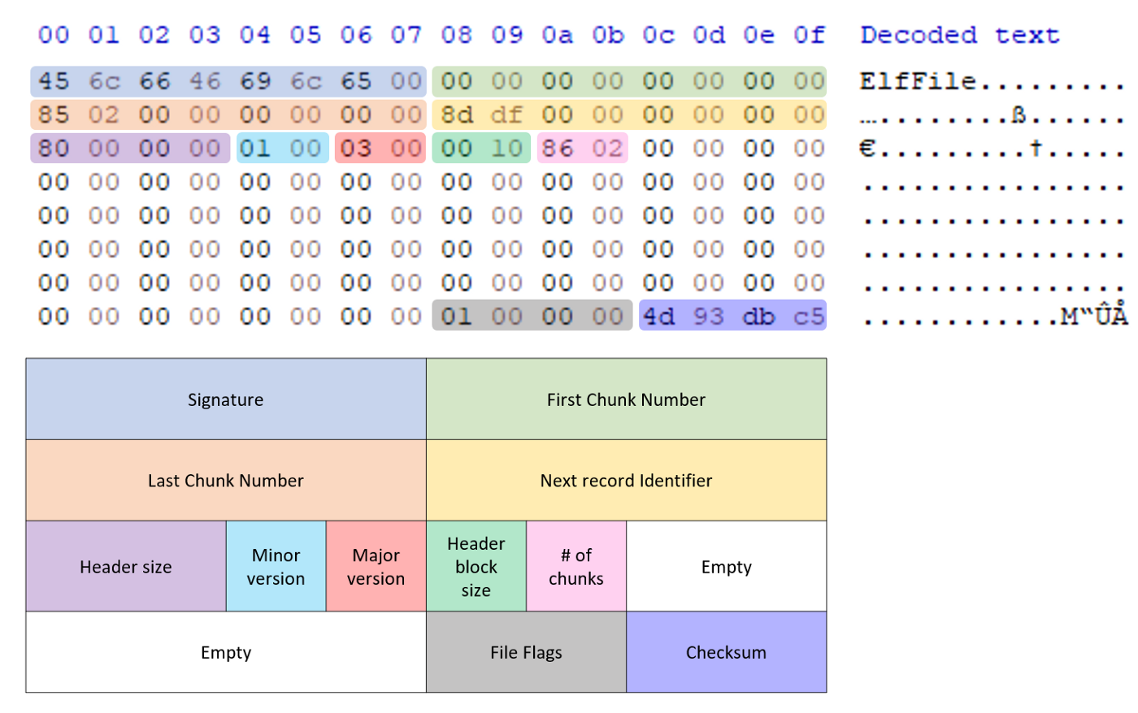
Evtx header
Source: @svch0st
Mohammed Hasan

Slide 5
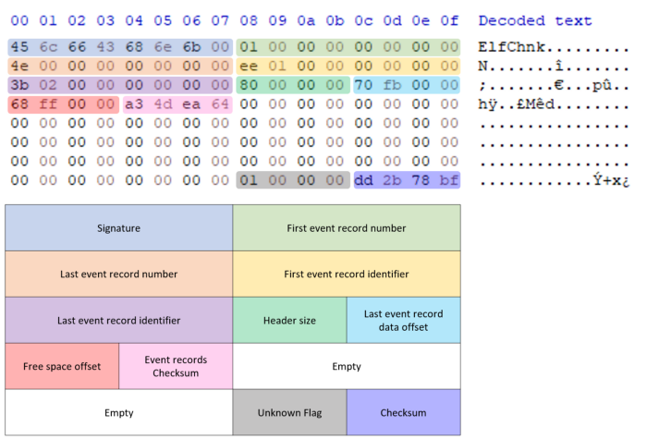
Chunk header
Source: @svch0st
Mohammed Hasan

Slide 6
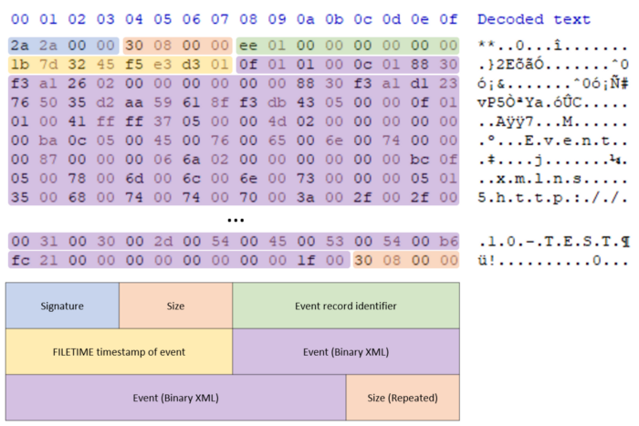
Records (Event) xml structure
Source: @svch0st
Mohammed Hasan

Slide 7
Eventlogs analysis tool
EventLog explorer
NirSoft EventLog view
Evtx (Linux)
Mohammed Hasan

Slide 8
Eventlogs auditing
Microsoft audit recommendations
CheatSheets
Sysmon
Mohammed Hasan

Slide 9

Thanks for Watching
Contact: 0xHasanM
Mohammed Hasan

