Slide 1



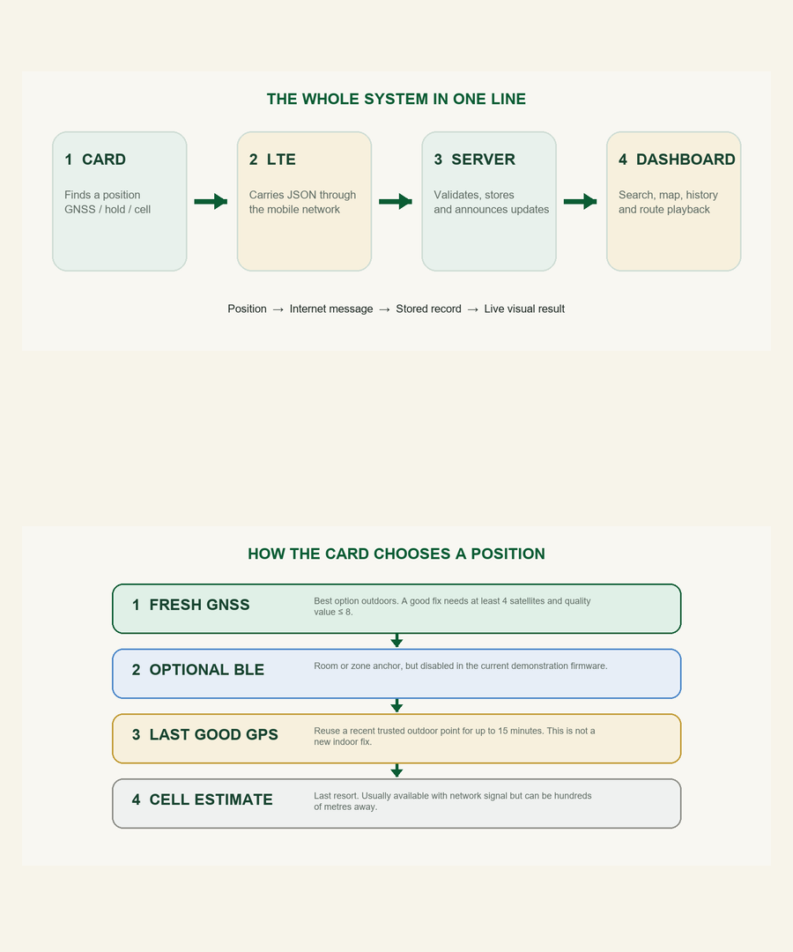
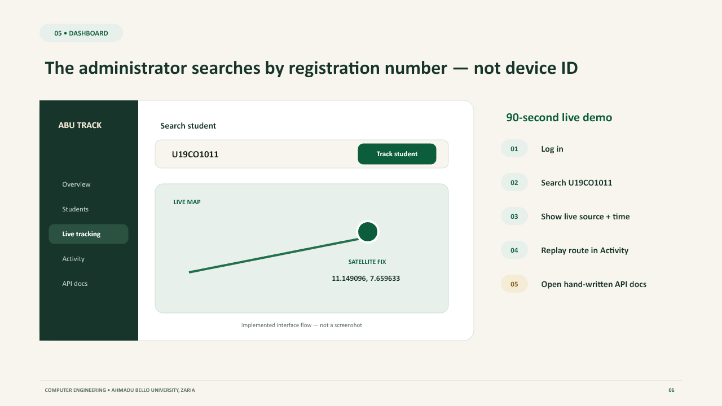
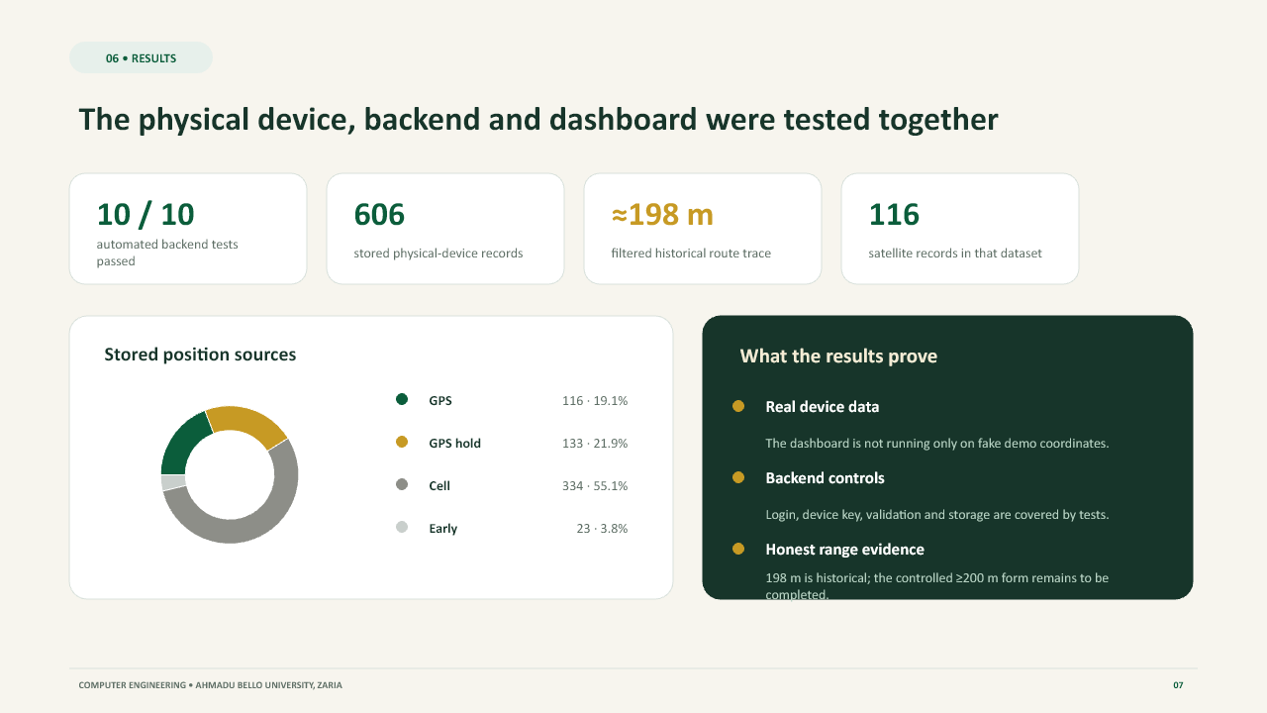
DESIGN AND IMPLEMENTATION OF A TRACKABLE STUDENT IDENTIFICATION CARD SYSTEM
Department of Computer Engineering, Faculty of Engineering,
Ahmadu Bello University, Zaria, Kaduna State, Nigeria
Student: DELIGHT IWORIMA (U19CO1011) Supervisor: Engr. Momoh
Abstract
This project presents the design and implementation of a portable student identification card that reports its position to an authorised university dashboard. The prototype uses a LilyGO T-A7670E board containing an ESP32 controller, A7670E 4G modem, GNSS receiver, SIM interface and charging circuit. Firmware obtains a fresh satellite position when available, temporarily reuses a recent trusted fix when the student enters a building, and uses a clearly labelled cell-tower estimate as a last resort. Each report is sent through the mobile network to a Flask backend, authenticated, validated and stored in SQLite. Flask-SocketIO updates the dashboard in real time. Staff can search by registration number, view the student on a map, inspect recent locations, replay a recorded route and review speed, distance and activity history. Physical-device tests produced 621 stored reports, 116 satellite fixes and a filtered 198 m route trace.
Introduction
Methodology
Results
Most student ID cards prove identity but cannot report location during emergencies, field exercises or controlled demonstrations. Phone tracking depends on the student's phone, permissions and battery, while Bluetooth-only solutions have short range. This project therefore combines identification and independent location reporting in one prototype. A single LilyGO T-A7670E board reduces wiring: its ESP32 runs the firmware while the A7670E provides LTE data and built-in GNSS. External LTE and GNSS antennas provide reception. The design labels every source honestly: satellite positions are GPS, recent trusted positions are GPS hold, and tower estimates are cell. The prototype proves the complete system, but it is not yet a wallet-sized commercial card. A custom PCB, measured enclosure, consent controls and indoor anchors remain future work.
Data flow: card position → LTE/Internet → Flask API → SQLite → live dashboard.
The implemented system demonstrated:
MTN LTE registration and authenticated reporting through ngrok.
621 stored readings: 116 GPS, 133 GPS hold, 349 cell and 23 legacy.
A 198 m GPS-only route after applying a 10 m jitter filter.
Repeated HTTP 200 responses and live dashboard updates.
Twelve passing automated backend tests.
ADMINISTRATOR DASHBOARD
Potential for Campus Deployment
With consent and university policy, the system could support field trips, laboratory safety, transport operations, emergency response and recovery of institution-owned ID cards. Administrators search by registration number, while the backend can be extended from one prototype to many registered cards. Real deployment requires restricted staff access, student consent, retention limits and audit logs. A custom PCB would reduce size, thickness and power consumption.
Innovation and Creativity
MEASURED SYSTEM RESULTS
One integrated board combines ESP32 control, 4G communication, GNSS, SIM support and battery charging, greatly reducing external wiring.
A transparent position hierarchy uses fresh GPS first, a time-limited saved fix second and labelled cell-tower estimation last; coarse data is never presented as satellite accuracy.
The complete path is demonstrated end-to-end: authenticated reports, validation, SQLite storage, live Socket.IO updates, registration-number search, recent locations and GPS-only route playback.
Conclusion
The prototype demonstrates a complete trackable student ID system using one portable device, the mobile network and a university-styled web dashboard. The physical card successfully sent authenticated location reports to the Flask backend, which stored and displayed them in real time. GPS-only filtering reduced false movement from coarse cell positions and ordinary satellite jitter. The work proves the end-to-end engineering concept, while honestly identifying indoor accuracy, enclosure size, battery testing, privacy and production security as areas requiring further development.
References
LilyGO. T-A7670 Series development board documentation and schematic.
SIMCom. A7670 Series AT Command Manual and GNSS command documentation.
Flask, Flask-SocketIO, SQLite and Leaflet official documentation.
Acknowledgement
Future Work
I acknowledge the support of my supervisor, lecturers, technical staff, classmates, friends and family, and the Department of Computer Engineering, Ahmadu Bello University, Zaria, throughout the design, implementation and testing of this project.
Future work will produce a measured custom PCB and wallet-compatible enclosure, add protected flat-LiPo power and runtime testing, evaluate BLE anchors for room-level indoor positioning, move the backend to secure HTTPS hosting, strengthen role-based access and audit logs, and complete controlled distance and battery-life trials.
Notes:
[Sources]
- Internal: firmware/card/card.ino; backend/app.py; backend/openapi.json; backend/tracking.db.
- Internal measured result: 621 stored physical-device reports; 116 GPS fixes; 198 m filtered GPS route; 12/12 backend tests passing.
- Internal visuals: Complete System Explanation architecture assets and Trackable Student ID Card Defence Slides.
- Visual/layout reference: Femi Banner.pptx, supplied by the user.
- Technical references named on the poster: LilyGO T-A7670 documentation; SIMCom A7670 AT/GNSS manuals; Flask, Flask-SocketIO, SQLite and Leaflet documentation.

