Slide 1
Max Plus Algebra
Waylon Jepsen

Slide 2
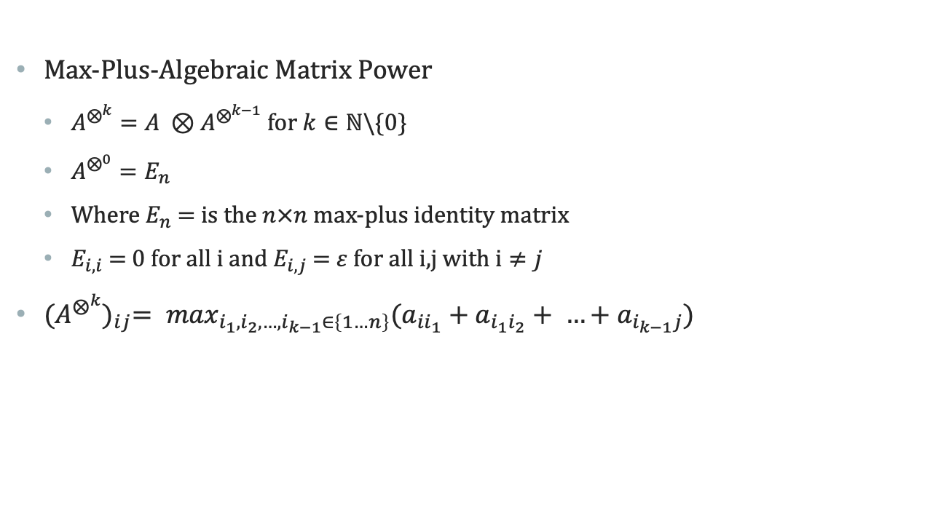
Overview
Max-Plus-Algebraic Matrix Power
$A^{⨂^{k}}=A ⊗A^{⨂^{k−1}}$ for $k∈ℕ\backslash \{0\}$
$A^{⨂^{0}}=E_{n}$
Where $E_{n}$ = is the $n×n$max-plus identity matrix
$E_{i,i}$ = 0 for all i and $E_{i,j}$ = $ε$ for all i,j with $i≠j$
${(A^{⨂^{k}})}_{ij}= \max_{i_{1},i_{2},…,i_{k−1}∈\left\{1…n\right\}}(a_{{ii}_{1}}+a_{i_{1}i_{2}}+ …+a_{i_{k−1}j})$

Slide 3

Example
If A = $\left[\begin{matrix}2 & 3 & ℰ \\ 1 & ℰ & 0 \\ 2 & −1 & 3\end{matrix}\right]$,
then $A^{⨂^{2}}=\left[\begin{matrix}2 & 3 & ℰ \\ 1 & ℰ & 0 \\ 2 & −1 & 3\end{matrix}\right]$ $⨂$ $\left[\begin{matrix}2 & 3 & ℰ \\ 1 & ℰ & 0 \\ 2 & −1 & 3\end{matrix}\right]$
$A^{⨂^{2}} =\left[\begin{matrix}4 & 5 & 3 \\ 3 & 4 & 3 \\ 5 & 5 & 5\end{matrix}\right]$

Slide 4
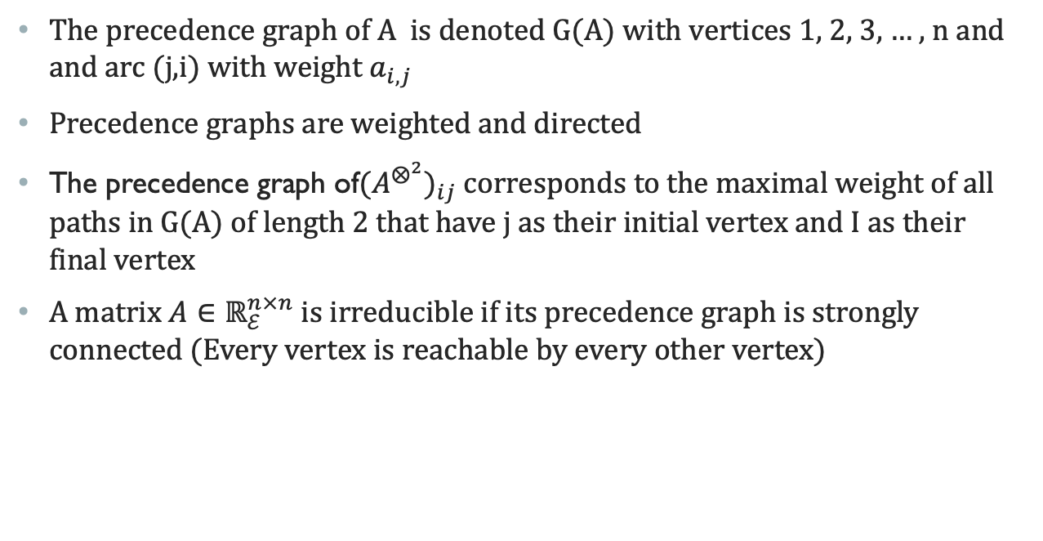
Graph Theory
The precedence graph of A is denoted G(A) with vertices 1, 2, 3, … , n and and arc (j,i) with weight $a_{i,j}$
Precedence graphs are weighted and directed
The precedence graph of${(A^{⨂^{2}})}_{ij}$ corresponds to the maximal weight of all paths in G(A) of length 2 that have j as their initial vertex and I as their final vertex
A matrix $A∈ℝ_{ℰ}^{n×n}$ is irreducible if its precedence graph is strongly connected (Every vertex is reachable by every other vertex)

Slide 5

Max Plus Eigen value/vector
Let $A∈ℝ_{ℰ}^{n×n}$. If there exists a $λ∈ℝ_{ℇ}$ and $v∈$ $ℝ_{ℰ}^{n}$ with $v≠0$such that $A⊗v=λ⊗v$ then we say $λ$ is a max-plus algebraic eigenvalue of A and v is the corresponding max-plus algebraic eigenvector of A. // find and send proof to sanjay
If $λ$ is the maximal average weights over all elementary circuits in G(A) then $λ$ is the max-plus algebraic eigen value of A.
An elementary circuit of A is a circuit in which no vertex except the starting vertex appears more than once.

Slide 6
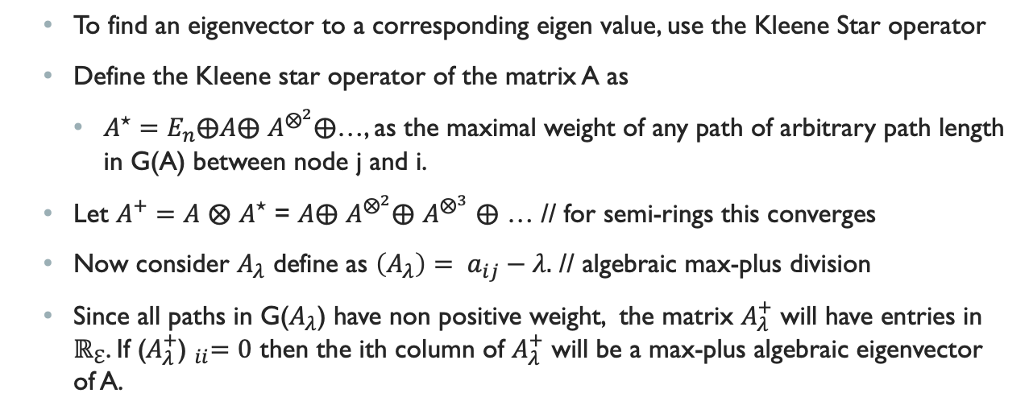
Max Plus Eigen value/vector
To find an eigenvector to a corresponding eigen value, use the Kleene Star operator
Define the Kleene star operator of the matrix A as
$A^{⋆}=E_{n}⨁A⨁$ $A^{⨂^{2}}⨁$…, as the maximal weight of any path of arbitrary path length in G(A) between node j and i.
Let $A^{+}=A$ $⨂$ $A^{⋆}$ = $A⨁$ $A^{⨂^{2}}⨁$ $A^{⨂^{3}}$ $⨁$ … // for semi-rings this converges
Now consider $A_{λ}$ define as $\left(A_{λ}\right)= a_{ij}−λ.$ // algebraic max-plus division
Since all paths in G($A_{λ}$) have non positive weight, the matrix $A_{λ}^{+}$ will have entries in $ℝ_{ℇ}$. If ${\text{(}A_{λ}^{+}\text{) }}_{ii}=0$ then the ith column of $A_{λ}^{+}$ will be a max-plus algebraic eigenvector of A.

Slide 7
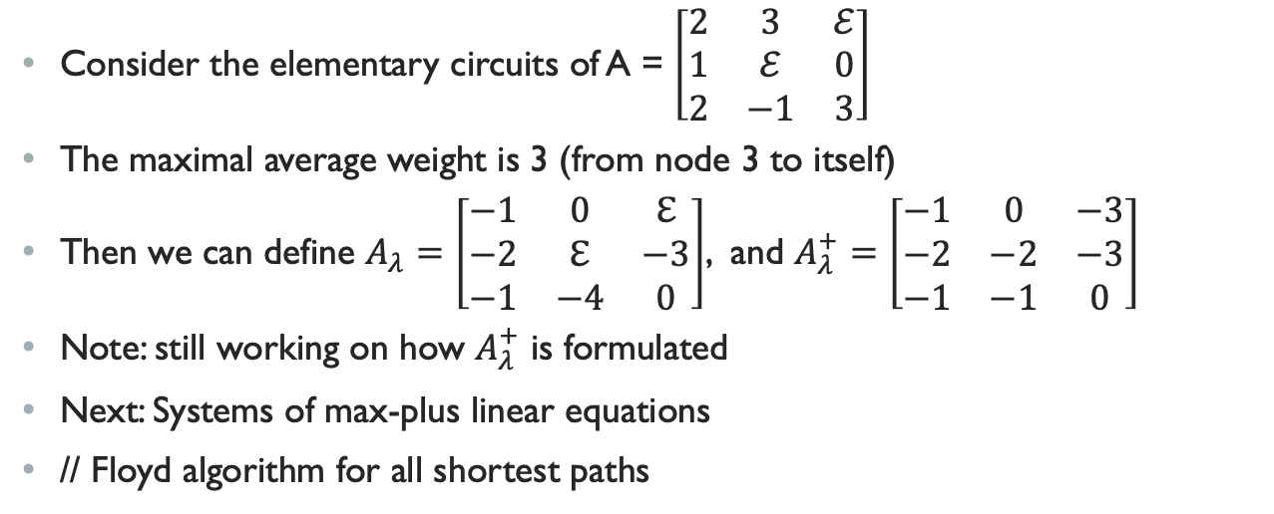
Example
Consider the elementary circuits of A = $\left[\begin{matrix}2 & 3 & ℰ \\ 1 & ℰ & 0 \\ 2 & −1 & 3\end{matrix}\right]$
The maximal average weight is 3 (from node 3 to itself)
Then we can define $A_{λ}=\left[\begin{matrix}−1 & 0 & ℇ \\ −2 & ℇ & −3 \\ −1 & −4 & 0\end{matrix}\right]$, and $A_{λ}^{+}=\left[\begin{matrix}−1 & 0 & −3 \\ −2 & −2 & −3 \\ −1 & −1 & 0\end{matrix}\right]$
Note: still working on how $A_{λ}^{+}$ is formulated
Next: Systems of max-plus linear equations
// Floyd algorithm for all shortest paths

