Slide 1

ADVERSARIAL GRAPH ML · EXPERIMENT REPORT
Diffusion-Based Node
Injection Attacks
Black-box · query-only · injection-only attacks on GNN graph classifiers
PROTEINS dataset · GCN / GIN / GAT / SAGE / median-pool victims
98.43%
+3.58 pp
−69%
PROTEINS GCN ASR
over baseline
variance

Slide 2




SETUP
The Threat Model
Black-box, query-only
Injection-only
Attacker sees only output logits — never gradients or weights. All gradients are zeroth-order (CGE) estimates from queries.
Original graph is never mutated. Attacker appends new nodes with chosen features + edges. Construction is provably pure.
Edge budget = avg degree
Goal: flip the prediction
Each injected node connects to at most ⌈2|E|/|N|⌉ original nodes — a stealth constraint, not full connectivity.
Untargeted CW-margin objective. Success = the classifier changes its label for a previously-correct graph.

Slide 3
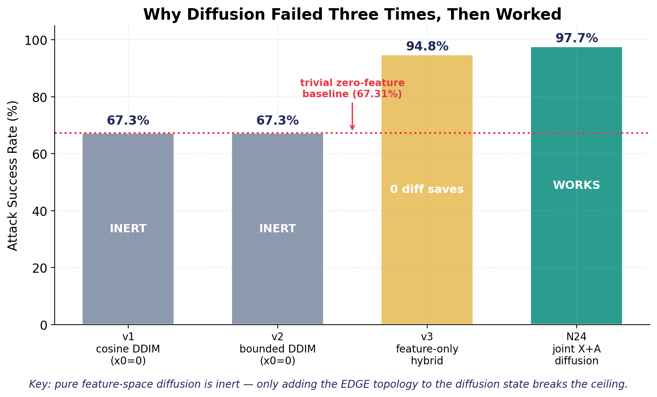
CORE FINDING
Why Diffusion Failed 3×, Then Worked
THE INSIGHT
Pure feature-space diffusion is inert.
With a fixed full-connectivity topology, GCN normalization absorbs all feature variation — ~5% of graphs are topology-immune.
Make edges part of the diffusion state →
the trajectory gains a dimension that actually changes the prediction. Ceiling broken.
67.3% → 97.7%
the moment edges entered the diffusion

Slide 4
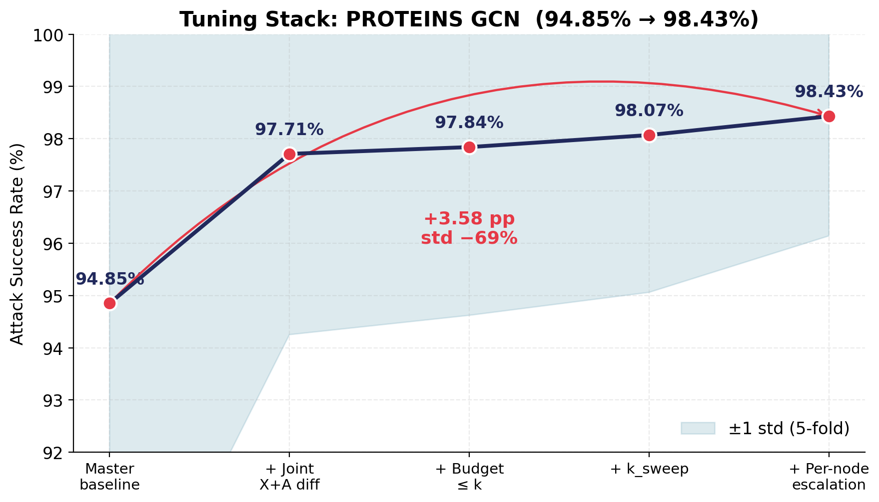





METHOD
The N24 Tuning Stack (94.85% → 98.43%)
1. Baseline
5-restart Adam + zeroth-order CGE
2. Joint X+A diffusion
bounded DDIM + greedy edge search
3. Budget ≤ k
edge budget as upper bound
4. k_sweep
retry stuck graphs at other k
5. Per-node escalation
m=2 with independent edge masks

Slide 5
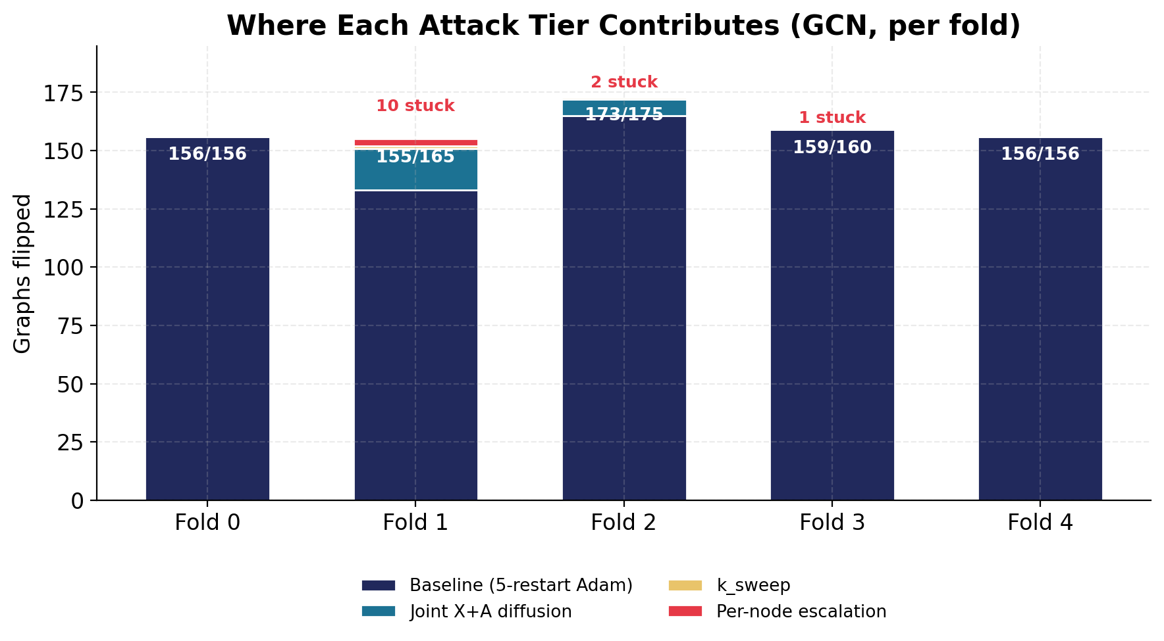


ANALYSIS
Where Each Tier Earns Its Keep
Folds 0 & 4 fully solved by the baseline alone — diffusion never fires.
Folds 1–2 are where joint diffusion + escalation rescue 30 graphs Adam missed.
13 graphs remain stuck — small graphs where one node can't move the readout.

Slide 6
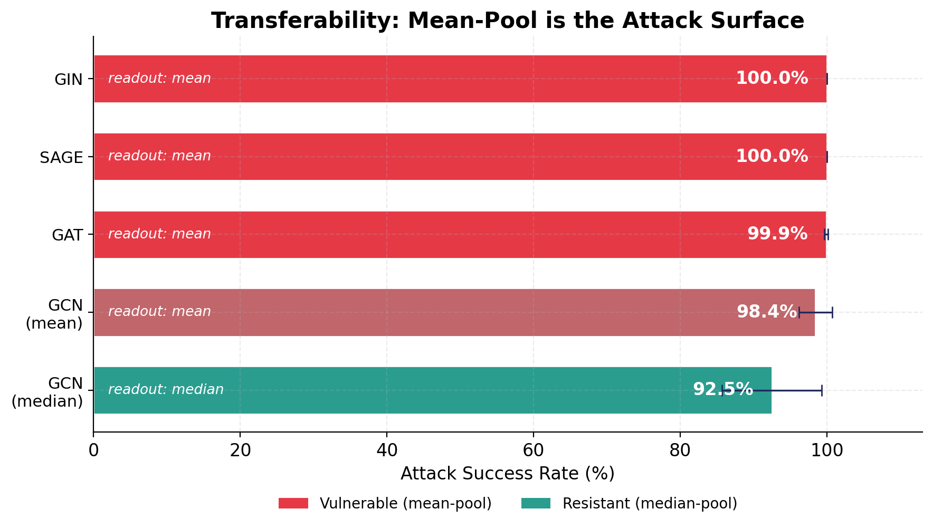

GENERALIZATION
What Actually Defends?
Conv type ≠ defense
GIN, GAT, SAGE all use mean-pool and are MORE vulnerable than GCN — 100% ASR with diffusion never firing.
Defend the READOUT
Only median-pool resists (92.46%). The pooling — not the aggregator — is the true attack surface.

Slide 7
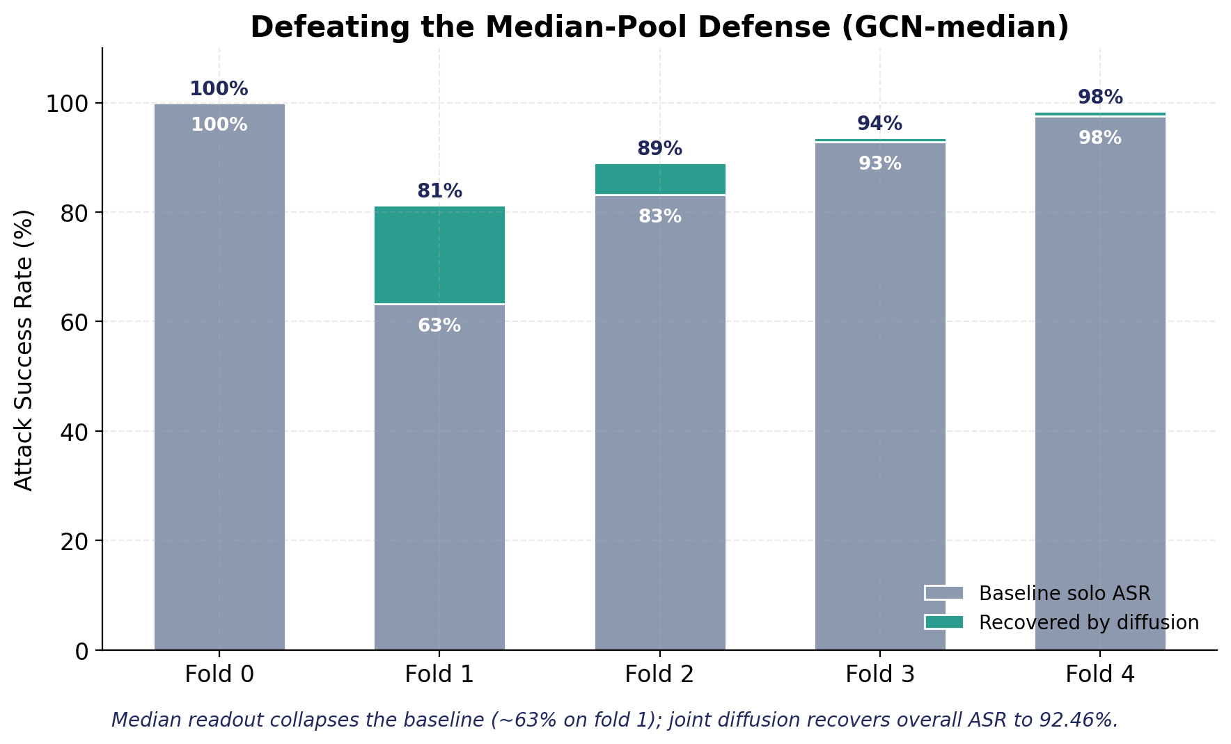
STRESS TEST
Defeating the Median-Pool Defense
WHEN DIFFUSION MATTERS
63%
baseline-solo ASR on the hardest fold once median-pool defends
92.46%
recovered by joint X+A diffusion + k_sweep
The diffusion mechanism earns its keep precisely against defenses — on undefended models a simple baseline suffices.

Slide 8


KEY TAKEAWAYS
Three Lessons
Topology must be in the diffusion state
Feature-only graph diffusion is inert — it never beats a trivial injection. Edges must be an optimization variable.
The readout is the attack surface
Changing the convolution (GIN/GAT/SAGE) is not a defense. Defend the pooling: median or trimmed-mean.
Diffusion proves itself against defenses
On undefended models a baseline suffices; against median-pool, diffusion is the difference between 63% and 92%.

