Slide 1

ADVERSARIAL GRAPH ML · ARCHITECTURE DEEP-DIVE
Diffusion-KATZE
How a discrete-time diffusion process injects adversarial nodes into a graph
Black-box · query-only · injection-only attack on GNN graph classifiers
The core idea: put edge topology — not just features — into the diffusion state
98.43%
X + A
1 node
PROTEINS GCN ASR
joint diffusion state
injection budget

Slide 2
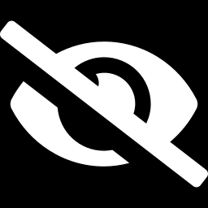
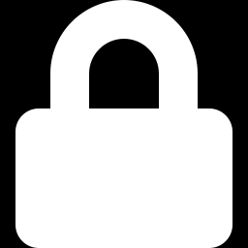
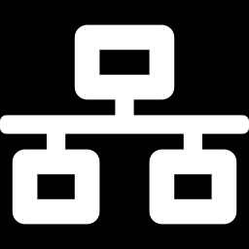

SETUP
Threat Model — What the Attacker May Do
Black-box, query-only
Injection-only
Sees only output logits — never gradients or weights. Every gradient is a zeroth-order (CGE) estimate from queries.
The original graph is never mutated. The attacker appends new nodes with chosen features + edges; construction is a pure function.
Tiny budget
Goal: flip the label
node_budget = 1 injected node; edges per node capped (1 ≤ k ≤ avg-degree). A stealth constraint, not full connectivity.
Untargeted CW-margin objective. Success = the classifier changes its prediction on a previously-correct graph.

Slide 3
ARCHITECTURE
End-to-End Pipeline — A Cascade of Fallbacks
Each stage fires only when the previous one fails. Cheap methods first; the diffusion machinery is the last resort for the hard graphs.
Input graph G
correctly classified
Select 1 node
+ edge targets
topk-deg / full
Adversarial
generator Gθ
feature proposal
ZO-CGE
gradient
query-only ∇
5-restart Adam
baseline
94.85% solo
Diffusion restart
(DDIM on x)
feature retry
Joint X+A diffusion
+ k_sweep
edges in state
Per-node
escalation
m=2 masks
Economics of the cascade: the 5-restart baseline alone flips ~95% of graphs; the diffusion core + escalation exist only to rescue the few topology-immune ones the optimizer misses.
Perturbed graph G′
label flipped ✓
Blue = data · Navy = generator / optimizer · Crimson = diffusion core · Gold = escalation · Green = success

Slide 4
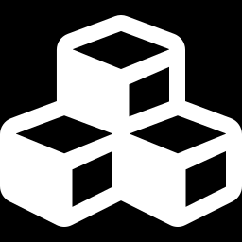
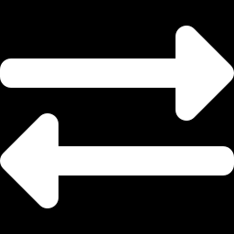
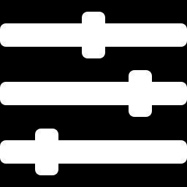
COMPONENT A
Generator + Zeroth-Order Gradient
Adversarial generator Gθ
CGE zeroth-order ∇
A small MLP maps noise → feature vector for the injected node. 5 random restarts (different lr / epochs) escape bad local optima.
No weights, no autograd. Coordinate-wise Gradient Estimation perturbs the input ±σ and reads logit changes to estimate ∇.
feat_scale = 2√N
CW-margin loss
Injected features are amplified to ≈2√N. This single lever — not the optimizer — is what lifts ASR from ~30% to ~95%.
Carlini-Wagner margin (κ = −0.1) drives the true-class logit below the best other class — a smooth flip objective.

Slide 5


COMPONENT B
The Multi-Restart Baseline Ladder
Before any diffusion, 5 Adam restarts try to flip the graph. The best (lowest-margin) x₀ is cached as the diffusion anchor.
1
2
3
4
5
lr 5e-3 · 50 ep
lr 1e-2 · 50 ep
lr 2e-2 · 75 ep
lr 5e-3 · 100 ep
lr 1e-2 · 100 ep
Cache the best x₀ across restarts
If any restart flips the graph → done (this alone solves ~95% of graphs). Otherwise the lowest-margin candidate becomes the anchor x_init that the diffusion process denoises toward.
Why an anchor matters
The early failure (N23) ran diffusion from x₀ = 0, where DDIM predicts x̂₀ = 0 — testing only a zero-feature injection. Anchoring at the best baseline x₀ gives the score a meaningful place to denoise from.

Slide 6
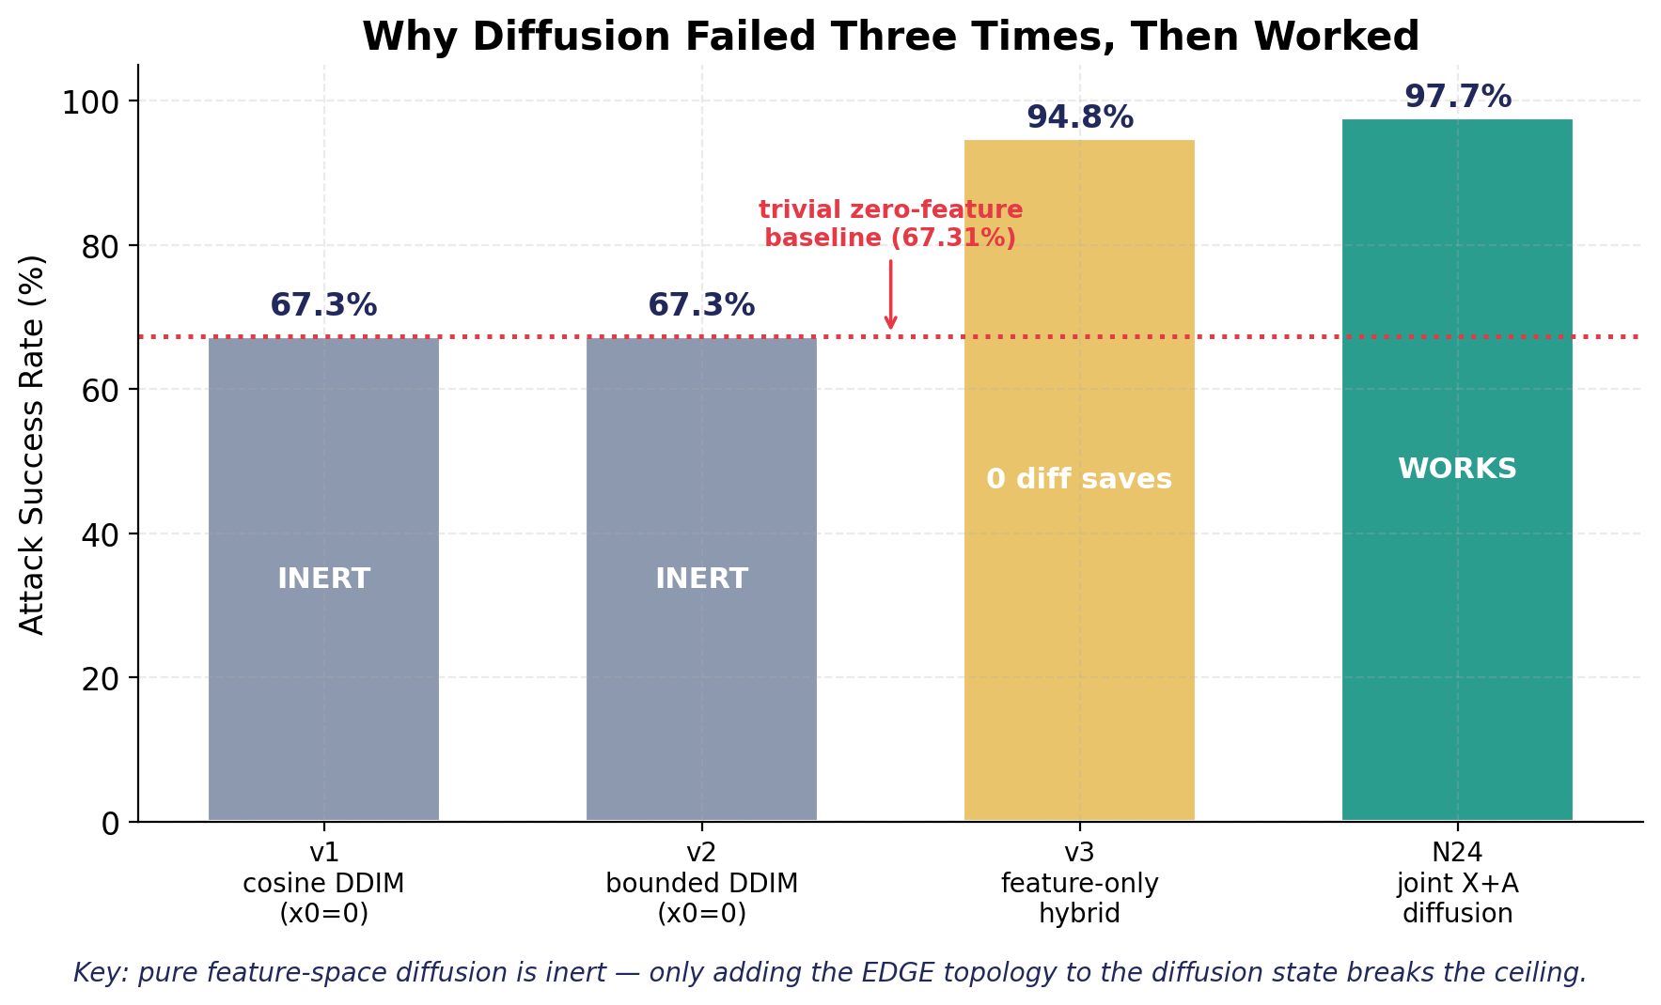
WHY IT'S BUILT THIS WAY
N23 → N24: Why Feature-Only Diffusion Failed
THE ROOT CAUSE
v1–v3 diffused features only.
Under a fixed full-edge topology, GCN normalization + feat_scale saturate — feature content stops mattering. ~5% of graphs are topology-immune: no feature vector flips them.
Fix → make edges a variable.
Joint X+A diffusion adds a topological dimension the score can actually move.
67.3% → 97.7%
the moment edges entered the state

Slide 7
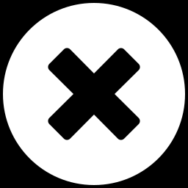
CORE IDEA
The Diffusion State is (X, A) — Not Just X
Feature-only diffusion
Joint X + A diffusion
state = x (node features)
• denoise x toward an adversarial feature vector
• edges fixed (full connect)
• GCN norm absorbs it → inert
state = (x, A_sv) features + edges
• denoise features AND search the edge mask
• edge cardinality bounded by budget k
• adds a topological dimension → flips
67.31% — no gain over a zero-feature injection
97.7%+ — the ceiling breaks

Slide 8
MECHANISM
The DDIM Engine + Adversarial-Margin Guidance
DISCRETE-TIME DDIM
ADVERSARIAL-MARGIN GUIDANCE
Bounded linear schedule
ᾱ : 0.99 → 0.50 over T = 20 steps
Forward (noise the anchor)
x_T = √ᾱ_T · x_init + √(1−ᾱ_T) · ε₀
Reverse step (predict-x₀ form)
x̂₀ = (x_t − √(1−ᾱ_t)·ε) / √ᾱ_t
x_{t−1} = √ᾱ_{t−1}·x̂₀ + √(1−ᾱ_{t−1})·ε̂
At each reverse step:
1. ZO-CGE estimates the score
s = ∇_{x̂₀} CW(model, graph)
2. steer the noise toward lower margin
ε̂ = ε₀ − λ·√(1−ᾱ_t)·s
(λ = guidance = 2.0)
3. take the DDIM step → repeat
Over T = 20 steps the injection is denoised straight toward the decision boundary; the lowest-margin x̂₀ is kept.
Queries replace gradients: the diffusion score is itself a zeroth-order estimate — the whole engine stays black-box.
Bounded (ᾱ never reaches 0 or 1): the anchor is only partially noised, so the trajectory stays near the adversarial manifold instead of wandering to pure noise.

Slide 9



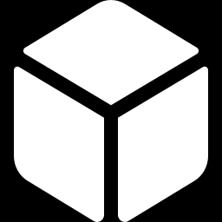
MECHANISM
Searching the Edge Mask (the A in X+A)
Per-node edge mask
Budget as upper bound
Each injected node i carries a binary mask edge_mask[i] ∈ {0,1}^N over original nodes, with ‖mask[i]‖₁ ≤ k (cardinality budget).
k is a ceiling, not a target. Greedy search keeps only positive-value edges, so the attack uses the fewest edges that still flip.
k_sweep on stuck graphs
2-swap refinement
If the default k fails, retry with k ∈ {0.25, 0.5, 1.5, 2}× — different cardinalities suit different graph sizes.
After top-k projection, try top-K-in × top-K-out swaps (K²=16) to escape coupled-edge optima. Same ASR, 35% faster.
Per-node escalation (m=2)
Multi-seed
Add a 2nd injected node with an INDEPENDENT mask. Shared masks make duplicate hubs that interfere (−1.85 pp); independent masks add +0.36 pp.
2 random seeds per diffusion attempt — cheap variance reduction on the stochastic edge search.

Slide 10
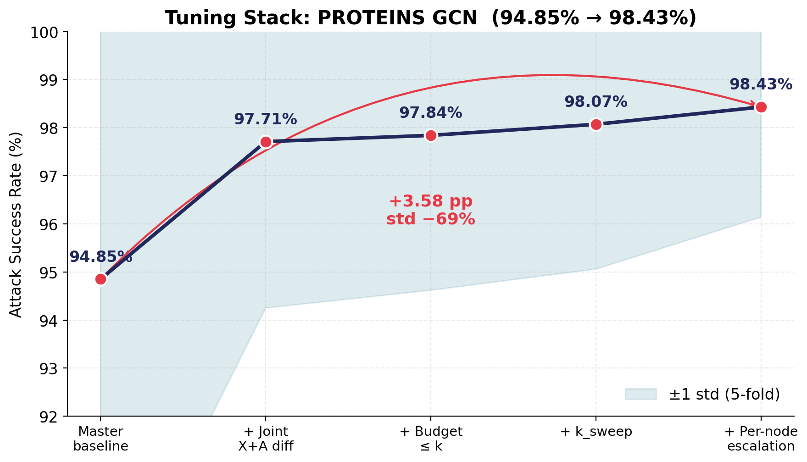

PUTTING IT TOGETHER
When Each Tier Fires (94.85% → 98.43%)
1. Baseline
5-restart Adam + ZO-CGE
2. Joint X+A diffusion
bounded DDIM + edge search
3. Budget ≤ k
edges as upper bound
4. k_sweep
retry stuck graphs at other k
5. Per-node escalation
m=2, independent masks

Slide 11
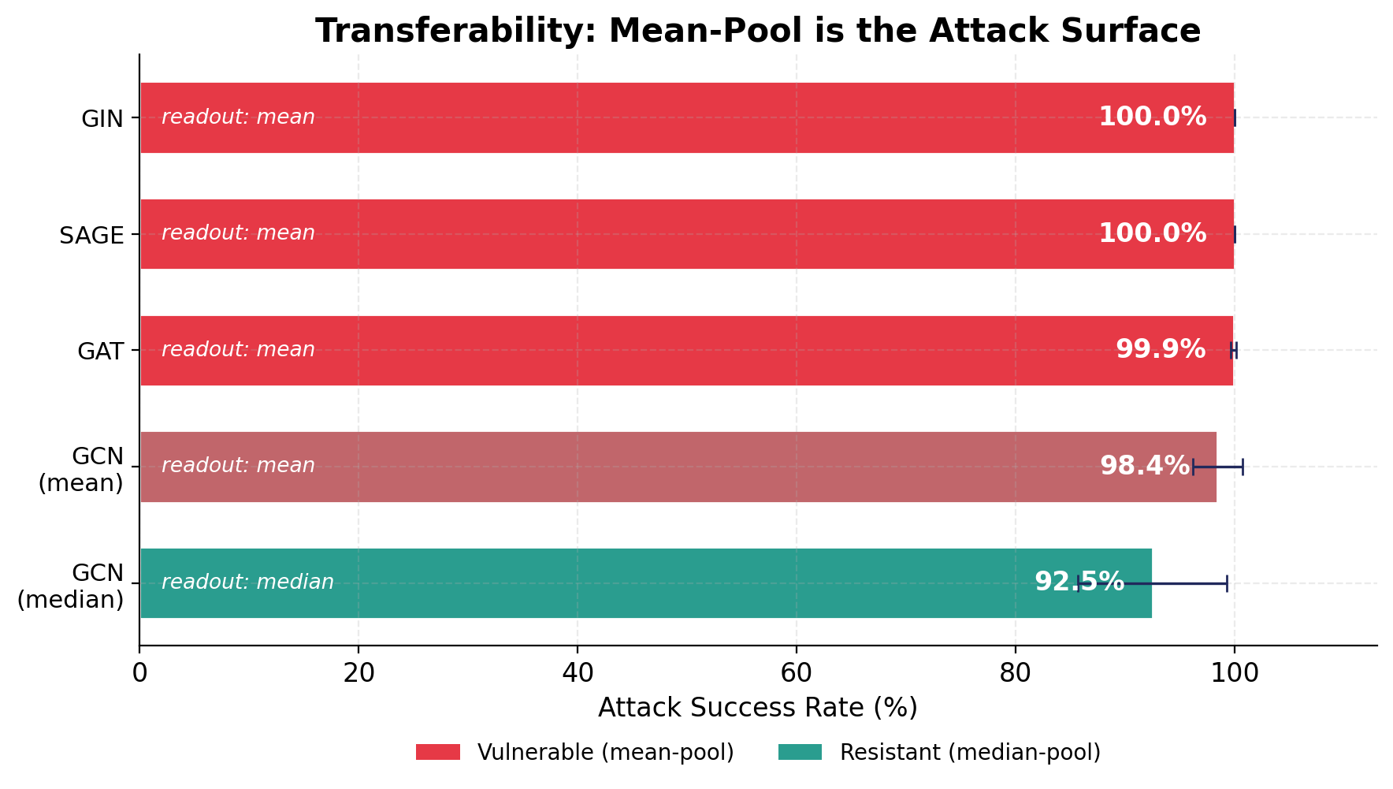

DESIGN INSIGHT
The Readout — Not the Convolution — is the Attack Surface
Mean-pool falls GIN (sum), GAT (attention), SAGE (sampling) all use mean-pool readout — and all hit 99.9–100% ASR. Changing the conv is no defense.
Median-pool resists Only a median / trimmed-mean readout ignores the injected outlier node — dropping ASR to 92.46%. Defend the pooling.
Diffusion earns its keep here On undefended models a baseline suffices; against median-pool, diffusion is the difference between ~63% and 92%.

Slide 12
RESULTS
Fair, Budget-Matched Comparison (PROTEINS GCN)
All methods at node_budget = 1, 5-fold. The original 54.26% → 98.43% was NOT budget-matched; under one identical budget the gap is honest.
Method
GZOO budget (1 edge)
N24 budget (full)
GZOO-origin (fs=1.0)
29.65 ± 12.04
75.25 ± 4.46
gzoo-katze (fs=auto_x2)
92.31 ± 5.42
94.85 ± 7.44
diffusion-katze (N24)
95.38 ± 3.87
98.43 ± 2.29
GZOO-paper (cited)
54.26
n/a
+65.7 pp
feat_scale
edges matter
diffusion-katze vs GZOO-origin
at the SAME 1-edge budget
the dominant lever — fs=1.0→auto_x2
moves ASR far more than the optimizer
every method gains from full edges;
topology is a real budget axis

Slide 13

Architecture in Three Sentences
1
Cascade of fallbacks — Cheap 5-restart Adam + ZO-CGE solves most graphs; the diffusion engine is the last resort for the hard, topology-immune ones.
2
Topology in the state — The decisive design choice is making edges part of the diffusion state (X+A). Feature-only diffusion is provably inert under mean-pool GCNs.
3
Black-box throughout — Even the diffusion score is a zeroth-order estimate — no gradients, no weights, 1 injected node. Defend the readout, not the convolution.
Diffusion-KATZE · autoresearch-katze · PROTEINS / GNN victims

