Slide 1


SKILLFORGE
Modular CV Building Web Application

Slide 2
Overview / Features
Break down skills and experience into reusable ‘modules’
Create and manage CVs tailored to target jobs that require specific experience.
Manage profile (email, user picture, password)
Export CVs in PDF format (ATS compliant)

Slide 3
Tech Stack Frontend
Front End:
NextJS (Full Stack React Framework)
Tailwind (CSS Framework)
ShadCN with Animate UI component libraries (built on top of tailwind)
User auth using AWS Amplify + Cognito

Slide 4
Tech Stack Backend
Back End:
NextJS (Api Routes)
AWS S3 Buckets (file storage e.g. pictures, exported CVs)
AWS DynamoDB (NoSQL database)
AWS Cognito (User management and authentication.

Slide 5
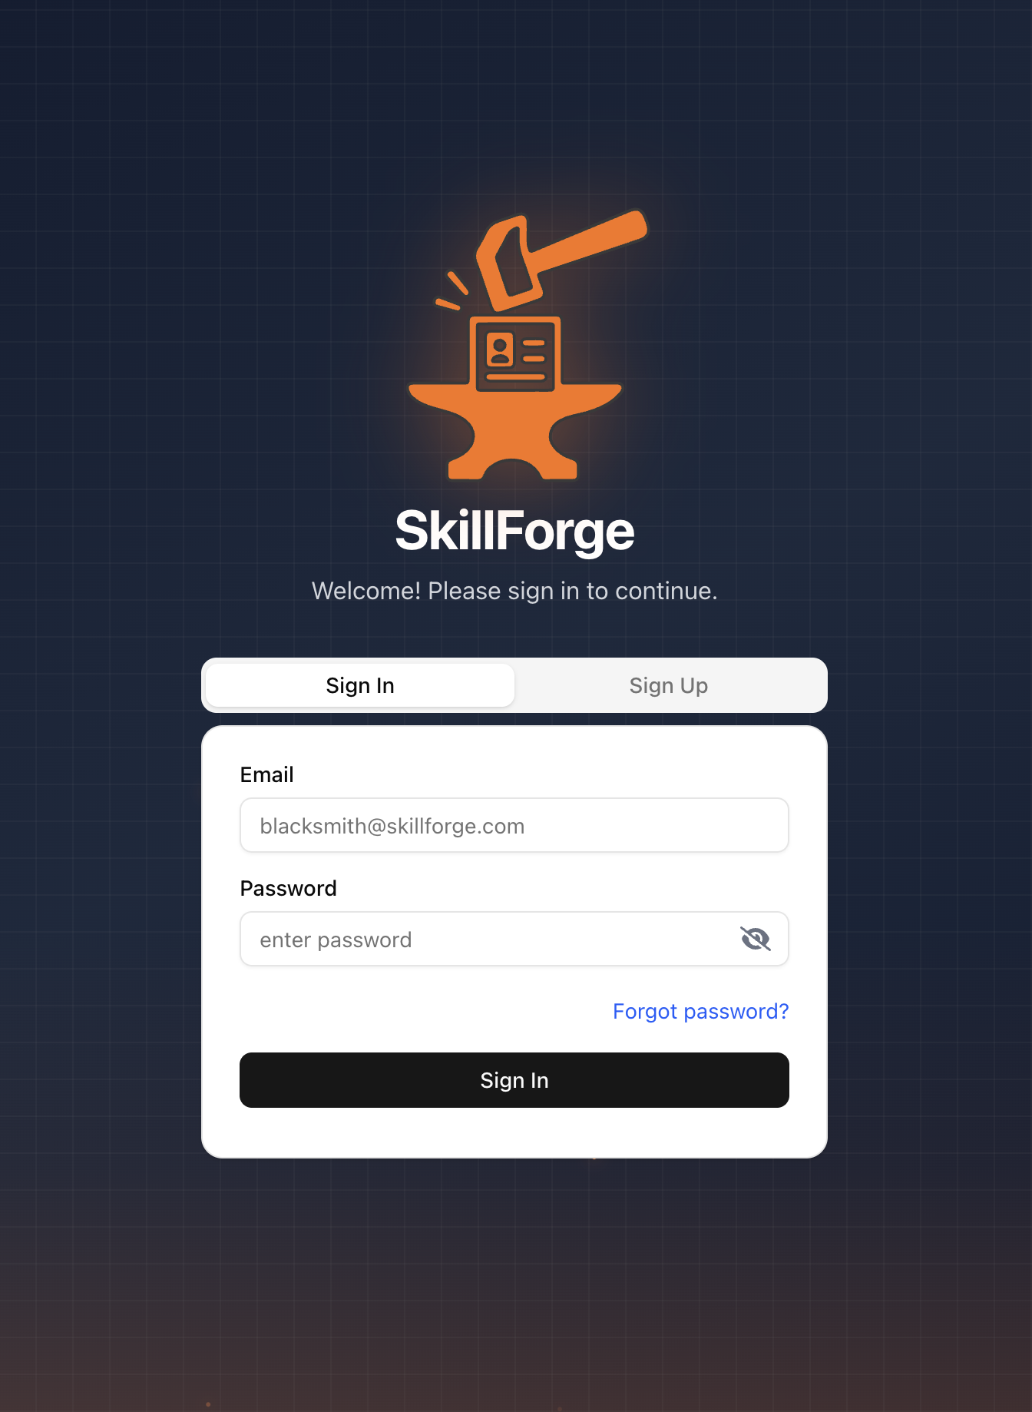
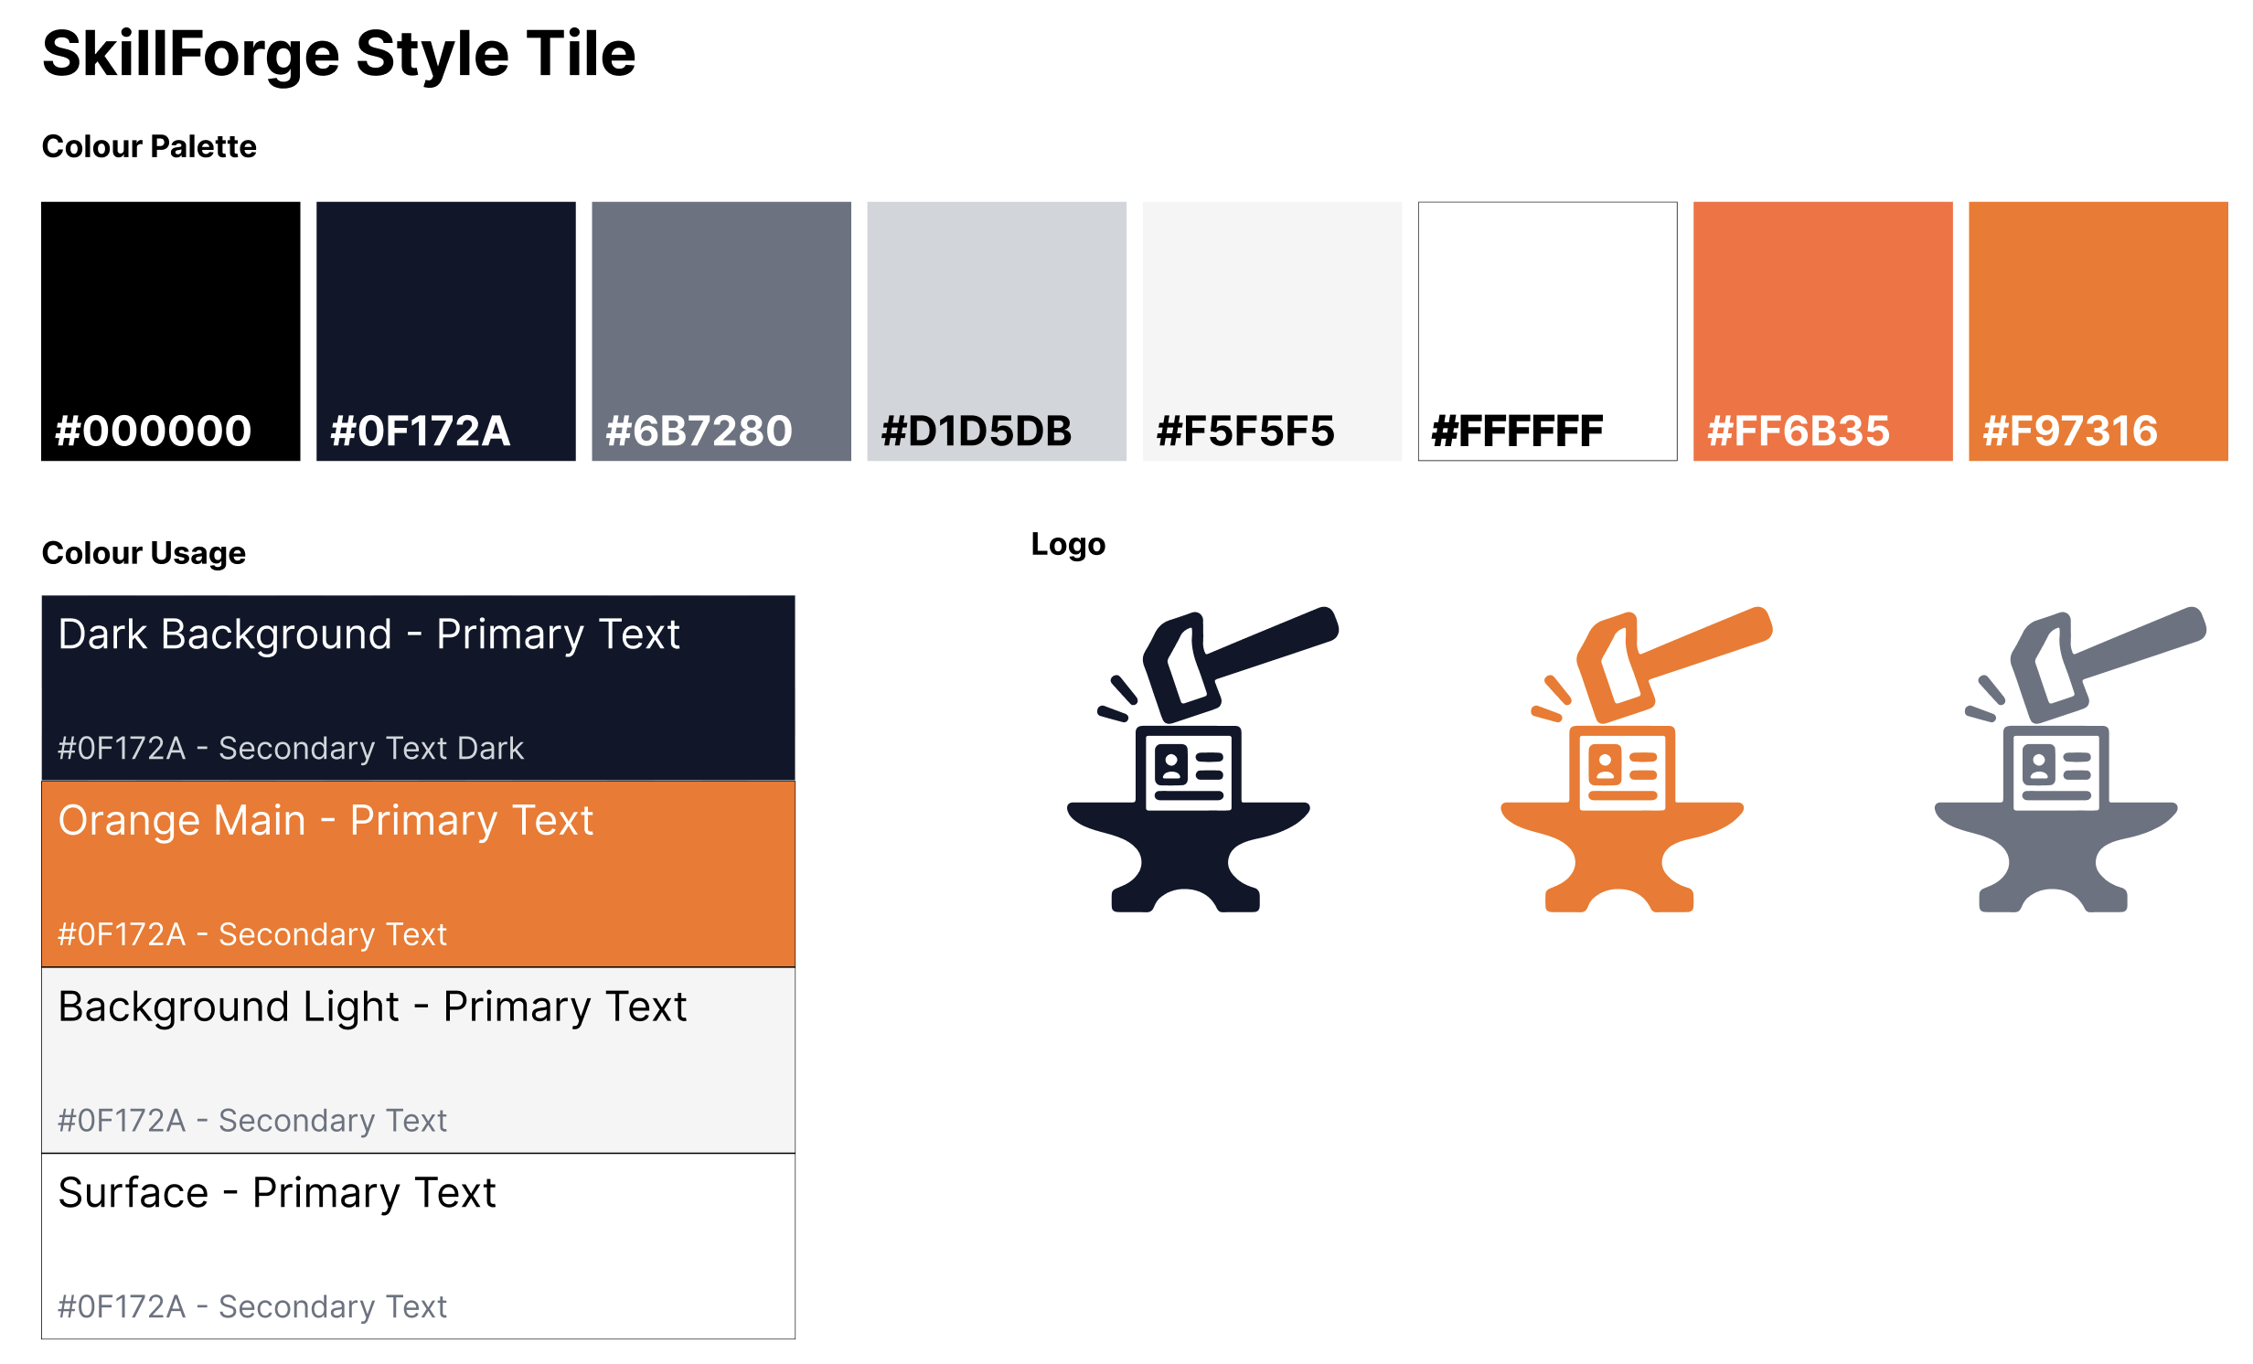
Design – Colour Palette

Slide 6
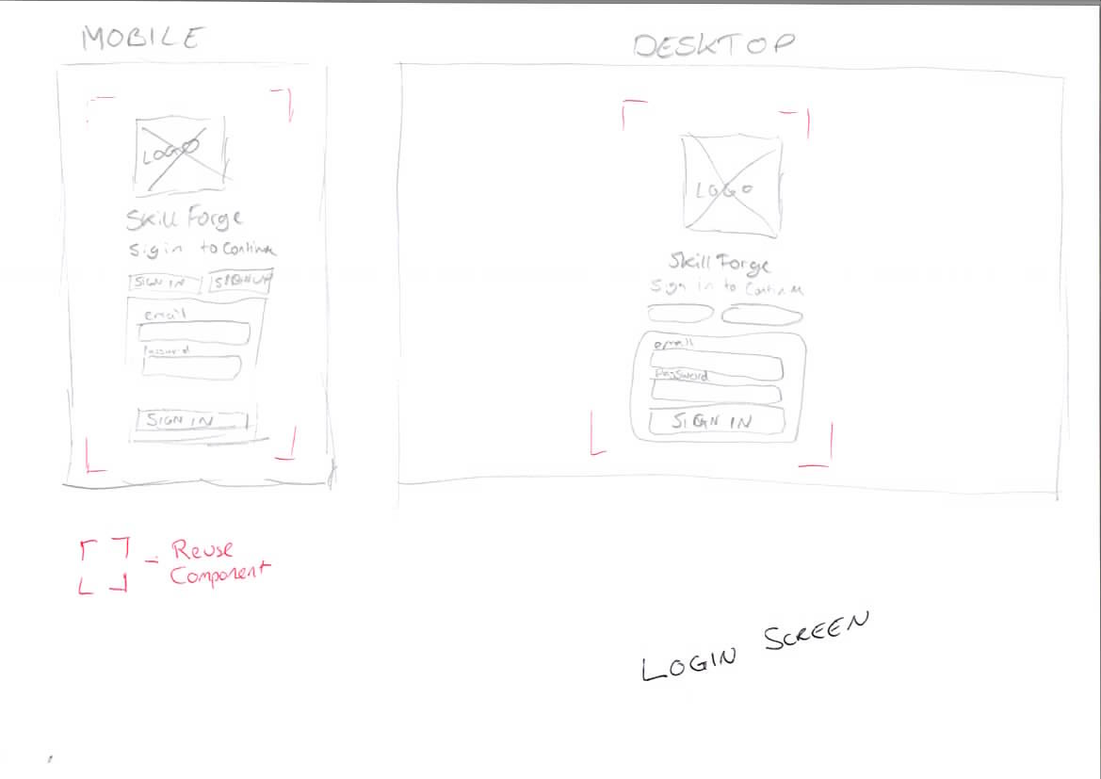
Design – Login (Initial Sketch)
Wireframe (Initial Sketch)

Slide 7
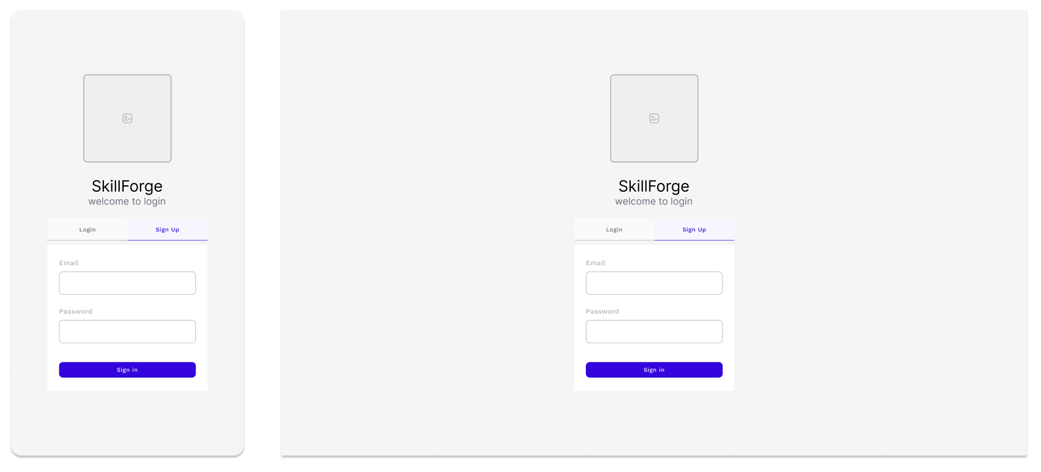
Design – Login (Figma Wireframe)

Slide 8
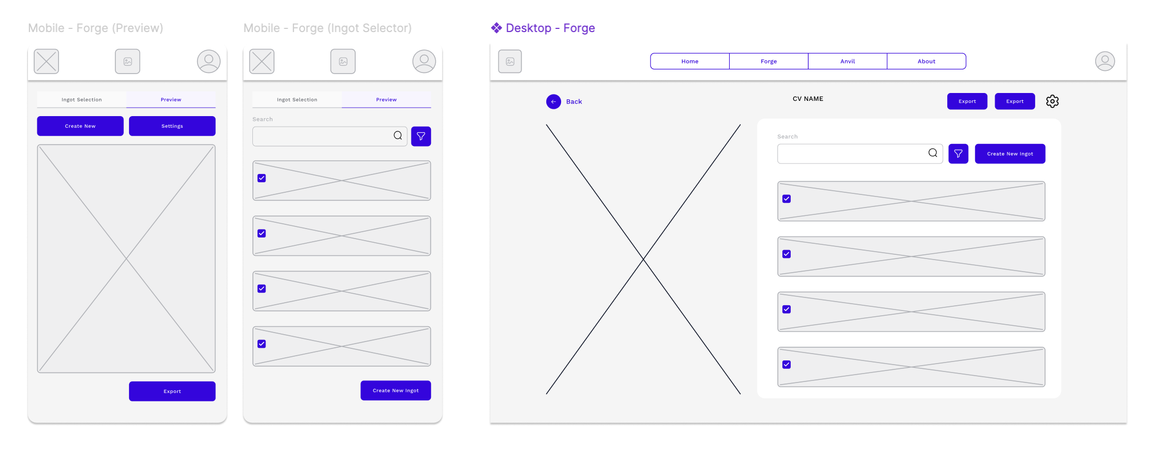
Design – Forge (CV Builder) - Wireframe

Slide 9
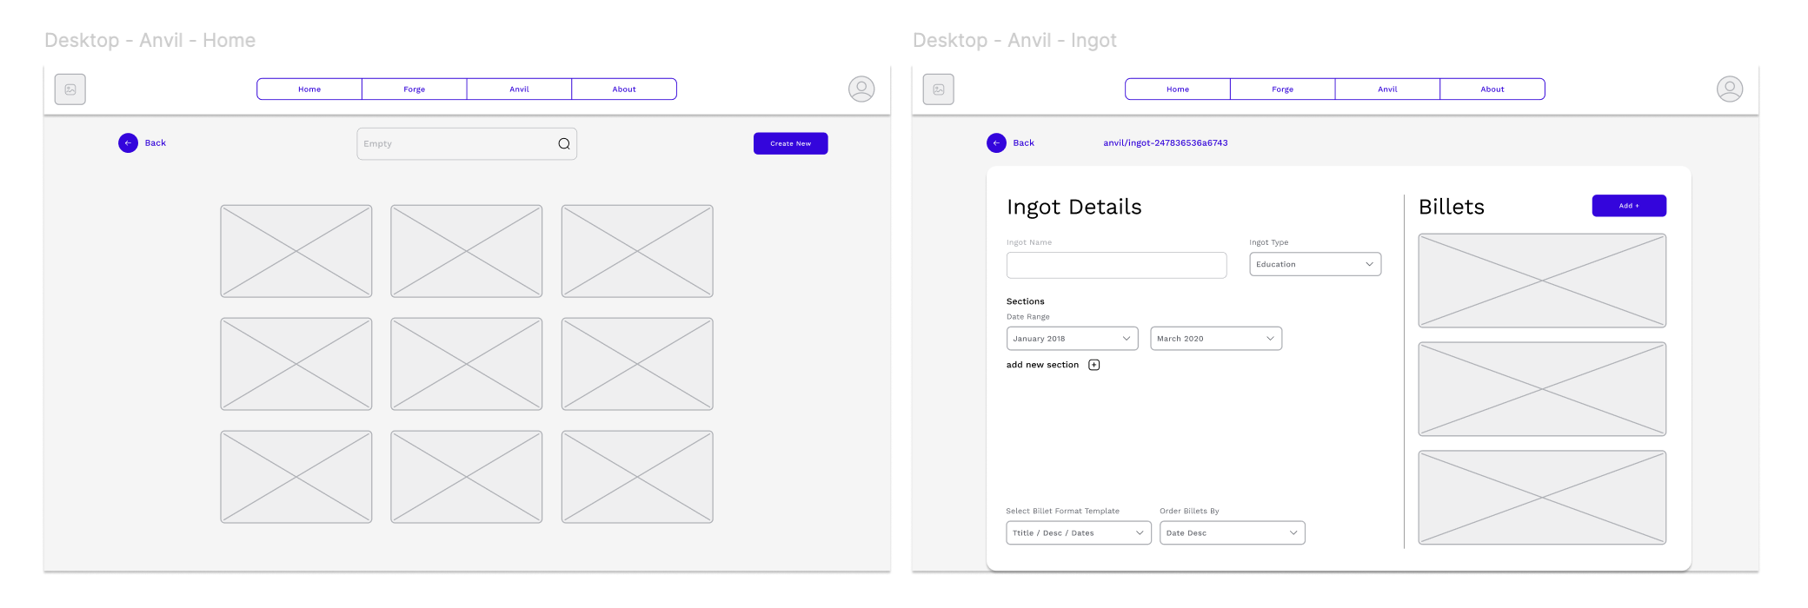
Desktop – Anvil (Module Manager) - Wireframe

Slide 10
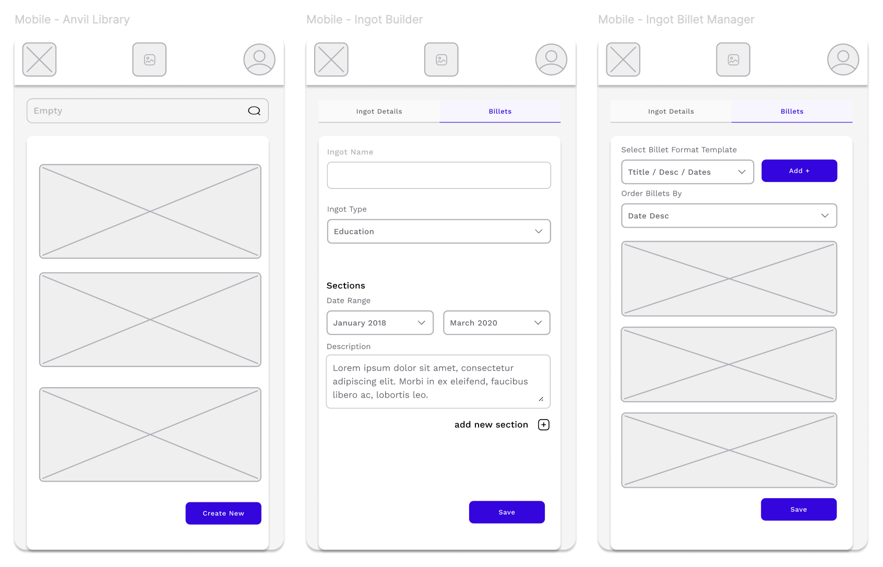
Mobile Anvil Figma Wireframes

Slide 11
Key Dependencies
AWS Amplify with NextJS adapter library https://www.npmjs.com/package/@aws-amplify/adapter-nextjs?activeTab=versions
Zod (Form validation) https://zod.dev/
Zustand (Client-side global state management) https://zustand.docs.pmnd.rs/getting-started/introduction
React PDF (For generating PDF CVs) https://react-pdf.org/
Prettier (Auto formats code e.g. keep consistent single quote or double quote usage)

Slide 12
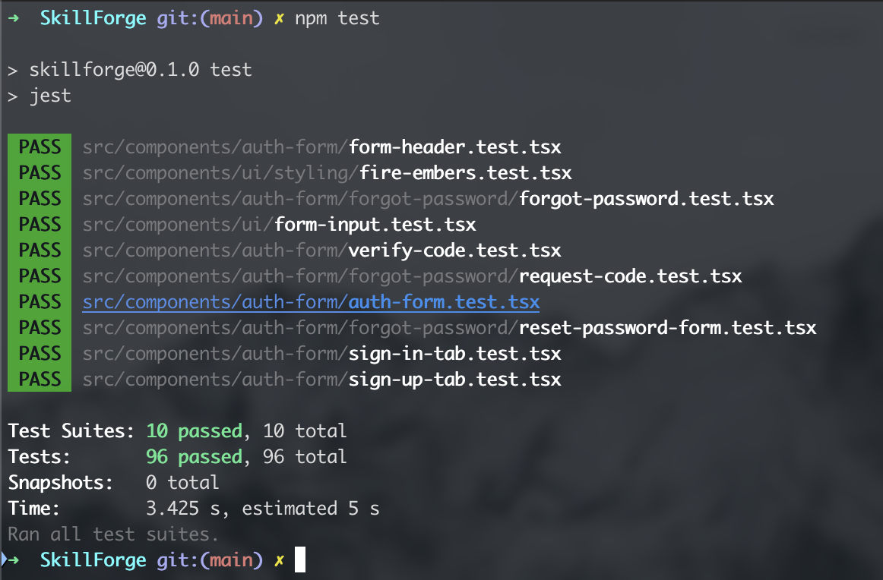
Testing
Using Jest for testing, the image shows the login tests passing.
Each pull request will require all existing tests to pass before being merged. (will set up a GitHub rule)

Slide 13

Q&A

