Slide 1
Introduction to Web Security

Slide 2
WHOAMI
I am Yasser Elsnbary.
Computer Science Student.
Cyber Security Enthusiast & Penetration Tester wannabe.
Leader of cyber security circle @CATReloaded.
You can find me at @YasserElsnbary2

Slide 3
Agenda
What is web security important ?
Web application security jobs
  Pen-testing
  Bug bounty
How to start
Why We Should Learn This
Magic Recipe

Slide 4

What is web security
It basically means protecting a website or web application by detecting, preventing and responding to cyber threats.

Slide 5
web application security jobs
You can be an employee at security company as Pen-Tester or freelancer as a Bug Bounty Hunter, so what is the different:

Slide 6

Pen-testing
Pen-tester
  Trust With Non-Disclosure Agreement
  Policy
  Fixed Salary
  Estimated time

Slide 7
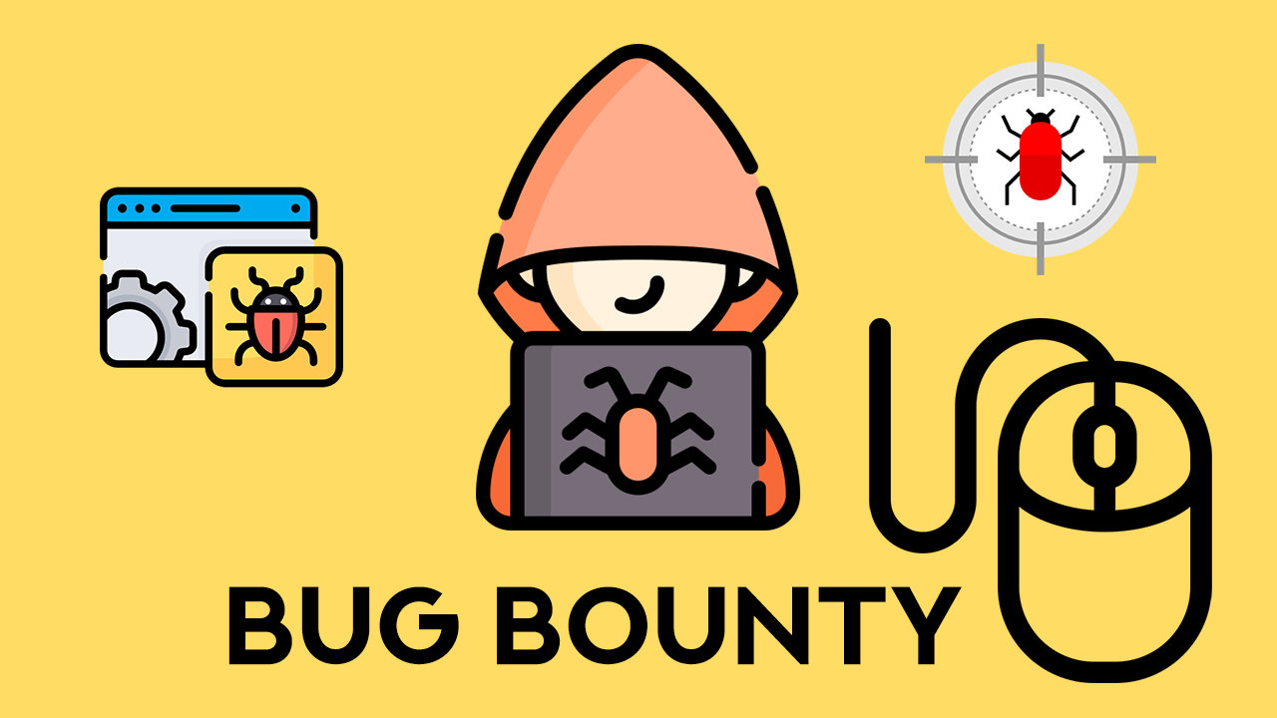
Bug Bounty
2. Bug-hunter
  Many Hunters Experience
  Army of friendly hackers.
  3.Cost-effective solution.
  Eliminate the risk

Slide 8
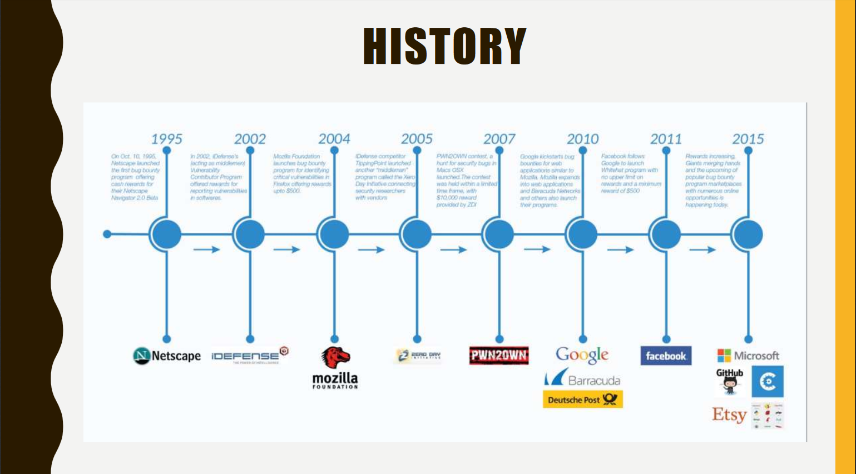
Bug Bounty History

Slide 9
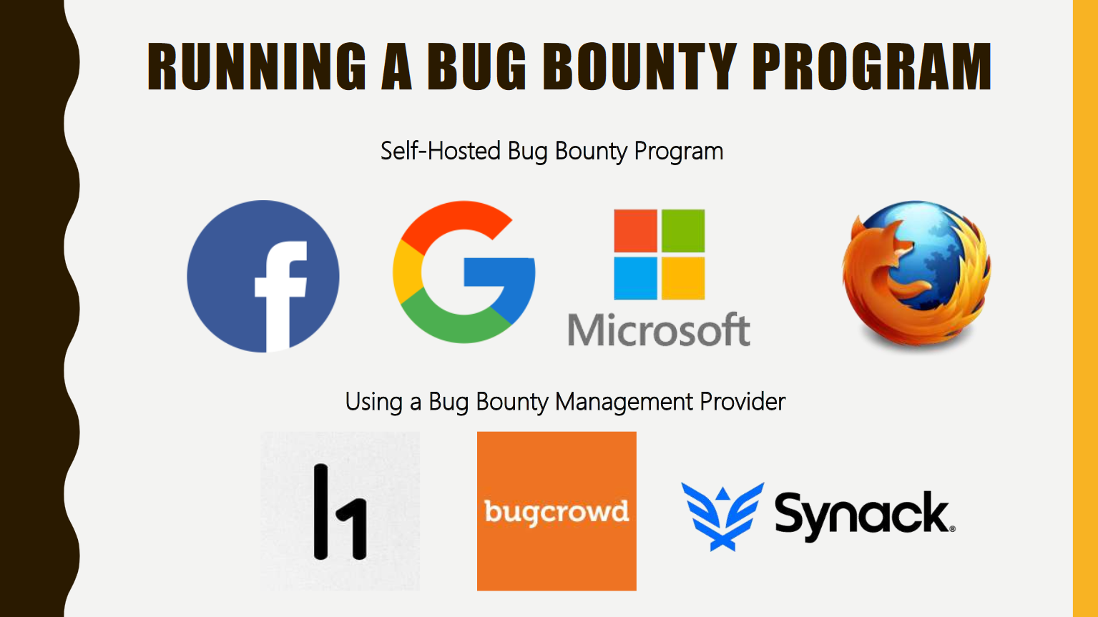
Bug Bounty

Slide 10
How to start
We in CAT Reloaded have technical circles one of them is cyber security circle which we have a roadmap : http://bit.ly/3aLtpI1
This Roadmap include three path:
Penetration Testing (Specifically in Web Pen Testing: https://bit.ly/38lolZL )
Reverse Engineering
Network Security
This Road map will take you from level zero to became an expert

Slide 11
Web App Pen-Tester
as mentioned in the road-map
we will explain how to start as a web pen-tester
  We should have a Knowledge in web development
    Html - JS – PHP - MySQL – JSON – Ajax – Xml – API – web life cycle
  Basics Knowledge in Linux – Network
    TCP/IP – OSI model
  Owasp top 10 Project
  Web App Hacker’s Handbook or ewapt from Elearn Security
    Practice on portswigger labs
  ewaptx from Elearn Security
  OWASP Web Security Testing Guide v 4.1

Slide 12
Magic recipe
there isn't any Magic recipe to become a Qualified you should learn in depth and continuous from many recourses
Through your journey will learn a lot of things and tools but you should do your effort and construct your mindset from other resources are suitable for you, doesn't stop Learning , doesn't stop practice

Slide 13
“ The best way to learn is simply by doing. That is how we learned to hack ’’
Michiel Prins and Jobert Abma Co-Founders, HackerOne

Slide 14
Any Question?
    You can find me at
      Twitter: @YasserElsnbary2
      Ask: @ElsnbaryYasser

Slide 15

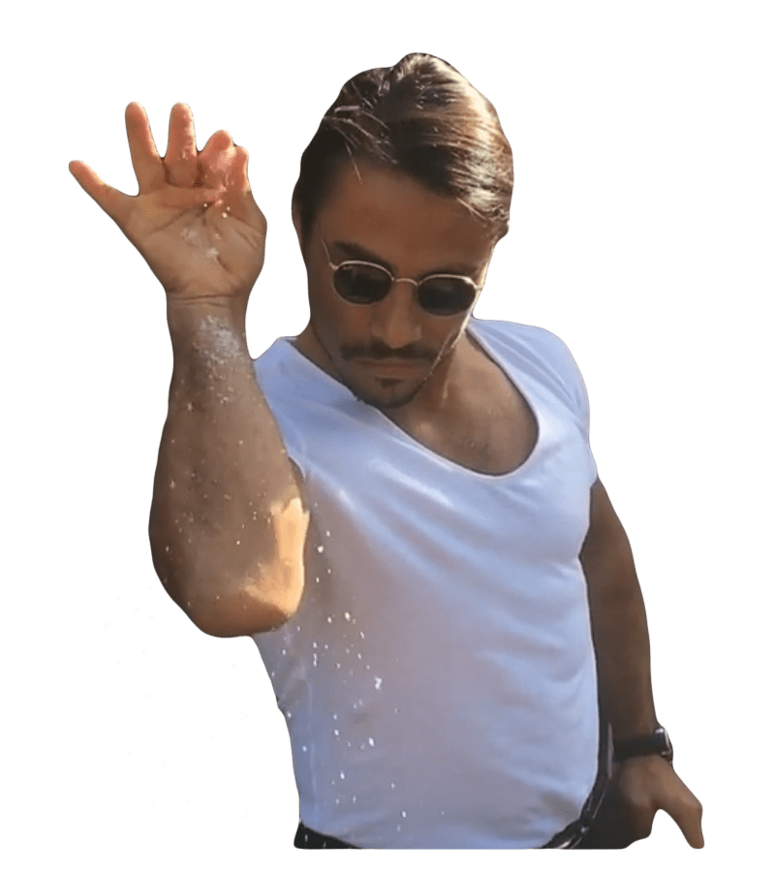

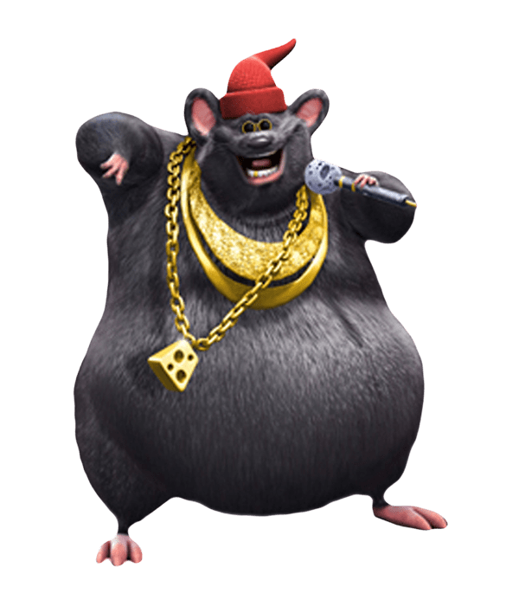




Slide 16
THANKS

