Slide 1
XDCTF FINAL 2014 思路分享
ADoG@萌萌萌

Slide 2
APK思路
Hash Length Extension Attack
https://blog.whitehatsec.com/hash-length-extension-attacks/
mac=hash(unknow)
file=index.txt
new mac
= F(hash(unknow) &
flag.txt )
mac = new mac
file=index.txt
+ garbage bytes
+ flag.txt

Slide 3
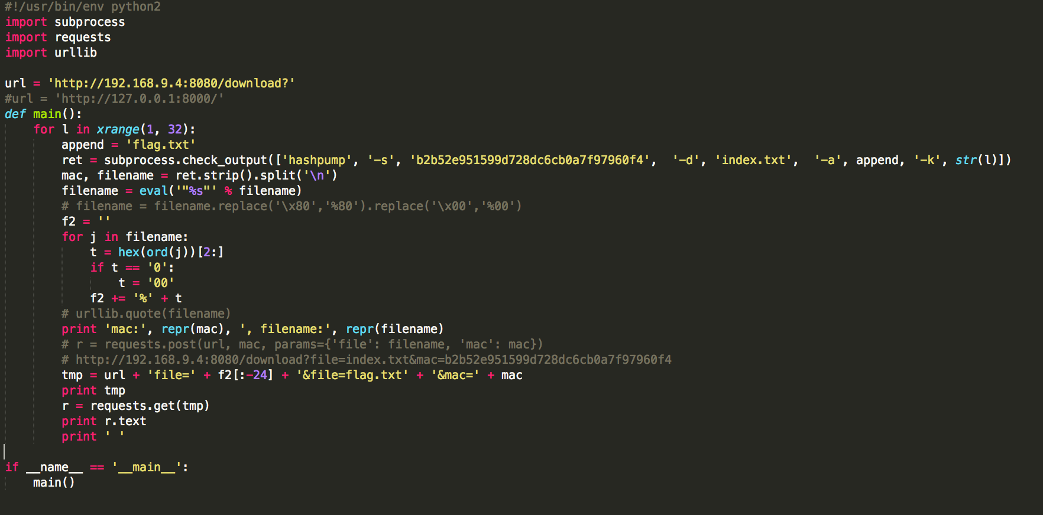
APK思路

Slide 4
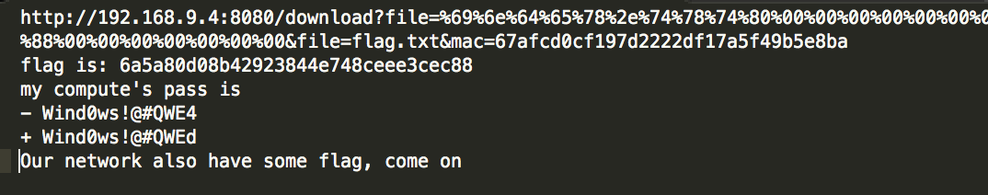
APK思路

Slide 5
Vlan1 思路
After PortKnock
Nmap
Rsync
RAR
Audit
Vulnerable

Slide 6
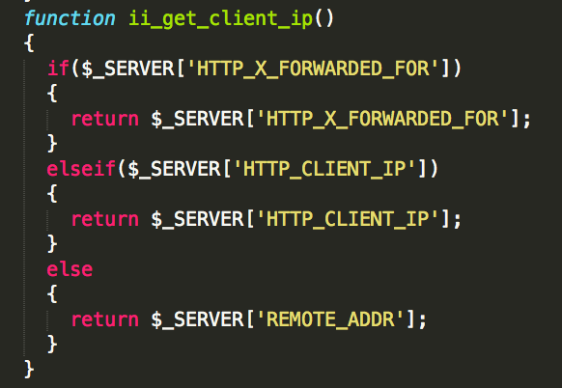
Vlan1 思路

Slide 7
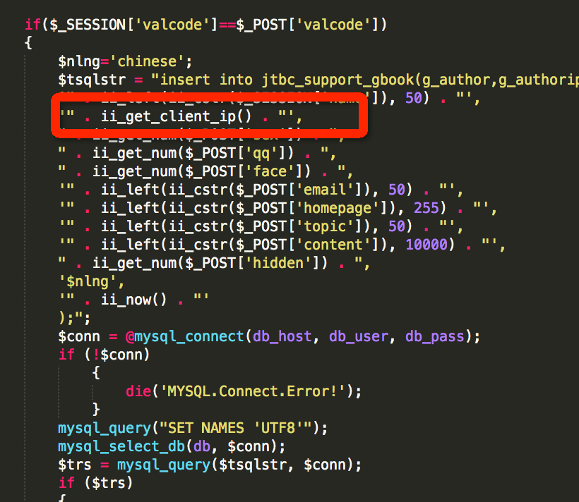
Vlan1 思路

Slide 8
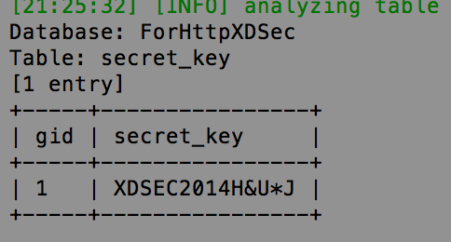
Vlan1 思路
SQL Insert Injection
Show in IP?
Blind?
SQLMAP is Awesome

Slide 9
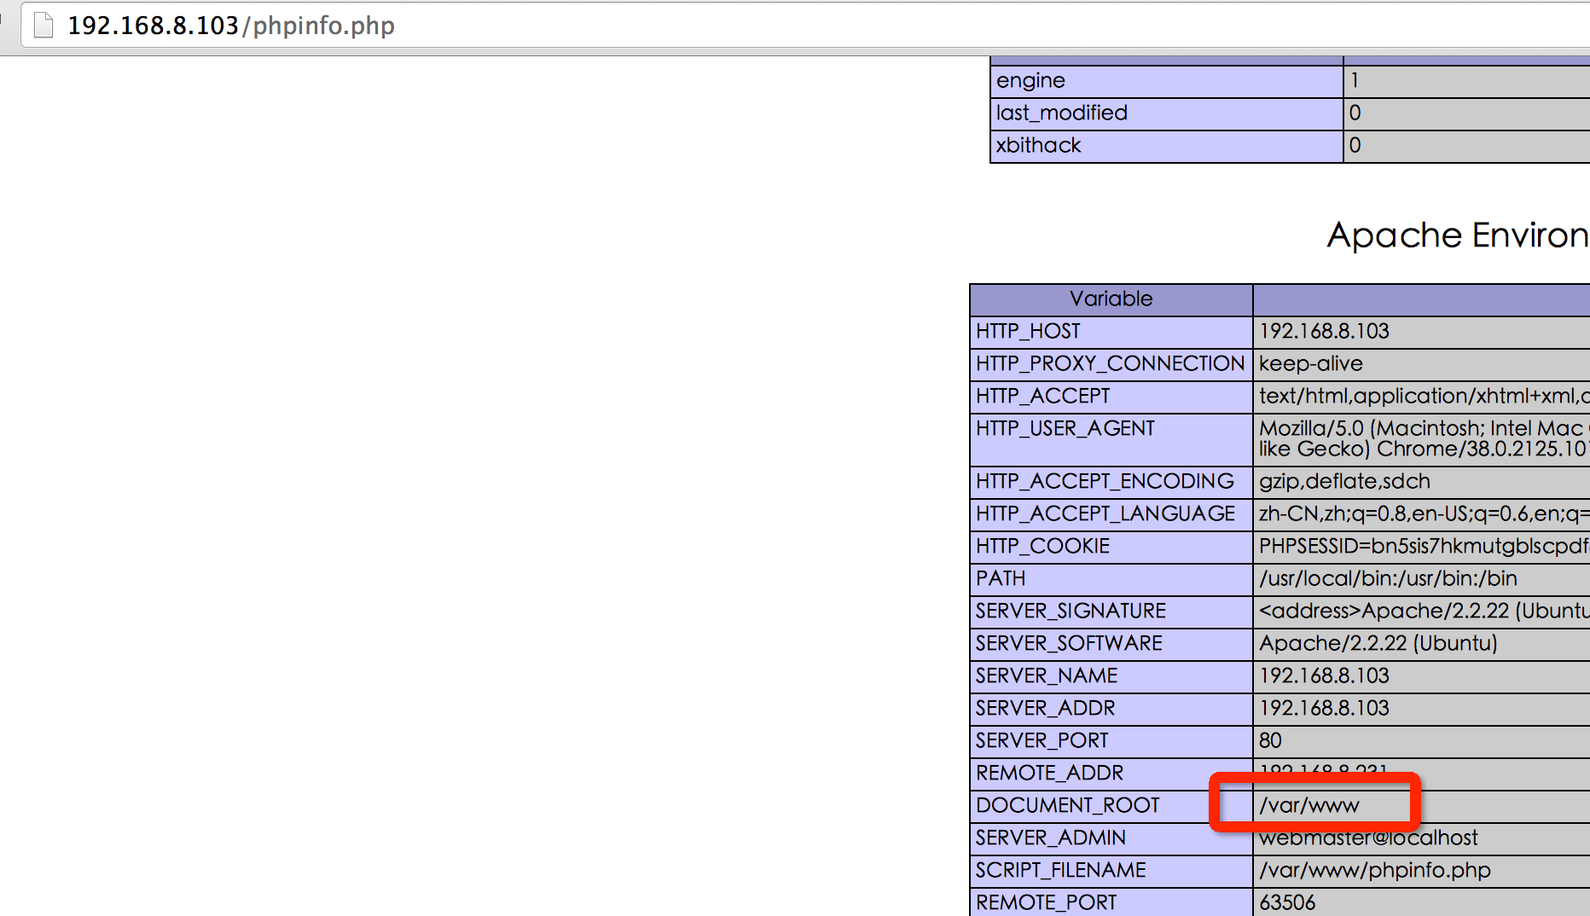
Vlan1 思路

Slide 10
Vlan1 思路
SQLMAP is Awesome x2
--os-shell
--sql-shell
select ‘xxx’ into outfile ‘/var/www/adog.php’;

