Slide 1

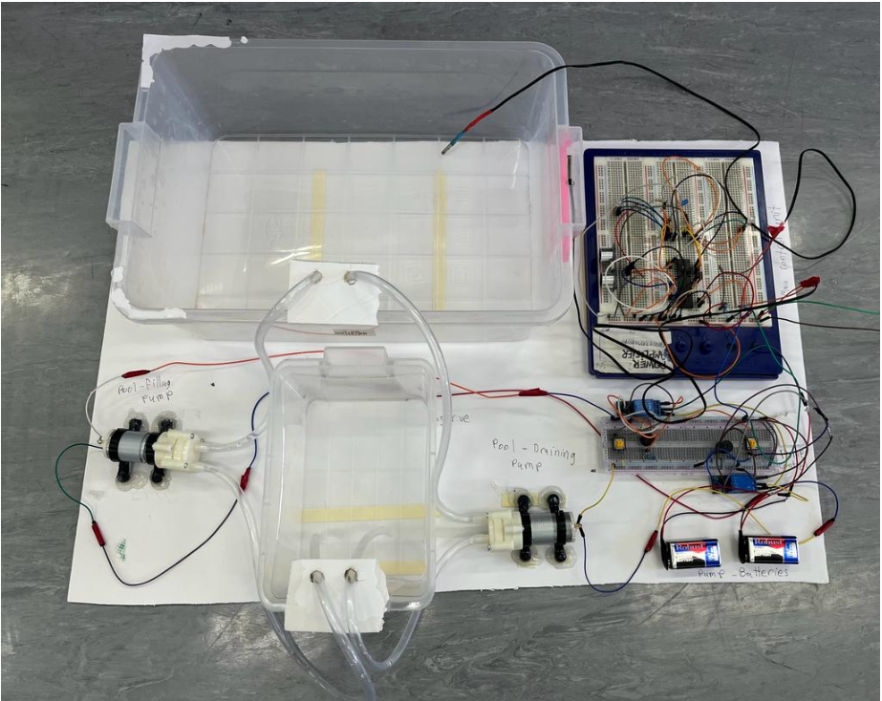
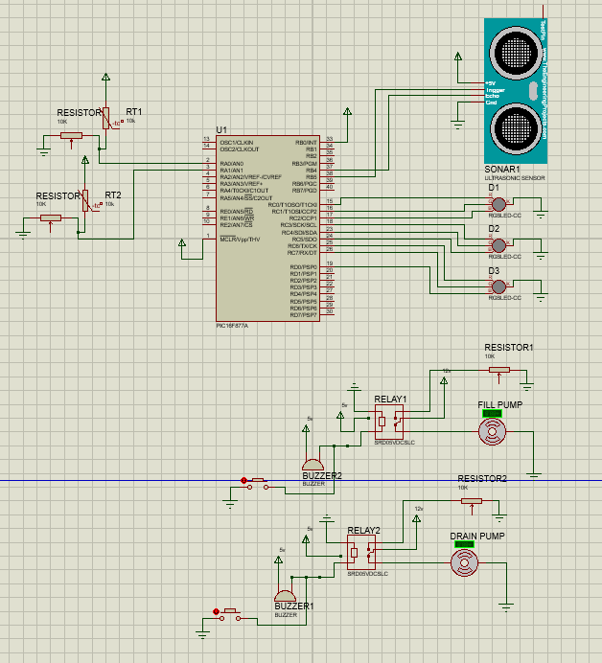
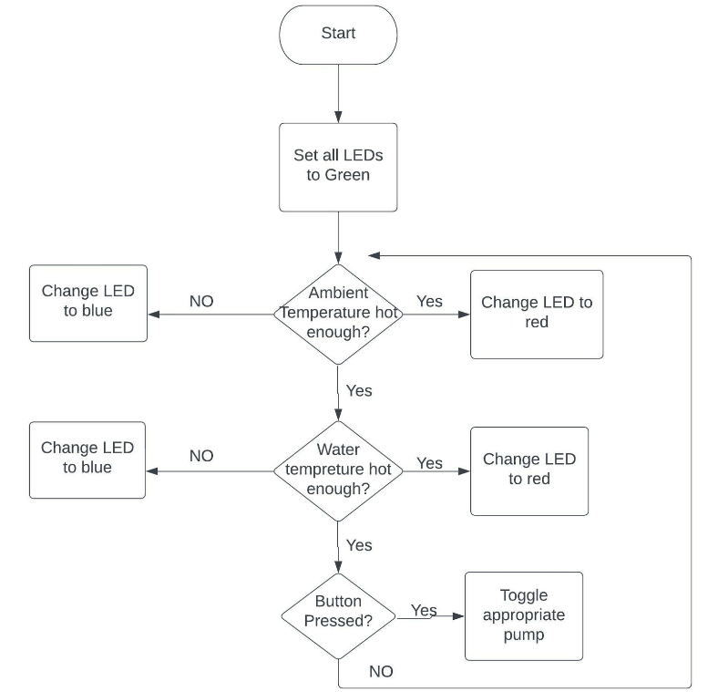
Pool Control system
Zaid Al-Kayed 20190249
Ghazi Hamad 20190397
Ahmad Dawood 20180960
Supervisor: Dr. Belal Sababha
Embedded Systems Final Design Project, Fall 2022
King Abdullah II School of Engineering
Princess Sumaya University for Technology
Introduction
This report presents the design of the Pool Control System. The Pool Control System aims to provide the functionality of filling up a pool with water, drain water from a pool to a tank, and indicate if water inside the pool is cold or hot. Moreover by using two temperature sensor that measure the ambient and the water temperature which give indicator on the led, the led will turn red if the temperature is hot, and turn blue if the temperature is cold.
Results
Results of the testing show that all functionalities worked as expected. However, testing showed that the ultrasonic sensor did not function properly when connected to the rest of the system components. As a result, we decided to remove the ultrasonic sensor from the final design. In future versions of this project, it would be recommended to thoroughly test all components of the pool control system, before integrating them into the final design. Adding the ultrasonic sensor to the current system would make the water pumps turn on to fill up or drain out water automatically
Figure 2: Pool control system prototype.
Figure 3: shows the schematic diagram of Pool Control System.
Design
Mechanical components:
  Water pumps, which is responsible of fill up and draining out the water from the pool to the tank and vice versa.
  A push button, which is used to turn the water pumps on and off.
  A buzzer, which provides a sound to alert when the water pumps is turned on for filling up or draining out the pool.
Electrical components:
  A PIC16F877A microcontroller, which is used to control all components of the Pool Control System to work together as one system.
  Two SRD-05VDC-SL-C Relays, which are used to connect the push button with the water pumps.
  Two RGB LEDs, which is responsible of displaying two temperature levels: red for hot and blue for cold.
  An Ultrasonic Sensor, which is used to measure the depth of the water.
  Two Temperature Sensors, which read the ambient and water temperature.
Software:
Figure 1: Shows Flowchart Diagram
Conclusion
We presented the prototype details of the Pool Control System, Using the push buttons, the user can turn on a water pump to fill in a pool with water or drain it out to a tank. Moreover, the system was able to monitor and indicate the ambient temperature and the water temperature status using LEDs. Results of testing the prototype show that all functionalities worked as expected except when the ultrasonic sensor was connected to the system. In the future, we aim to integrate the ultrasonic sensor in the Pool Control System and try to implement the project on a bigger scale.

