Slide 1
Marketing Analytics Report ProGear Sports
By Nathnael Dagnaw Mellese
February 2026

Slide 2
Executive Summary
Conversion rate: While the 9.6% aggregate conversion rate shows strong buyer intent, the decline from 11.6% (2023) to 8.6% (2025) reveals a 25.8% erosion in sales efficiency that must be addressed through better funnel optimization.
Customer engagement: Total reach and Click-Through Rate has significantly collapsed by 80% and 68% respectively over the last two years. Suggesting that our current content strategy is no longer resonating despite sustained financial investment.
Marketing spend efficiency is deteriorating, with high reach not translating into proportional clicks or purchases.
Customer satisfaction is moderate (avg rating 3.69), with a meaningful negative sentiment share that may be suppressing conversions.
Performance gaps across products and demographics reveal clear opportunities for targeted optimization and budget reallocation.

Slide 3
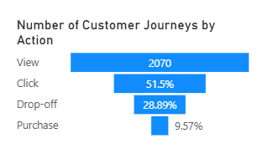
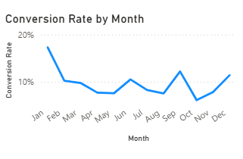
Conversion Performance
Overall Conversion Performance
An overall conversion rate of 9.6% still outperforms industry standards, suggesting those who reach the site are ready to buy.
The conversion rate has dropped from 11.6% in 2023 to 8.6% in 2025. This decline in sales efficiency is happening at the same time our total reach has collapsed from 5 million to 1 million views.
Business implication: We are not just reaching fewer people; we are converting a smaller percentage of the ones we do reach, pointing to a need for a refreshed value proposition or checkout experience.
Funnel Drop-Off Analysis (Customer Journey)
The primary "revenue leakage" is the transition from 9,079,276 social views to only 2,070 website visits.
51.5% of users move from website vist to click. Initial interest is healthy.
We are losing 28.89% of potential buyers during the digital journey, highlighting a technical or friction-based barrier to purchase.
Monthly Conversion Trends
Conversion peaks early in the year and again slightly around early Q4.Noticeable decline occurs through the mid-year period.
Performance remains inconsistent month to month.
Insight: Seasonality plays a role, but the volatility suggests campaign effectiveness and on-site experience are not stable.

Slide 4
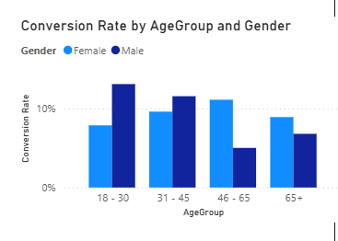
Conversion Performance
Age Group & Gender Conversion Patterns
Highest conversion rates occur in the 18–30 and 31–45 age groups.
Males convert more in younger segments (18–45).
Females outperform males in older age groups (46–65 and 65+).
Insight: A single broad marketing approach is inefficient; demographic segmentation can significantly improve conversion performance.
Product-Level Conversion Performance
Top Converting Products
Hockey Stick - 15.5%
Ski Boots - 14.6%
Baseball Glove - 13.7%
Low Converting Products
Swim Goggles - 5.6%
Running Shoes - 6.3%
Dumbbells - 7.0%
Visibility ≠ Conversion: Our most-viewed product, Basketball (529K views), has a below-average conversion of 7.4%.
Business implication: Niche products like Hockey Sticks (15.5%) and Ski Boots (14.6%) are our most efficient revenue drivers and should be prioritized in ad spend to combat the overall conversion decline.

Slide 5
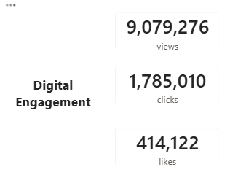
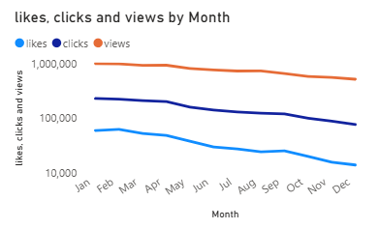
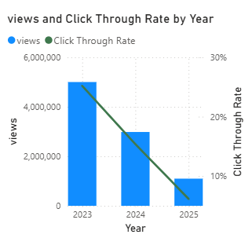
Engagement
The "Engagement-to-Traffic" Gap
Our digital platforms generated over 9 million views, yet the conversion funnel shows only 2,070 website views. This indicates that while social media is excellent at generating "likes" and "clicks," it is currently failing to drive users from the social platforms to the actual website.
There is a clear downward trend in engagement as the year progresses. Monthly views peaked in January (982K) and declined to a yearly low in December (510K) - a nearly 48% drop.
Insight: Social media engagement is strong, but it isn’t translating into website traffic. Introducing clear calls to action will help convert that attention into meaningful visits and, ultimately, purchases.
Intra-Year Seasonal Trends
Likes, clicks, and views all trend downward across the year. Total Monthly views peaked in January and steadily declined to a low in December, representing a nearly 48% drop.
2023–2025 Performance Erosion
Total views have plummeted from 5 million in 2023 to 1 million in 2025.
The Click-Through Rate (CTR) has dropped from 25% in 2023 to 6% in 2025, suggesting that our current creative content is no longer resonating or capturing the audience's attention as effectively as it once did.
Insight: Despite continued financial investment, marketing efficiency is significantly declining over the years.

Slide 6
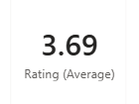
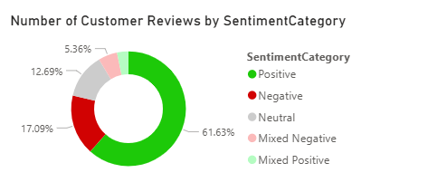
Customer Sentiment & Satisfaction
Average customer rating is 3.69, below the strong ecommerce benchmark (4.0+), indicating customer experience is meeting expectations but not strongly exceeding them.
Positive sentiment accounts for 61.63% of feedback, but the combined 22%+ negative and mixed negative share is large enough to impact purchase confidence.
A substantial portion of reviews cluster around 3-star ratings, showing many customers feel neutral rather than highly satisfied, which weakens word-of-mouth and repeat purchase momentum.
Satisfaction is consistent across age groups and genders. However, Males 65+ represent the highest satisfaction segment, while Males 18-30 and Female 31 - 45 are slightly more critical.

Slide 7
Recommendations
Optimize Checkout Experience (Immediate impact): Reduce friction steps, improve payment options, strengthen trust signals, clarify delivery and returns.
Bridge the Traffic Gap: Implement aggressive "Call-to-Action" (CTA) overlays on high-performing social content to convert "Likes" into "Website Visits”.
Reallocate Budget: Shift spend away from high-reach/low-conversion items (e.g., Basketball) toward high-intent products like Ski Boots and Hockey Sticks to maximize ROI.
Leverage Social Proof: Combat the falling CTR by integrating our high volume of 5-star customer reviews into our ad creatives to rebuild trust and interest.
Address Seasonal Attrition: Investigate the 48% decline in engagement from January to December and develop a Q4 "Retention and Re-engagement" campaign.
Improve Traffic Quality: Tighten audience targeting on social media and reduce low-intent reach campaigns.
Segment Campaigns by Demographics and align marketing with seasonal demand.
Elevate Customer Experience to Push Rating > 4.0. For long-term conversion lift.
Prioritize high-conversion, high-margin SKUs.
Come up with new and creative marketing campaigns to reignite engagement.

Slide 8




Project Links
GitHub Repository
Portfolio Website
LinkedIn
Contact

