Slide 1
RIFT
ONCHAIN INTELLIGENCE
See the signal.
Follow the evidence.
BEST
GRANDPA
BEEFY
PRODUCTION → FINALITY → CHECKPOINT
Live Portaldot V3 finality monitoring and hash-based report investigation.
Monitoring and report evidence for operators
NODE OPERATIONS & TOOLING
PORTALDOT HACKER HOUSE 2026 · 29 OCTOBER 2026
RIFT · PORTALDOT V3
01 / 06
Notes:
RIFT gives Portaldot operators a live view of the imported head, GRANDPA finality, and BEEFY checkpoint progress, then lets them investigate a reporter-submitted on-chain report and its archived bytes. The registry does not verify consensus proofs.

Slide 2
RIFT / PORTALDOT V3
The finality pipeline
One latest-block number does not show which stage is waiting.
01
02
03
BEST
GRANDPA
BEEFY
Latest imported head
Finalized head
Checkpoint finalized
GRANDPA LAG = BEST − GRANDPA
BEEFY LAG = GRANDPA − BEEFY
RIFT puts lag, source freshness, thresholds, and session-local authors in one operator view.
Initial user hypothesis: Portaldot node and validator-program operators.
RIFT · PORTALDOT V3
02 / 06
Notes:
RIFT focuses on the operational stages of the network pipeline rather than general block search. GRANDPA lag is Best minus GRANDPA. BEEFY lag is GRANDPA minus BEEFY. Author counts begin when the dashboard session connects and are not historical validator rankings.

Slide 3
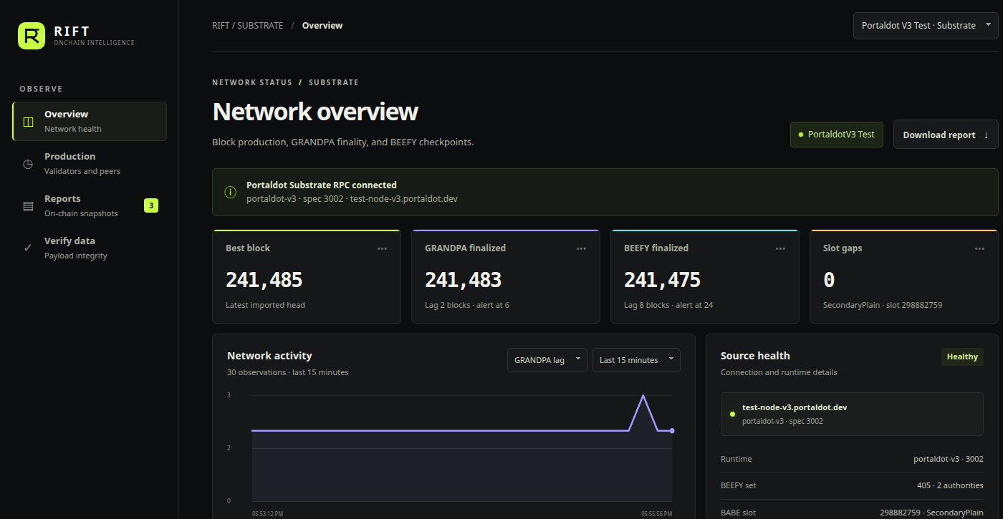
RIFT / PORTALDOT V3
Live network signal
Portaldot V3 Substrate RPC · live capture from 29 October 2026
OBSERVED HEADS
BEST
241,485
GRANDPA 241,483 · lag 2
BEEFY 241,475 · lag 8
Freshness, thresholds, and the three head positions stay visible together.
The chart and author sample begin when this monitor session connects.
RIFT · PORTALDOT V3
03 / 06
Notes:
This screenshot was captured from the public Portaldot V3 native WebSocket on 29 October 2026. At capture, Best was 241,485, GRANDPA 241,483, BEEFY 241,475, GRANDPA lag 2 and BEEFY lag 8. These are RPC observations. The page history and author counters are session-local.

Slide 4
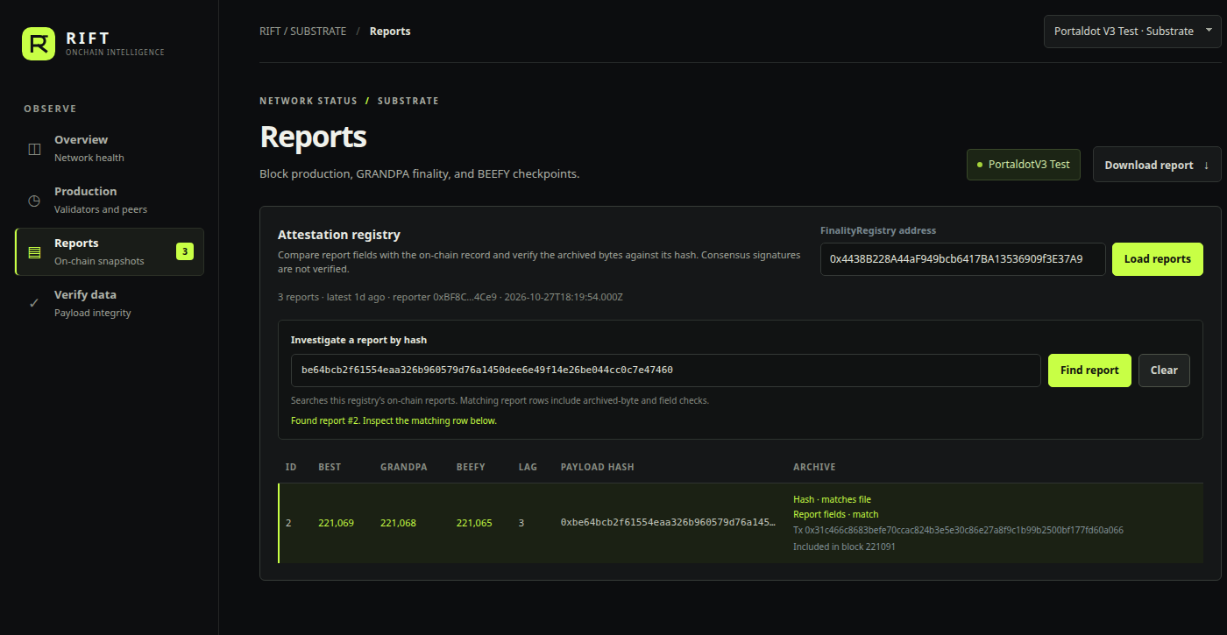
RIFT / PORTALDOT V3
Investigate a report by hash
Paste a payload hash or publication transaction hash to find the on-chain record.
REPORT #2 · 27 OCT 2026
01 Find the report
Search by its payload hash or publishing transaction hash.
02 Check the archive
RIFT rehashes the exact archived bytes and compares six stored fields.
HASH MATCH · REPORT FIELDS MATCH
Publication included in block 221,091.
RIFT · PORTALDOT V3
04 / 06
Notes:
The report hash shown is snapshot id 2, captured and published on 27 October 2026 and included in block 221,091. The on-chain record and archived JSON were both loaded by the RIFT dashboard during capture. The input accepts a 32-byte payload hash or a publication transaction hash.

Slide 5
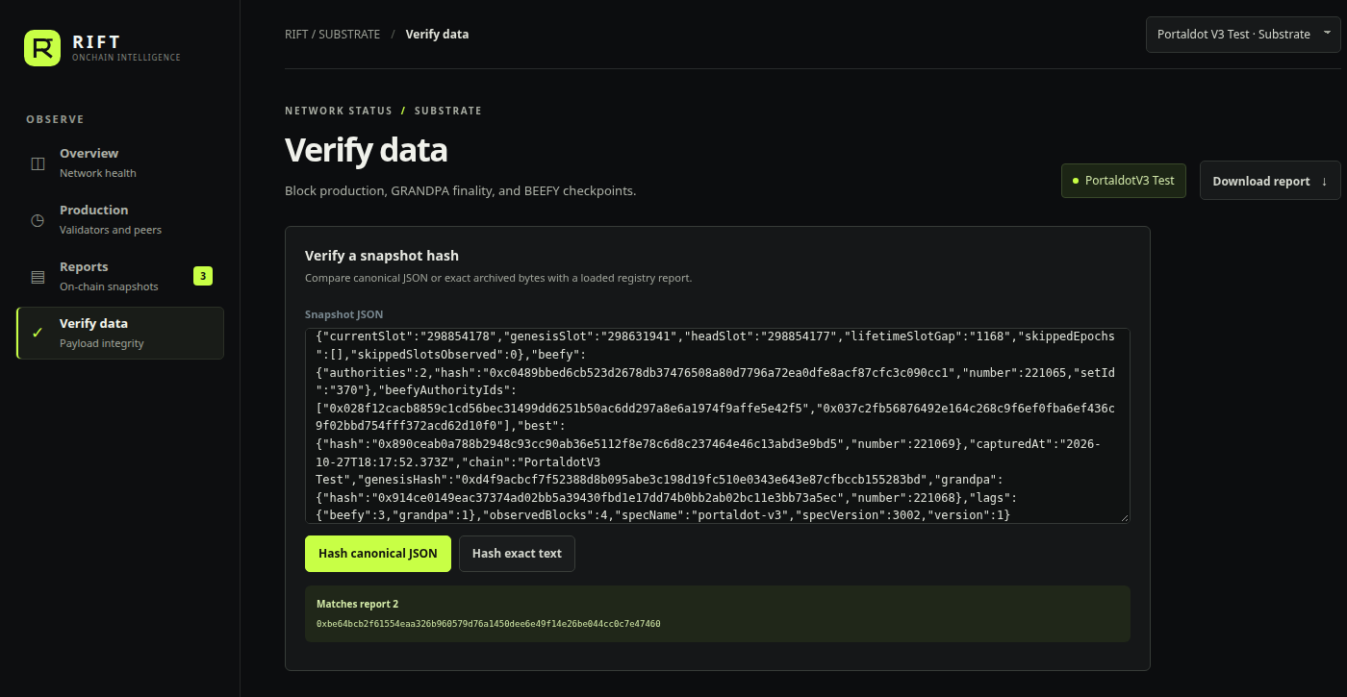
RIFT / PORTALDOT V3
Evidence integrity is not consensus proof
The report can be checked against its archive without overstating what that proves.
WHAT THE CHECK ESTABLISHES
Keccak of the exact archived JSON matches the payload hash.
Six archived fields match the registry record: head heights, BEEFY set, authority count, and observed slot gaps.
TRUST BOUNDARY
The registry stores reporter-submitted values. It does not validate BABE, GRANDPA, or BEEFY proofs.
PORTALDOT V3 · CHAIN 420420777 · REPORT #2
RIFT · PORTALDOT V3
05 / 06
Notes:
The archive hash and six anchored values match the on-chain report. The six fields are Best, GRANDPA-finalized, BEEFY-finalized, BEEFY set id, authority count, and observed skipped slots. This proves consistency between the reporter-submitted archive and report fields. It does not prove the source observation was true or verify consensus proofs.

Slide 6
RIFT / PORTALDOT V3
From demo to operator product
A self-hosted monitor is the first useful release. A managed service is a hypothesis to validate.
01 · TEAM USE
02 · CLOSE THE LOOP
03 · PAID, IF PULLED
Keep it running
Make alerts useful
Host the workflow
Run the collector as a supervised service.
Persist observations beyond a browser session.
Export health and lag metrics.
Tune freshness and finality thresholds with operators.
Send alerts to Slack, Discord, or webhooks.
Attach the report and source context.
Shared workspaces, alert policies, incident history, and longer retention.
Never put reporter keys in the browser.
Price only after a pilot confirms demand.
FIRST VALIDATION
One Portaldot operator team: measure alert usefulness, false alarms, and time to investigate before building a hosted tier.
RIFT · PORTALDOT V3
06 / 06
Notes:
This is a proposed commercialization path, not validated demand. Today the dashboard reads RPC directly in the browser and keeps its chart history in session memory. The CLI collector already provides a starting point for a long-running service. First, use it internally or with one operator team; add persistence, service health, and alert delivery. Consider a paid hosted control plane only if teams ask for shared access, retention, and alert routing. No pilot, customer, or pricing commitment has been secured.

