Slide 1
Rx
NightRx
Prove medication eligibility without revealing your diagnosis
Midnight Hackathon
Healthcare Track

Slide 2
THE PROBLEM
38 million people with HIV. 60% avoid treatment due to stigma.
Because getting medication means revealing your most private health information.
38M+
60%
1 in 5
People living with HIV globally
Avoid treatment due to stigma
US adults with mental illness

Slide 3
A pharmacy doesn't need to know why you need medication.
They only need to verify: "This person is authorized to receive medication X, confirmed by a trusted clinic."

Slide 4
HOW IT WORKS
Three steps. Zero diagnosis exposure.
01
02
03
Clinic Issues
Patient Proves
Pharmacy Verifies
After diagnosis, the clinic issues a private credential. Commitment stored on-chain. No medical data exposed.
→
Patient generates a ZK proof on their own device. Proof says: "I'm eligible." Diagnosis never leaves.
→
Pharmacy submits proof to Midnight. Contract verifies: issuer trusted, nullifier fresh. Medication dispensed.

Slide 5
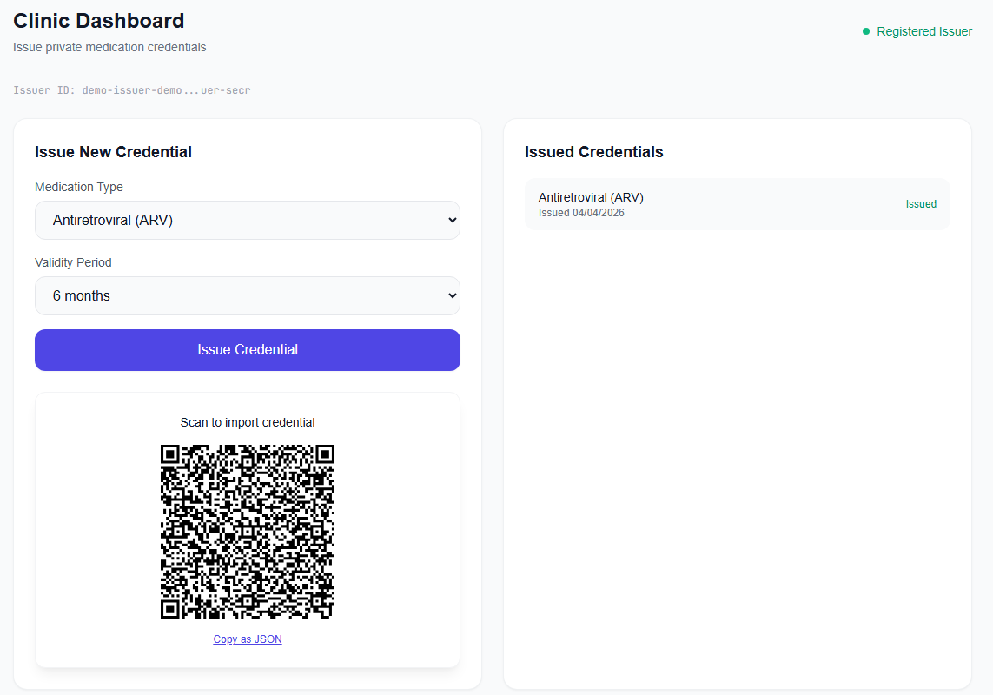
THE APP
Clinic Dashboard
Register as a trusted issuer, issue private medication credentials with QR codes.
✓ One-click issuer registration
✓ Medication type selector
✓ QR code credential output
✓ On-chain TX confirmation

Slide 6
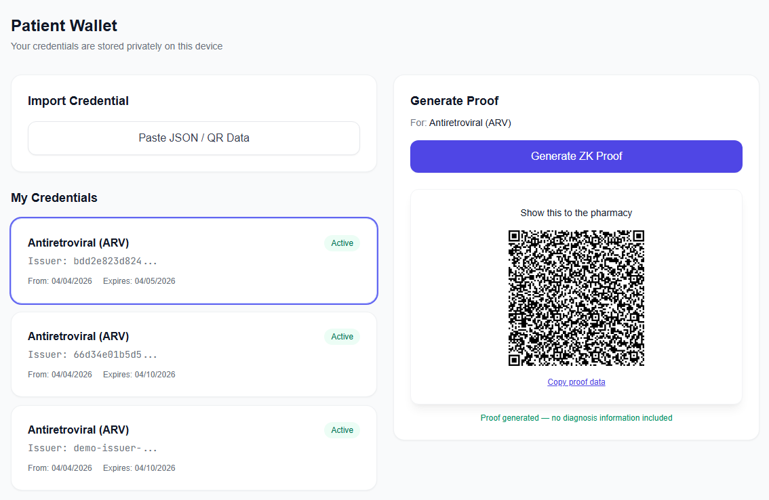
THE APP
Patient Wallet
Import credentials, generate zero-knowledge proofs privately on your device.
✓ Import via QR or JSON paste
✓ Credential status tracking
✓ Local ZK proof generation
[Patient Wallet Screenshot]

Slide 7
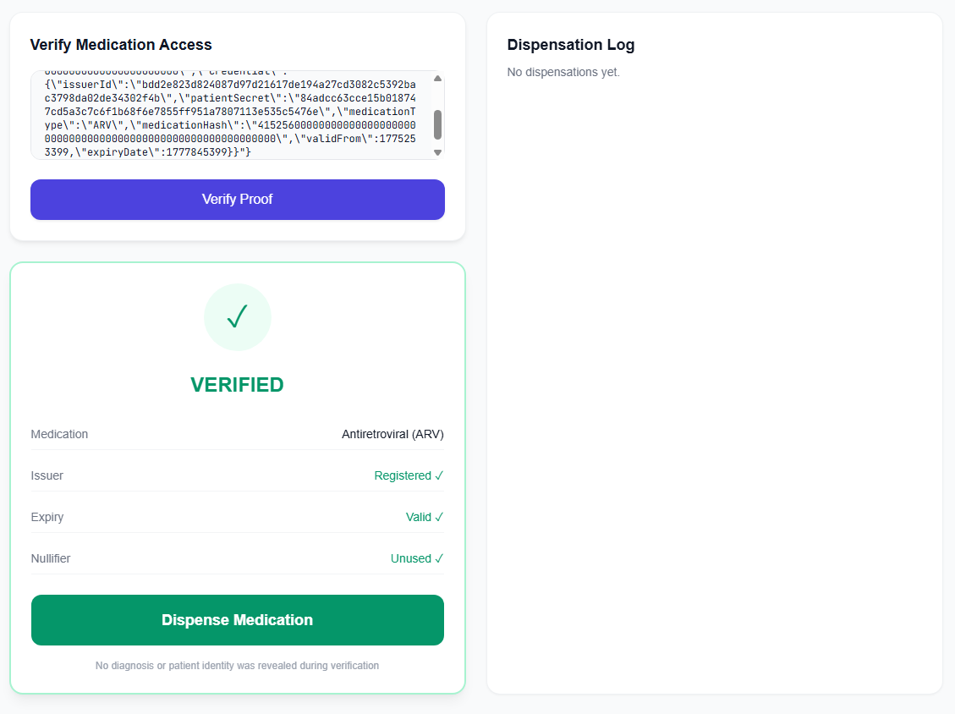
THE APP
Pharmacy Verifier
Verify patient eligibility on-chain. Never see diagnosis or identity.
✓ Paste proof or scan QR
✓ On-chain ZK verification
✓ VERIFIED / REJECTED result
[Pharmacy Verifier Screenshot]
✓ TX hash with explorer link

Slide 8
WHY MIDNIGHT
This cannot be built on a transparent chain.
Zero-Knowledge Proofs
Halo 2 proof system. Prove statements without revealing underlying data. No trusted setup.
Selective Disclosure
Patients control exactly what is shared. Only proof validity is visible — never medical data.
Compact Smart Contracts
TypeScript-like language with built-in privacy. Witness functions keep secrets off-chain.
Ethereum, Solana, and other transparent chains expose all transaction data by design. Midnight doesn't.

Slide 9
ON-CHAIN
Three circuits. Real ZK proofs.
registerIssuer()
Clinic proves identity via private key witness. Registered in on-chain issuer map.
issueCredential()
Stores hash commitment on-chain. Full credential details stay private. Only the hash is public.
verifyPickup()
Patient proves eligibility. Contract checks: commitment exists + nullifier unused = VERIFIED.
CONTRACT ADDRESS
preprod.midnightexplorer.com /contracts/5741
05d3e2900cf0a09f73dca91225f1594928d7dbcfcfa22bbcc4990ffcddf98ea5

Slide 10
PRIVACY MODEL
What the pharmacy never sees
On-Chain (Public Ledger)
Never On-Chain
✓
Credential commitment (hash only)
✗
Patient identity
✓
Nullifier (unlinkable hash)
✗
Diagnosis or medical condition
✓
Registered issuer public keys
✗
Full credential details
✓
Anonymous dispensation counter
✗
Medication-to-condition mapping

Slide 11
Live Demo
Real ZK proofs. Real blockchain transactions. Real privacy.
1
2
3
4
Register Issuer
→
Issue Credential
→
Import + Generate Proof
→
Verify + Dispense
Each transaction verified on Midnight Preprod • TX hashes visible in explorer

Slide 12
REAL-WORLD IMPACT
Beyond HIV — any sensitive medication
Mental Health
Addiction Recovery
Reproductive Health
STI Treatment
Antidepressants, antipsychotics— without workplace or insurance stigma
Methadone, naloxone— without the label of "addict"
Contraception, fertility treatment— without moral judgment
Antibiotics, antivirals— without social consequences
"Privacy in healthcare isn't a feature — it's a fundamental right. NightRx makes it cryptographically guaranteed."
Designed for dignity, consent, and access to care

Slide 13
ROADMAP
From prototype to production
Multi-Refill Tracking
Anonymous Health Stats
Separate nullifiers per refill cycle
Aggregated data without individual tracking
Credential Revocation
Mobile Wallet
Clinics invalidate changed prescriptions
React Native + Midnight Mobile SDK
Emergency Disclosure
Cross-Institution
Patient-controlled reveal for emergencies
Credential portability between systems
All future features leverage Midnight's native privacy model — no additional ZK infrastructure needed.

Slide 14
Rx
Prove eligibility. Not your condition.
CONTRACT
EXPLORER
GITHUB
05d3e290...df98ea5
midnightexplorer.com
0xNoramiya/nightrx
Midnight Preprod
/contracts/5741
Open Source • MIT License
Built with Midnight Network | Healthcare Track | 2026

