Slide 1







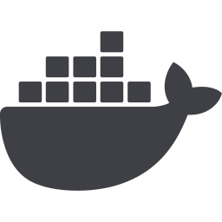

ShaderMesh
A decentralized marketplace for renting GPU compute on Ethereum
Rakesh Kumar Rabha (24BCC7002), Nilam Sikdar (24BCC7025), Animesh Mishra (24BCC7016)
Guide: [GUIDE NAME]
VIT-AP University
Final review | October 2026
1
Notes:
Introduce the project and the team. Eight to ten minutes in total.

Slide 2
Problem and why blockchain
Renting compute from a stranger requires trusting the stranger.
The problem
Concentrated supply
A few clouds set price while consumer GPUs sit idle.
Nothing to re-run
A rented interval has no output to recompute and check.
Pay first, hope later
No automatic remedy for downtime.
Why a blockchain
Neutral escrow
Funds sit in a contract neither party controls.
Enforceable collateral
Stake and slashing make downtime costly.
Public record
Heartbeats and settlement are auditable.
ShaderMesh
2
Notes:
Rental has no checkable output, so trust must come from collateral and provable availability. The chain is the trust, coordination and payment layer, not the compute layer.

Slide 3
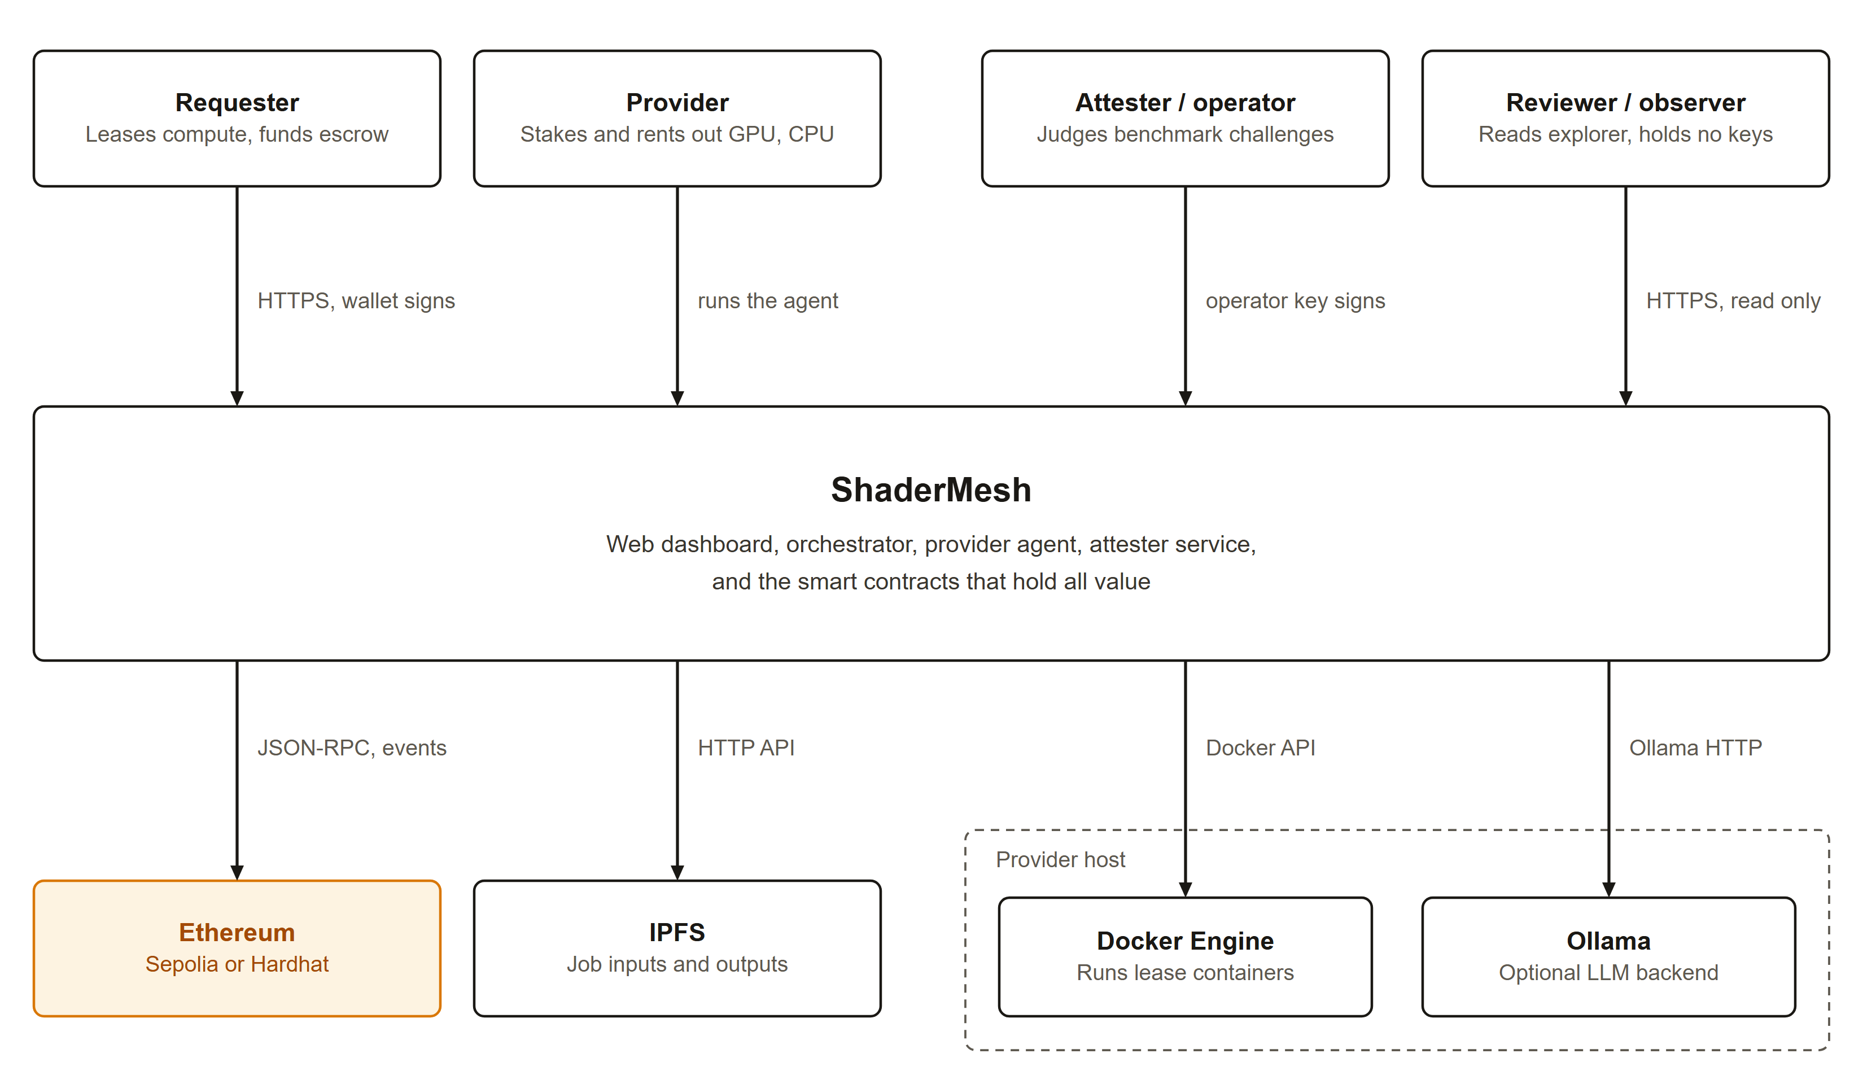
What ShaderMesh is
Two market modes share one staking, reputation and slashing layer.
Rental (primary)
GPU leases and model inference. Trust from stake, heartbeats and slashing.
Verifiable task
Jobs with checkable output. Trust from randomized re-execution.
ShaderMesh
3
Notes:
Rental is the headline use case. The verifiable task mode is retained and shares the same stake and slashing layer.

Slide 4
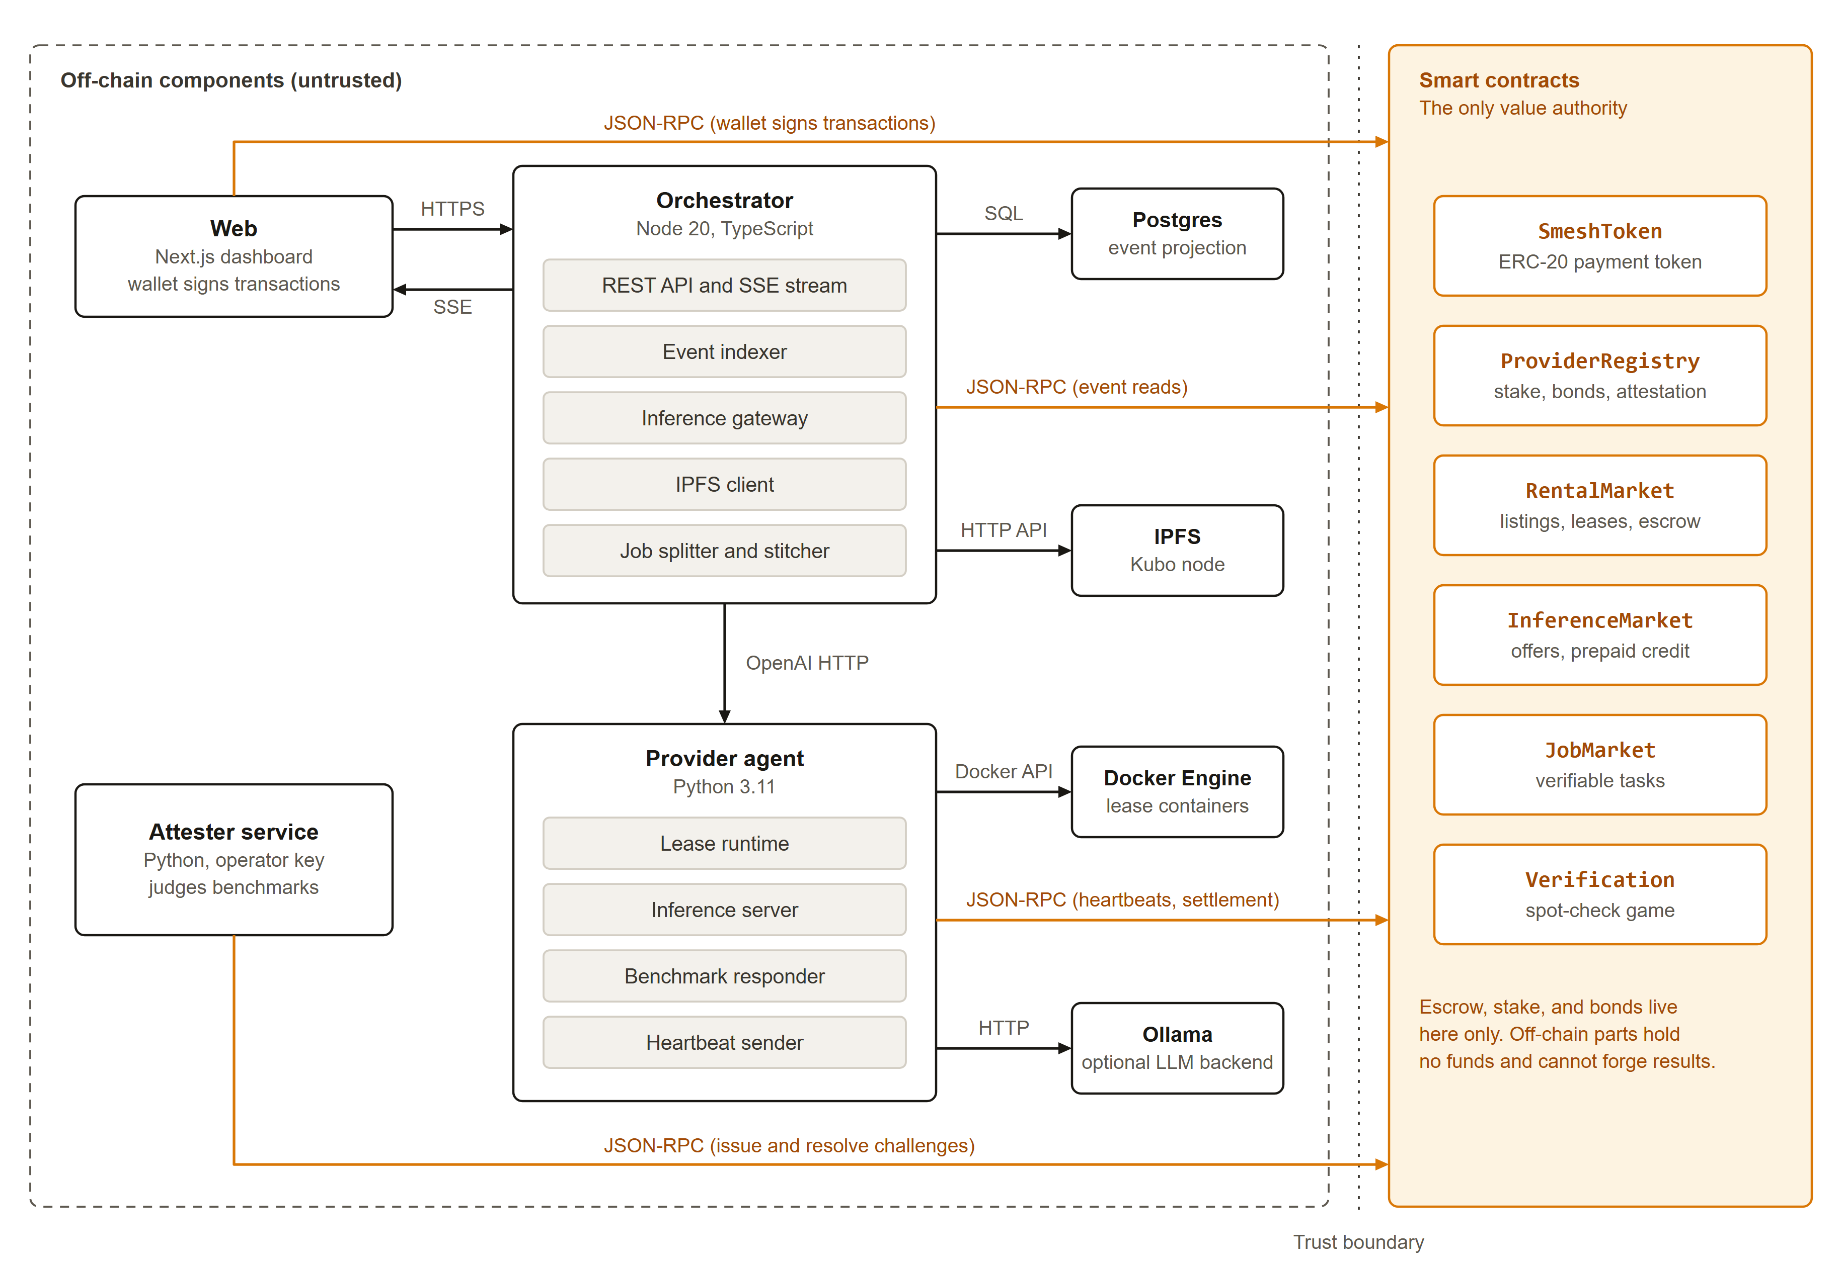
Architecture
Four off-chain components, one on-chain authority.
Contracts
Escrow, stake, slashing.
Agent and orchestrator
Serve and index. Untrusted.
Web
Console and explorer.
ShaderMesh
4
Notes:
The chain holds value and decides outcomes. Everything else can be replaced or can lie without moving funds.

Slide 5
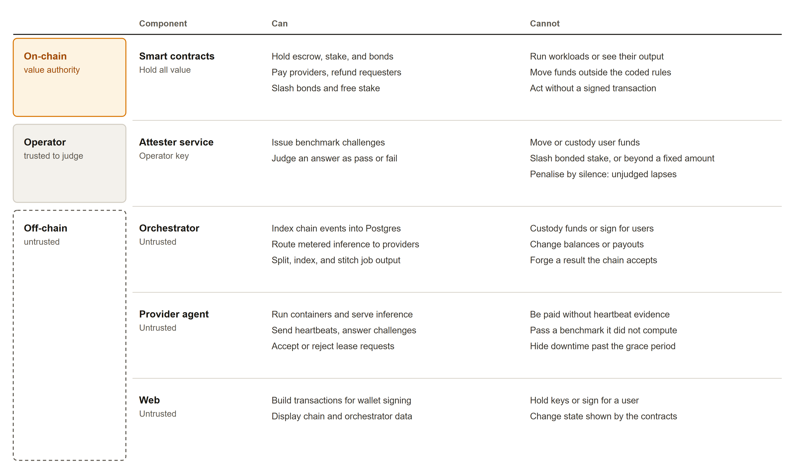
Trust boundary
Contracts move funds. Off-chain parts cannot hold funds or forge settlement.
ShaderMesh
5
Notes:
Contracts hold value and decide outcomes. The agent, orchestrator and web app are untrusted and cannot custody funds or forge results. The attester judges challenges and is the one trusted operator role.

Slide 6
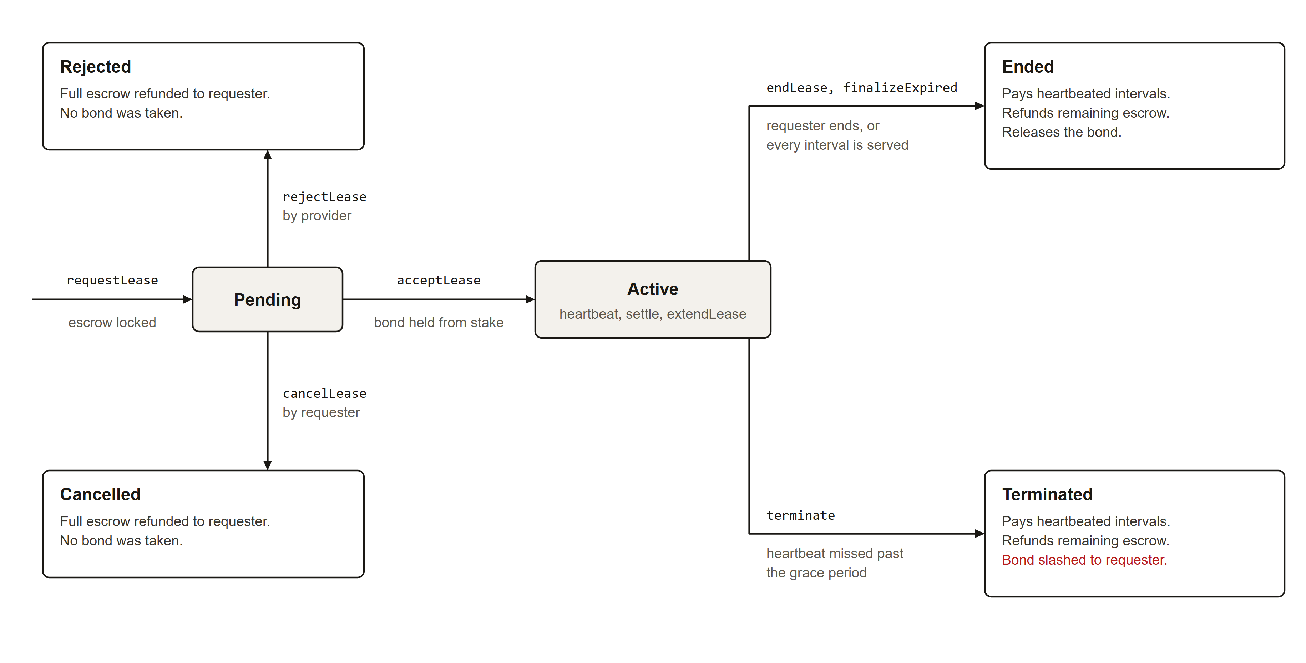
Rental lifecycle
Escrow streams to the provider one interval at a time.
Proven prefix
Escrow releases only for contiguous proven intervals.
Downtime
The remainder is refunded and the bond is slashed.
ShaderMesh
6
Notes:
A missed interval cannot be back-filled, so payment follows proven availability.

Slide 7
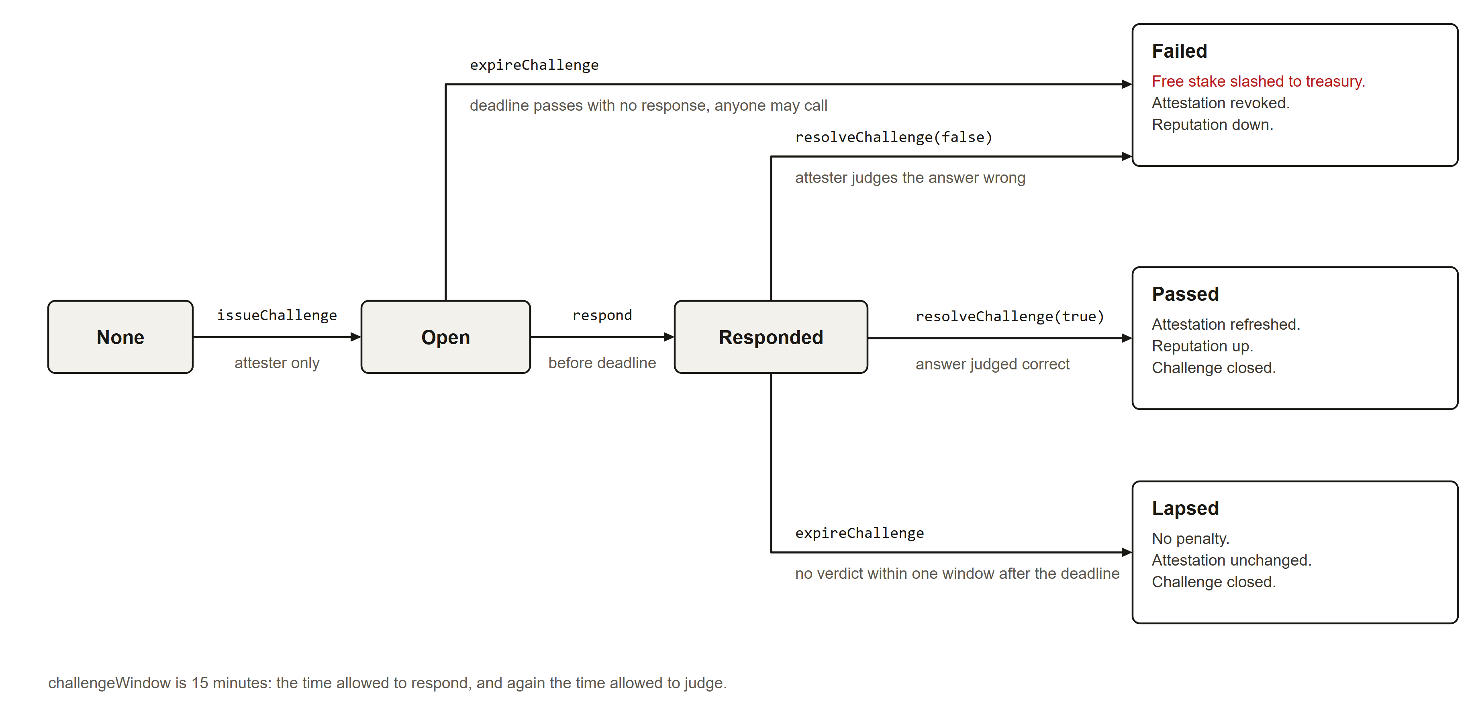
Benchmark challenges
Output speed is checked against a seeded hash chain.
Seeded hash chain
Work cannot be precomputed.
Failure
Free stake is slashed to the treasury.
Expiry
Anyone can expire a stale challenge.
Attester
Still trusted to judge.
ShaderMesh
7
Notes:
This closes the gap where a provider claims hardware it does not have. The attester remains the trusted party.

Slide 8
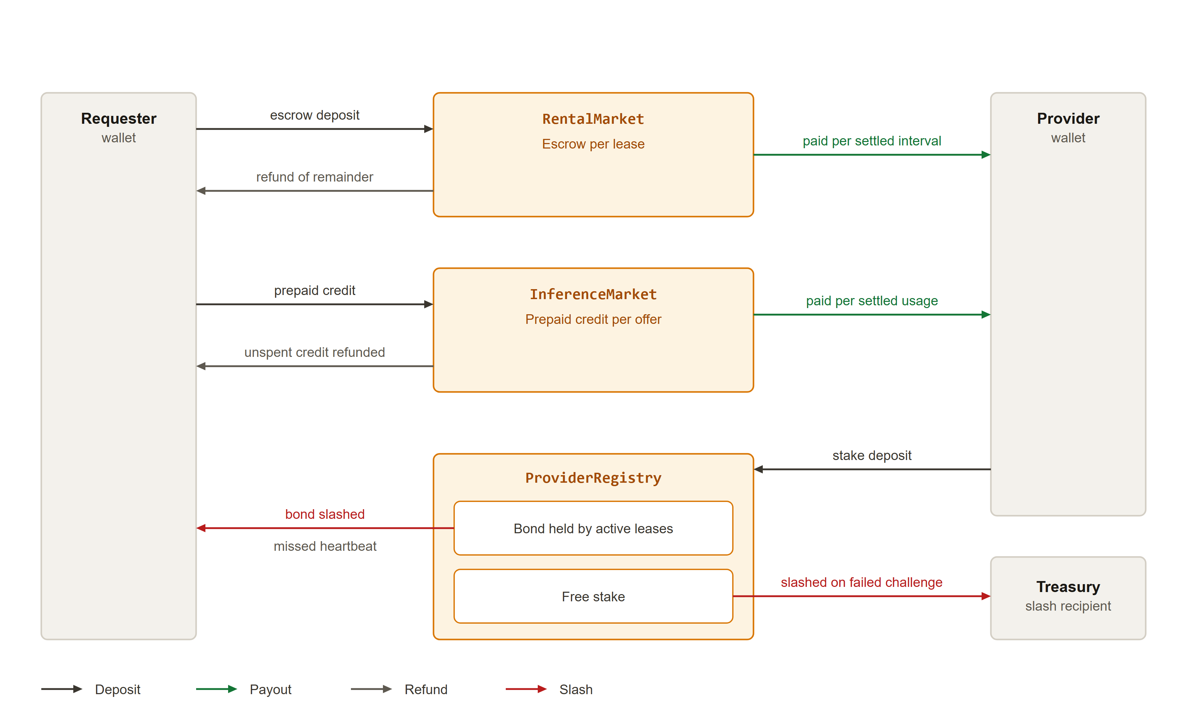
Token flow
Every movement of value is on chain.
In
Requester escrow and provider stake.
Out
Provider payout, refund, slash to treasury.
ShaderMesh
8
Notes:
Value only moves through contract calls.

Slide 9
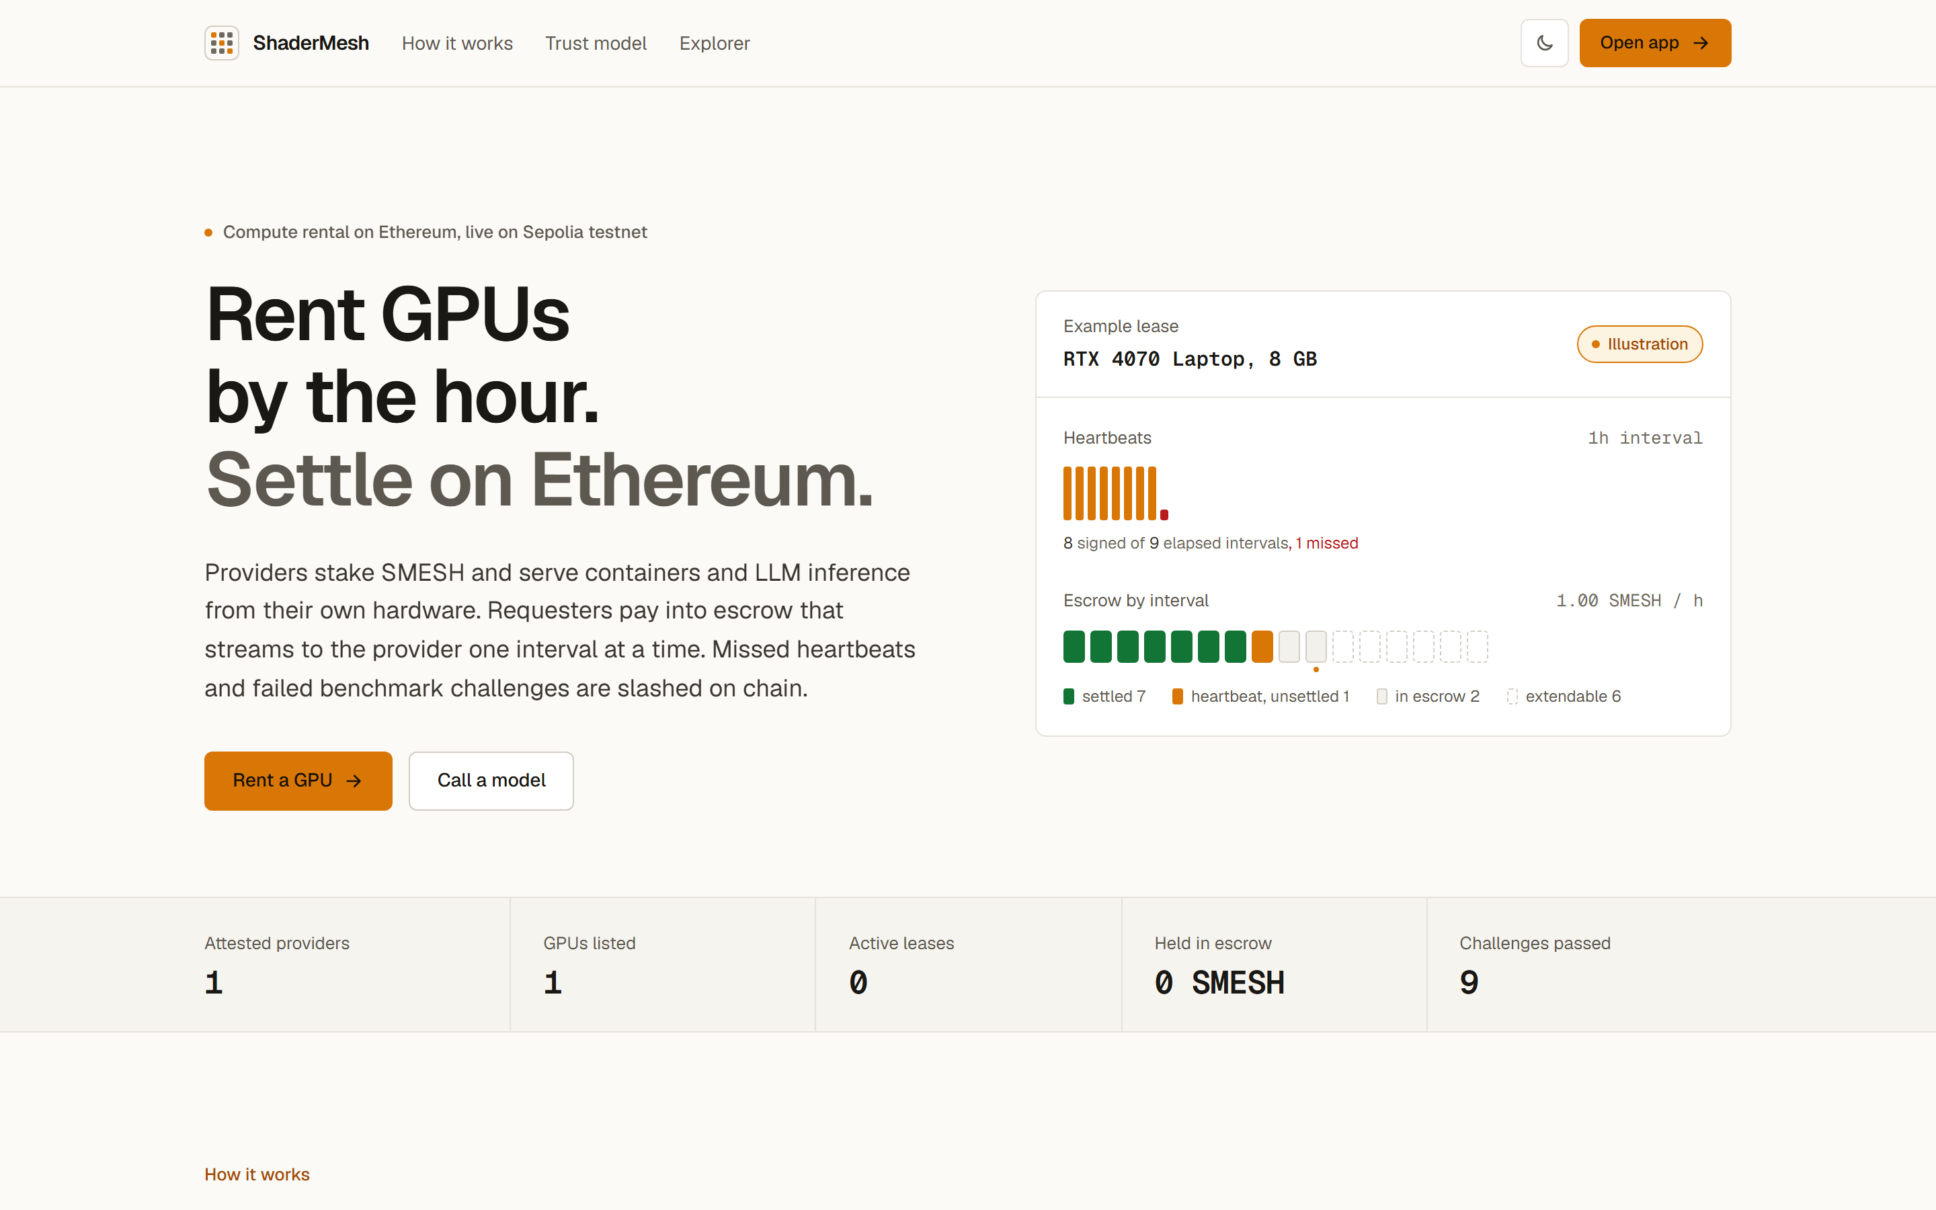
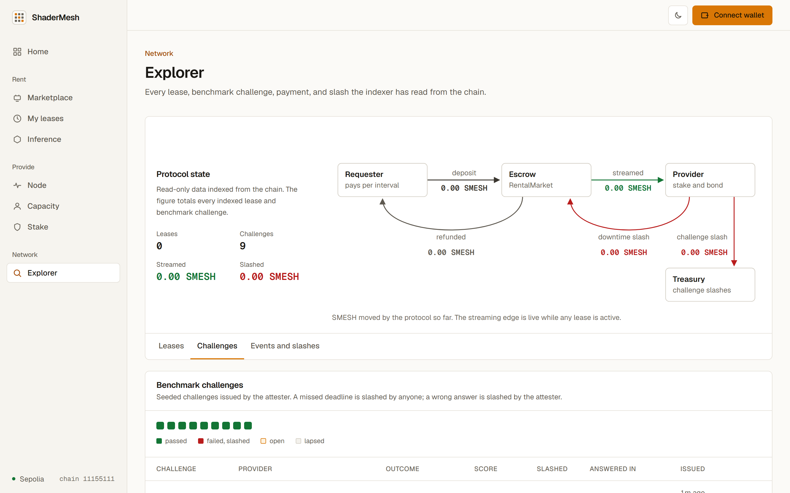
The product
A web console and a public explorer, both reading the chain.
Landing page
Explorer: benchmark challenges
Also built: dashboard, providers, model offers, rent flow, lease and event explorer.
ShaderMesh
9
Notes:
Screenshots are from the running local stack.

Slide 10
Testing and gas cost
Every layer has an automated suite, and CI runs all of them.
SUITE
TESTS
COVERS
TRANSACTION
GAS USED
Contracts (Hardhat)
42
unit and scenario
rental.requestLease
251,540
leases, challenges
rental.acceptLease
154,207
Provider agent
58
rental.heartbeat
56,487
Orchestrator
54 + 1 skipped
skipped needs live stack
rental.settle
59,987
Simulator
15
game economics
registry.issueChallenge
129,754
Web (Playwright)
30
incl. 4 wallet-write
registry.respondChallenge
76,217
CI compiles and tests every component on each push. Playwright signs real transactions.
ShaderMesh
10
Notes:
Counts are from the latest local run. The skipped orchestrator test is an integration test that needs a running stack. Gas figures come from the measured run in the report.

Slide 11
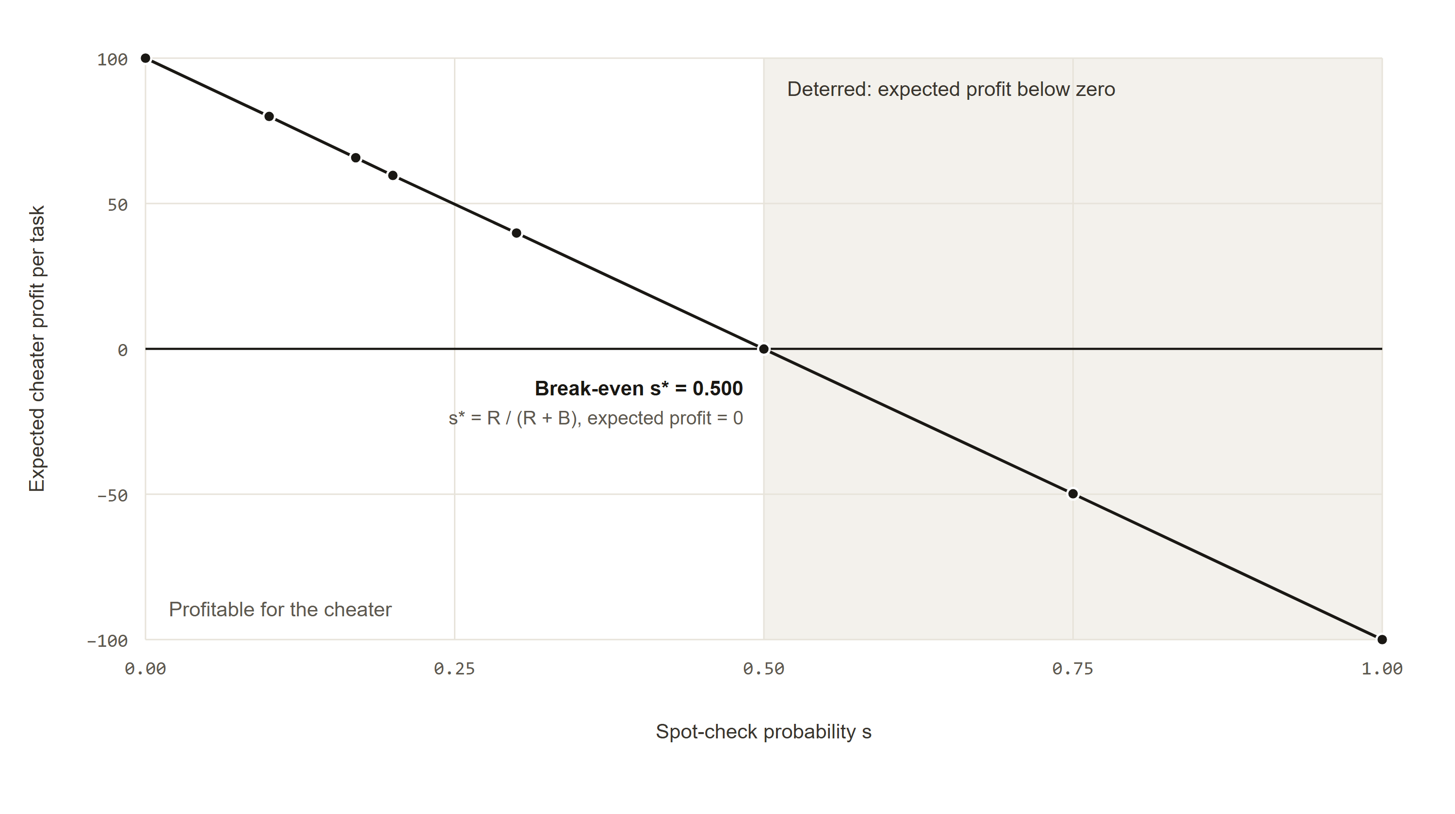
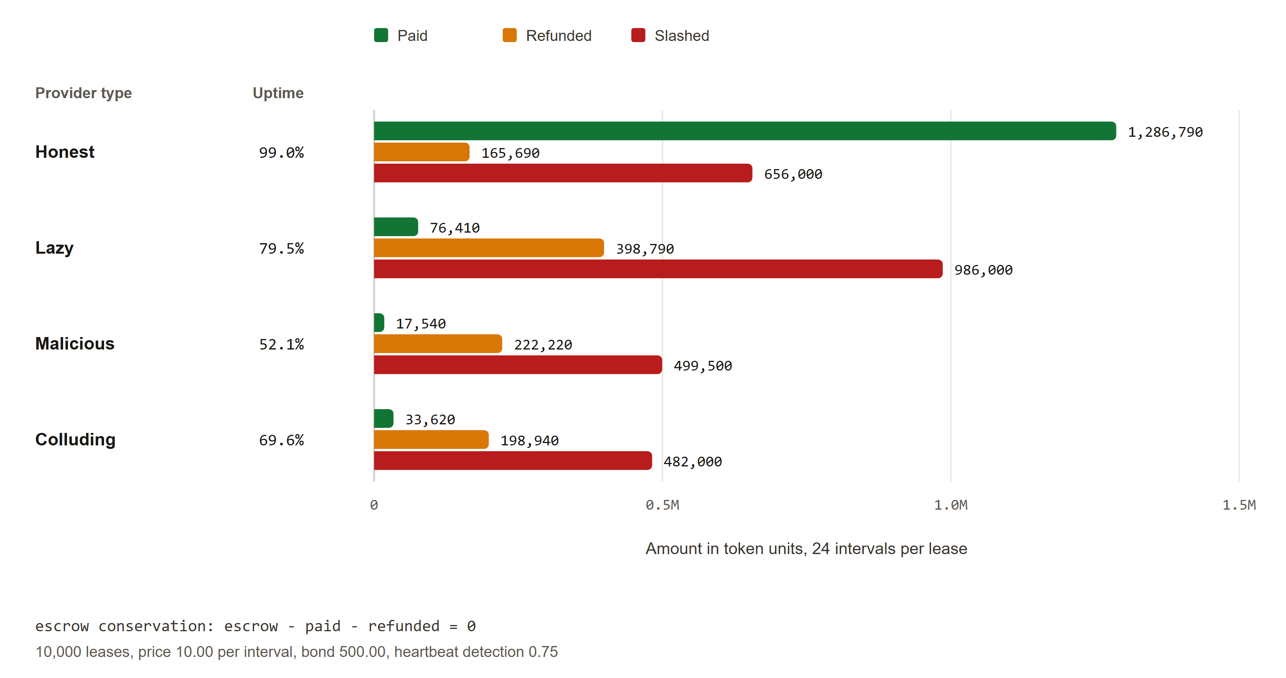
Evaluation
Detection odds and rental economics were measured.
Spot-check break-even is at s* = 0.5.
Escrow conservation holds exactly.
ShaderMesh
11
Notes:
Detection chart: cheating pays below the break-even spot-check rate and loses above it. Rental economics: provider payout plus requester refund plus slash always equals escrow plus bond.

Slide 12
Live on Sepolia
The full path ran on a public testnet with a real GPU.
6
contracts source-verified
RTX 4070 Laptop
provider GPU, attested
#1
listing
qwen3:0.6b
model offer #1
28,919
challenge #1 passed, about 289 tokens per second
108 s
time to answer
ShaderMesh
12
Notes:
Contract addresses and transaction hashes are in the final report.

Slide 13
Limitations and future work
The remaining trust assumptions are stated, not hidden.
Limitations
The attester is still trusted to judge challenges.
Providers submit their own heartbeats and pay the gas.
One provider tested on a public network.
No automatic check of rendering output.
Future work
Decentralized judging.
Relayed heartbeats.
More providers and an L2 deployment.
Perceptual verification for rendering.
ShaderMesh
13
Notes:
Be direct about the attester: it is the main remaining trust assumption in the challenge design.

Slide 14
Demo plan
Shown live, in this order.
Fallback
If the network or GPU is unavailable, the same flow runs on the local stack.
1
Open the explorer and a lease
2
Rent a model offer and ask a question
3
Run a benchmark challenge and watch it settle
4
Show the slash path on the local stack
ShaderMesh
14
Notes:
Have the local stack running in the background before the talk starts.

Slide 15
Thank you
Questions
15

