Slide 1
PROJECT REVIEW 1
SHADERMESH
A decentralized marketplace for renting compute
[STUDENT NAME(S) AND ROLL NUMBER(S)]
[INSTITUTION NAME]
Proposal and Design

Slide 2
Idle hardware and compute demand lack a neutral agreement layer
UNDERUSED SUPPLY
COMPUTE DEMAND
Gaming PCs
Laboratory workstations
Small GPU providers
THE TRUST GAP
LLM inference
Rendering
Batch workloads
Who holds payment?
Was service available?
Is the hardware genuine?
What happens after failure?
A public contract layer can make these rules visible and enforceable without running the workload on chain.
SHADERMESH | PROJECT REVIEW 1
2

Slide 3
Five objectives define a testable prototype
01
Rental market
Listings, escrow, interval settlement, refund, and termination
02
Provider trust
Stake, attestation, reputation, and defined slashing paths
03
AI workloads
OpenAI-compatible inference and accepted container execution
04
Verifiable tasks
Commitments and disputes, then randomized verification hardening
05
Evaluation
Tests, multi-laptop operation, gas, security, and economics
SHADERMESH | PROJECT REVIEW 1
3

Slide 4
Prior systems solve different parts of the trust problem
CAPABILITY
REPRESENTATIVE WORK
LESSON FOR SHADERMESH
Settlement
Ethereum
Keep consensus focused on value and state transitions
Compute markets
Golem, Akash, Vast.ai
Resource matching does not settle every trust question
Verification
Truebit, Livepeer
Re-execution applies only to reproducible work
Attestation
iExec
Hardware evidence introduces its own trust assumptions
GPU workloads
Render Network
Domain-specific clients trade generality for control
Inference
vLLM
Efficient serving still needs market and settlement layers
SHADERMESH | PROJECT REVIEW 1
4

Slide 5
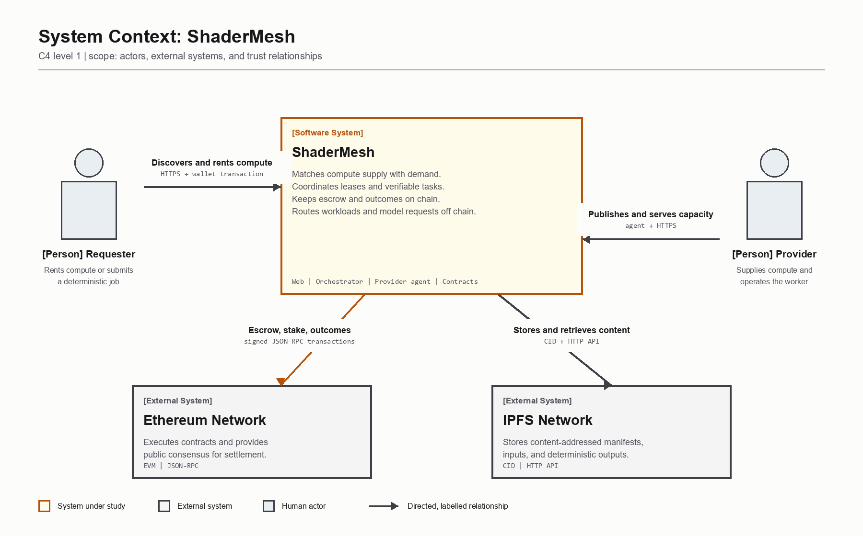
SHADERMESH | PROJECT REVIEW 1
5

Slide 6
ShaderMesh uses two workload-specific trust models
TIME-BASED RENTAL
DETERMINISTIC TASK
CORE QUESTION
CORE QUESTION
Was service available?
Does execution match?
EVIDENCE
EVIDENCE
Timely availability evidence
Commitment and re-execution
ECONOMIC OUTCOME
ECONOMIC OUTCOME
Escrow, refund, SLA slashing
Challenge, dispute, slashing
Shared foundation: provider stake | public reputation | contract escrow | auditable outcomes
SHADERMESH | PROJECT REVIEW 1
6

Slide 7
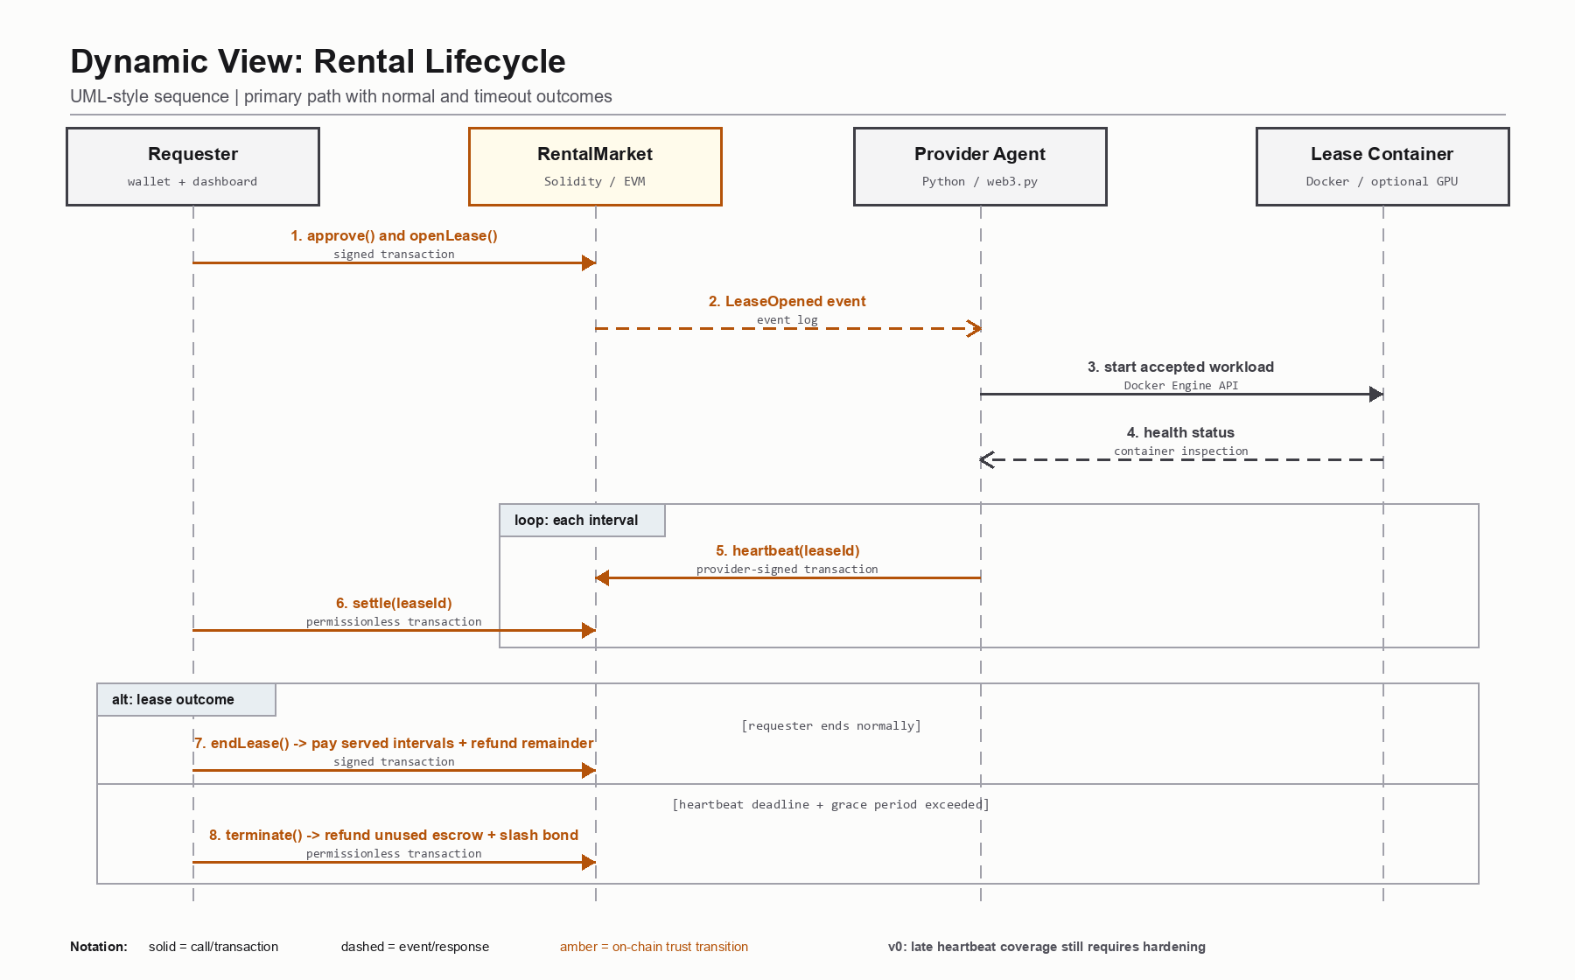
SHADERMESH | PROJECT REVIEW 1
7

Slide 8
Ethereum controls value while compute remains off chain
PUBLIC CONSENSUS
Ethereum proof of stake
APPLICATION TRUST
SmeshToken | ProviderRegistry | RentalMarket | JobMarket | Verification
OFF-CHAIN COORDINATION
Dashboard | Orchestrator | Provider agent | IPFS adapter
COMPUTE EXECUTION
Constrained Docker runtime | CPU / optional GPU | model server
SHADERMESH | PROJECT REVIEW 1
8

Slide 9
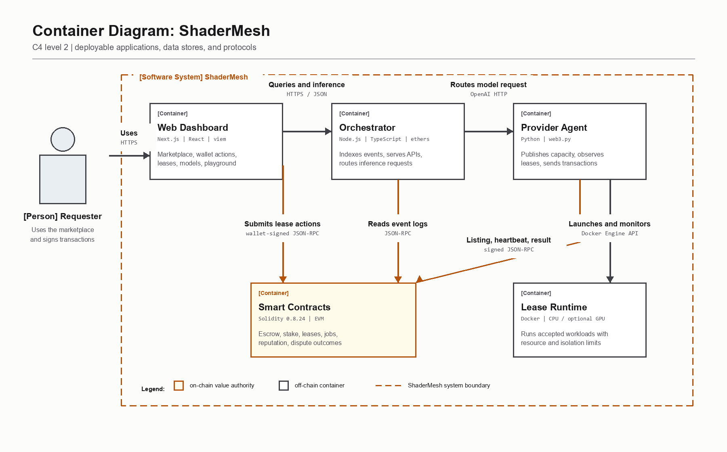
SHADERMESH | PROJECT REVIEW 1
9

Slide 10
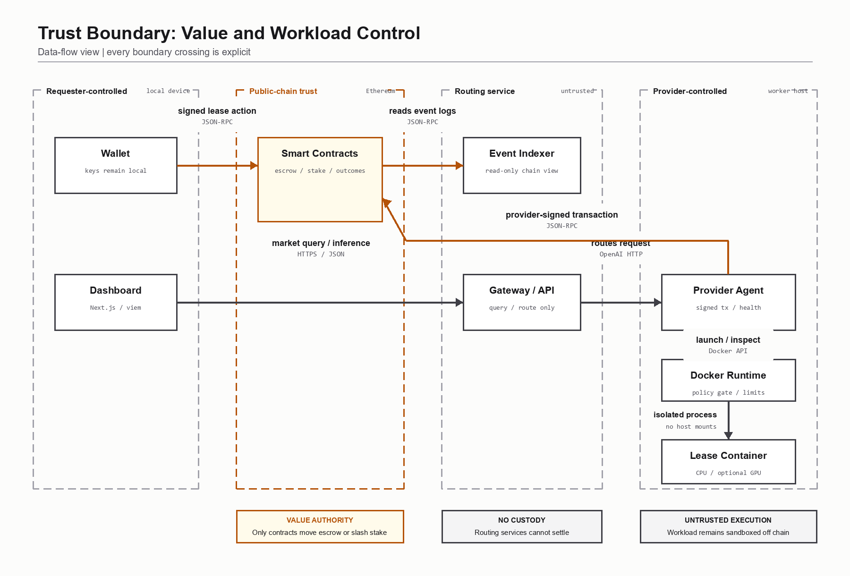
SHADERMESH | PROJECT REVIEW 1
10

Slide 11
Implementation follows a contract-first sequence
1
2
3
4
5
6
7
Trust model
State machines
Contract tests
Agent + runtime
Indexer + API
Dashboard
Sepolia
Each off-chain component was added only after its contract boundary and failure path were defined.
SHADERMESH | PROJECT REVIEW 1
11

Slide 12
The stack separates settlement, coordination, and execution
INTERFACE
Next.js | React | Tailwind | viem
COORDINATION
Node.js 20 | TypeScript | ethers
PROVIDER
Python 3.11 | web3.py | Docker SDK
SETTLEMENT
Solidity 0.8.24 | Hardhat | OpenZeppelin
DATA + INFRA
IPFS | Kubo | PostgreSQL | Docker Compose
SHADERMESH | PROJECT REVIEW 1
12

Slide 13
Operational inputs replace a training dataset
INPUTS
EVALUATION
01 Lease duration and listing ID
01 Escrow conservation and refunds
02 Resource specification and manifest
02 Heartbeat and outage response
03 Model ID, prompt, and sampling parameters
03 Gas use by state transition
04 Task CID and output commitment
04 Sandbox and GPU-access enforcement
05 Simulator reward, bond, and spot-check rate
05 Route correctness, latency, and verification cost
Dataset applicability: not applicable. ShaderMesh is a marketplace protocol, not a trained model.
SHADERMESH | PROJECT REVIEW 1
13

Slide 14
The local prototype completes the main transaction path
DEPLOY
SEED
LEASE
RUN
ROUTE
contracts
providers
escrow
container
inference
7
12
17
3
1
contract tests
agent tests
orchestrator tests
seeded listings
Compose command
SHADERMESH | PROJECT REVIEW 1
14

Slide 15
Current evidence proves integration, not production trust
REAL
SEEDED
MUST BE HARDENED
contract transactions
provider identities
timely heartbeat evidence
escrow and settlement
GPU declarations
random challenger selection
wallet calls and APIs
operator attestation
commit-reveal and quorum
container lifecycle
echo inference
real GPU benchmarks
The documented limitations are part of the engineering result, not hidden assumptions.
SHADERMESH | PROJECT REVIEW 1
15

Slide 16
The next milestone is a reproducible multi-laptop demonstration
1
2
3
4
5
Sepolia
NVIDIA nodes
Accepted workload
Real model
Failure test
public contract deployment
real hardware discovery
lease-bound container
Ollama or vLLM
refund and slashing
Success means the full flow works across physical machines with explicit evidence and repeatable setup.
SHADERMESH | PROJECT REVIEW 1
16

Slide 17
The remaining work fits a four-week integration plan
1
2
3
4
5
6
7
8
9
10
11
12
Requirements + architecture
Core contracts
Agent + inference
Orchestrator + dashboard
Sepolia + multi-laptop
GPU + model integration
Adversarial testing
Evaluation + delivery
Completed Next milestone Planned
SHADERMESH | PROJECT REVIEW 1
17

Slide 18
Selected sources establish the design baseline
[1] Buterin, Ethereum Whitepaper, 2014
[7] Render Network Whitepaper, 2023
[2] Golem official documentation
[8] Protocol Labs, Filecoin, 2017
[3] Teutsch and Reitwiessner, Truebit, 2019
[9] Kwon et al., vLLM, SOSP 2023
[4] Petkanics and Tang, Livepeer Whitepaper, 2017
[10] Vast.ai official documentation
[5] iExec Proof-of-Contribution documentation
[11] OpenZeppelin Contracts documentation
[6] Akash Network documentation
Full citations and access dates are included in the report.
SHADERMESH | PROJECT REVIEW 1
18

Slide 19
Compute stays off chain.
Trust and settlement stay auditable.
Rental mode: availability evidence + escrow
Task mode: reproducible output + dispute
Next: Sepolia + separate NVIDIA provider laptops
19

