Slide 1
DG INTERNS HUB — CYBERSECURITY INTERNSHIP PROGRAM
Week 3: Advanced Network Security Assessment &
Traffic Investigation Report
Prepared By: Prakhar Gupta (Cybersecurity Intern) | Submission Date: 21/Sept/2026
TARGET HOST SCOPE
IP: 192.168.1.10
MAC: 9C:C7:D3:2D:94:B8
OS: Windows (10/11 Build)
ANALYST VANTAGE
Kali Linux 2025.3 VM
Tools: Nmap 7.95, Wireshark
Net: 192.168.1.0/24
LAB ENVIRONMENT
VirtualBox Isolated Segment
Gateway: 192.168.1.1
Scope: Authorized Assessment

Slide 2
CYBERSECURITY INTERNSHIP WEEK 3
Assessment Objectives & Methodology Workflow Framework
SECURITY LIFECYCLE: Discover ➔ Enumerate ➔ Analyze ➔ Assess ➔ Harden ➔ Verify
CORE ASSESSMENT OBJECTIVES
• Discover authorized hosts on 192.168.1.0/24 local subnet.
• Perform multi-layered Nmap scans (version, OS, SYN, UDP, NSE).
• Capture live traffic with Wireshark (DNS, ARP, ICMP, TCP/TLS).
• Correlate Nmap scanning activity with on-the-wire packet captures.
• Identify security findings supported strictly by packet evidence.
• Apply netsh Windows Firewall hardening & evaluate verification.
THE EVIDENCE DEMONSTRATION CHAIN
EVIDENCE: Wireshark captures & raw Nmap console logs
ANALYSIS: Cross-vantage point comparison (External vs Local)
FINDING: Discovered 7 exposed services & Slowloris DoS risk
RISK: CVE-2007-6750 exposure & unauthenticated admin ports
HARDENING: Windows netsh advfirewall inbound block rules
VERIFICATION: Post-hardening local scan & stack bypass analysis

Slide 3
CYBERSECURITY INTERNSHIP WEEK 3
VirtualBox Isolated Lab Architecture & Network Topology
LAB ENVIRONMENT COMPONENTS
• Analyst OS: Kali Linux 2025.3 (VirtualBox Guest)
• Analyst Tools: Nmap 7.95 (Kali), Wireshark 4.x
• Target Host: 192.168.1.10 — Windows Target Host
• Target MAC: 9C:C7:D3:2D:94:B8 (Verified via ARP/Nmap)
• Target Local Tools: Nmap 7.98 (Windows Command Prompt)
• Default Gateway: 192.168.1.1
• Subnet Scope: 192.168.1.0/24 (IPv4/IPv6 Dual-Stack)
NETWORK TOPOLOGY & BROADCAST DOMAIN
✔ Single Local Subnet: All test systems reside on 192.168.1.0/24.
✔ Shared Broadcast Domain: Wireshark ARP captures recorded active neighboring hosts on the same segment (e.g., 192.168.1.74, 192.168.1.100, 192.168.1.57).
✔ Direct L2 Communication: Target answered ARP probes directly with MAC 9C:C7:D3:2D:94:B8.
✔ Perimeter Filtering: Internal host firewall filters external inbound probes while allowing full local binding.

Slide 4
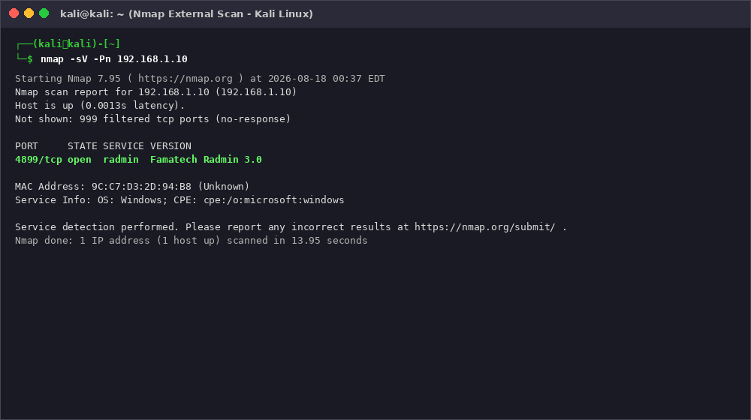
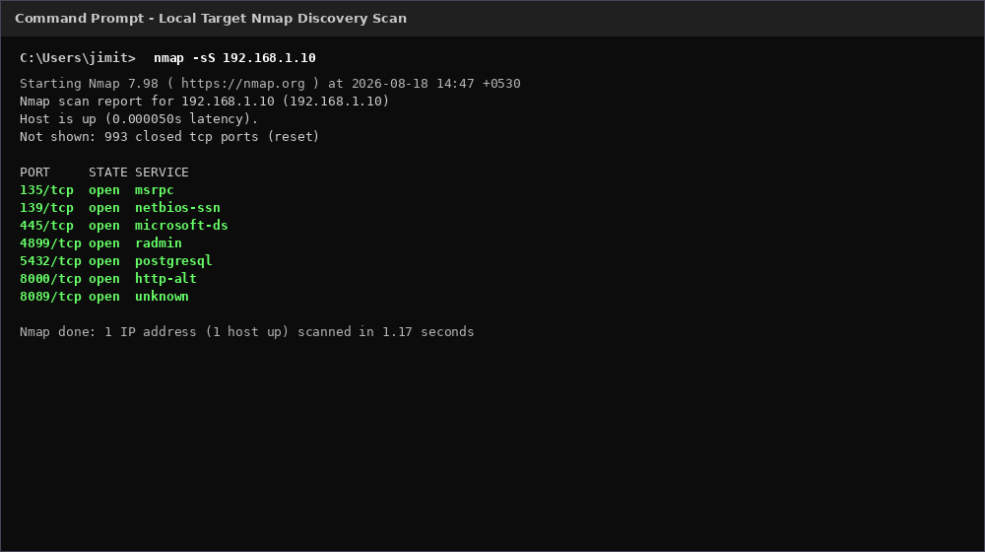
TASK 7 & TASK 8 SCAN RESULTS
Nmap Assessment: External Scan vs Local Target Discovery
MULTI-VANTAGE DISCOVERY
External Scan (Kali Nmap 7.95)
• nmap -Pn 192.168.1.10: Host UP (8.14s), 4899/tcp OPEN (radmin), 999 ports FILTERED.
• nmap -sV -Pn: Confirmed Famatech Radmin 3.0 (13.95s).
• nmap -sS: Stealth scan matches (17.25s).
• nmap -sU --top-ports 20: All 20 ports open|filtered due to ICMP rate limiting.
Local Target Scan (Nmap 7.98)
• nmap -sS 192.168.1.10 (Local Cmd): Discovered 7 OPEN PORTS in 1.17s:
135 (MSRPC), 139 (NetBIOS), 445 (SMB),
4899 (Radmin), 5432 (PostgreSQL),
8000 (Splunk HTTP), 8089 (Splunk HTTPS).

Slide 5
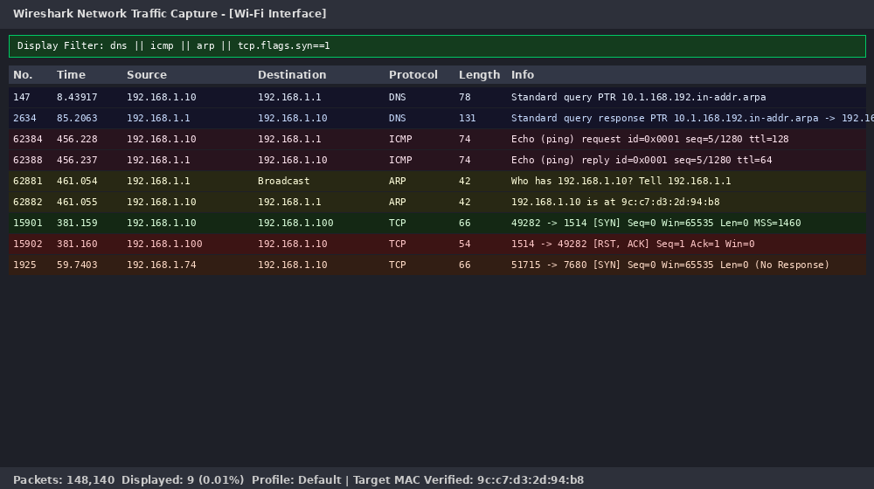
TASK 9 WIRESHARK ANALYSIS
Wireshark Live Capture & Multi-Protocol Traffic Investigation
CAPTURED PROTOCOL SUMMARIES
• DNS Captures: Reverse PTR lookup 10.1.168.192.in-addr.arpa -> 192.168.1.10. Extended captures recorded telemetry (v10.events.data.microsoft.com), MS Clarity (r.clarity.ms), Google, Nessus plugins, and ChatGPT.
• ICMP & ARP Traffic: Ping echo requests/replies to gateway 192.168.1.1 (TTL=128/64). Gateway ARP probe for .10 answered directly with MAC 9C:C7:D3:2D:94:B8.

Slide 6
TASK 10 & 11 INVESTIGATION
Nmap Scan Correlation & Unexplained Traffic Event Analysis
Nmap Observed Result | Wireshark On-the-Wire Evidence | Security Interpretation & Finding
External Scan: 4899 Open, 999 Filtered | No SYN/ACK received for 999 filtered ports | Firewall filtering inbound probes from external vantage point.
Local Scan: 7 Ports Open (1.17s) | SYN probes answered immediately on loopback/stack | Services are bound and listening; local scan bypasses perimeter filter.
Outbound HTTPS Active | tcp.flags.syn==1 && tcp.flags.ack==1 matched | Target host's outbound connectivity & TLS handshakes operating normally.
EVENT 1: OUTBOUND CONNECTION ATTEMPT REFUSED
• Traffic: Target (192.168.1.10) sent TCP SYN from reused ephemeral ports 49282/49284 to 192.168.1.100:1514/1515.
• Response: Destination immediately answered with RST, ACK.
• Analysis: Target initiated connections to a non-standard collector/syslog port on a peer host, which actively refused.
EVENT 2: UNANSWERED INBOUND PROBE ON PORT 7680
• Traffic: Neighboring host (192.168.1.74) sent TCP SYN to Target (192.168.1.10) port 7680 (Windows Connect/Miracast).
• Response: No response from target; retransmitted twice.
• Analysis: External peer attempted wireless display connection; target host firewall dropped or ignored inbound probe.

Slide 7
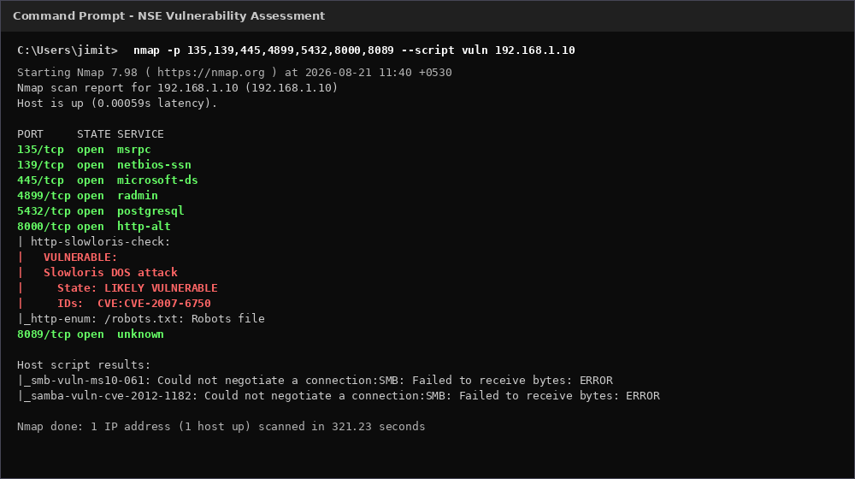
TASK 12 FINDINGS TABLE
Security Assessment Findings & Vulnerability Risk Analysis
KEY VULNERABILITY FINDINGS
F-01: Splunk Slowloris DoS (CVE-2007-6750)
HIGH RISK — NSE http-slowloris-check marked port 8000 LIKELY VULNERABLE. Attacker can exhaust connection pool.
F-02: Radmin Remote Admin Exposed (4899)
MEDIUM RISK — Unrestricted remote administration listener increases brute-force & credential attack surface.
F-03: PostgreSQL Database Exposed (5432)
MEDIUM RISK — PostgreSQL 9.6.0+ database engine directly reachable on general network segment.
F-04: External vs Local Port Discrepancy
LOW RISK — Local scan shows 7 services, external shows 1. Indicates reliance on host firewall filter.

Slide 8
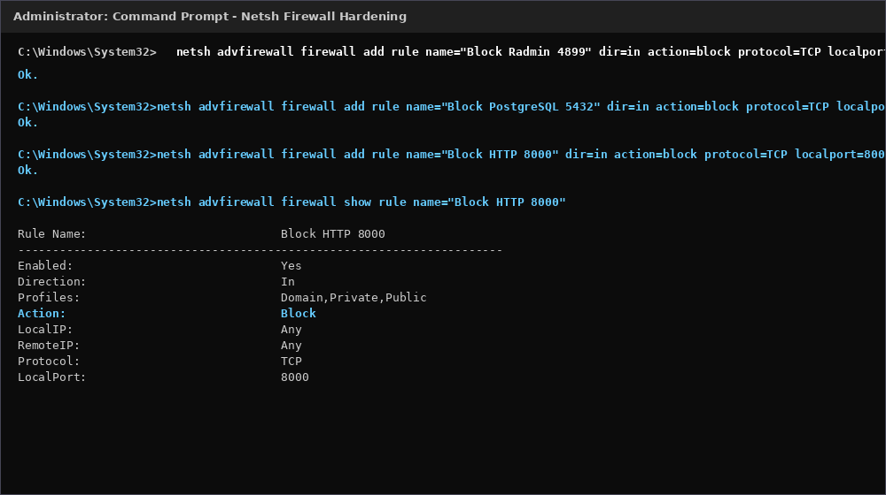
TASK 13 HARDENING ACTION
Host Security Hardening: Windows Netsh Firewall Implementation
EXECUTED HARDENING COMMANDS
Baseline Status
Scan confirmed 4899 (Radmin), 5432 (PostgreSQL), and 8000 (Splunk) OPEN prior to hardening.
Netsh Rules Created
• Block Radmin 4899: netsh advfirewall firewall add rule name="Block Radmin 4899" dir=in action=block protocol=TCP localport=4899
• Block PostgreSQL 5432: localport=5432
• Block HTTP 8000: localport=8000
Rule Verification
netsh advfirewall firewall show rule verified rules Active with Action: Block across Domain, Private, and Public profiles.

Slide 9
TASK 13 & 14 VERIFICATION
Before vs. After Hardening Results & Verification Analysis
Service / Port | Before Status | Netsh Hardening Action Taken | After (Local Scan) | Firewall Status
Radmin (4899/TCP) | OPEN | Inbound Block Rule Added (All Profiles) | Reported Open* | ACTIVE / BLOCKED
PostgreSQL (5432/TCP) | OPEN | Inbound Block Rule Added (All Profiles) | Reported Open* | ACTIVE / BLOCKED
Splunk HTTP (8000/TCP) | OPEN | Inbound Block Rule Added (All Profiles) | Reported Open* | ACTIVE / BLOCKED
*TECHNICAL ANALYSIS OF LOCAL SCAN STACK BYPASS
• Verification Methodology Limitation: Post-hardening verification scans were executed locally on the target host targeting 192.168.1.10.
• Network Stack Bypass Effect: Packets generated by a host targeting its own local IP address traverse the OS loopback / internal socket layer and bypass inbound Windows Firewall filtering hooks entirely.
• Evidence Conclusion: While local scans continue to report ports open due to active service sockets, the netsh firewall rules are confirmed Active and Enabled for external inbound traffic.
• Post-Hardening Stability: Subsequent Wireshark DNS capture confirmed target network connectivity and DNS resolution remained fully operational with zero adverse impact.

Slide 10
SECTION 18 & 20 SUMMARY
Priority Security Recommendations & Assessment Conclusion
Priority 1: External Firewall Re-Testing
Re-test block rules (4899, 5432, 8000) from Kali VM to verify filtering on external network path.
ASSESSMENT CONCLUSION
✔ Full Security Lifecycle Achieved: Successfully completed discovery, multi-layered scanning, packet capture, correlation, assessment, and netsh hardening.
✔ Value of Multi-Vantage Scans: Comparing external vs local Nmap scans exposed a critical host filtering boundary that single vantage scans missed.
✔ Evidence-Grounded Posture: Identified Slowloris DoS risk on Splunk HTTP (CVE-2007-6750) and documented host firewall stack bypass behavior transparently.
✔ Final Submission Status: Complete, evidence-backed assessment ready for DG Interns Hub evaluation.
Priority 2: Splunk Slowloris Mitigation
Deploy reverse proxy with connection timeouts, WAF, or vendor patch for CVE-2007-6750 on port 8000.
Priority 3: VLAN/VPN Network Isolation
Restrict Radmin (4899) and PostgreSQL (5432) to dedicated management VLAN/VPN with MFA.
Priority 4: Firewall Rule Documentation
Formally document perimeter firewall rules limiting external exposure to prevent silent drift.
Priority 5: Conclusive SMB Assessment
Re-run SMB checks (ms10-061, cve-2012-1182) on port 445 with full protocol negotiation enabled.

