Slide 1
DG INTERNS HUB • CYBER SECURITY INTERNSHIP
Week 5: VAPT Tools Assessment
Practical Vulnerability Assessment & Penetration Testing via Nmap, Nikto & Burp Suite
INTERN NAME
Krina Sorathiya
Cyber Security Intern
ORGANIZATION
DG Interns Hub
Practical Learning Track
AUTHORIZED TARGET
testphp.vulnweb.com
Lab Scope: 192.168.1.10
SUBMISSION DATE
07 September 2026
Week 5 Deliverable
Notes:
Title Slide: Week 5 practical learning report on VAPT Tools for DG Interns Hub, submitted by Krina Sorathiya. Focuses on practical vulnerability assessment and penetration testing across Nmap, Nikto, and Burp Suite against authorized target testphp.vulnweb.com.

Slide 2
ASSESSMENT METHODOLOGY
Structured 10-Step VAPT Workflow Enforces Ethical Scoping, Tool Correlation & Verification
Vulnerability Assessment vs Penetration Testing
• Vulnerability Assessment: Systematic discovery and documentation of weaknesses, open ports, exposed services, and outdated software across target assets.
• Penetration Testing: Goes beyond discovery by safely validating whether discovered weaknesses can be practically exploited without business disruption.
The 10-Step Complete VAPT Practical Workflow
Step 1: Confirm authorization & select approved target (testphp.vulnweb.com)
Step 2: Perform Nmap network discovery to enumerate exposed ports & services
Step 3: Execute Nmap service and version detection (-sV, -A) for technology fingerprinting
Step 4: Run Nikto web vulnerability scan against HTTP application endpoints
Step 5: Review automated scanner findings to filter informational noise & false positives
Step 6: Configure Burp Suite as a local intercepting proxy listener (127.0.0.1:8080)
Step 7: Intercept browser HTTP client requests; inspect headers, parameters & cookies
Step 8: Correlate cross-tool observations across network, web-server, and application tiers
Step 9: Document evidence-backed security findings with risk ratings & remediation steps
Step 10: Deliver finalized report, presentation deck, GitHub repository & learning summary
Ethical Authorization & Safety Guardrails
• Authorized Scope: Testing is strictly limited to the official training target http://testphp.vulnweb.com (resolved to lab host 192.168.1.10).
• Strict Internship Rule: No unauthorized external systems scanned. Scans designed to evaluate controls without degrading target availability.
Notes:
Methodology Slide: Establishes the core distinction between Vulnerability Assessment (discovering weaknesses) and Penetration Testing (safely validating exploitability). Details the strict ethical authorization boundaries and the full 10-step lifecycle executed during the Week 5 practical.

Slide 3
ARCHITECTURE & TOOL ROLES
Dedicated Security Lab Evaluates Target testphp.vulnweb.com Across Network & Application Layers
NMAP (Network Mapper)
Network & Port Discovery
• Identifies open TCP/UDP listening ports
• Discovers running network services and daemons
• Fingerprints application versions and underlying OS
• Outputs provide foundational network attack surface
NIKTO (v2.5.0)
Web Server Security Scanner
• Scans for server misconfigurations & risky files
• Detects outdated web server components (Apache/PHP)
• Flags missing browser security response headers
• Identifies exposed directory indexing & admin pages
BURP SUITE (v2024.1.1)
HTTP Request Interception & Analysis
• Operates as local HTTP proxy listener on 127.0.0.1:8080
• Intercepts in-flight browser requests before forwarding
• Examines HTTP request methods, headers, and payloads
• Inspects session cookies (PHPSESSID) and URL parameters
Target Architecture & Authorized Lab Boundary Specifications
• Primary Target: testphp.vulnweb.com — safe, intentionally vulnerable educational web application hosted for authorized security assessments.
• Lab Host Mapping: Target system mapped to IP 192.168.1.10 within the local security testing environment for full port and vulnerability discovery.
• Multi-Tier Security Analysis: Nmap covers Layer 4 transport & services; Nikto inspects Layer 7 server configuration; Burp Suite inspects application-tier HTTP traffic.
Notes:
Architecture Slide: Defines the functional division of labor among the 3 core tools: Nmap for Layer 4 network discovery, Nikto for Layer 7 web-server hygiene and configuration checks, and Burp Suite Community Edition for application-level traffic interception. All testing conducted strictly within authorized scope against testphp.vulnweb.com / 192.168.1.10.

Slide 4
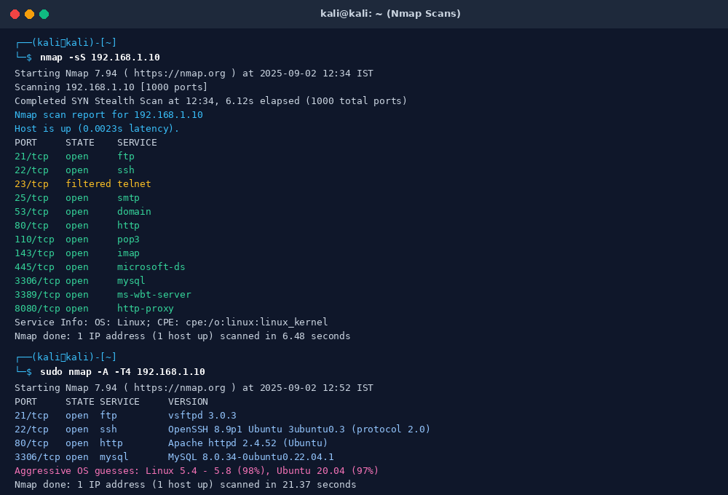
TASK 1: NETWORK SCANNING
Nmap Scans Expose 12 Open TCP Services Across Web, Database, Mail & Administrative Ports
Nmap Scan Evidence & Technical Analysis
Command Executed
nmap -sS 192.168.1.10 & sudo nmap -A -T4 192.168.1.10
Execution Metrics
SYN stealth scan finished in 6.48s; aggressive scan completed in 21.37s with 0.0023s latency.
12 Open TCP Ports
• Web: 80/tcp (Apache 2.4.52), 8080/tcp (HTTP proxy)
• Database: 3306/tcp (MySQL 8.0.34-0ubuntu0.22.04.1)
• Remote Access: 22/tcp (OpenSSH 8.9p1), 3389/tcp (RDP/MS-WBT), 21/tcp (vsftpd 3.0.3)
• Mail & DNS: 25/tcp (Postfix), 110/tcp (Dovecot pop3), 143/tcp (Dovecot imap), 53/tcp (BIND 9.16.1)
• File Sharing: 445/tcp (microsoft-ds)
1 Filtered Port
23/tcp (telnet) reported filtered, indicating firewall packet filtering.
OS Fingerprint
Linux kernel 5.4 - 5.8 (98%), Ubuntu 20.04 (97%) / Ubuntu 22.04 (96%).
Notes:
Nmap Slide: Displays actual terminal output from nmap -sS and aggressive scan nmap -A against 192.168.1.10. Identifies 12 open ports including web services (Apache 2.4.52 on 80 and 8080), database (MySQL 8.0.34 on 3306), file transfer (vsftpd 3.0.3), and remote management (SSH 8.9p1 and RDP 3389). Port 23 telnet is filtered.

Slide 5
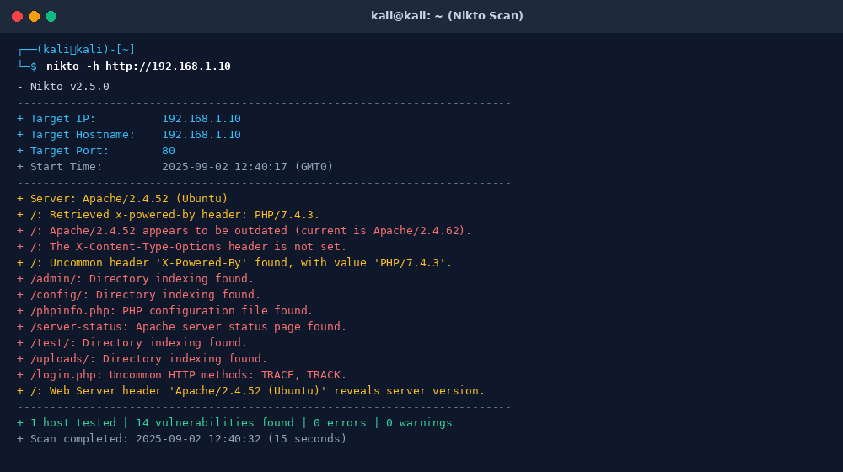
TASK 2: WEB SERVER ASSESSMENT
Nikto Automated Scan Flags 14 Vulnerabilities Highlighting Information Leaks & Exposed Endpoints
Nikto v2.5.0 Scan Analysis & Key Findings
Scan Execution
Command: nikto -h http://192.168.1.10 (Port 80)
Execution Time: 15 seconds | 14 vulnerabilities identified
Outdated Web Server
Apache/2.4.52 detected as outdated compared to upstream release (Apache/2.4.62), presenting potential known CVE risks.
Technology Disclosure
HTTP header 'X-Powered-By: PHP/7.4.3' explicitly leaks back-end runtime version, aiding attacker reconnaissance.
Missing Security Headers
Header 'X-Content-Type-Options' is not configured, exposing client browsers to MIME-confusion attacks.
Exposed Directories
Directory indexing actively enabled on /admin/, /config/, /test/, and /uploads/, permitting public browsing of files.
Sensitive Files & Methods
Exposes /phpinfo.php, /server-status, and supports debugging HTTP methods TRACE and TRACK on /login.php.
Notes:
Nikto Slide: Shows actual Nikto v2.5.0 output against 192.168.1.10:80. The 15-second scan uncovered 14 vulnerabilities, chiefly outdated Apache 2.4.52, PHP 7.4.3 disclosure, missing X-Content-Type-Options header, exposed directory indexing on /admin/, /config/, /test/, /uploads/, exposed server-status, and active TRACE/TRACK methods.

Slide 6
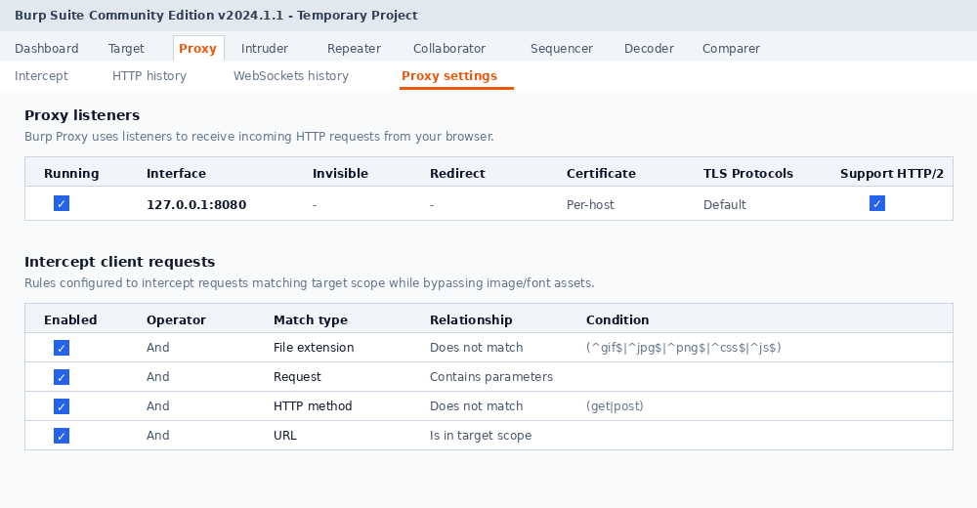
TASK 3: PROXY ARCHITECTURE
Burp Suite Local Proxy at 127.0.0.1:8080 Successfully Intercepts and Decouples HTTP Client Traffic
Proxy Listener Setup & Interception Logic
Proxy Listener Configuration
• Interface: Loopback 127.0.0.1 bound to Port 8080
• State: Running [Checked] | Protocol: HTTP & HTTP/2 support
• Certificate: Per-host generated Burp CA for SSL/TLS inspection
Browser Traffic Routing
• Client web browser configured to direct all HTTP/S egress through 127.0.0.1:8080.
• Enables inspection and real-time modification of requests prior to target server receipt.
Client Interception Rules
• In-Scope Filtering: Restricted to target host testphp.vulnweb.com.
• Asset Exclusion: Automated regex bypass for static media (^gif$|^jpg$|^png$|^css$|^js$) to focus purely on active transaction endpoints.
Core Analytical Advantage
Decouples application requests, exposing hidden fields, parameters, authentication payloads, and cookie states in cleartext.
Notes:
Burp Proxy Slide: Details the architecture of Burp Suite Community Edition v2024.1.1 configured as an intercepting proxy. Highlights listener binding to 127.0.0.1:8080, browser routing configuration, and custom client intercept rules that exclude static media files while intercepting core application transactions.

Slide 7
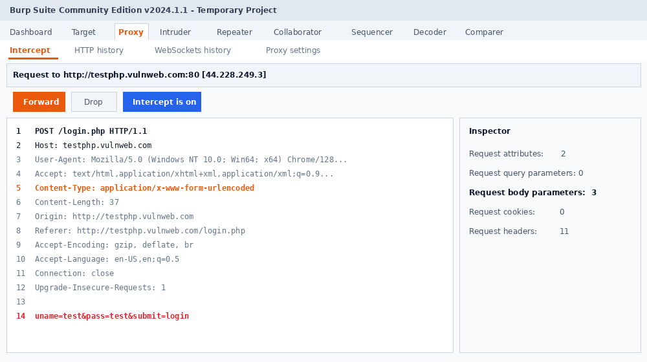
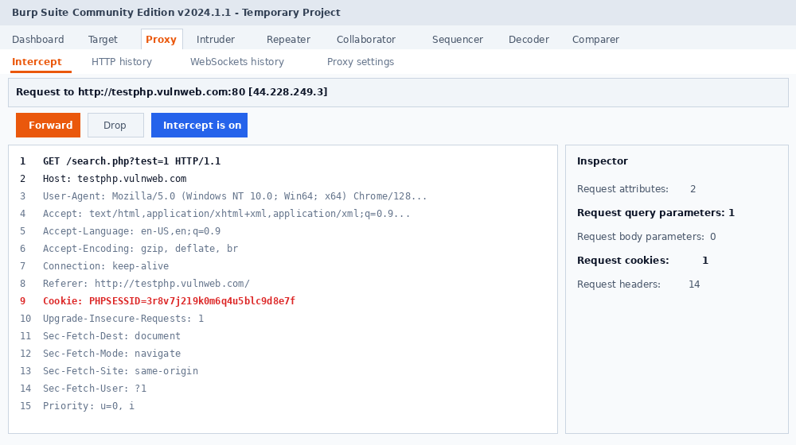
TASK 3: TRAFFIC INSPECTION
Targeted Interception Analyzes Authentication Submissions and Session Cookie Structures
In-Flight HTTP Request Inspection & Findings
Request 1: POST /login.php [Port 80]
• Host: testphp.vulnweb.com (44.228.249.3:80)
• Payload: uname=test&pass=test&submit=login
• Content-Type: application/x-www-form-urlencoded
• Security Observation: Authentication credentials submitted over unencrypted cleartext HTTP, vulnerable to local sniffing and MITM extraction.
Request 2: GET /search.php?test=1 [Port 80]
• Parameter: test=1 query parameter passed in URL
• Session Identifier: Cookie: PHPSESSID=3r8v7j219k0m6q4u5blc9d8e7f
• Headers: 14 total headers including Host, User-Agent, and Referer
• Security Observation: Session cookie lacks Secure and HttpOnly flags over plain HTTP; input parameter provides entry point for injection testing.
Analytical Takeaway
Burp Suite provides exact visibility into client-server handshakes, revealing hidden application state and unencrypted sensitive data flows.
Notes:
Burp Traffic Slide: Examines two primary intercepted HTTP requests from the report: 1) POST /login.php exposing cleartext username and password transmission over HTTP port 80. 2) GET /search.php?test=1 exposing query parameter handling and session cookie PHPSESSID=3r8v7j219k0m6q4u5blc9d8e7f.

Slide 8
ASSESSMENT FINDINGS
Seven Documented Findings Range From Medium-Risk Directory Exposure to Informational Headers
ID | FINDING | SOURCE | RISK | EVIDENCE & EXPLANATION
F-01 | Server Version Disclosure | Nikto | Low | Web server reveals Apache/2.4.52 in Server header, facilitating attacker version fingerprinting.
F-02 | PHP Version Disclosure | Nikto | Low | X-Powered-By header reveals PHP/7.4.3, exposing backend component details and known CVE exposure.
F-03 | Missing X-Content-Type-Options | Nikto | Low | Header is not configured, allowing client browsers to perform MIME-sniffing attacks.
F-04 | Directory Indexing Enabled | Nikto | Medium | Directories /admin/, /config/, /test/, /uploads/ allow public directory browsing and file discovery.
F-05 | Server-Status Page Detected | Nikto | Medium | Apache /server-status endpoint is exposed, leaking server performance and runtime connection data.
F-06 | Risky HTTP Methods TRACE/TRACK | Nikto | Medium | Uncommon debugging methods active on /login.php, presenting Cross-Site Tracing (XST) risks.
F-07 | HTTP Traffic & Cookie Observed | Burp Suite | Informational | Demonstrates interception of unencrypted credentials on /login.php and PHPSESSID session cookies.
Notes:
Findings Slide: Directly replicates the 7 verified security findings from the Week 5 report table (F-01 to F-07). Classifies 3 Low risk findings (version leaks, missing header), 3 Medium risk findings (directory indexing, server-status, TRACE/TRACK), and 1 Informational finding from Burp Suite traffic observation.

Slide 9
REMEDIATION & HARDENING
Five Targeted Remediation Steps Harden Web Server Headers, Directory Access & Methods
RECOMMENDATION 1 • Disable Directory Indexing
Addresses: Medium Risk Vulnerability
Configure 'Options -Indexes' in Apache httpd.conf or target .htaccess files to eliminate directory browsing across /admin/, /config/, /test/, and /uploads/.
RECOMMENDATION 2 • Suppress Component & Version Leaks
Addresses: Low Risk Vulnerability
Set 'ServerTokens Prod' and 'ServerSignature Off' in Apache; configure 'expose_php = Off' in php.ini to suppress Apache 2.4.52 and PHP 7.4.3 disclosure.
RECOMMENDATION 3 • Deploy Browser Security Headers
Addresses: Low Risk Vulnerability
Add 'Header set X-Content-Type-Options "nosniff"', 'X-Frame-Options "SAMEORIGIN"', and 'Content-Security-Policy' in web server response configuration.
RECOMMENDATION 4 • Restrict Sensitive Endpoints
Addresses: Medium Risk Vulnerability
Restrict access to /server-status and /phpinfo.php by requiring administrative authentication or binding access strictly to authorized internal management IPs.
RECOMMENDATION 5: Disable Insecure HTTP Methods — Configure 'TraceEnable Off' in Apache server configuration to disable TRACE and TRACK methods, eliminating Cross-Site Tracing (XST) attack vectors.
Notes:
Remediation Slide: Translates the findings into 5 actionable configuration hardening steps: 1) Options -Indexes to close directory browsing, 2) ServerTokens Prod and expose_php=Off to conceal versions, 3) X-Content-Type-Options nosniff header, 4) Restricting /server-status and /phpinfo.php, and 5) TraceEnable Off to disable TRACE/TRACK.

Slide 10
LEARNING OUTCOMES & CONCLUSION
Week 5 Practical Solidifies Core VAPT Competencies Across Discovery, Scanning & Traffic Analysis
Network Reconnaissance Mastery
Developed hands-on mastery of Nmap scanning techniques, distinguishing between surface-level port discovery (-sS) and in-depth application/service version enumeration (-sV, -A).
Web Misconfiguration Auditing
Learned to execute Nikto web scans to detect vulnerable configurations, sensitive exposed endpoints, outdated components, and missing browser-side defense headers.
Traffic Interception & Inspection
Configured Burp Suite as a functional local HTTP proxy, intercepting and analyzing raw HTTP headers, unencrypted authentication credentials, and session cookie behaviors.
Responsible Security Testing
Reinforced professional VAPT standards: strict adherence to written authorization, scoped testing targets, evidence-backed finding documentation, and remediation delivery.
PRACTICAL COMPLETION SIGN-OFF • DG INTERNS HUB
Intern: Krina Sorathiya | Track: Vulnerability Assessment & Penetration Testing | Deliverable: Week 5 Assessment Deck
Notes:
Conclusion Slide: Summarizes the 4 key learning outcomes: reconnaissance depth, web misconfiguration auditing, traffic interception with Burp Suite, and ethical security testing standards. Concludes the Week 5 VAPT practical report.

