Slide 1

DG INTERNS HUB
Cybersecurity Internship
Networking
Fundamentals
WEEK 1 · Presented by Prakhar Gupta
Internship track: Cybersecurity Internship

Slide 2







AGENDA
What We'll Cover
The OSI Model
The TCP/IP Model
7 layers that explain how data travels across a network
The 4-layer practical model powering the Internet
Network Protocols
IP Addressing
HTTP/HTTPS, FTP, DNS and DHCP in action
Public vs private IPs and basic subnetting
Network Commands
Cisco Packet Tracer
Hands-on with ping, ipconfig and tracert
Building and testing a simple two-PC network
DG INTERNS HUB • CYBERSECURITY INTERNSHIP • WEEK 1
02

Slide 3
NETWORKING BASICS
The OSI Model — 7 Layers
How data travels between devices, one layer at a time — from raw bits to the apps we use.
7
Application
Network services to applications
Web browser, HTTP/HTTPS
6
Presentation
Data formatting, encryption & compression
Data encryption
5
Session
Establishes, manages & terminates sessions
Login session
4
Transport
End-to-end, reliable data delivery
TCP, UDP
3
Network
Routing and IP addressing
Router, IP address
2
Data Link
Node-to-node data transfer
MAC address, Switch
1
Physical
Transmits raw bits through cables & signals
Ethernet cable
DG INTERNS HUB • CYBERSECURITY INTERNSHIP • WEEK 1
03

Slide 4
NETWORKING BASICS
The TCP/IP Model — 4 Layers
The practical, real-world model that actually runs the Internet.
Application
HTTP, HTTPS, DNS, FTP
4
Handles communication between apps and network services
Transport
TCP, UDP
3
Controls how data is delivered between applications
Internet
IPv4, IPv6
2
Handles IP addressing & routing of packets across networks
Network Access
Ethernet, Wireless LAN
1
Physical transmission & local network communication
DG INTERNS HUB • CYBERSECURITY INTERNSHIP • WEEK 1
04

Slide 5



NETWORKING BASICS
Network Protocols
Rules that let devices and applications exchange data over a network.
HTTP / HTTPS
FTP
Communication between web browsers and web servers. HTTPS adds encryption for secure browsing.
Transfers files between computers over a network.
e.g. Opening a website in a browser
e.g. Uploading or downloading files from a server
DNS
DHCP
Converts human-readable domain names into IP addresses.
Automatically assigns IP addresses and network settings to devices.
e.g. google.com → IP address
e.g. Connecting a laptop to Wi-Fi
DG INTERNS HUB • CYBERSECURITY INTERNSHIP • WEEK 1
05

Slide 6
NETWORKING BASICS
IP Addressing & Subnetting
A unique numerical address assigned to a device on a network — it identifies devices and enables communication.
Public IP
Private IP
Identifies a device or network on the Internet
Usually assigned by an Internet Service Provider (ISP)
Used for communication over the Internet
Used inside local networks only
10.0.0.0 – 10.255.255.255
172.16.0.0 – 172.31.255.255
192.168.0.0 – 192.168.255.255
Basic Subnetting
IP Address: 192.168.1.10
Subnet Mask: 255.255.255.0
Divides one network into smaller networks
DG INTERNS HUB • CYBERSECURITY INTERNSHIP • WEEK 1
06

Slide 7

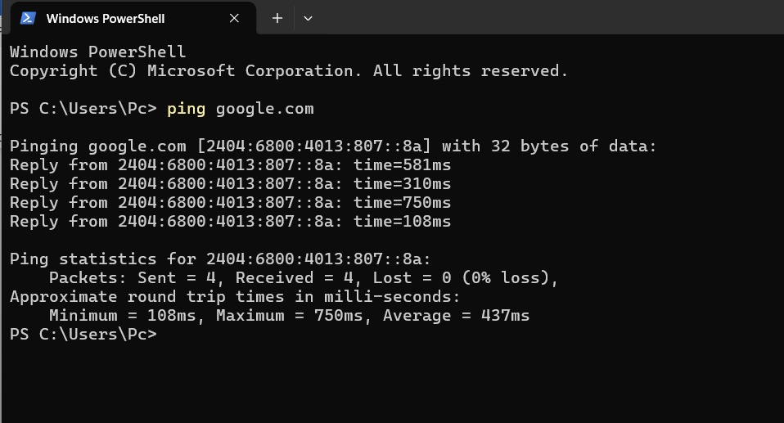
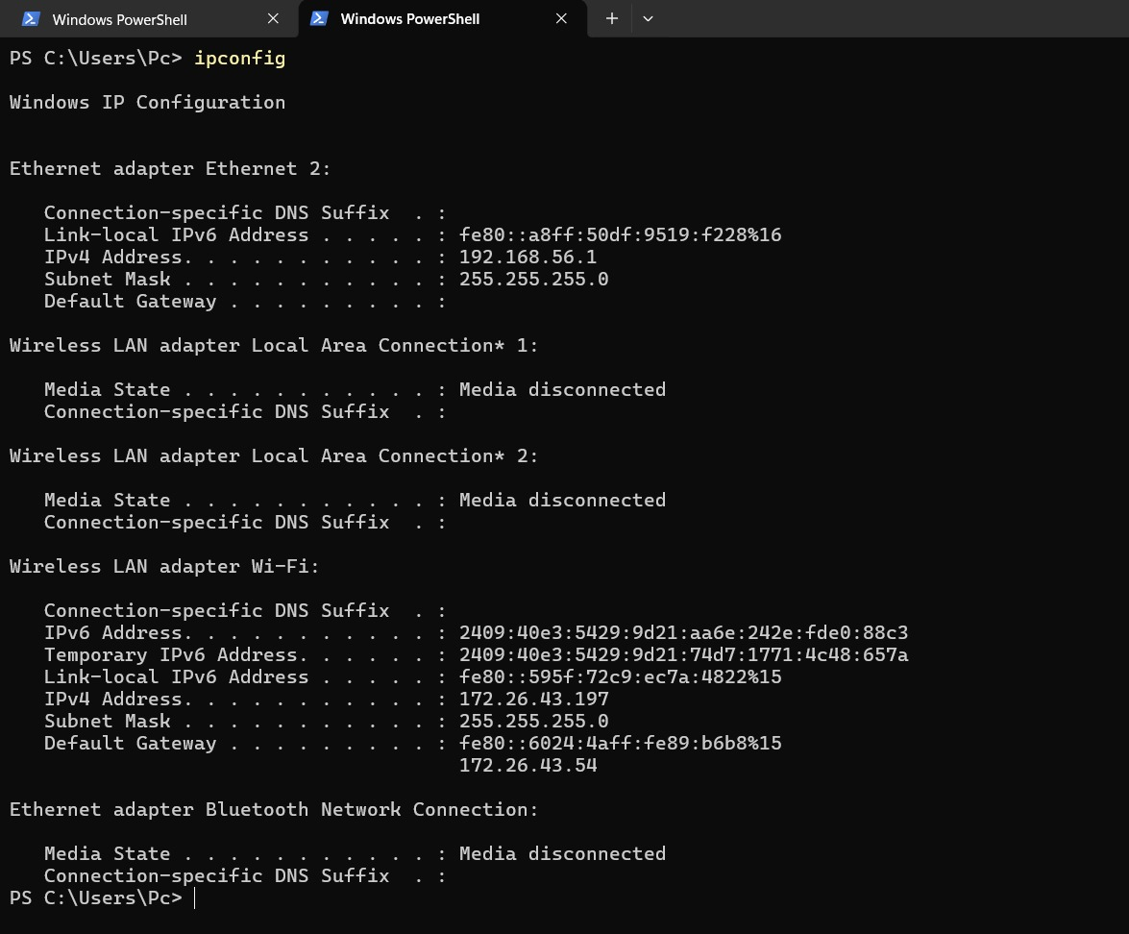
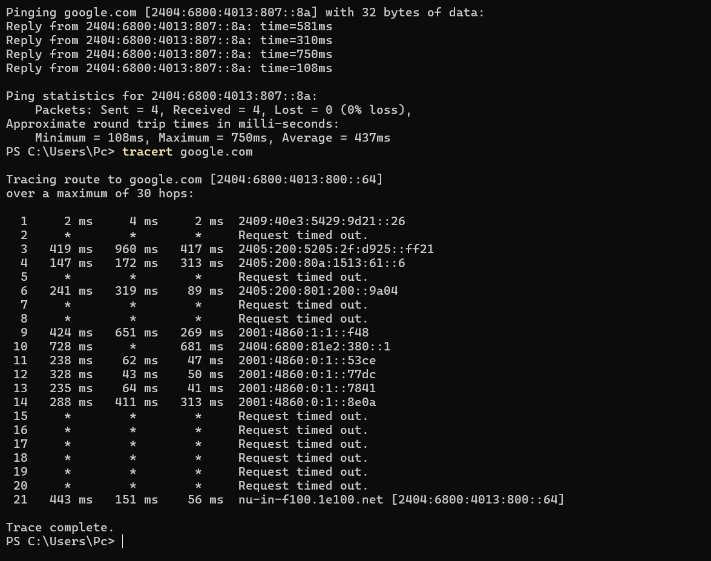
HANDS-ON PRACTICAL
Network Commands
Basic Windows CMD / PowerShell commands used to understand and troubleshoot network connectivity.
Ping
IP Configuration
Traceroute
Checks connectivity between my computer and the destination.
Displays the device's IP address, subnet mask and default gateway.
Shows the path taken by packets from my computer to the destination.
ping google.com
ipconfig
tracert google.com
DG INTERNS HUB • CYBERSECURITY INTERNSHIP • WEEK 1
07

Slide 8
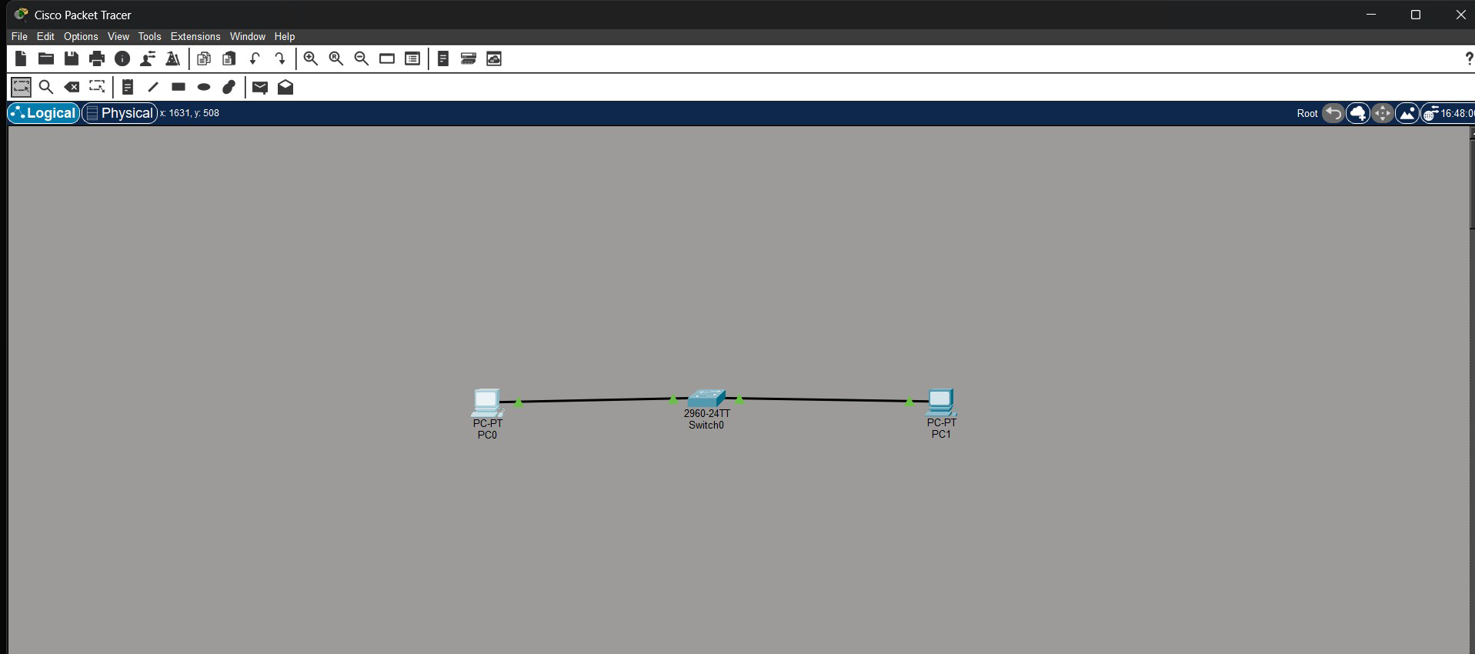
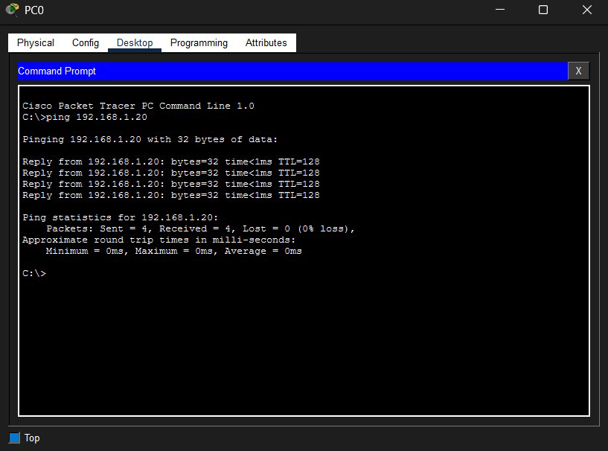

HANDS-ON PRACTICAL
Cisco Packet Tracer
Aim: create and test a simple computer network using Cisco Packet Tracer.
Network Components
Device | IP Address | Subnet Mask
PC0 | 192.168.1.10 | 255.255.255.0
PC1 | 192.168.1.20 | 255.255.255.0
Procedure
1
Add two PCs and one switch in Packet Tracer
2
Connect both PCs to the switch with Copper Straight-Through cables
3
Configure the IP address & subnet mask on each PC
4
Open Command Prompt on PC0 and run: ping 192.168.1.20
Result: PC0 successfully communicates with PC1 through the switch.
DG INTERNS HUB • CYBERSECURITY INTERNSHIP • WEEK 1
08

Slide 9

WEEK 1 WRAP-UP
Key Learnings
Fundamentals of computer networking
Basics of IP addressing and subnetting
The 7 layers of the OSI model
Practical commands: ping, ipconfig & tracert
The 4 layers of the TCP/IP model
Building & configuring a network in Cisco Packet Tracer
Key protocols: HTTP, HTTPS, FTP, DNS & DHCP
Testing network connectivity end-to-end with ping
Conclusion
This assignment strengthened my understanding of networking, IP addressing, protocols, and troubleshooting — providing a solid foundation for cybersecurity and network security.
DG INTERNS HUB • CYBERSECURITY INTERNSHIP • WEEK 1
09

Slide 10
THANK YOU
Onward to Week 2
Cybersecurity Internship · DG Interns Hub
Presented by Prakhar Gupta

