Slide 1
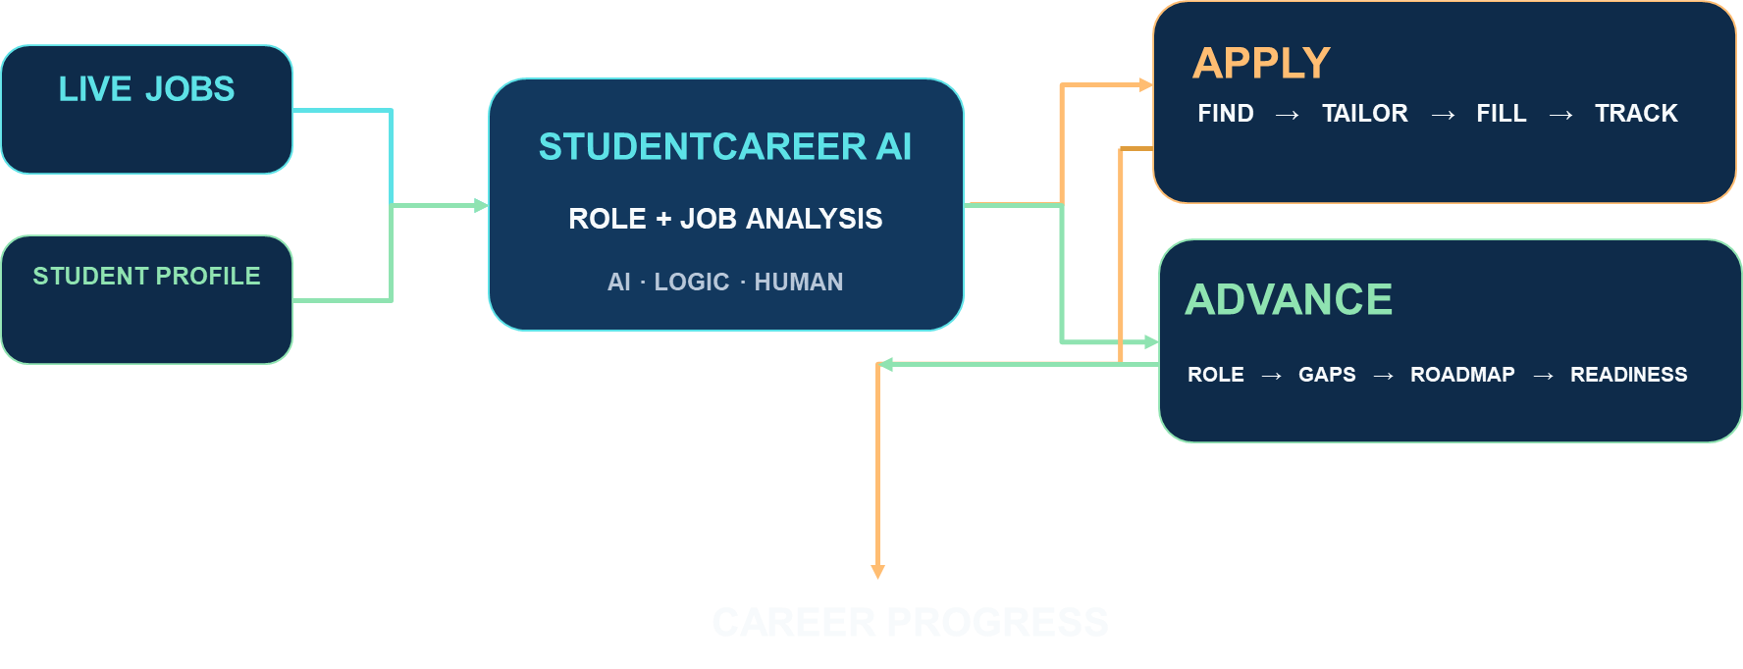
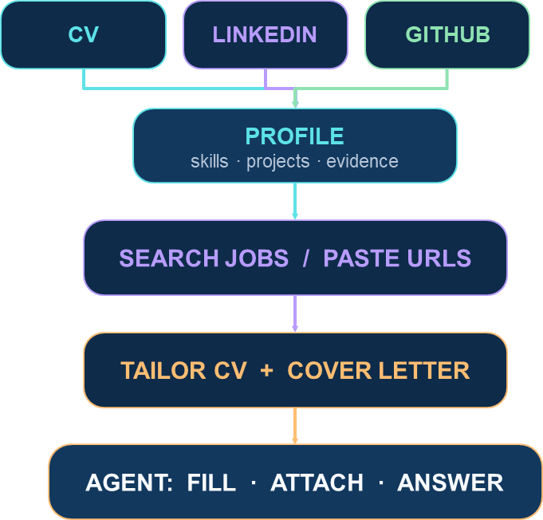
StudentCareer AI
NOT JUST JOB SEARCH
What next?
analyzes career roles, identifies skill gaps, and automates tailored job applications.
Platform: Jobs, skills, readiness, and applications in one system.
Analyzer: Maps market demand to student evidence and skill gaps.
AI: Drafts tailored CVs, cover letters, and application answers.
Difference: Deterministic decisions with human-controlled application assistance.
REVIEW → SUBMIT

