Slide 1
import Hvordan lage et shell script

Slide 2
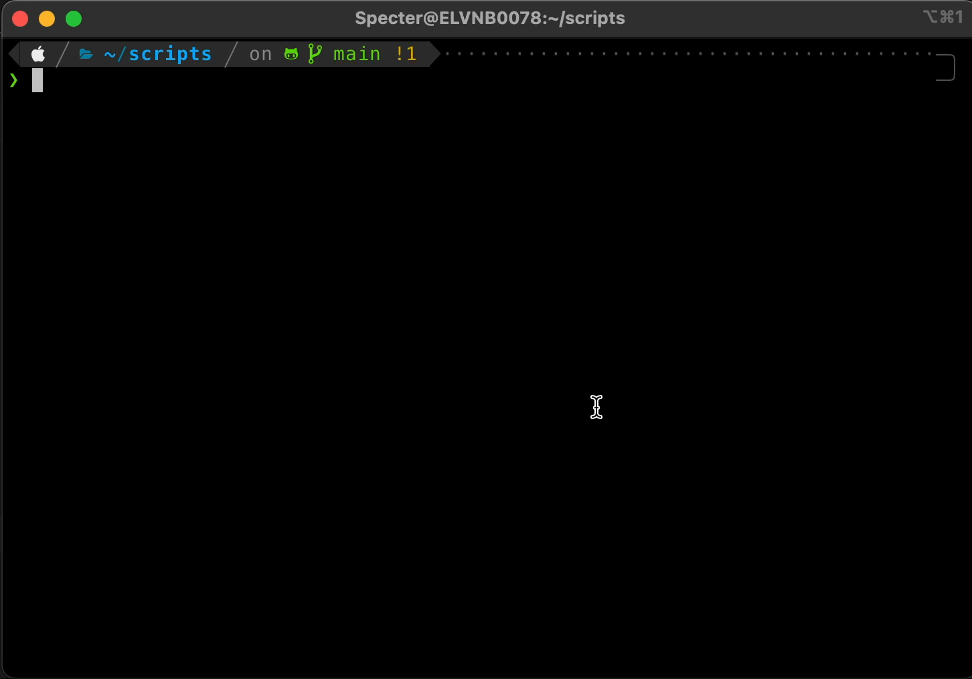
import Hvordan lage et shell script
1
2
spørsmål = Hva er et shell script?
3
4
Mål():
5
6
Sette opp et shell script
7
Lære om bruk av terminalen
8
Eksempler():
9
10
$ pwd, ls, id, mkdir
11
$ git, touch, curl
12

Slide 3
1
import Dependencies
2
3
Git
4
Python
5
Terminal: helst iterm med zsh
6
7
VsCode_extensions():
8
Python
9
Better Comments
10
11
12

Slide 4
1
import Info
2
3
begreper():
4
5
directory = folder
6
shell = terminal
7
$ = terminal kommando
8
kommandoer():
9
10
$ cd
11
$ ls
12
$ git clone
13
$ nano

Slide 5
1
import Info
2
3
begreper():
4
5
directory = folder
6
shell = terminal
7
$ = terminal kommando
8
kommandoer():
9
10
$ cd
11
$ ls
12
$ git clone
13
$ nano

Slide 6

1
2
3
4
5
6
7
8
9
10
11
12

Slide 7
1
#!/usr/local/bin/python3
2
Import os, sys, subprocess
3
4
args = sys.argv[1:]
$ hello arg1 arg2 arg3
5
6
if len(args) != 1:
7
print(“Tar bare et argument”)
8
exit(1)
exit(0), exit(1)
9
10
11
12
13
14
15
16
17
18

Slide 8
1
#!/usr/local/bin/python3
2
Import os, sys, subprocess
3
4
exit(0), exit(1)
args = sys.argv[1:]
$ hello arg1 arg2 arg3
5
6
if len(args) != 1:
7
print(“Tar bare et argument”)
8
exit(1)
9
10
directory_name = args[0]
$ mkdir
$ cd
11
os.mkdir(directory_name)
12
os.chdir(directory_name)
13
14
with open(“main.py“, “w”) as python_file:
15
python_file.write(“print(‘Hello World’)”)
16
17
subprocess.run([”python3”, “main.py”])
$ python3 main.py
18
exit(0)

Slide 9
exit(0), exit(1)
$ hello arg1 arg2 arg3
#!/usr/local/bin/python3
1
2
import os, sys, subprocess
3
4
args = sys.argv[1:]
5
$ chmod +x ./filnavn
6
if len(args) != 1:
7
print(“Tar bare et argument”)
$ mkdir
$ cd
8
exit(1)
9
$ filnavn
10
directory_name = args[0]
11
os.mkdir(directory_name)
12
os.chdir(directory_name)
13
Krt.im/shell
14
with open(“main.py“, “w”) as python_file:
15
python_file.write(“print(‘Hello World’)”)
16
$ python3 main.py
17
subprocess.run([”python3”, “main.py”])
18
exit(0)

