Slide 1
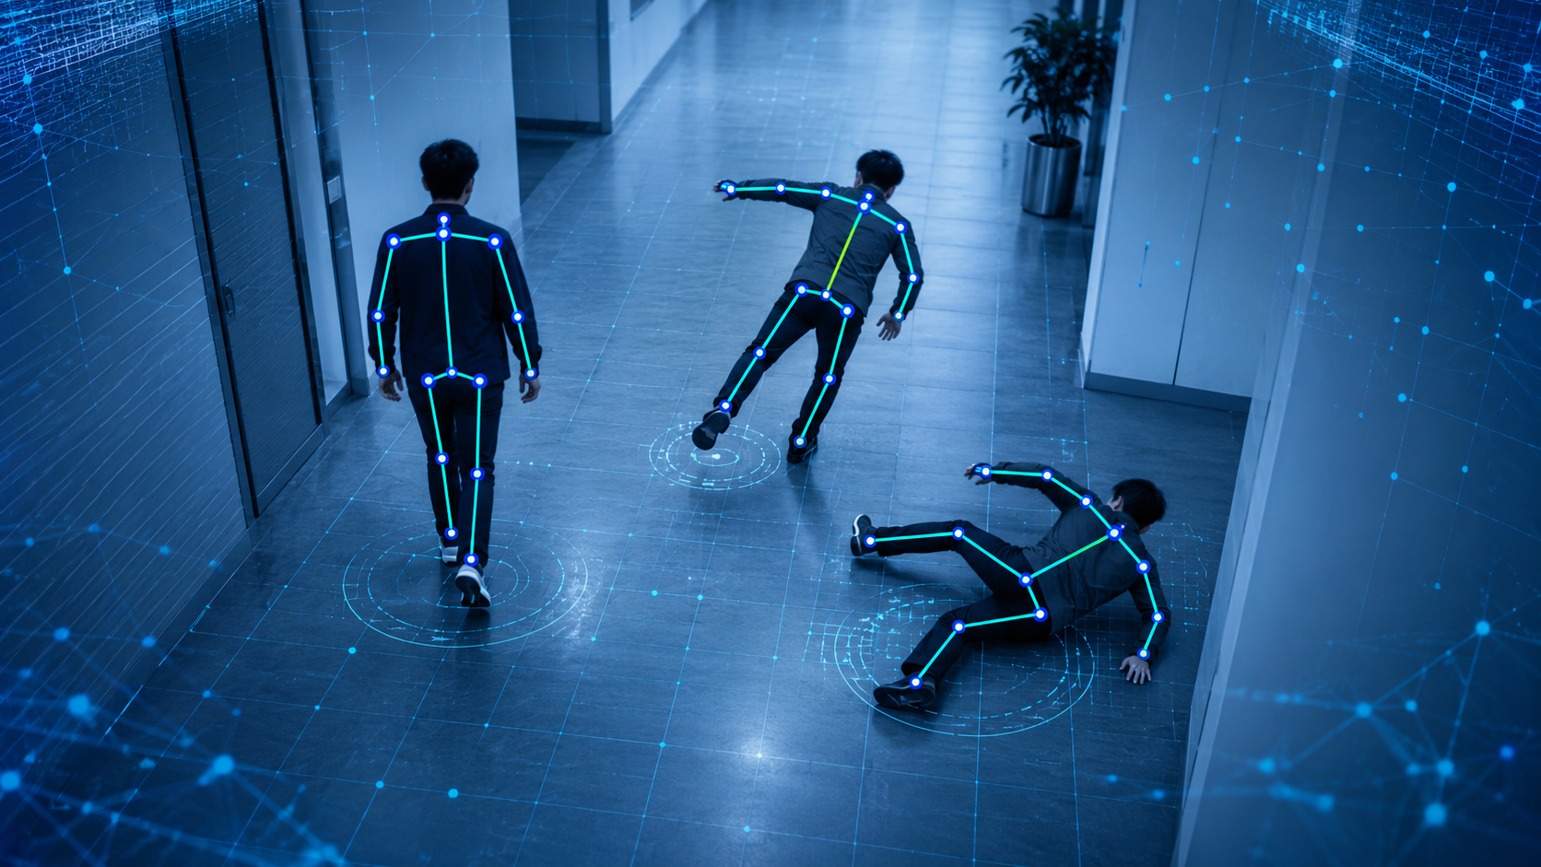
01
PROJECT IDEA | CSE445.2 | SUMMER 2026
Emergency Behaviour
Classification from Video
Using Machine Learning
PROBLEM TO SOLVE
CCTV or recorded video is often reviewed manually after an incident. Our system will automatically classify emergency-related human movement and mark the time where it happens.
VISUAL SCENARIO
PROJECT OUTPUT
The demo will show a person moving from normal walking to abnormal movement/fall, with pose landmarks drawn over the frame.
Input: video clip / live camera frame stream
Output: behaviour label + confidence score + timestamp
Target classes: Normal Activity • Staggering / Unbalanced Movement • Touch Chest / Chest Pain Gesture • Falling • Motionless After Fall
Team: Tarif Bin Mehedi — 2221265042 | Sabiha Binte Siraj — 2222633042 | Antara Labiba — 2233585042
Project idea based on team proposal notes: abnormal / emergency behaviour classification from video using pose landmarks.
Emergency Behaviour Classification from Video using ML
Notes:
Explain that the project is not trying to understand medical diagnosis from video. It detects visible movement patterns that may indicate emergency behaviour. Emphasise timestamp and confidence score because these make the demo practical.

Slide 2
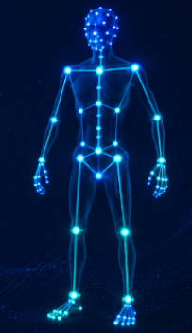
02
DATASET AND PREPARATION
Dataset Strategy: NTU RGB+D Skeleton Data
We will train on labelled skeleton action sequences, then use MediaPipe to extract comparable skeleton-like landmarks from demo videos.
56,880
60
25
4
NTU RGB+D samples
original action classes
3D body joints / frame
modalities: RGB, depth, IR, skeleton
SELECTED NTU ACTION LABELS
SKELETON NORMALISATION
A42
staggering
Unbalanced Movement
Select common joints only: shoulders, elbows, wrists, hips, knees, ankles.
A43
falling
Fall Detection
Convert every frame into one fixed 12-joint format.
A45
touch chest
Chest Pain Gesture
Centre skeleton at hip midpoint, then scale by torso/body size.
WHY SKELETON DATA?
A1/A8/A9/...
daily actions
Normal Activity baseline
Drop missing/incomplete skeleton samples before training.
Skeleton sequences are smaller than raw video, avoid learning background noise, and provide movement-focused features suitable for classical ML models.
Note: “Motionless After Fall” will be treated as a temporal rule after a fall, not as a separate NTU class.
Sources: NTU RGB+D GitHub states 56,880 samples, 60 classes, RGB/depth/IR/3D skeleton modalities, and 25 joints per frame.
Emergency Behaviour Classification from Video using ML
Notes:
Mention that the downloaded files shown by the user are skeleton ZIP files, so the team already has the correct modality for this plan. The chosen labels are not guessed: A42 staggering, A43 falling, and A45 touch chest are official NTU action labels.

Slide 3
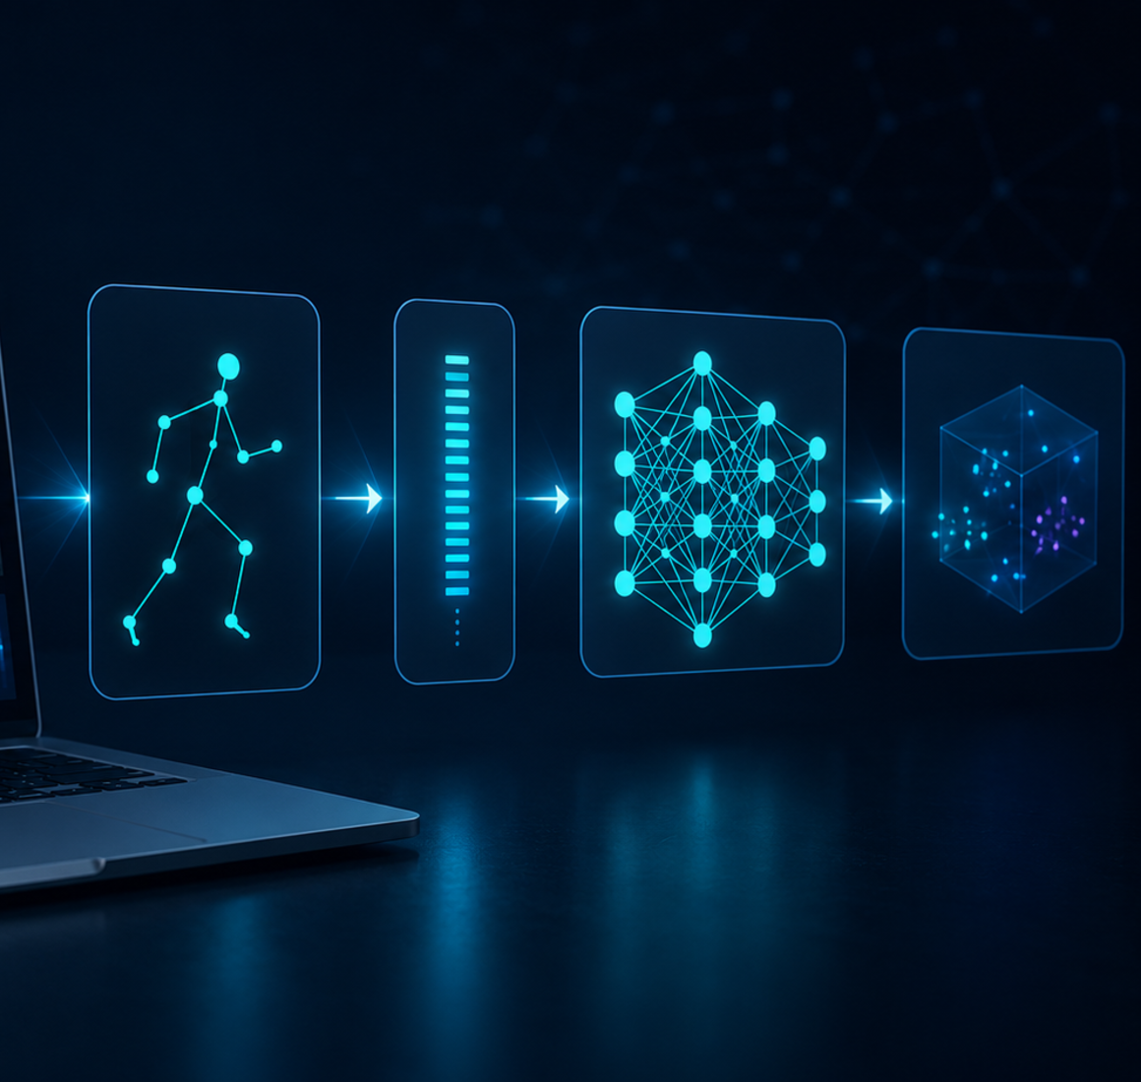
03
APPROACH AND COMPONENTS
Method Pipeline: From Video to Behaviour Label
The system turns a video into pose landmarks, extracts movement features, then classifies the behaviour using supervised ML.
01
Read video
02
Estimate pose
03
Unify joints
04
Extract features
05
Classify
OpenCV frames
MediaPipe
12-joint format
angles/speeds
ML model
FEATURE ENGINEERING
MODELS TO COMPARE
TEMPORAL SMOOTHING
Feature
Meaning
Used for
Logistic Regression — interpretable baseline
Frame-level predictions can flicker. We will classify short windows, then smooth labels over time. “Motionless after fall” = fall detected + very low keypoint velocity for several seconds.
Body angle
torso lean / rotation
fall, stagger
SVM — strong for small/medium feature sets
Hip drop
sudden vertical fall
fall
Wrist–chest
hand near chest
chest gesture
Decision Tree / Random Forest — handles non-linear patterns
Why MediaPipe over OpenPose for demo: easier Python setup, lightweight real-time pose estimation, and 33 landmarks from image/video input.
Sources: Google MediaPipe Pose Landmarker detects body pose landmarks from images/video and outputs image/world coordinates.
Emergency Behaviour Classification from Video using ML
Notes:
The important explanation is consistency: train on NTU skeleton data; for demo videos, MediaPipe gives landmarks; both are converted into one common 12-joint representation before features are calculated. Mention that LSTM is not the main model because the course asks for machine learning/classical ML; it can be future work.

Slide 4
04
EVALUATION AND DELIVERABLES
Success Criteria, Risks and Final Submission
The project will be judged by model performance, clarity of the pipeline, and whether the demo produces understandable timestamped outputs.
EVALUATION METRICS
VALIDATION PLAN
EXPECTED DEMO OUTPUT
Accuracy — overall correctness
Split skeleton samples by subject/setup where possible, train models on selected NTU classes, evaluate per class, then test with a prerecorded CCTV-style demo. Best model is selected using F1-score and recall, not accuracy alone.
00:04.8 — Normal Activity — 88%
00:11.2 — Staggering — 81%
00:14.5 — Falling — 92%
00:18.0 — Motionless After Fall — Alert
Precision — false alarm control
Recall — catches real emergencies
F1-score + confusion matrix — class-wise comparison
RISK MANAGEMENT
DELIVERABLES
Risk: class imbalance, missing skeleton frames, MediaPipe/NTU coordinate mismatch, and chest gesture ambiguity. Mitigation: ignore incomplete NTU samples, normalise joints, use window-based features, keep “chest distress” as visible hand-to-chest gesture instead of medical diagnosis.
1) Python source code and preprocessing notebook 2) trained model file 3) model comparison table 4) final report 5) PowerPoint presentation 6) prerecorded/live demo video with timestamped behaviour classification.
Final scope: supervised ML classification using skeleton features. LSTM/OpenPose can be written as future extension; main implementation stays achievable with NTU skeleton data + MediaPipe + scikit-learn.
References used: NTU RGB+D ROSE Lab/GitHub; Google AI Edge MediaPipe Pose Landmarker; team proposal PDFs.
Emergency Behaviour Classification from Video using ML
Notes:
End by saying exactly what the group will submit. The evaluation slide should reassure the teacher that this is measurable, not just a demo. Repeat that recall matters because false negatives are dangerous in fall/emergency detection.

