Slide 1
ForgeX
AI for ABM:
What You Need to Know
About MCPs, Agents & Prompts
TREY HARNDEN | FORGEX
SEPTEMBER 17, 2026 | 12 PM ET | LIVE WORKSPACE BUILD
Notes:
Open with the outcome: attendees will identify their current level, see what it takes to move up one level, and leave with the assets to start.
[Sources]
- ForgeX promo creative supplied by Trey
- /Users/treyharnden/Projects/forgex-practical-abm-skills/webinar/2026-09-17-ai-for-abm-foundations/slide-outline.md

Slide 2
ForgeX
Part I showed the output. Part II builds the system.
01
02
03
04
PROPENSITY
→
LANDING PAGES
→
MICROSITES
→
OPERATING SYSTEM
Who is likely to care
A focused destination
A personal experience
The context, skills, access, and review underneath
The page was never the whole product. The repeatable system is the real asset.
FORGEX | AI FOR ABM
02
Notes:
Recap Part I in one breath. Then move beneath the output: context, process, access, and human review.
[Sources]
- /Users/treyharnden/Projects/forgex-practical-abm-skills/webinar/2026-09-17-ai-for-abm-foundations/README.md

Slide 3
ForgeX
Nine terms. One operating system.
MODEL
reasons and generates
TOOL
performs a capability
HARNESS
holds files, tools, state, controls
MCP
connects approved resources and tools
PROMPT
directs this request
AUTOMATION
runs a known path
CONTEXT
grounds the work in evidence and rules
AGENT
chooses a path toward a goal
SKILL
standardizes a reusable process
Access is not permission. Fluency starts with knowing which layer owns which decision.
FORGEX | AI FOR ABM
03
Notes:
Use plain language. Model is the engine. Harness is the workbench. MCP is a connection standard. Governance still defines authority.
[Sources]
- https://modelcontextprotocol.io/docs/getting-started/intro
- https://www.anthropic.com/engineering/building-effective-agents

Slide 4
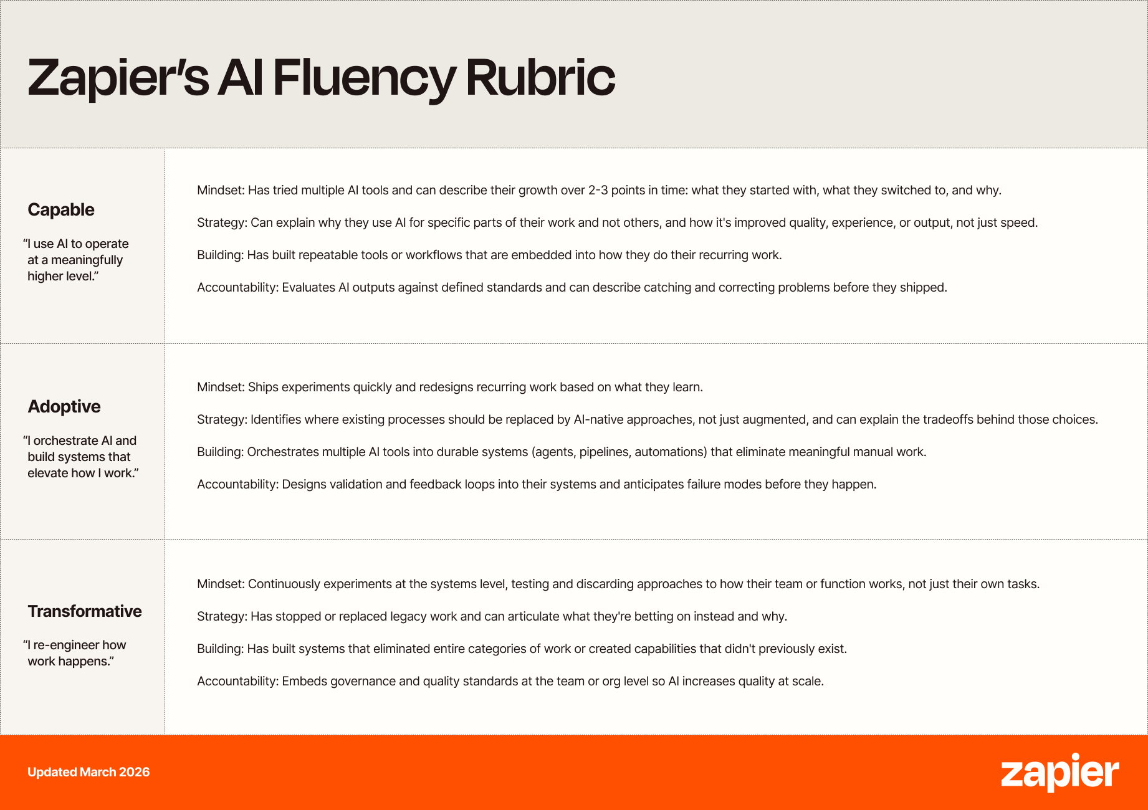
ForgeX
Fluency is observable behavior, not tool familiarity.
CAPABLE
ADOPTIVE
TRANSFORMATIVE
Mindset • Strategy • Building • Accountability
ForgeX adds the ABM infrastructure between a good prompt and a governed outcome.
FORGEX | AI FOR ABM
04
Notes:
Credit Zapier. Point to Building and Accountability, then explain why ABM needs more resolution between a prompt, company brain, reusable skill, automation, and agent.
[Sources]
- https://zapier.com/blog/raising-ai-fluency-bar-in-hiring/
- https://images.ctfassets.net/lzny33ho1g45/4k3Lhj5hWuAxfBmPAqOYVe/4474ad100a57fa1eddfe880af5b70f2c/FINAL_Rubric_3Levels_V2.png

Slide 5
ForgeX
Move up one useful level.
5
4
3
2
1
0
FANCY
SEARCH
CONTEXTUAL
COPILOT
GROUNDED
WORKSPACE
REUSABLE
SKILL
GOVERNED
AUTOMATION
GOAL-DRIVEN
AGENT
Do not jump to Level 5. Earn the context, process, and controls underneath it.
FORGEX | AI FOR ABM
05
Notes:
Ask attendees for a private zero-to-five rating. Remove the status anxiety: a well-run Level 3 can outperform a poorly governed Level 5.
[Sources]
- /Users/treyharnden/Projects/forgex-practical-abm-skills/webinar/2026-09-17-ai-for-abm-foundations/maturity-rubric.md

Slide 6
ForgeX
Level 0: Fancy Search
INPUT
OUTPUT
Teach me about AI security for manufacturers. Give me five campaign ideas.
Generalized ideas you still have to sift, verify, and rebuild.
A fluent answer is not an account insight.
LAYER ADDED
Model or search interface
FORGEX | AI FOR ABM
06
Notes:
Fancy Search is useful for learning and orientation. The trap is mistaking fluency for seller or account specificity.
[Sources]
- /Users/treyharnden/Projects/forgex-practical-abm-skills/webinar/2026-09-17-ai-for-abm-foundations/maturity-rubric.md

Slide 7
ForgeX
Level 1: Contextual Copilot
INPUT
OUTPUT
North Peak sells Discover, Protect, and Monitor. Alder is expanding industrial AI. Draft three campaign premises for a VP of Infrastructure. Separate facts from hypotheses.
A more relevant one-off draft.
The marketer still knows what to paste, what to ask, and what to correct.
LAYER ADDED
Structured prompt + supplied context + human iteration
FORGEX | AI FOR ABM
07
Notes:
Show the five parts of the stronger request: seller, target, job, output, and guardrail. Quality still lives in the operator who knows what to paste.
[Sources]
- /Users/treyharnden/Projects/forgex-practical-abm-skills/webinar/2026-09-17-ai-for-abm-foundations/maturity-rubric.md

Slide 8
ForgeX
Level 2: Grounded Workspace
INPUT
OUTPUT
Use the North Peak company brain and Alder evidence pack. Recommend one campaign premise. Cite the source file for each material claim.
A grounded draft that uses the same brand, ICP, persona, product, and proof rules every time.
Stop making the model relearn the company.
LAYER ADDED
Persistent, approved context
FORGEX | AI FOR ABM
08
Notes:
Distinguish the context window from the company brain. More files are not automatically better. Scope, ownership, and freshness matter.
[Sources]
- /Users/treyharnden/Projects/forgex-practical-abm-skills/webinar/2026-09-17-ai-for-abm-foundations/maturity-rubric.md
- /Users/treyharnden/Projects/forgex-practical-abm-skills/webinar/2026-09-17-ai-for-abm-foundations/northpeak/README.md

Slide 9
ForgeX
Build a company brain, not a document dump.
NORTH PEAK / CONTEXT
SCOPED
Only what this job needs
/brand-guidelines.md
SOURCE-BACKED
Claims retain provenance
/messaging-framework.md
/icp.md
FRESH
Owners and review dates
/personas.md
/product-portfolio.md
PERMISSION-AWARE
Access follows policy
/proof-and-claims.md
/source-manifest.md
VERSIONED
Changes stay inspectable
GitHub is one useful pattern. The rule is durable ownership and change history.
FORGEX | AI FOR ABM
09
Notes:
A company brain centralizes reliable access, not necessarily every source file. GitHub is useful for plain text, review, portability, and history, but it is not the only answer.
[Sources]
- https://www.cerebras.ai/blog/how-we-built-our-knowledge-base
- https://www.stellarwork.com/captains-log/how-cerebras-built-their-company-brain
- https://docs.github.com/en/repositories/creating-and-managing-repositories/about-repositories

Slide 10
ForgeX
Learn the plumbing. Keep the durable parts portable.
THE FIXTURES CHANGE
MODELS
HARNESSES
CONNECTORS
EMPLOYERS
THE CRAFT COMPOUNDS
CONTEXT
SKILLS
TEMPLATES
TESTS
DECISION HISTORY
Company tools are fixtures. Your ability to reconnect the system is the craft.
FORGEX | AI FOR ABM
10
Notes:
Use the trade metaphor respectfully. Take portable methods and blank templates to a new role, never confidential company content.
[Sources]
- /Users/treyharnden/Projects/forgex-practical-abm-skills/webinar/2026-09-17-ai-for-abm-foundations/slide-outline.md

Slide 11
ForgeX
Level 3: Reusable Skill
TELL ME X ANSWER
→
PRODUCE Y OUTCOME
THROUGH THIS PROCESS
INPUT
OUTPUT
Follow the ABM Strategist skill. Use the North Peak corpus and Alder evidence. Produce the required campaign brief. Apply the output contract and QA. Stop before creative or outreach.
The same inspectable brief structure across accounts and users.
LAYER ADDED
Skill + template + output contract + QA + stop conditions
FORGEX | AI FOR ABM
11
Notes:
Deliver the key mental shift slowly. A skill packages the judgment that usually hides in the best operator's head.
[Sources]
- /Users/treyharnden/Projects/forgex-practical-abm-skills/skills/abm-strategist/SKILL.md
- /Users/treyharnden/Projects/forgex-practical-abm-skills/webinar/2026-09-17-ai-for-abm-foundations/maturity-rubric.md

Slide 12
ForgeX
A skill is a small operating manual for an agent.
01
02
03
04
05
06
WHEN TO USE
→
INPUTS
→
PROCESS
→
OUTPUT CONTRACT
→
QUALITY CHECKS
→
STOP CONDITIONS
ABM Strategist turns evidence into an approval-ready account campaign brief.
Fix the shared process once. Every future run starts stronger.
FORGEX | AI FOR ABM
12
Notes:
Reveal the anatomy in order. Emphasize the stop condition: useful draft generation does not require publishing, sending, or spending.
[Sources]
- /Users/treyharnden/Projects/forgex-practical-abm-skills/skills/abm-strategist/SKILL.md
- /Users/treyharnden/Projects/forgex-practical-abm-skills/shared/SAFETY.md

Slide 13
ForgeX
Verify, interpret, qualify, then draft.
1 VERIFY | HIRING SIGNAL VERIFICATION
2 INTERPRET | Signal Interpreter | Din Arbel T3 synthetic | meaning + confidence + why-now | no routing or writes
Peter S. Borkovich | T3 synthetic + T4 live read-only
3 QUALIFY | AUDIENCE ICP FILTER
4 DRAFT | Multichannel Campaign Builder | Erwann Lefevre T3 conditional synthetic | source-backed inputs + mandatory human QA
Erwann Lefevre | T3 synthetic | Keep / Exclude / Review
LEVEL 2 TO 3 SOURCE BRIDGE
Company Deep Dive | Uriel Knorovich | T1 static only | source hierarchy, dated claims, contradictions, refresh deduplication
22 ICP records reconciled | 45/45 checks | hiring audit: 2 accepted, 4 narrowed, 5 dropped
External community work. Teaching references only. No Swan packages in the live build or external actions from these examples.
FORGEX | AI FOR ABM
13
Notes:
Treat the GTM community as a pattern library, not an app store.
Read the Level 3 sequence left to right: verify evidence, interpret meaning, qualify the audience, then generate a draft.
Hiring Signal Verification is the evidence gate. The local evaluation passed six adversarial synthetic cases. A live read-only audit of 11 labels accepted 2, narrowed 4, and dropped 5. Verification belongs before scoring or messaging.
Signal Interpreter is a pure interpretation gate. It returns meaning, strength, confidence, why-now, limits, and open questions without routing or writing.
Audience ICP Filter is the qualification gate. A 22-person synthetic fixture reconciled every record into Keep, Exclude, or Review, and the bundled suite passed 45 of 45 checks.
Multichannel Campaign Builder is a conditional draft-generation example. One synthetic brief produced three distinct angles and a five-touch sequence. Require source-backed inputs and human copy QA before any send or activation.
Company Deep Dive is only a Level 2-to-3 source-hierarchy concept. Its evidence is T1 static review, so do not call the package operationally verified.
Do not install or run Swan GTM packages in the live build. Keep the North Peak and Alder path unchanged.
[Sources]
Swan GTM Skills license: https://github.com/swan-gtm/gtm-skills/blob/d378356a2668095d71e8dfb0661155255cf6776b/LICENSE
Hiring Signal Verification, Peter S. Borkovich: https://github.com/swan-gtm/gtm-skills/tree/d378356a2668095d71e8dfb0661155255cf6776b/skills/peter-borkovich/hiring-signal-verification
Signal Interpreter, Din Arbel: https://github.com/swan-gtm/gtm-skills/tree/d378356a2668095d71e8dfb0661155255cf6776b/skills/din-arbel/signal-interpreter
Audience ICP Filter, Erwann Lefevre: https://github.com/swan-gtm/gtm-skills/tree/d378356a2668095d71e8dfb0661155255cf6776b/skills/erwann-lefevre/audience-icp-filter
Multichannel Campaign Builder, Erwann Lefevre: https://github.com/swan-gtm/gtm-skills/tree/d378356a2668095d71e8dfb0661155255cf6776b/skills/erwann-lefevre/multichannel-campaign-builder
Company Deep Dive, Uriel Knorovich: https://github.com/swan-gtm/gtm-skills/tree/d378356a2668095d71e8dfb0661155255cf6776b/skills/uri-knorovich/company-deep-dive
Local evaluation evidence: /Users/treyharnden/Projects/Folloze-Skills-swan-eval/evaluations/swan-gtm at commit 8dd94e1

Slide 14
ForgeX
Level 4: Governed Automation
INPUT
OUTPUT
Every Monday, check approved Alder sources. If material evidence changed, rerun the skills, update the brief, show the diff, and route exceptions. Do not publish or send.
Updated brief
Diff
No-change record
Exception queue
Audit trail
A good workflow records no change when the evidence does not justify a change.
LAYER ADDED
Trigger + state + routing + retries + monitoring
FORGEX | AI FOR ABM
14
Notes:
Level 4 adds time and state. The workflow must understand the current artifact, what changed, and what no change looks like.
[Sources]
- /Users/treyharnden/Projects/forgex-practical-abm-skills/webinar/2026-09-17-ai-for-abm-foundations/maturity-rubric.md

Slide 15

ForgeX
A cron job IN a trench coat
Do not dress up a brittle automation
and call it an agent.
AUTOMATION
Predetermined path and tools
AGENT
Goal, dynamic planning, and tool choice
Useful automation is still useful. Fake sophistication is the problem.
FORGEX | AI FOR ABM
15
Notes:
Get the wording right: a cron job IN a trench coat. Respect deterministic workflows. The warning is about claiming judgment that the system does not have.
[Sources]
- /Users/treyharnden/Projects/forgex-practical-abm-skills/webinar/2026-09-17-ai-for-abm-foundations/assets/cron-job-in-a-trench-coat.png

Slide 16
ForgeX
Workflow, agent, MCP, and governance solve different problems.
1
2
3
4
WORKFLOW
AGENT
MCP
GOVERNANCE
defines a known route
chooses the route
connects approved resources and tools
defines authority and human decisions
MCP gives access. It does not give judgment or permission.
FORGEX | AI FOR ABM
16
Notes:
Use the road analogy. Workflow is the marked route. Agent is the driver. MCP provides on-ramps. Governance defines the gates.
[Sources]
- https://www.anthropic.com/engineering/building-effective-agents
- https://modelcontextprotocol.io/docs/getting-started/intro

Slide 17
ForgeX
Level 5: Goal-Driven Agent System
I GIVE YOU TEXT,
YOU GIVE ME AN ANSWER
I GIVE YOU A GOAL,
YOU PRODUCE THE OUTCOME
→
INPUT
OUTPUT
Increase qualified engagement across North Peak's top industrial AI accounts. Decide which accounts need research, a refreshed brief, a personalized experience, or no action. Request approval before activation.
A prioritized plan and the right mix of research, briefs, experiences, and next actions.
LAYER ADDED
Goals + planning + tool choice + evaluation + interrupt controls
FORGEX | AI FOR ABM
17
Notes:
Agency does not remove the human. The human owns the goal, authority, evaluation standard, and consequential decisions.
[Sources]
- /Users/treyharnden/Projects/forgex-practical-abm-skills/webinar/2026-09-17-ai-for-abm-foundations/maturity-rubric.md
- https://www.anthropic.com/engineering/building-effective-agents

Slide 18
ForgeX
Keep one ABM campaign current across all six levels.
5
4
Prioritized plan and required artifacts
3
Refreshed brief, diff, exceptions
2
Repeatable approval-ready brief
1
Grounded draft
0
One-off tailored draft
Generic ideas
The artifact becomes grounded and repeatable before it becomes autonomous.
FORGEX | AI FOR ABM
18
Notes:
Move quickly down the outputs. Level 5 still needs the prompt discipline, company brain, skill, and controls below it.
[Sources]
- /Users/treyharnden/Projects/forgex-practical-abm-skills/webinar/2026-09-17-ai-for-abm-foundations/maturity-rubric.md

Slide 19
ForgeX
Measure outcomes, not AI activity.
SPEED
QUALITY
CONSISTENCY
CAMPAIGN VOLUME
PERSONALIZATION
When the system runs without direct supervision, also track corrections, exceptions, failed runs, stale sources, unsupported claims, overrides, and cost per approved outcome.
FORGEX | AI FOR ABM
19
Notes:
Avoid vanity metrics such as prompt count or number of tools purchased. Add operational measures when the system begins running without direct supervision.
[Sources]
- /Users/treyharnden/Projects/forgex-practical-abm-skills/webinar/2026-09-17-ai-for-abm-foundations/maturity-rubric.md

Slide 20
ForgeX
Most teams should focus here.
2
3
4
YOUR STARTER KIT
→
→
North Peak company brain
Context Corpus Builder
ABM Strategist
30-day upgrade plans
Ground the work
Package the process
Run it safely
Level 4 to 5 needs a one-to-one architecture session around your systems, data, permissions, and failure tolerance.
FORGEX | AI FOR ABM
20
Notes:
Ask attendees to choose Level 2 to 3 or Level 3 to 4. Be direct that Level 4 to 5 is not a generic checklist.
[Sources]
- /Users/treyharnden/Projects/forgex-practical-abm-skills/webinar/2026-09-17-ai-for-abm-foundations/attendee-resource-guide.md

Slide 21
ForgeX
Live build: fresh workspace to grounded ABM system
1
Open a fresh Claude Code workspace through ForgeX
2
Bring in the ForgeX repository
15
3
Inspect safety, North Peak context, and ABM Strategist
MINUTES
4
Run the Level 3 Alder prompt
5
Review evidence, gaps, approvals, and the Level 4 extension
Leave with one repeated job you are ready to move up one level.
FORGEX | AI FOR ABM
21
Notes:
Switch screens only after orienting the audience. Run the Level 3 prompt, inspect the output, then explain Level 4 without activating a schedule.
[Sources]
- /Users/treyharnden/Projects/forgex-practical-abm-skills/webinar/2026-09-17-ai-for-abm-foundations/live-demo-runbook.md
- /Users/treyharnden/Projects/forgex-practical-abm-skills/webinar/2026-09-17-ai-for-abm-foundations/demo/demo-prompts.md

