Slide 1
SIS Exam System
by team Enrollment 2
Jakub Maťa, Lukáš Hellesch, Viktor Závodský,
Matúš Jurčák, Šimon Stehlík, Zdeněk Bambas

Slide 2
Qualitative Requirement Overview
Runtime
Exam DB For Students (Runtime, Availability) (Jakub Mata)
Exam DB For Teacher (Runtime, Availability) (Jakub Mata)
Exam period sign-up (Runtime, Performance) (Šimon Stehlík)
DOS Attacks (Runtime, Security) (Zdeněk Bambas)
DB access (Runtime, Security)
Student can only view own data (Runtime, Security)
System correctly scales up and down with demand (Runtime, Elasticity)
Notifications queue (Runtime,Availability)
Grade Tampering Prevention (Runtime, Security)

Slide 3
Qualitative Requirement Overview
Design
New ways of notifying (Design, Modifiability) (Matúš Jurčák)
Interoperability with the rest of the SIS (Design, Interoperability) (Lukáš Hellesch)
Plugin Architecture for Grade Suggestion (Design, Extensibility)

Slide 4
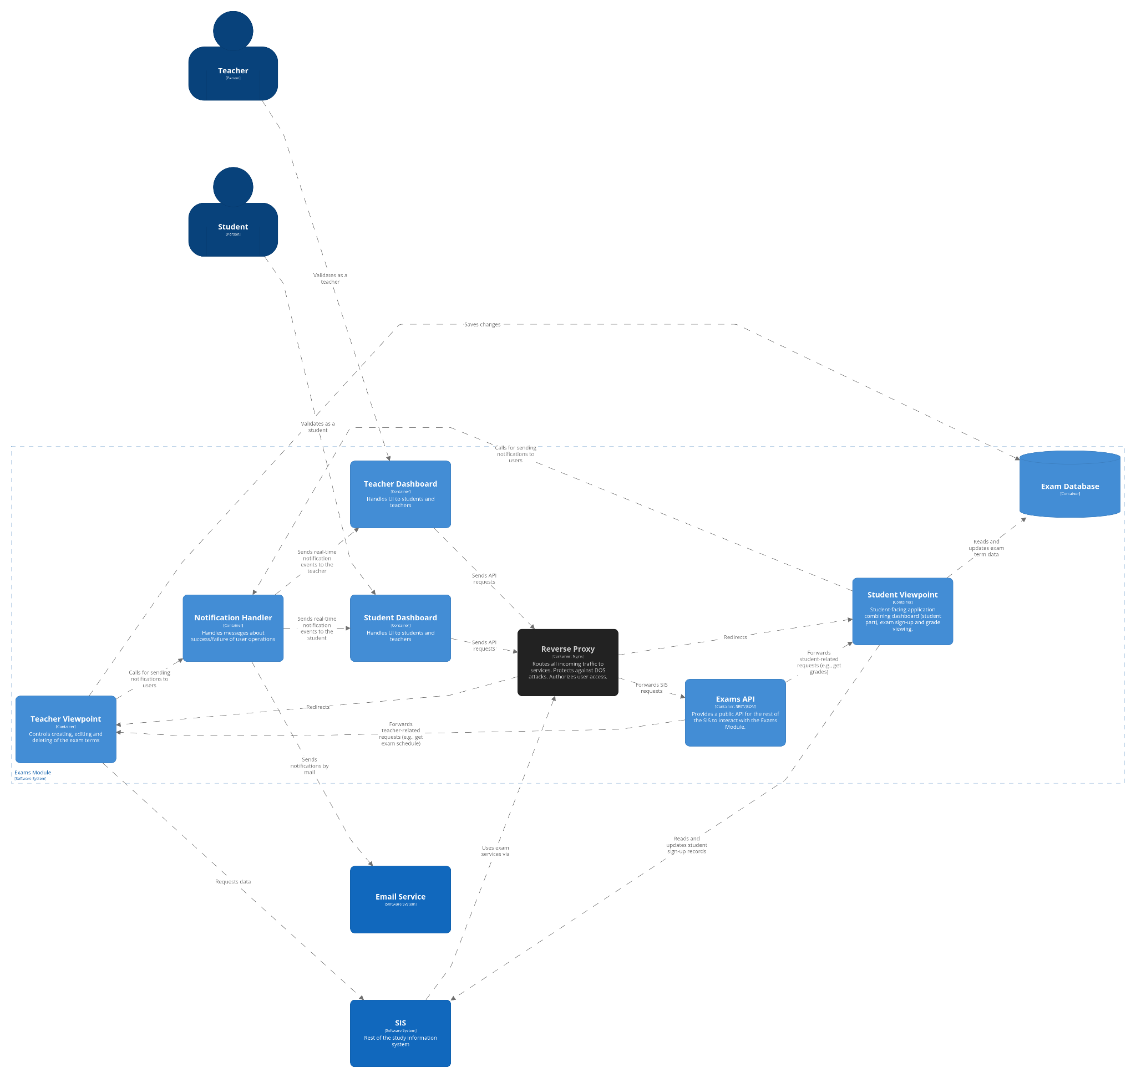

Slide 5
Runtime Qualitative Requirements

Slide 6
Exam DB For Students
runtime, availability
Jakub Mata
what: Student Viewpoint tries to access ExamDB (normal operation) during peaks (500 req / s) and this operation needs to succeed within 5 seconds
how: Student Viewpoint --- (unable to read ExamDB) ---> ExamDB --- (mask & reload, log) ---> 5s downtime
solution: Student Viewpoint will check the heartbeat of the ExamDB. In case of failure, it tries to restart the DB.
reasoning: Offered exam capacities are often limited so a lot of eager students are signing up at once. Signing up for an exam can also be stressful which leaves little room for failures in the system. Hence high availability is required. Students need to be assured they have signed up successfully.

Slide 7
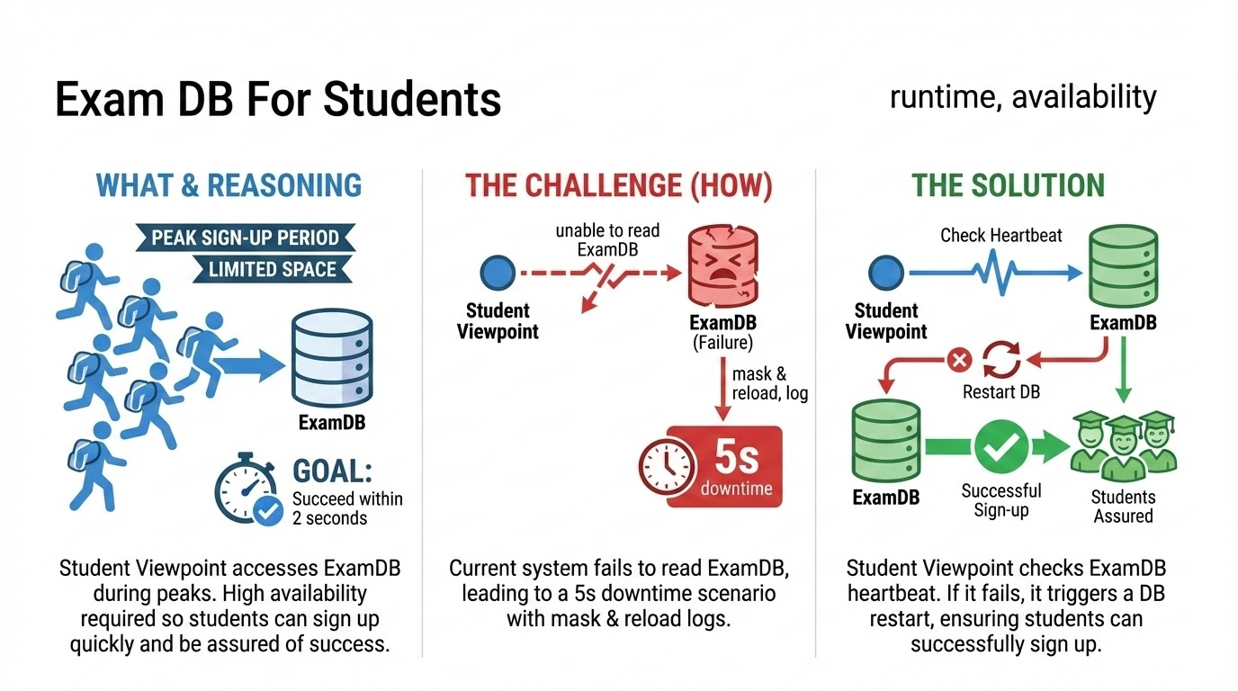

Slide 8
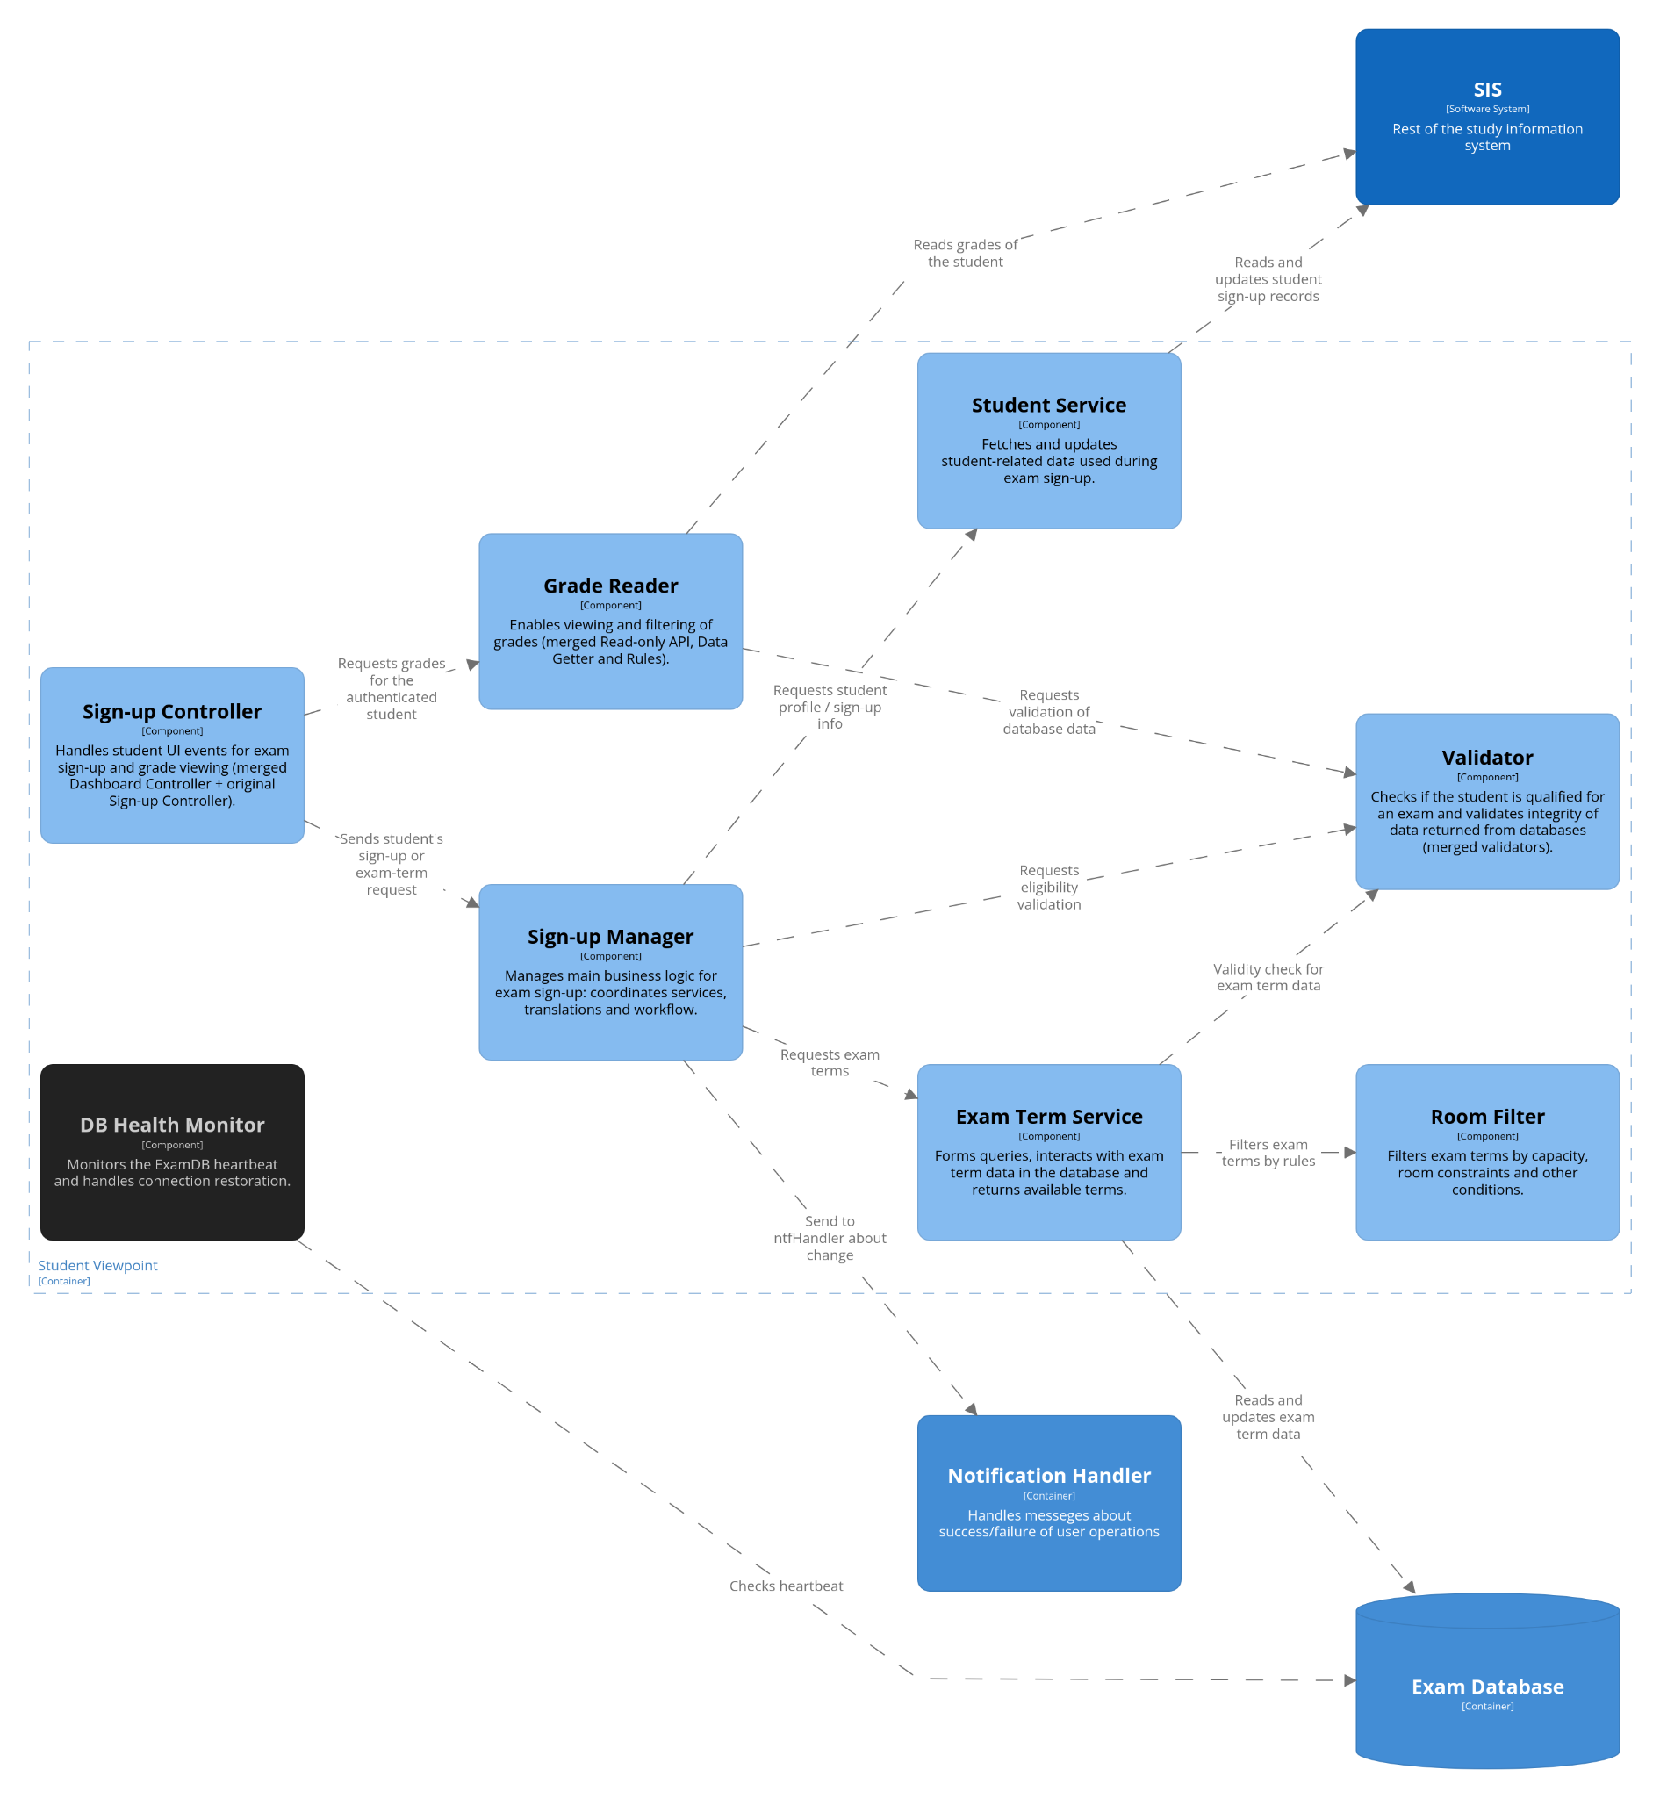

Slide 9
Exam DB For Teachers
runtime, availability
Jakub Mata
what: Teacher Viewpoint tries to access ExamDB (normal operation) and this operation needs to succeed within 1 hour
how: Teacher Viewpoint --- (unable to read ExamDB) ---> ExamDB --- (mask & reload, log) ---> 1h downtime
solution: Student Viewpoint will check the heartbeat of the ExamDB. In case of failure, it tries to restart the DB.
reasoning: Teachers are usually not pressured to release exam dates at specific times. They are also more understanding and can tolerate higher response times.

Slide 10
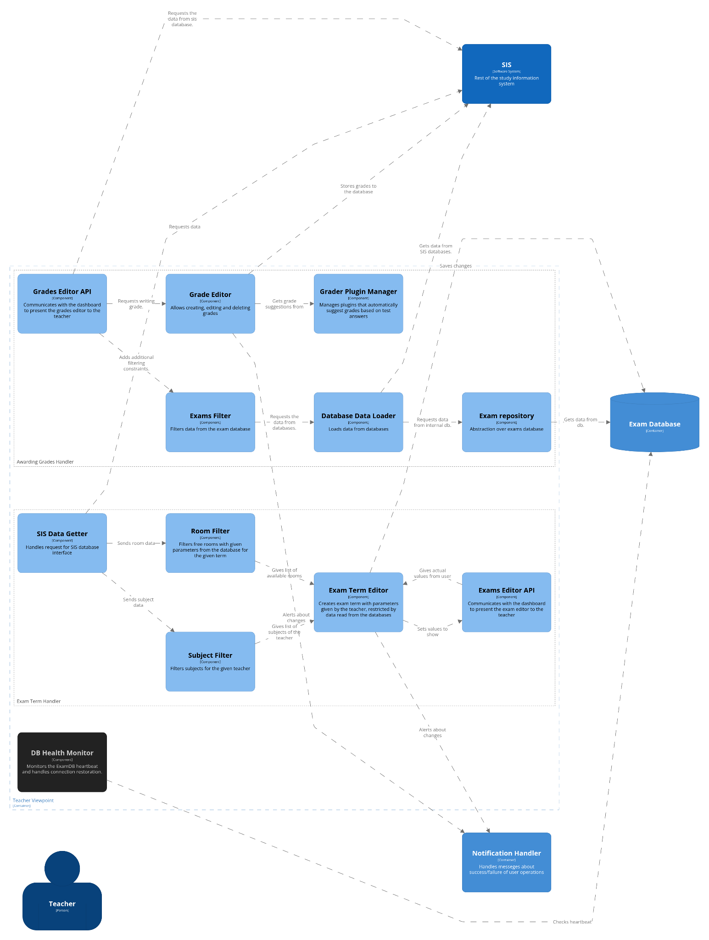

Slide 11
Exam period sign-up
Šimon Stehlík
runtime, performance
what: Student wants to sign up for an exam and the system must be responsive enough even during high times
how: Student (signing up for an exam during exam period): high demand (500 requests / second) --> System --> response within 5s
solution: Profile the hotpaths and improve performance. No architectural change needed.
reasoning: Profiling and improving the code can help handle peak loads better.

Slide 12
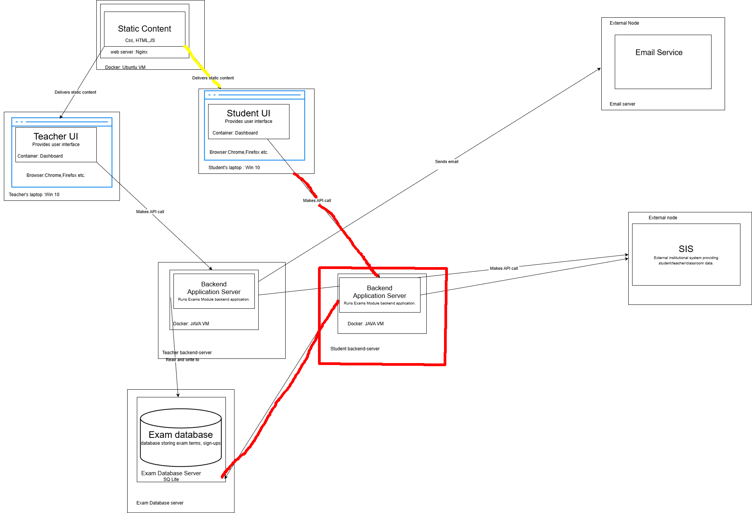

Slide 13
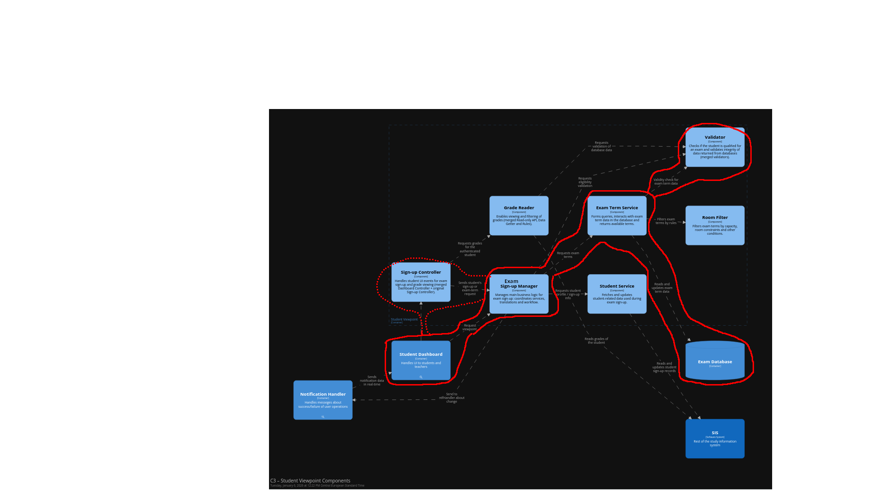
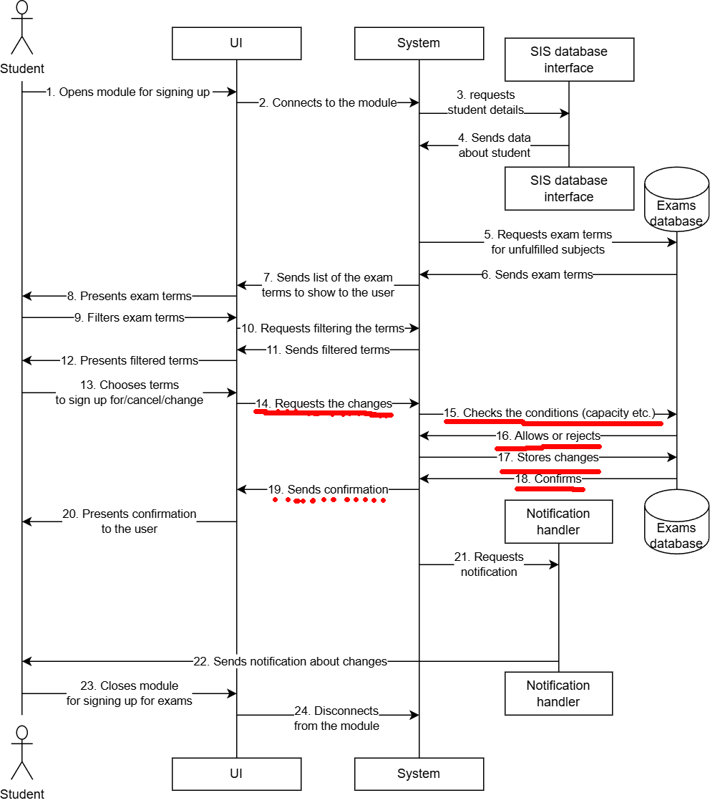

Slide 14
DOS Attacks
Jakub Mata, Viktor Závodský, Zdeněk Bambas
runtime, security
what: an attacker tries to overload the system using Denial Of Service. The system has to be resilient enough to say available; other users should not notice a dump in performance.
how: Attacker --- (many reqs from one device) --- System --- (ignore / block incoming requests)
solution: Use a reverse proxy (Nginx) and put it in front the server. Configure it using the "leaky bucket" technique, purposefully slowing down excessive requests or even discarding them completely without informing the client.

Slide 15
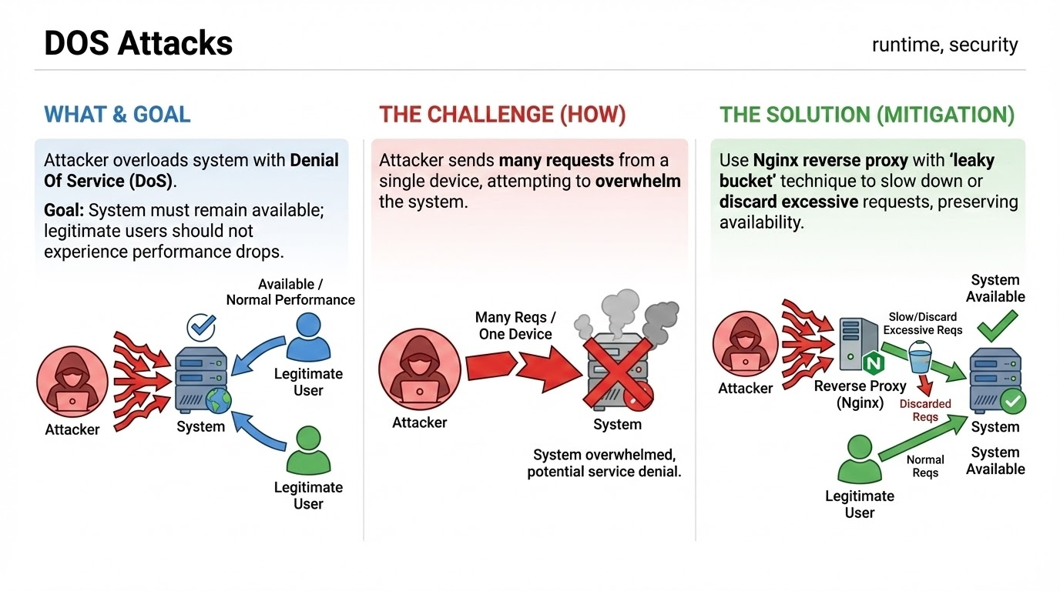

Slide 17
Database Access
runtime, security

Slide 18
Students can only view own data
runtime, security

Slide 19
System correctly scales with demand
runtime, elasticity

Slide 20
Grade tampering prevention
runtime, security

Slide 21
Notifications queue
runtime, performance
Matúš Jurčák

Slide 22
Design Qualitative Requirements

Slide 23
New ways of notifying
design, modifiability
Matúš Jurčák
what: The system must be designed to easily accommodate new notification methods (e.g., SMS, push notifications) in the future
how: Notifications ---> (new kind of notification requested) ---> Notification Maker ---> (new delivery method integrated) ---> 1 week development time
solution: Implement a notification delivery router that can direct notifications from the notification maker to all the supported notification methods. New methods can be added by implementing a new delivery module and registering it with the router.
reasoning: …

Slide 24
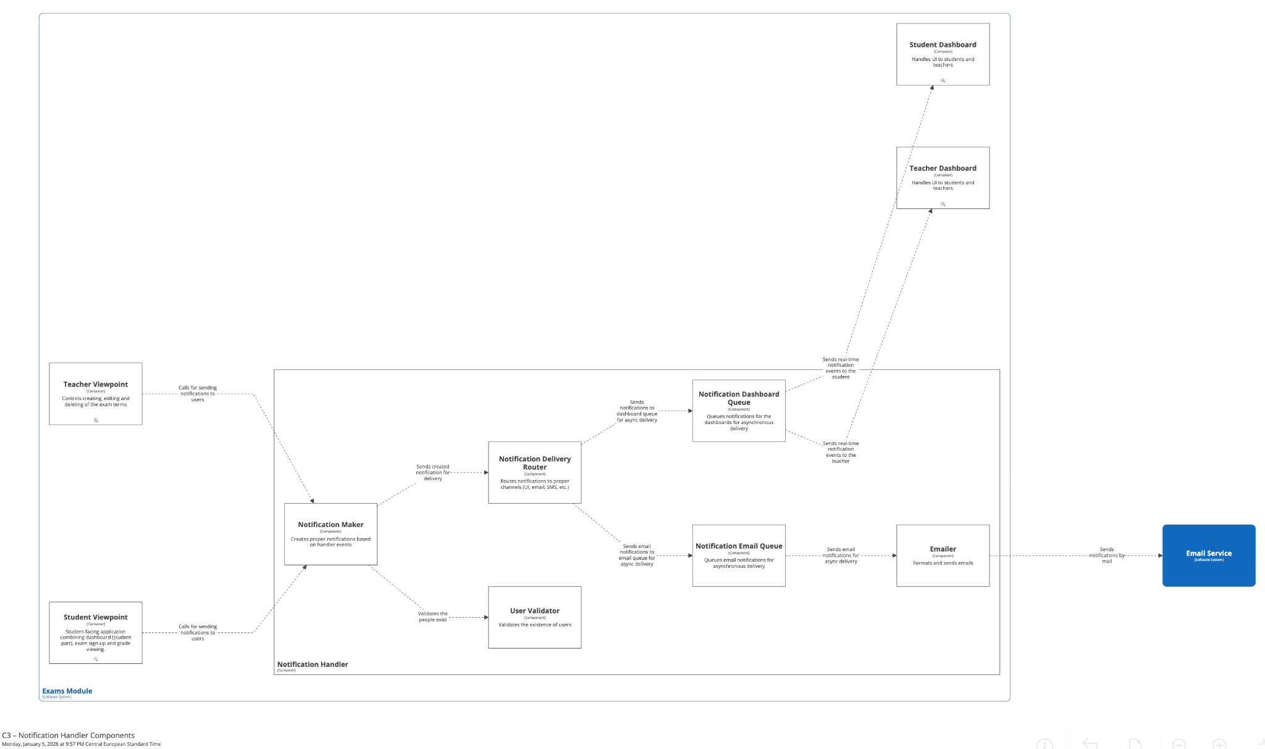

Slide 25
Interoperability with SIS
design, interoperability
Lukáš Hellesch, Viktor Závodský
what: The exam system must be able to communicate with the rest of the system. Other parts of the system must be able to easily access the functionality this system.
how: Exam System <---> (data exchange) <---> SIS
solution: Create an extra container as an interface for the Exam System.
reasoning: Isolates the Exam System's internals from the rest of the university, ensuring that changes to our database don't break other systems

Slide 26
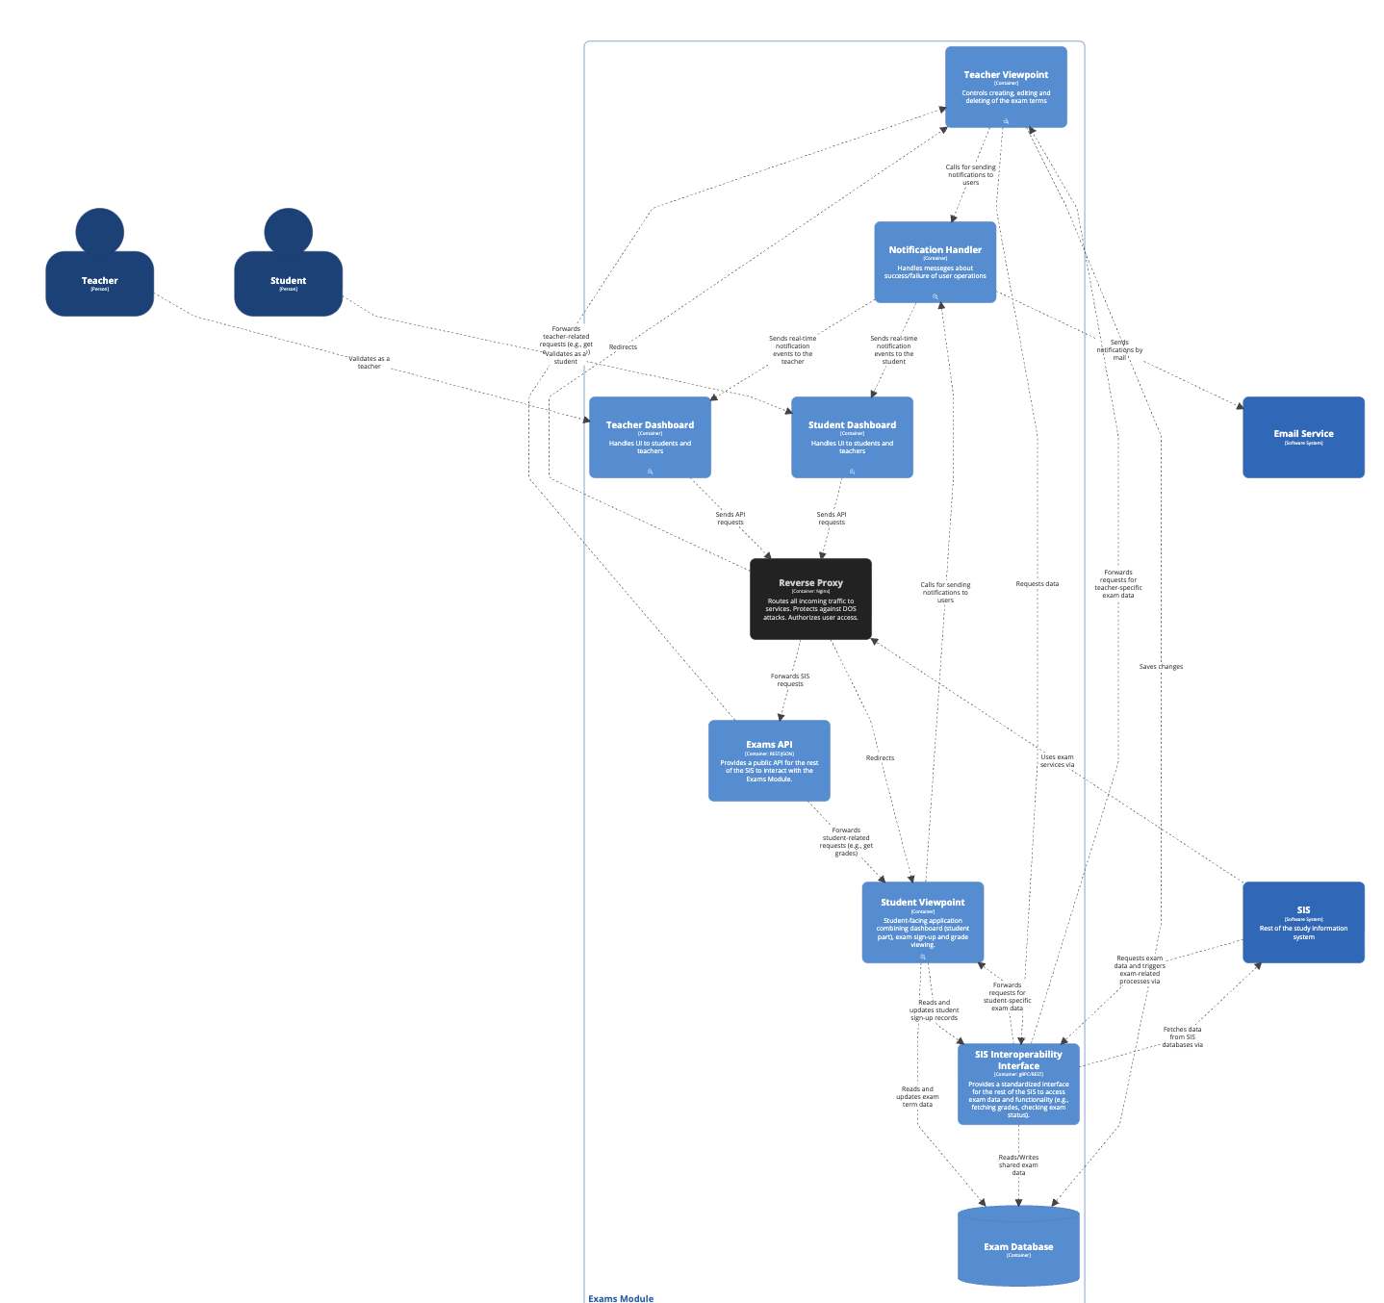

Slide 27
Plugin architecture for grade suggestion
design, extensibility

Slide 28
Thank you for your attention!

